Slide 1
Prevention of Infection: Vaccination
Key Stage 2

Slide 2
Learning Outcomes
All students will:
• Understand that vaccines help prevent a range of infections, including the flu.
Most students will:
• Understand that there are not vaccines for all infections.

Slide 3
Curriculum Links
PHSE/RHSE
• Health and prevention
Science
• Working scientifically
• Living things and their habitats
English
• Reading & comprehension
• Spoken language
• Writing

Slide 4
Why Do We Vaccinate?
There are many harmful microbes that can make us ill, in some cases, there are things we can do to prevent this happening.
Vaccinations are a harmless small amount of the microbe (e.g. disease markings or outer coat) that teaches our body how to fight the harmful microbe when or if we get attacked by the disease.
Without vaccinations, many of the students in the class would not have survived past 5 years of age. Explain that diseases like whooping cough, polio and TB are now extremely rare due to vaccinations.
Some microbes change their outer coats like we change our clothes. Some microbes change their markings/coats so quickly that scientists cannot create vaccines for many infections (e.g. common cold/sore throat) or they have to make a new vaccine every year, like the flu vaccine.

Slide 5
MS PowerPoint Presentation: Common Disease We are Vaccinated Against

Slide 6
Common Diseases We Are Vaccinated Against

Slide 7
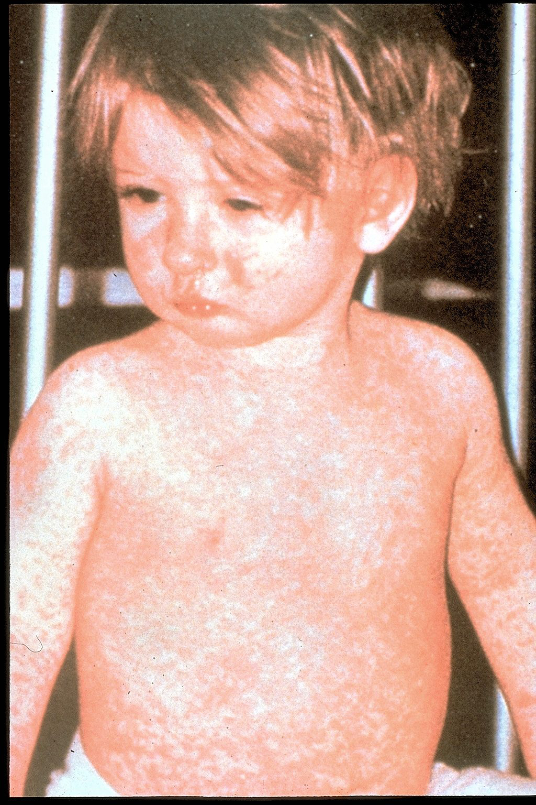
Measles caused by the morbillivirus:
Measles spreads through the air when an infected person coughs or sneezes.
It is so contagious that if one person has it, up to 9 out of 10 people around him or her will also become infected if they are not protected.
Measles can cause serious health complications especially in children under 5 years old.
Measles rash covering child's arms and stomach
Photo: Centers for Disease Control and Prevention

Slide 8
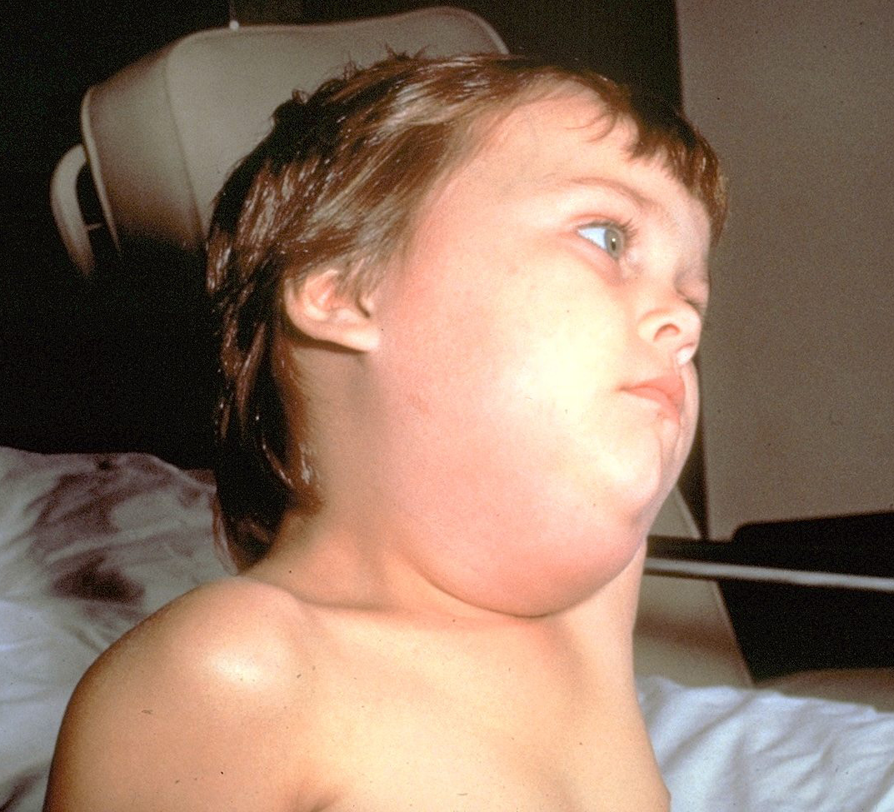
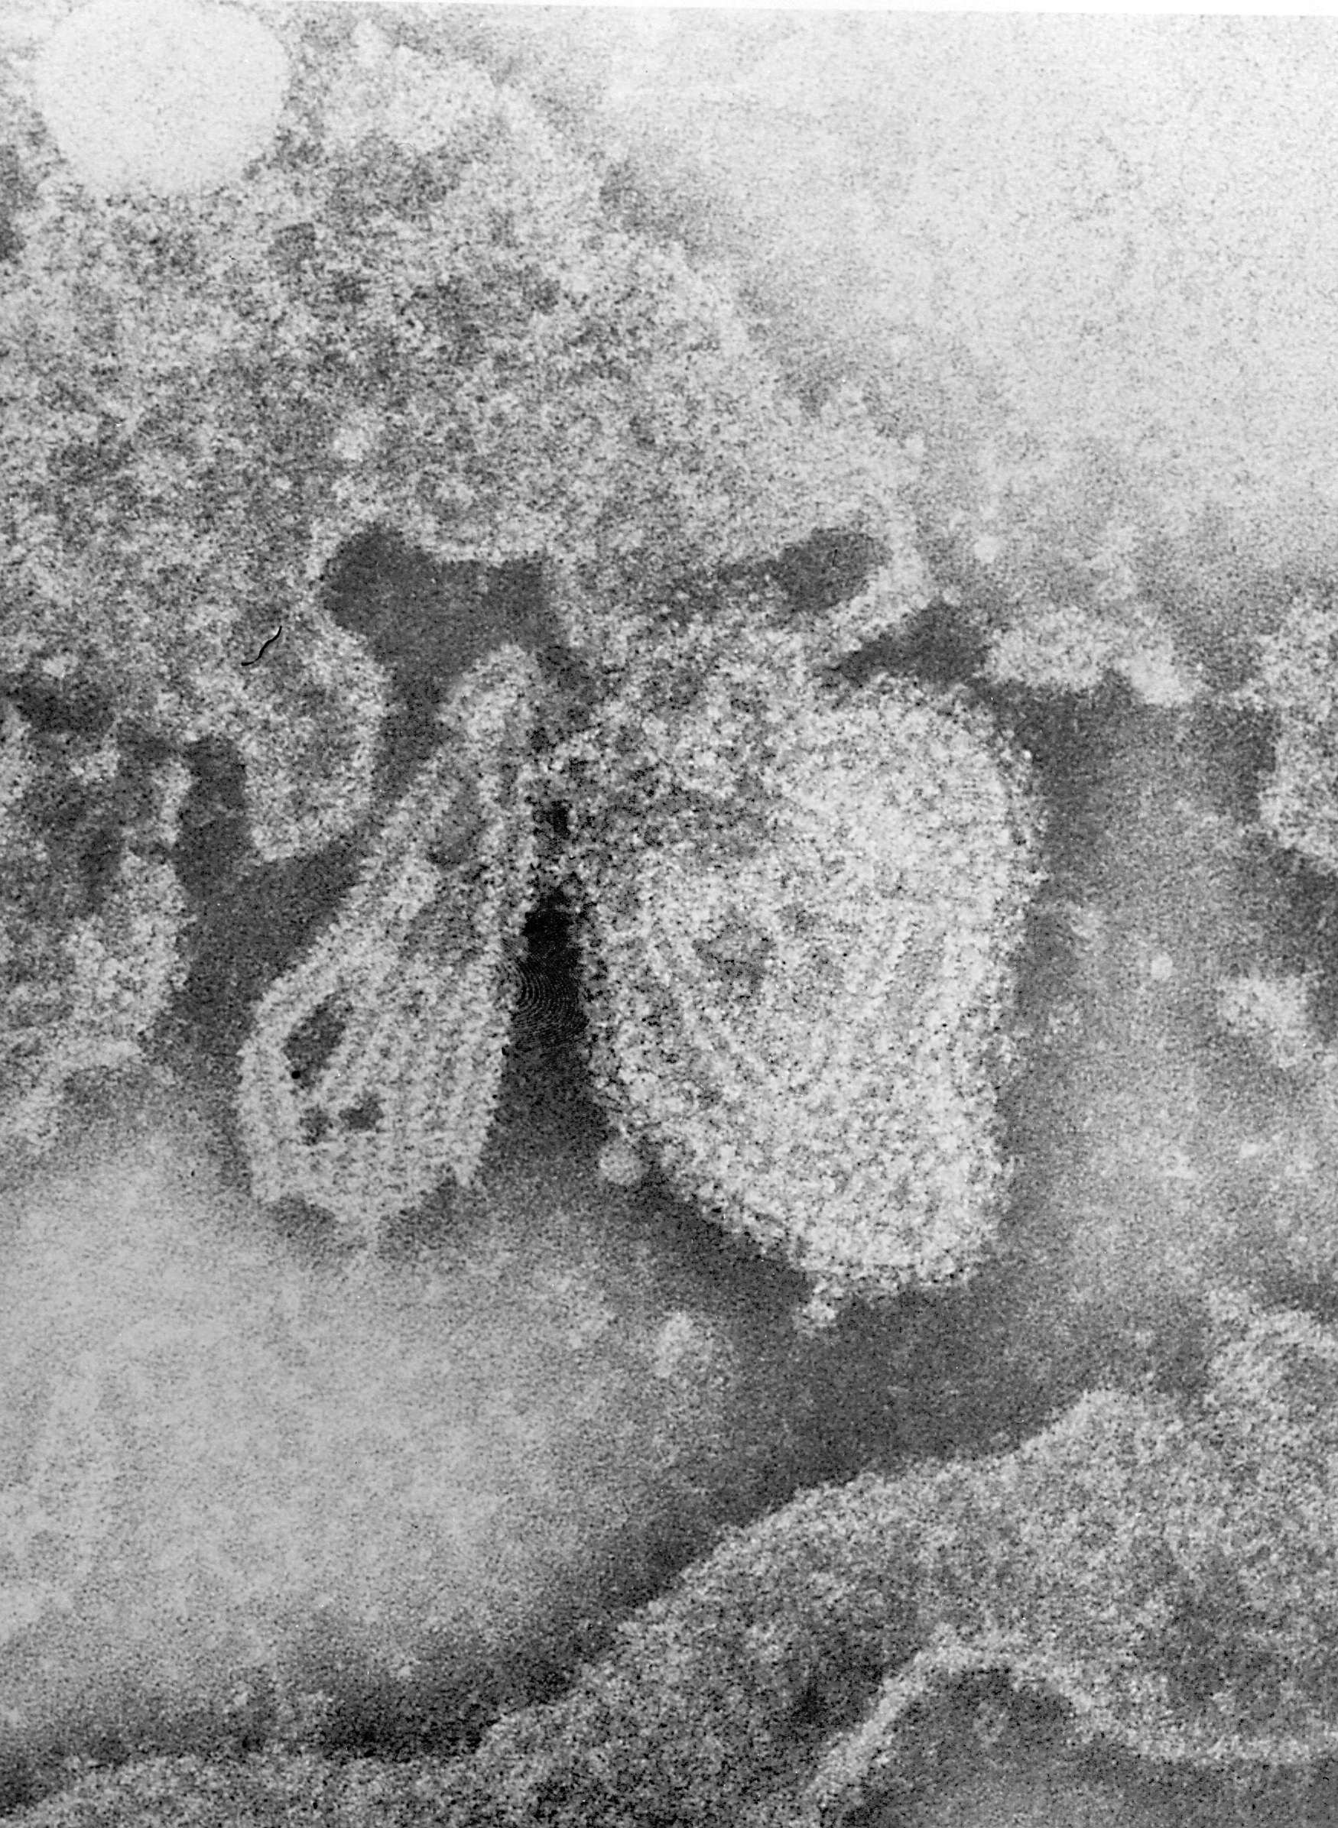
Mumps caused by the Mumps orthorubulavirus
Mumps is best known for the puffy cheeks and tender, swollen jaw that it causes.
Child with a very swollen under the jaw and in the cheeks due to mumps
Electron microscope image of the mumps virus
Photo: Centers for Disease Control and Prevention

Slide 9
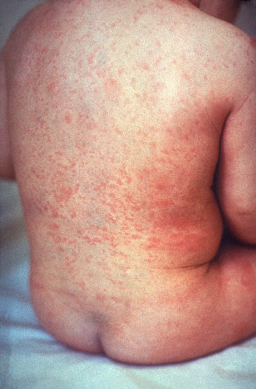
Rubella caused by the Togavirus
Rubella causes a spotty rash that usually gets better in 1 week.
It can be more serious if someone catches it while pregnant.
Child with a rash caused by rubella.
Photo: Centers for Disease Control and Prevention

Slide 10
We are protected against measles, mumps and rubella using the MMR vaccine when we are babies.

Slide 11
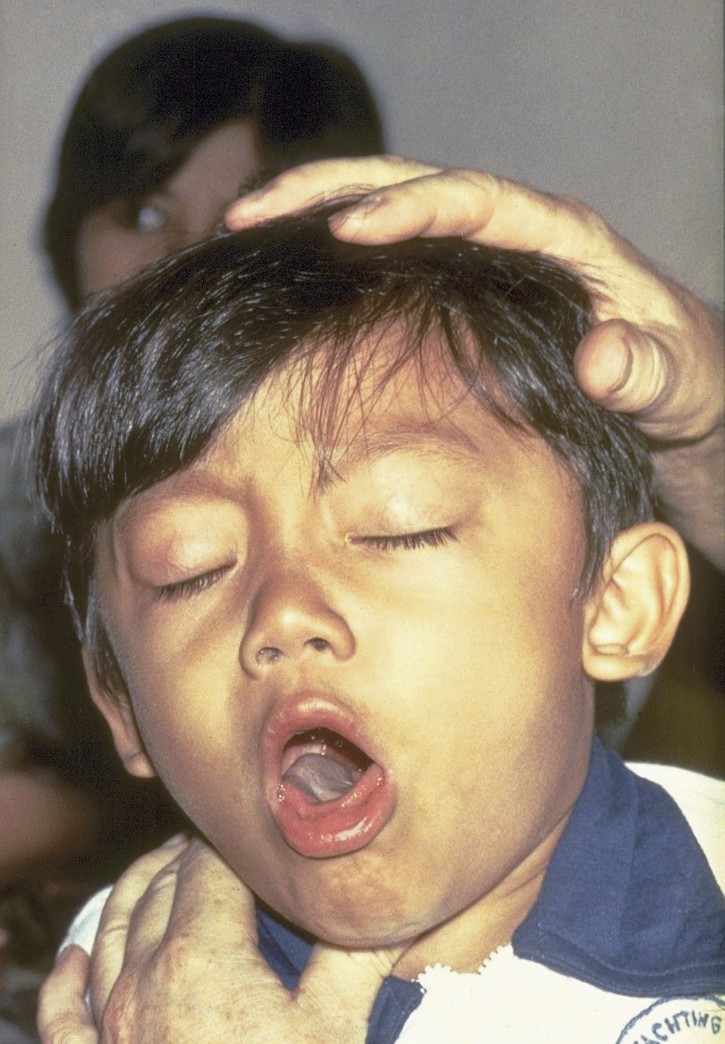
Whooping cough caused by the bacterium Bordetella pertussis
Whooping cough is known for uncontrollable coughing which often makes it hard to breathe.
It can affect people of all ages, but can be very serious, even deadly, for babies less than a year old.
Child has whooping cough; it is difficult for him to stop coughing and to get air.
Photo: Centers for Disease Control and Prevention

Slide 12
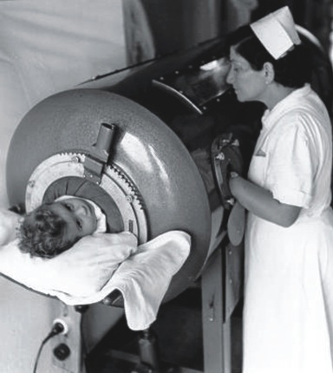
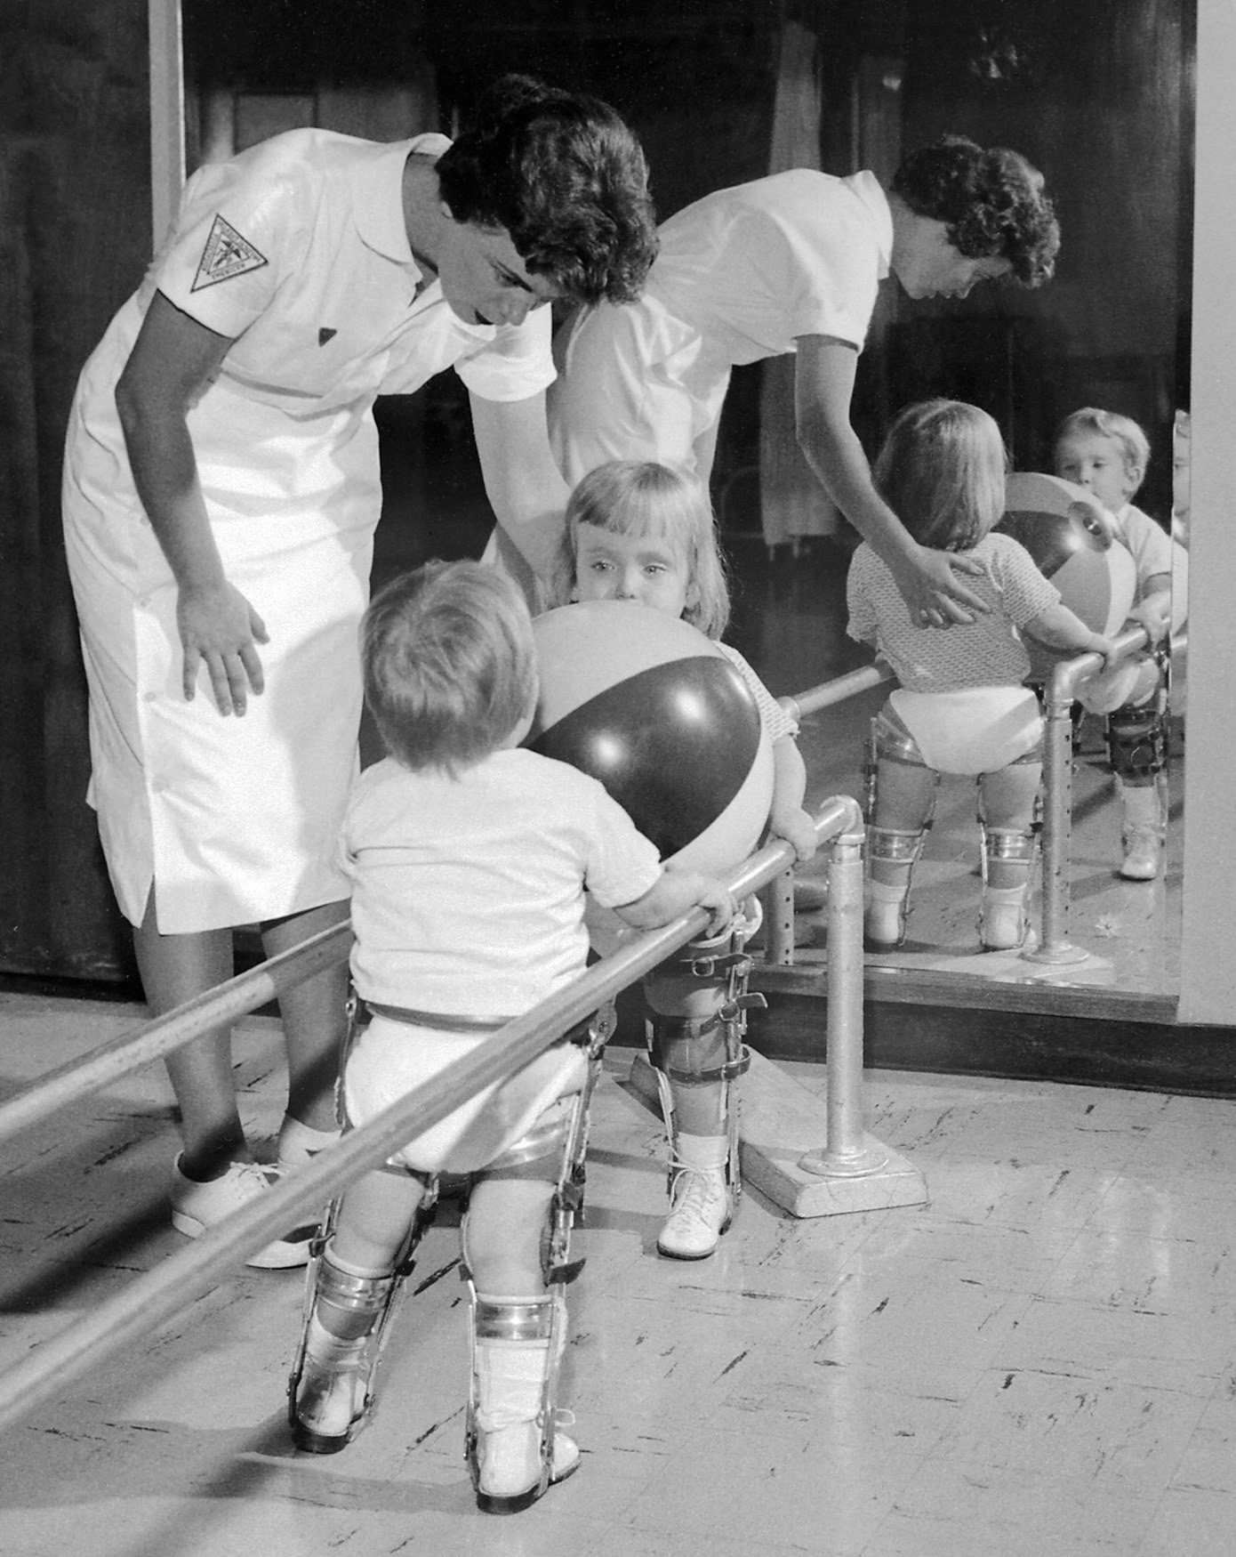
Poliomyelitis (polio) caused by Poliovirus
Most people who get infected with poliovirus will not have any visible symptoms.
About 1 out of 4 people (or 25 out of 100) with poliovirus infection will have flu-like symptom.
A smaller proportion of people with poliovirus infection will develop other, more serious symptoms that affect the brain and spinal cord which can include paralysis (can’t move parts of the body) or weakness in the arms, legs, or both.
Patients whose respiratory muscles were affected were placed in an "iron lung" machine to enable them to breathe
Two children with polio receiving physical therapy
Photo: Centers for Disease Control and Prevention

Slide 13
Tetanus caused by the bacterium Clostridium tetani
When the bacteria invade the body, they produce a toxin that causes painful muscle contractions.
Another name for tetanus is “lockjaw”. It often causes a person’s neck and jaw muscles to lock, making it hard to open the mouth or swallow.
Photo: Centers for Disease Control and Prevention

Slide 14
We are protected against whooping cough, polio, tetanus and other infections using the 6-in-1 vaccine when we are babies.

Slide 15
Main Activity:
Historic Heroes

Slide 16
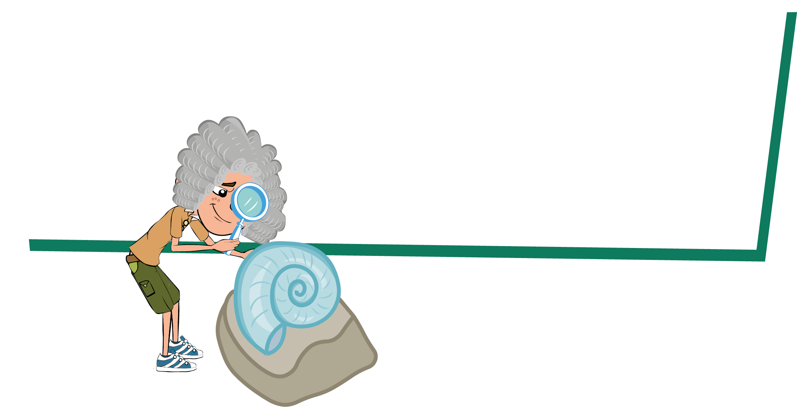
Historic Heroes Activity
1. Read the story of Edward Jenner
2. Learn how Jenner created the first vaccine
3. Test your understanding by filling in the blanks and completing the quiz

Slide 17
Discussion

Slide 18
Discussion Points
What are vaccines?
Who discovered vaccines?
When should vaccines be used?
How does a vaccine work?
Why should I get vaccinated?

Slide 19
Extension Activities

Slide 20
Vaccine Facts
What are vaccinations?
Vaccinations are another means of helping our immune system protect us against harmful diseases. They use your body’s natural defences to build resistance to specific infections and help build our immune system stronger.
How do vaccines work?
When the vaccine is injected into the body the immune system attacks it as if harmful microbes were attacking the body. White blood cells, a part of our immune system, create lots of antibodies to attach to specific markers on the surface, called antigens, of the vaccine organisms. Because the vaccine is an extremely weakened or killed version of the microbes, our immune system can detect the vaccine and eliminate it, and it will not make you ill. By successfully eliminating all the vaccine, the immune system remembers how to combat those microbes. The next time microbes carrying the same markers/antigen enter the body the immune system is ready to fight it before it has a chance to make you ill. This means you develop immunity against diseases.

Slide 21
Vaccine History
English doctor Edward Jenner created the first vaccine in 1796. He saw people around him getting ill from a disease called smallpox. As a doctor, Edward Jenner listened to what the country people said about smallpox. They believed that someone who caught a different mild infection called cowpox from their cows would not catch the much more serious smallpox. Jenner carried out an experiment to see if the people were right. In 1796 a milk maid called Sarah Nelmes came to Jenner complaining of a cowpox rash on her hand that she caught from Blossom the cow. Jenner took some of the pus from the cowpox rash on Sarah’s hand. He scratched some of the pus into the hand of an 8-year-old boy called James Phipps, the son of his gardener. James fell ill with cowpox but soon recovered. Jenner then took some pus from someone with the dangerous disease, smallpox, and scratched this into James’ arm. James developed a scab but did not develop smallpox, Jenner’s theory was right. Jenner's discovery came to be known as vaccination from the Latin word for a cow: vacca. Jenner went on to vaccinate all the local children with the cowpox to stop them from getting the more dangerous smallpox disease.
A French scientist called Louis Pasteur was also another important researcher. In the 1880s he developed a vaccine against rabies. He used a weakened form of the rabies virus to protect against a full attack by the same virus.
Since, many more scientists have gone on to develop many different vaccinations to protect us against many diseases!

Slide 22
Fascinating Facts
A Historic Hero
Dr Edward Jenner is one of the most
important people in
scientific history.
Without his discovery of vaccinations more
than half your class would not be here today.
Did you know? By the age of 9 each child may have had at least 12 injections to prevent 13 different dangerous infections.
Vaccination comes
from the Latin word
for a cow – vacca.

Slide 23
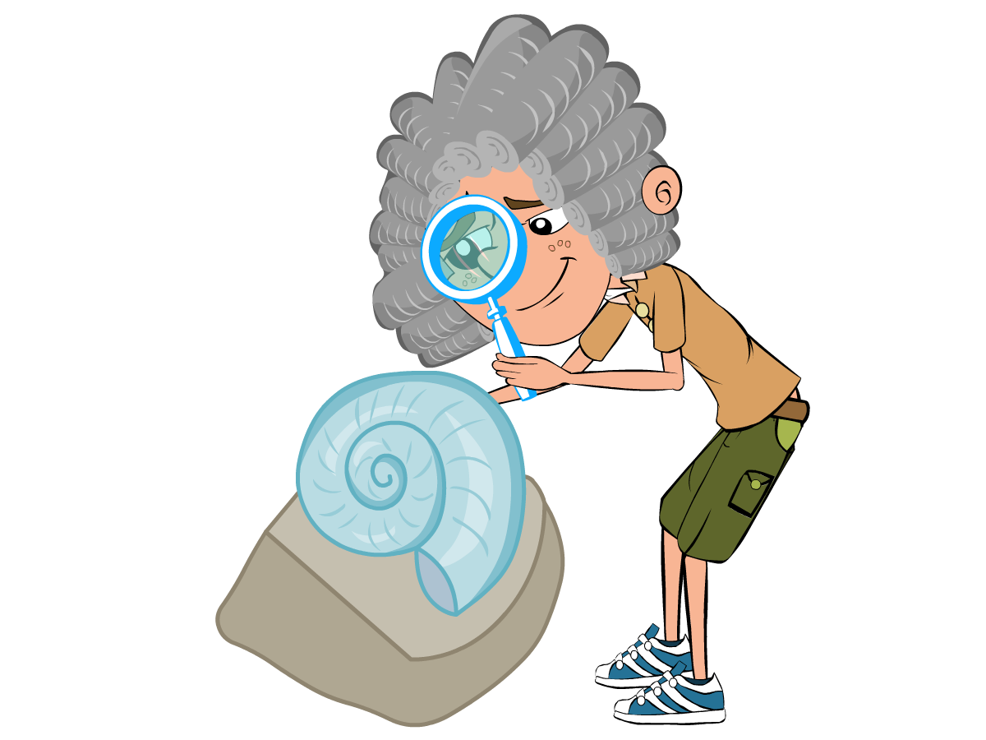
Historic Heroes 1
Historic Heroes
Edward Jenner was born in 1749. As a young boy, Edward
enjoyed science and nature, and spent hours on the banks
of the River Severn looking for fossils. In 1770, at the age of
twenty one, he began training as a doctor in London. Two
years later Edward began to practise as a doctor in his
home town of Berkeley, Gloucestershire.

Slide 24
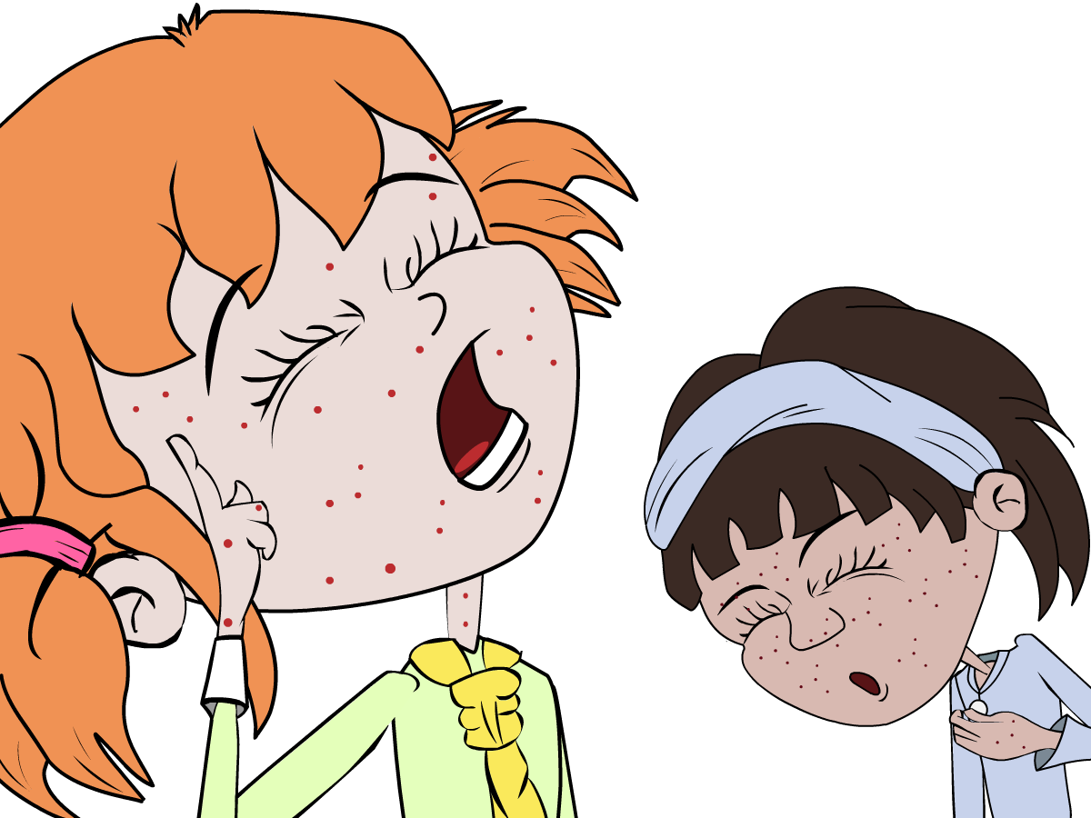
Historic Heroes 2
Historic Heroes
During this time, people were terrified of a horrible disease
called smallpox. People who got this disease got severe
scarring from lesions and sometimes even died. As a
doctor, Edward Jenner listened to what the country people
said about smallpox. They believed that someone who
caught a different mild infection called cowpox from their
cows would not catch the much more serious smallpox.

Slide 25
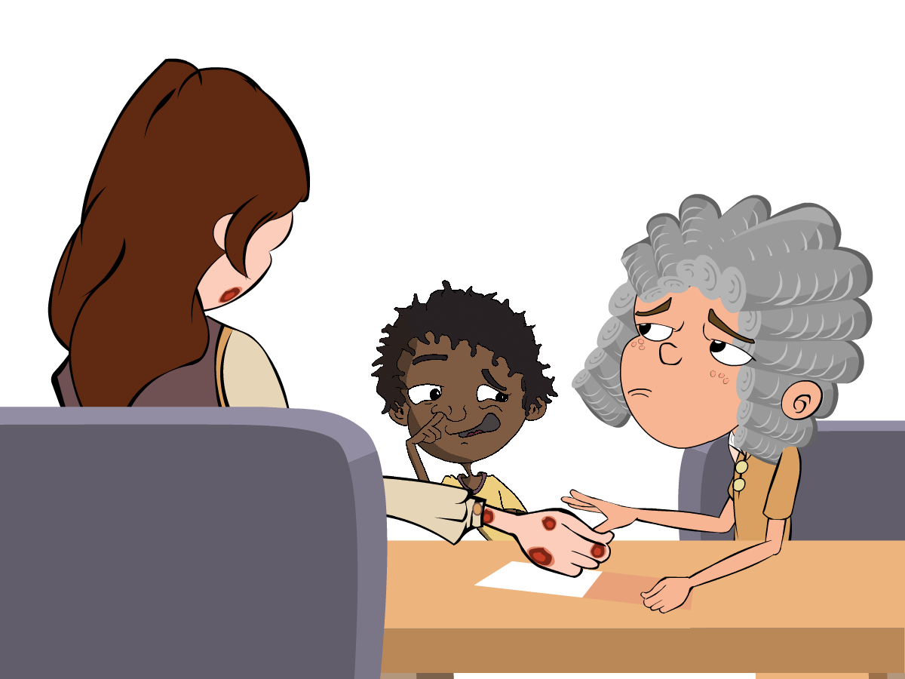
Historic Heroes 3
Historic Heroes
Jenner carried out an experiment to see if the people were
right. In 1796 a milk maid called Sarah Nelmes came to
Jenner complaining of a cowpox rash on her hand that she
caught from Blossom the cow. Jenner took some of the pus
from the cowpox rash on Sarah’s hand. He scratched some
of the pus into the hand of an 8 year old boy called James
Phipps, the son of his gardener. James fell ill with cowpox
but soon recovered.

Slide 26
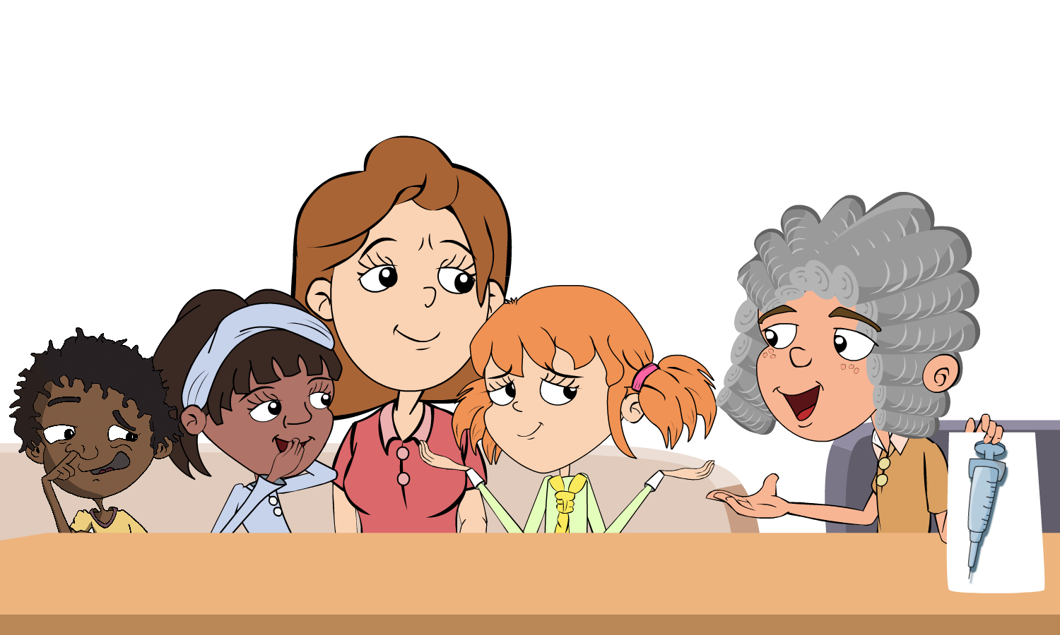
Historic Heroes 4
Historic Heroes
Jenner then took some pus from someone with the dangerous disease, smallpox, and scratched this into James’ arm. James developed a scab but did not develop smallpox, Jenner’s theory was right. Jenner's discovery came to be known as vaccination from the Latin word for a cow: vacca. Jenner went on to vaccinate all the local children with the cowpox to stop them from getting the more dangerous smallpox disease.

Slide 27
The Discovery of Vaccination Script – Scene 1
The Discovery of Vaccination Script
Scene 1 - by a river
Narrator - Edward Jenner was born in 1749. As a young boy Edward enjoyed science and nature, spending hours on the banks of the river Severn looking for fossils.
Jenner - What a lovely day to go looking for fossils on the bank of the river Severn. What could be more perfect?
Narrator - In 1770, at the age of 21, he began training as a doctor in London. Two years later Edward began to practice as a doctor in his home town of Berkeley, Gloucestershire. At this time smallpox and cowpox were a problem.

Slide 28
The Discovery of Vaccination Script - Scene 2
The Discovery of Vaccination Script
Scene 2 - Dr Jenner's office
Jenner - Oh come in come in, what seems to be the problem Mr and Mrs Smith?
Mrs Smith - Well Dr Jenner, my husband has got himself a cowpox rash. What can be done for him?
Mrs Smith - Also doctor, a friend of mine died last year from smallpox. But he never had cowpox.
Jenner - Yes, do go on Mr Smith.
Mrs Smith - Well, I know lots of other people who have had cowpox but then never got smallpox. Do you think this means I won’t get it doctor?
Jenner - You know Mr Smith, you are not the first patient to say that to me. I have my suspicions that you are correct. I will investigate the matter
Narrator - And the good doctor did just that. When milk maid Sarah Nelmes came to Dr Jenner with a cowpox rash he took the opportunity to experiment with the help of an 8 year old boy, James Phipps.

Slide 29
The Discovery of Vaccination Script – Scene 3
The Discovery of Vaccination Script
Scene 3 - Dr Jenner's office
Sarah - Doctor, I’ve got a cowpox rash on my hand.
Jenner - OK Miss Nelmes, let me take a look at that. Right young James, come here please and hold out your hand.
Sarah – What are you doing doctor?
Jenner - An experiment Miss Nelmes. I shall take some of the pus from your rash and scratch it into James’ hand.
Narrator - James fell ill with cowpox but soon recovered. Dr Jenner was ready for part 2 of his experiment. It was now that the doctor scratched some pus from someone with smallpox into James’ arm.
Jenner - James my boy, if all goes to plan your name will go down in medical history.
James - But what if it doesn’t go to plan Dr Jenner?
Jenner - I won’t lie to you James, you might well die.
James - (Gulps) Oh!
Narrator - But James didn’t die. Jenner’s theory was right and in time his discovery came to be known as vaccination. He then went on to vaccinate all the local children with cowpox to stop them from getting smallpox. Even today his work is still recognized and Gloucestershire Royal Hospital has a unit named after him.

Slide 30
The Story of Edward Jenner - Q1
The Story of Edward Jenner
Can you fill in the blanks in the story from the words in the box below?
Edward Jenner was born in ___________________, England. As a young boy Jenner’s favourite subject was ___________ and when he grew up he became a ___________. At the time the people of England were terrified of a deadly disease called ___________. Symptoms included severe _____________ and many people died. Jenner noticed that milkmaids who caught the harmless infection ____________, from their milking cows did not die from smallpox. Jenner took pus from the hand of a ___________ who had cow pox and infected a boy called __________. The boy got infected with cowpox but soon recovered. Jenner then __________ James with smallpox. A ______ developed but the boy did not develop smallpox. Jenner was
delighted that his idea was correct, he went on to __________ all the children in his town with cowpox to stop them getting smallpox.
Key words:
Cowpox, James Phipps, Smallpox, Gloucestershire, Doctor, Milk-maid,
Science, Scarring, Infected, Scab, Vaccinate

Slide 31
The Story of Edward Jenner – Q2
The Story of Edward Jenner
Answer the following questions:
What was the name of the doctor who discovered vaccinations? ____________________________________________
What was the name of the deadly disease at the time? ____________________________________________
What was Jenner’s idea to stop the deadly disease? ____________________________________________

Slide 32
The Story of Edward Jenner – Q3
The Story of Edward Jenner
Answer the following questions:
4. What happened to James after he was infected with the cowpox? ____________________________________________
5. What happened to James after he was infected with the smallpox? ____________________________________________
6. Why was it important for Jenner to test his idea on James before treating lots of children? ____________________________________________

Slide 33
The Story of Edward Jenner Q1 - Answers
The Story of Edward Jenner - Answers
Can you fill in the blanks in the story from the words in the box below?
Edward Jenner was born in ___________________, England. As a young boy Jenner’s favourite subject was ___________ and when he grew up he became a ___________. At the time the people of England were terrified of a deadly disease called ___________. Symptoms included severe _____________ and many people died. Jenner noticed that milkmaids who caught the harmless infection ____________, from their milking cows did not die from smallpox. Jenner took pus from the hand of a ___________ who had cow pox and infected a boy called ___________________. The boy got infected with cowpox but soon recovered. Jenner then __________ James with smallpox. A ______ developed but the boy did not develop smallpox. Jenner was delighted that his idea was correct, he went on to __________ all the children in his town with cowpox to stop them getting smallpox.
Gloucestershire
science
doctor
smallpox
scarring
cowpox
milk-maid
James Phipps
infected
scab
vaccinate
Key words:
Cowpox, James Phipps, Smallpox, Gloucestershire, Doctor, Milk-maid,
Science, Scarring, Infected, Scab, Vaccinate

Slide 34
The Story of Edward Jenner Q2 - Answers
The Story of Edward Jenner - Answers
Answer the following questions:
What was the name of the doctor who discovered vaccinations? ____________________________________________
What was the name of the deadly disease at the time? ____________________________________________
What was Jenner’s idea to stop the deadly disease? ____________________________________________
Dr. Edward Jenner.
Smallpox.
Infecting people with a similar but relatively harmless infection to provide immunity – the earliest concept of vaccination.

Slide 35
The Story of Edward Jenner Q3 - Answers
The Story of Edward Jenner - Answers
Answer the following questions:
4. What happened to James after he was infected with the cowpox? ____________________________________________
5. What happened to James after he was infected with the smallpox? ____________________________________________
6. Why was it important for Jenner to test his idea on James before treating lots of children? ____________________________________________
He recovered quickly and developed immunity to cowpox.
He had some scabs but did not develop smallpox.
Smallpox was a very deadly disease and if it didn’t work they may have all died.

Slide 36
Vaccination Quiz 1
Vaccination Quiz
Vaccines are used to:
(1 point)
Prevent infections
Treat infections
Postpone infections
By getting vaccinated you can:
(2 points)
Protect yourself
Protect people around you
Protect your useful microbes

Slide 37
Vaccination Quiz 2
Vaccination Quiz
How do vaccines work?
(1 point)
They block the entry of microbes in the body
They kill microbes in your body
The immune system attacks the vaccine and remembers for next time
Which diseases cannot be prevented by vaccination?
(2 points)
Common cold
Measles
Sore throat
Polio

Slide 38
Vaccination Quiz 3
Vaccination Quiz
Vaccines can be effective against:
(1 point)
Bacterial infections
Viral infections
Both bacterial and viral infections
Neither bacterial or viral infections
Vaccines are made up of:
(1 points)
Antibodies
White blood cells
Weak or inactive versions of the microbe that makes us ill
Strong microbes that make us ill

Slide 39
Vaccination Quiz 4
Vaccination Quiz
Herd immunity is:
(1 point)
When animals such as cattle have been vaccinated
A type of immunity naturally present in the body
When enough of the population is vaccinated to prevent the spread of
None of the above
Which diseases are eradicated or rare thanks to vaccinations?
(3 points)
Smallpox
Cough
Polio
Tetanus

Slide 40
Vaccination Quiz 1 - Answers
Vaccination Quiz - Answers
Vaccines are used to:
(1 point)
Prevent infections
Treat infections
Postpone infections
By getting vaccinated you can:
(2 points)
Protect yourself
Protect people around you
Protect your useful microbes
✓
✓
✓

Slide 41
Vaccination Quiz 2 - Answers
Vaccination Quiz - Answers
How do vaccines work?
(1 point)
They block the entry of microbes in the body
They kill microbes in your body
The immune system attacks the vaccine and remembers for next time
Which diseases cannot be prevented by vaccination?
(2 points)
Common cold
Measles
Sore throat
Polio
✓
✓
✓

Slide 42
Vaccination Quiz 3 - Answers
Vaccination Quiz - Answers
Vaccines can be effective against:
(1 point)
Bacterial infections
Viral infections
Both bacterial and viral infections
Neither bacterial or viral infections
Vaccines are made up of:
(1 points)
Antibodies
White blood cells
Weak or inactive versions of the microbe that makes us ill
Strong microbes that make us ill
✓
✓

Slide 43
Vaccination Quiz 4 - Answers
Vaccination Quiz - Answers
Herd immunity is:
(1 point)
When animals such as cattle have been vaccinated
A type of immunity naturally present in the body
When enough of the population is vaccinated to prevent the spread of
None of the above
Which diseases are eradicated or rare thanks to vaccinations?
(3 points)
Smallpox
Cough
Polio
Tetanus
✓
✓
✓
✓

Slide 44
Learning Consolidation

Slide 45
Discussion Question 1
What bodily system fights any harmful microbes that may enter our bodies?
Our immune system

Slide 46
Discussion Question 2
Vaccines help prevent a range of infections, for example...?
For example: influenza, COVID-19, measles, mumps, rubella, polio, meningitis, whooping cough, TB.

Slide 47
Discussion Question 3
There are vaccines for all infections?
True or False?
False

