Slide 1
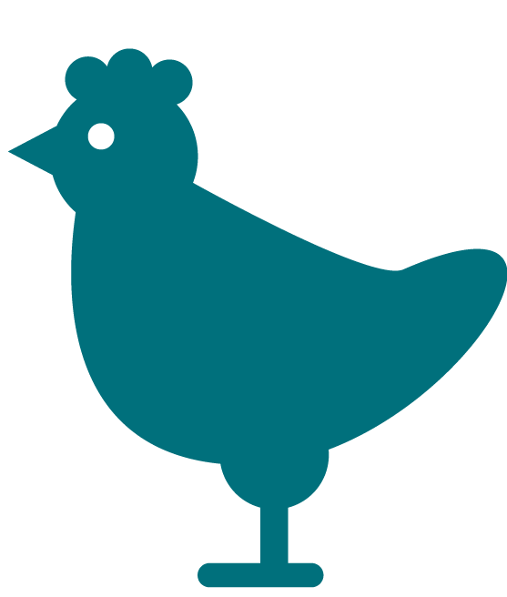
Food Hygiene & Safety Food Safety Scenarios

Slide 2
Learning outcomes
To understand that foodborne illness can have severe consequences and does not contribute to strengthening the immune system
To understand the consequences of not following food hygiene rules at home, such as cross-contamination, and how to prevent this
To understand types of food labels and why these are important
To explain the difference between food safety and food quality
To understand that food cooked at home is not necessarily safer than food eaten at restaurants

Slide 3
Scenario 1: Hannah gets symptoms of foodborne illness after eating at a barbecue. Hannah visits the pharmacist to talk about her symptoms
Hannah: “I went to a barbecue a couple of days ago, and I’ve been terribly sick- diarrhoea and vomiting. I ate some chicken there, that had been cooking for a good 15 minutes. But… there were still some pink bits inside.”
Pharmacist : “Oh dear, it’s really important to check with any raw meat, like chicken, that it has been cooked thoroughly inside. There are harmful microbes that could make you ill if the meat is undercooked. You should cut the meat at the thickest part to check there are no pink bits and any juices run clear.”
Hannah: “I thought most of it was cooked through at the time, from what I saw on the outside. Anyway, I thought it didn’t matter if I got ill from food poisoning, wouldn’t that make my immune system stronger?”
Pharmacist: “The immune system will naturally try to fight off infection, but this doesn’t make it any stronger. It’s better to avoid illnesses from food in the first place. If you get ill from food once, you can get ill from it again, and there can be severe consequences. Make sure you drink plenty of fluids, and avoid going to work until you have no symptoms for two days.”

Slide 4
Scenario 2: Tiago’s mum is preparing chicken for dinner that evening and takes the chicken to the sink to wash it
Tiago’s mother: “I’m getting the dinner ready for tonight. Just going to start by washing the chicken, to get any blood off.”
Tiago: “Mum, you shouldn’t be washing the chicken. The juices will splash everywhere and contaminate the surfaces.”
Tiago’s mother: “But this is what I’ve always done, so does your aunt, as does your grandma. We’ve never been ill from washing chicken. Why would we change now?”
Tiago: “I learnt in my food hygiene class about a type of bacteria called Campylobacter, it’s found on raw chicken. If we wash chicken before cooking it, Campylobacter can splash onto other surfaces, clothes and our hands. If it gets inside us, we could get really ill.”

Slide 5
Scenario 3: Hugo is making his lunch for the next day. He checks the fridge to see what he can use
Hugo: “I’m making some lunch for tomorrow. Let’s see, I have some ham – ham and cheese sandwich sounds like a good idea.”
Hugo’s brother: “Hasn’t that ham been in the fridge for a while? You should check the date on that.”
Hugo: “Let me see. It’s three days past the use by date. It still smells and looks fine though. There’s not much else, and I can’t be bothered to go to the shop now.”
Hugo’s brother: “You need to throw that away Hugo. You need to stick to use by dates on food, because there could be harmful bacteria growing on it. Do you remember the last time I had something past its use by date – I didn’t leave the toilet for 2 days! Don’t come crying to me if you get ill!”

Slide 6
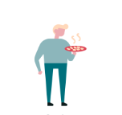
Scenario 4: Stavros and his family are having dinner at home. They are talking about a family who got ill from eating out a buffet restaurant last week
Stavros: “I wouldn’t want to eat at that restaurant again. I don’t trust it - they’ve changed management twice now, and poor Petra and her family got sick from the food there. I don’t trust any of these takeaways or buffets.”
Stavros’s daughter: “I would rather eat at home instead of the school canteen. You don’t know who has touched the food, or whether they have even washed their hands!”
Stavros’s wife: “I don’t think it matters what place you eat at, what matters is the way food is prepared, and how it is cooked, especially making sure meat is cooked thoroughly. Restaurant staff have to do food hygiene training so they probably know more than most of us at home!”

Slide 7
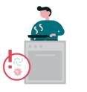
Scenario 5: Maria and her brother are preparing lunch for their guests. Maria has prepared the vegetables and is about to prepare the meat
Maria’s brother: “Maria, I’m about to get started on the dessert for lunch this afternoon. How are you doing with the main?”
Maria: “So far I’ve cut up the vegetables, prepared the salad and dressing, and put it in the fridge. Please can you pass me that wooden chopping board for the meat?”
Maria’s brother: “Maria, use this red plastic board instead. I’ll be doing the washing up after, and it will be a lot easier and safer to wash up the plastic board compared to the wooden one.”
Maria: “Good point, the red board should only ever be used for meat, and the green one for the vegetables.”
Maria’s brother: “Yes, you’re right. We don’t want to contaminate the boards, or I’m not sure our guests would return!”

