Slide 1
Food Hygiene and Safety: An outbreak at a dinner party
This project has received funding from the European Union’s Horizon 2020 research and innovation programme under grant agreement No 727580.

Slide 2
Learning outcomes
To identify harmful microbes that are commonly found in food
To identify conditions that promote the growth of harmful microbes and how to prevent this
To understand how to safely transport, store and prepare food
To understand risks and consequences of food poisoning

Slide 3
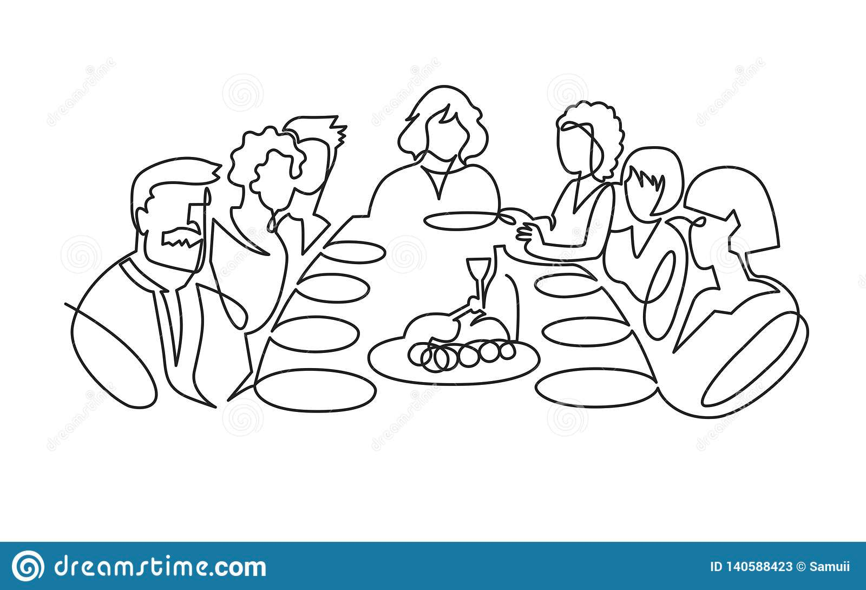
The Dinner Party
John’s mother has invited 4 guests for a dinner party, but she couldn’t get off work early so she has asked John to do some of the shopping beforehand, since the supermarket is very close to his school.
John would rather spend the afternoon with his friends , but reluctantly agrees to help.

Slide 4
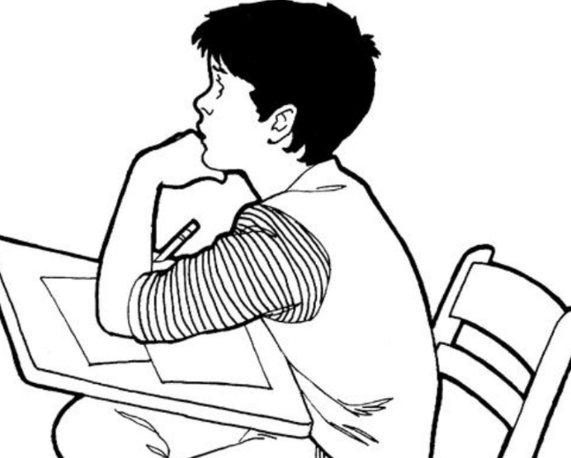
The Dinner Party
1:15 PM
John goes to the supermarket and buys:
Cold smoked salmon
Chicken fillets
Strawberries
Carrots
Cookies
1:30 PM
John meets some friends who are playing football outside in the nice weather 30 °C and he joins them.
He leaves the shopping by the side of the field while they play.
3:00 PM
The friends quit playing football and walk to the local shop where they buy and drink a coke outside.
Luckily John remembers to pick up the shopping before leaving!
1 PM
John’s afterschool club is cancelled and he gets away early.
“Great! I will go shopping right away and then I can spend the afternoon with my friends.”
4 to 15 °C
30 °C
30 °C

Slide 5
The Dinner Party
5:45 PM
John
- Sets the table
- Peels the carrots
-Washes the strawberries
Mum
- Prepares salad
- Puts chicken on a plate
-Pre-heats the grill
5:30 PM
Mum comes home and starts to prepare the starter with the smoked salmon. John helps out.
The starter is left on the table after preparation
4:30 PM
John remembers that some of the food needs to go into the fridge.
He puts the salmon and chicken in the fridge
4:00 PM
John comes home, leaves the bag of groceries on the kitchen counter and takes a shower
30 to RT °C
RT to 4 °C
4 to RT °C
RT °C

Slide 6
The Dinner Party
2 days after
John and two of the guests are sick with stomach ache, diarrhea and vomiting. John and one of the guests had eaten a bit of everything, but the other guest was pescatarian, so hadn’t eaten the chicken. One of them, an elderly diabetic gets symptoms of a severe infection and has to go to hospital
6:30 PM
Guests arrive and start eating the carrots
6:45 PM
One of the guests helps to grill the chicken on the barbeque. The pieces are small and cook quite quickly. When it is done, the chicken is returned to the same plate
7:00 PM
They sit down to eat
RT °C
75°C
RT °C

Slide 7
What went wrong?
To figure out what went wrong, we need to go back and look at what John bought, how it was handled and what harmful microbes could have grown in food.

Slide 8
Did John and his mum follow the instructions on the labels?
What is the typical labelling on the purchased items?
 | Chicken | Salmon | Vegetables and fruit | Cookies
Type of label: Best before or Use by?
Shelf life before opening
Shelf life after opening
Recommended storage temperature
Recommended heat treatment

Slide 9
Did John and his mum follow the instructions on the labels?
What is the typical labelling on the purchased items?
 | Chicken | Salmon | Vegetables and fruit | Cookies
Type of label: Best before or Use by? | Use by | Use by | Best before | Best before
Shelf life before opening | 2 – 3 days | 2 – 3 weeks | 1 week | Freshly baked – 2 – 3 weeks Packet – 8 – 12 months
Shelf life after opening | 1 – 2 days | 5 days | N/A | 1 week
Recommended storage temperature | 4°C or below | 4°C or below | 4°C or below | N/A
Recommended heat treatment | 75°C | Ready to eat | N/A | N/A

Slide 10
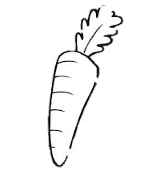
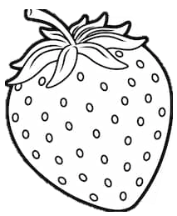
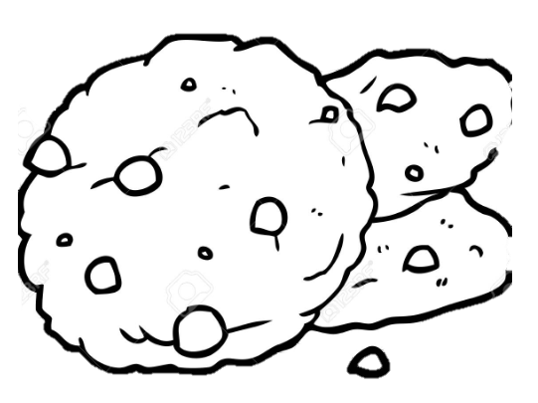
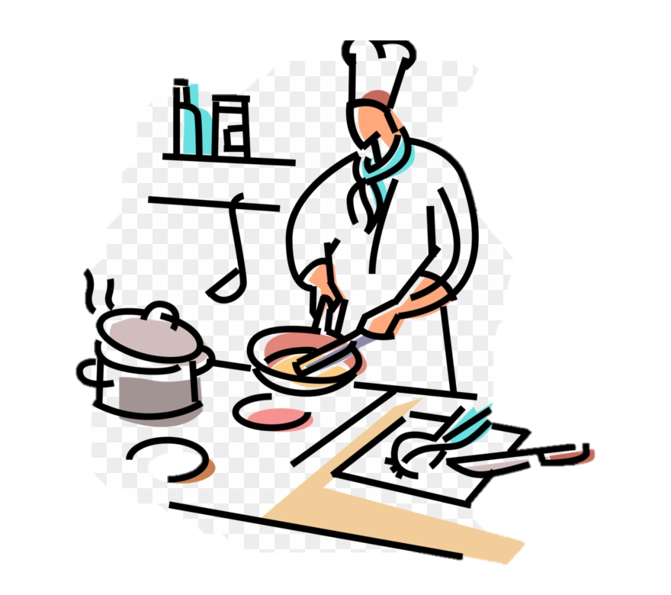
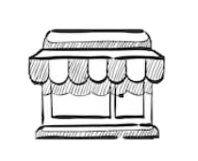
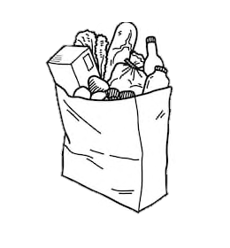
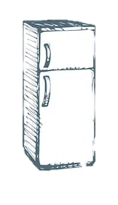
Did John and his mum do something wrong?
Which items do you believe could be the biggest safety hazard?
Were there any major safety faults during the food journey: shopping, storage and cooking?
Supermarket
5 °C
Outside
30 °C
Inside
25 °C
Fridge
5 °C
Food preparation
25 °C
Guest arriving and eating
25 °C

Slide 11
Did John and his mum do something wrong?
Which items do you believe could be the biggest safety hazard?
Were there any major safety faults during the food journey: shopping, storage and cooking?
Cir
Outside
30 °C
Inside
25 °C
Food preparation
25 °C
Guest arriving and eating
25 °C

Slide 12
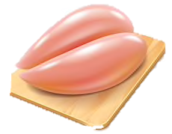
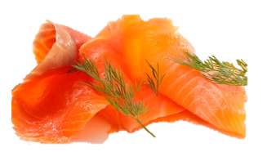
Did John accidentally cause growth of harmful microbes in the food he bought?
Harmful microbes that you would suspect to find in the types of food that John bought:
E. Coli
Cross contamination
Not a big risk
Listeria monocytogenes
Salmonella
Norovirus
Campylobacter jejuni

Slide 13
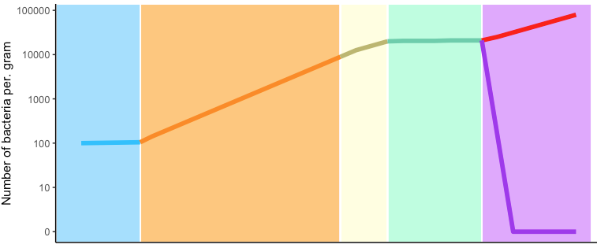
The Chicken
The Salmonella left in the juices from the chicken will keep on growing.
The grilled chicken is re-contaminated when returned to the dirty plate
Microbial hazard: Salmonella
15 m
Super-market
2h 30min
Outside
30min
Counter
1h 15 min
Fridge
1h 15min
Grilled, but returned to dirty plate
4 - 15°C
30 °C
25 °C
4 °C
Grilling + 25 °C
Combase prediction: https://browser.combase.cc/ComBase_Predictor.aspx?model=1
Notes:
Note: Assuming that the salmonella is from the juice on the plate and therefore not killed by the grilling

Slide 14
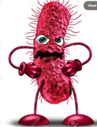
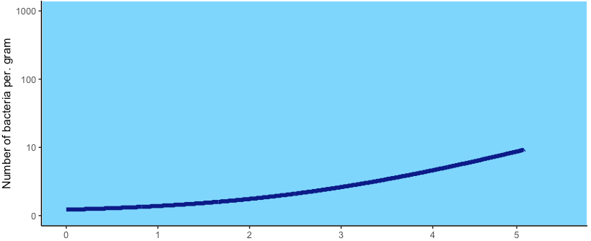
The Cold Smoked Salmon
Microbial hazard: Listeria monocytogenes
Before purchase
0 1 2 3 4 5
5 days
Supermarket
4 °C
Combase prediction: https://browser.combase.cc/ComBase_Predictor.aspx?model=1

Slide 15
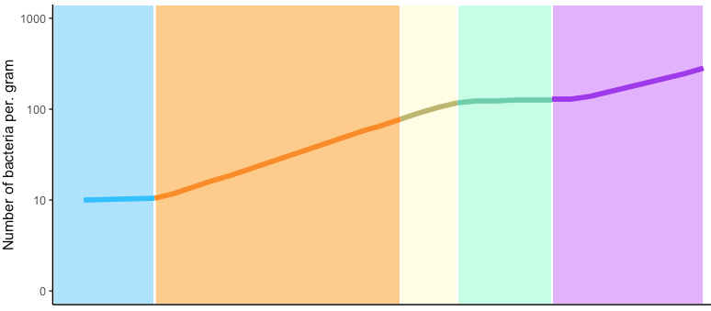
The Cold Smoked Salmon
Microbial hazard: Listeria monocytogenes
After purchase
15 m
Super-market
2h 30min
Outside
30min
Counter
1h 15 min
Fridge
1h 15min
Grilled, but returned to dirty plate
4 - 15°C
30 °C
25 °C
4 °C
Grilling + 25 °C
Combase prediction: https://browser.combase.cc/ComBase_Predictor.aspx?model=1
Notes:
Note: Assuming that the salmonella is from the juice on the plate and therefore not killed by the grilling

Slide 16
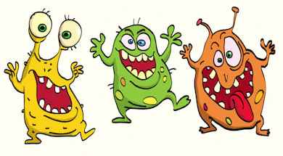
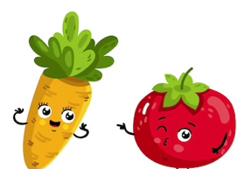
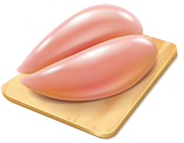
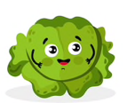
Cross-contamination
To prevent cross-contamination, what should John’s mum remember to do when preparing the salad and the chicken?
Why do you need to be careful when you have a plate of raw chicken next to your vegetables?
Notes:
Cross – contamination -

Slide 17
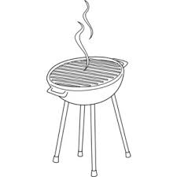
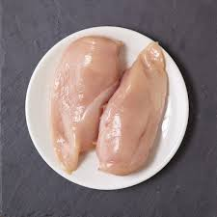
Cooking meat
What happens to the bacteria on the raw meat when cooked?
What can you do to cook meat properly on a barbecue?
How do you check that meat is cooked?
Why is it important to put meat on a clean plate, once cooked?

Slide 18
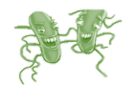
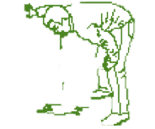
Food poisoning
What microbe(s) do you think made John and his guests ill and how?
Why was the elderly guest more at risk of becoming ill?
Why didn’t all of the guests become sick?
Notes:
The answers should be given in the teachers material

