Slide 1
The Immunity Chain Reaction Game: World Immunisation Week 2025
Key Stage 2

Slide 2
Introduction
What are microbes? What different types of microbes do you know?
Microbes include bacteria and viruses that can make us sick
For examples, click “control” + “enter” here and see slides 4 to 14
Vaccines help protect us against many different harmful microbes including important viruses like measles, chickenpox, flu, and COVID-19
Vaccines teach our bodies to recognise and fight off specific harmful microbes

Slide 3
How to play the Immunity Chain Reaction Game
Have everyone stand at their desks
Everyone will get a coloured dot - keep your colour a secret!
When infected, you must infect two other people
After infecting others, sit down
Let's see how fast infections spread!

Slide 4
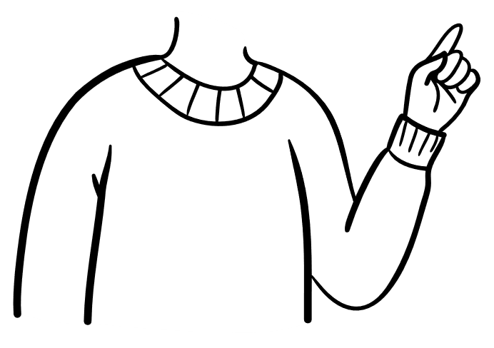
Round 1: No One Is Vaccinated
Everyone can catch and spread the infection
Infection is passed by pointing and saying "I pass my harmful microbe to you"
After infecting two people, sit down
Let's see how quickly it spreads!

Slide 5
Discussion
How quickly did the infection spread?

Slide 6
Round 2: Few People Vaccinated
Anyone with a red dot? You are now vaccinated!
Vaccinated students cannot pass on the infection - remember to keep your colour a secret
If you're vaccinated and get pointed at, don’t pass it on, and don't sit down
Let's see what happens now!

Slide 7
Discussion
How quickly did infection spread?
Why didn't the vaccinated children get sick?

Slide 8
Round 3: Many People Vaccinated
If you have a red OR green dot, you are now vaccinated!
Remember: vaccinated students don't pass on infection
If you're vaccinated and get pointed at, don’t pass it on, and don't sit down
Let's see if the babies and others stay protected!

Slide 9
Discussion
Did the disease spread as easily this time?
Why do you think it was harder for the disease to spread?
What happened to the people with black dots?

Slide 10
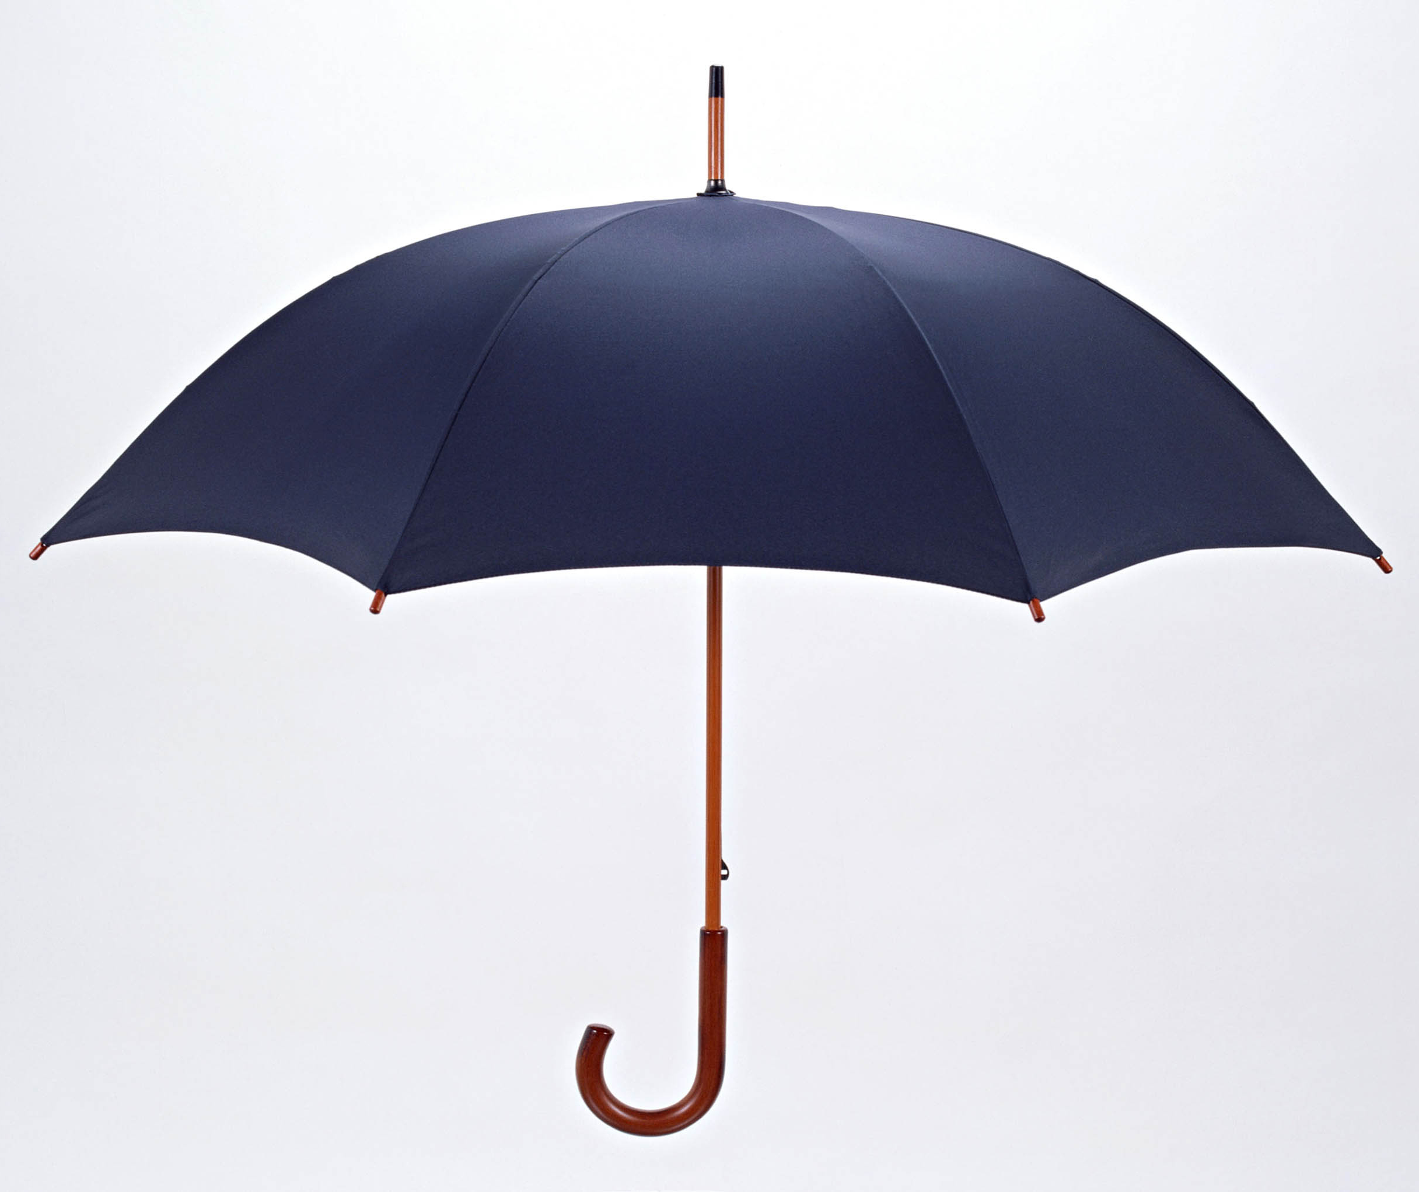
Community Protection (Herd Immunity)
When enough people are vaccinated, the whole community is protected
Like an umbrella that shields everyone underneath
This helps protect babies and those who cannot get vaccines

Slide 11
Booster Vaccines
Sometimes protection from vaccines gets weaker over time, like a shield that gets thinner
Booster vaccines add an extra layer to keep our protection strong
Examples: tetanus boosters, flu shots each year
If you have time, how about a Quiz!
Click control + enter and go to slide 36

