Slide 1
Oral Hygiene
Key Stage 1

Slide 2
Learning Intention
• Explore how plaque forms on teeth and understand the impact of sugary food and drinks on dental health, empowering them to make better choices to protect their teeth.

Slide 3
Northern Ireland Curriculum Links
Curriculum Key Elements
Personal Health and Moral Character
Curriculum Skills
Communication, Managing Information, Problem Solving and Decision Making, Working with Others
Curriculum Areas of Learning
Personal Development (PDMU), The World Around Us (TWAU)

Slide 4
What Are Your Teeth Made of?
Our teeth are hard, white, shiny and strong, so we can chew and bite food.
Teeth are made of layers. The hard layer on our teeth called the enamel is a bit like an egg shell.
Throughout the day, germs called bacteria grow on teeth to form a sticky substance that hardens to form plaque.
When we eat sugary foods and drinks the bacteria uses the sugar to attack our teeth, especially the hard outer enamel layer.

Slide 5
Main Activity:
Egg Shell Experiment

Slide 6

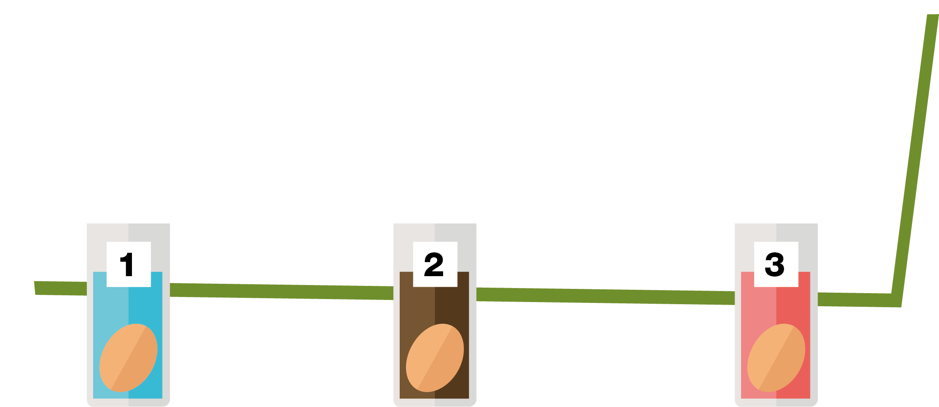
=
3. Pour one of the liquids in each cup (enough to cover the egg).
4. Wait at least one day. What do you see?
1. Label each cup 1 to 3.
2. Place each egg in a different cup.

Slide 7
Discussion

Slide 8
Discussion Points
What will happen to the egg if you leave it in the drink for a long time?
Which liquid will change the egg most?
Which liquid will change the egg least?
What changes can you see?
Why has that happened?
What can damage our teeth?
What should you do to keep your teeth healthy?

Slide 9
Extension Activities

Slide 10

What do you Remember -Answers
Healthy Eating
What do you remember?
Are these True or False?
Dried fruits should be
eaten at mealtimes not
as a snack
True
Chocolate biscuits are
a healthier snack than
plain yoghurt and fruit
False
Biscuits contain a lot of added sugar
Lower-fat milk is a
healthier drink choice
than a sports drink
True
Sports drink can contain lots of sugar. Water or lower-fat milk are better choice
Eating too much sugar
can cause tooth decay
True

Slide 11
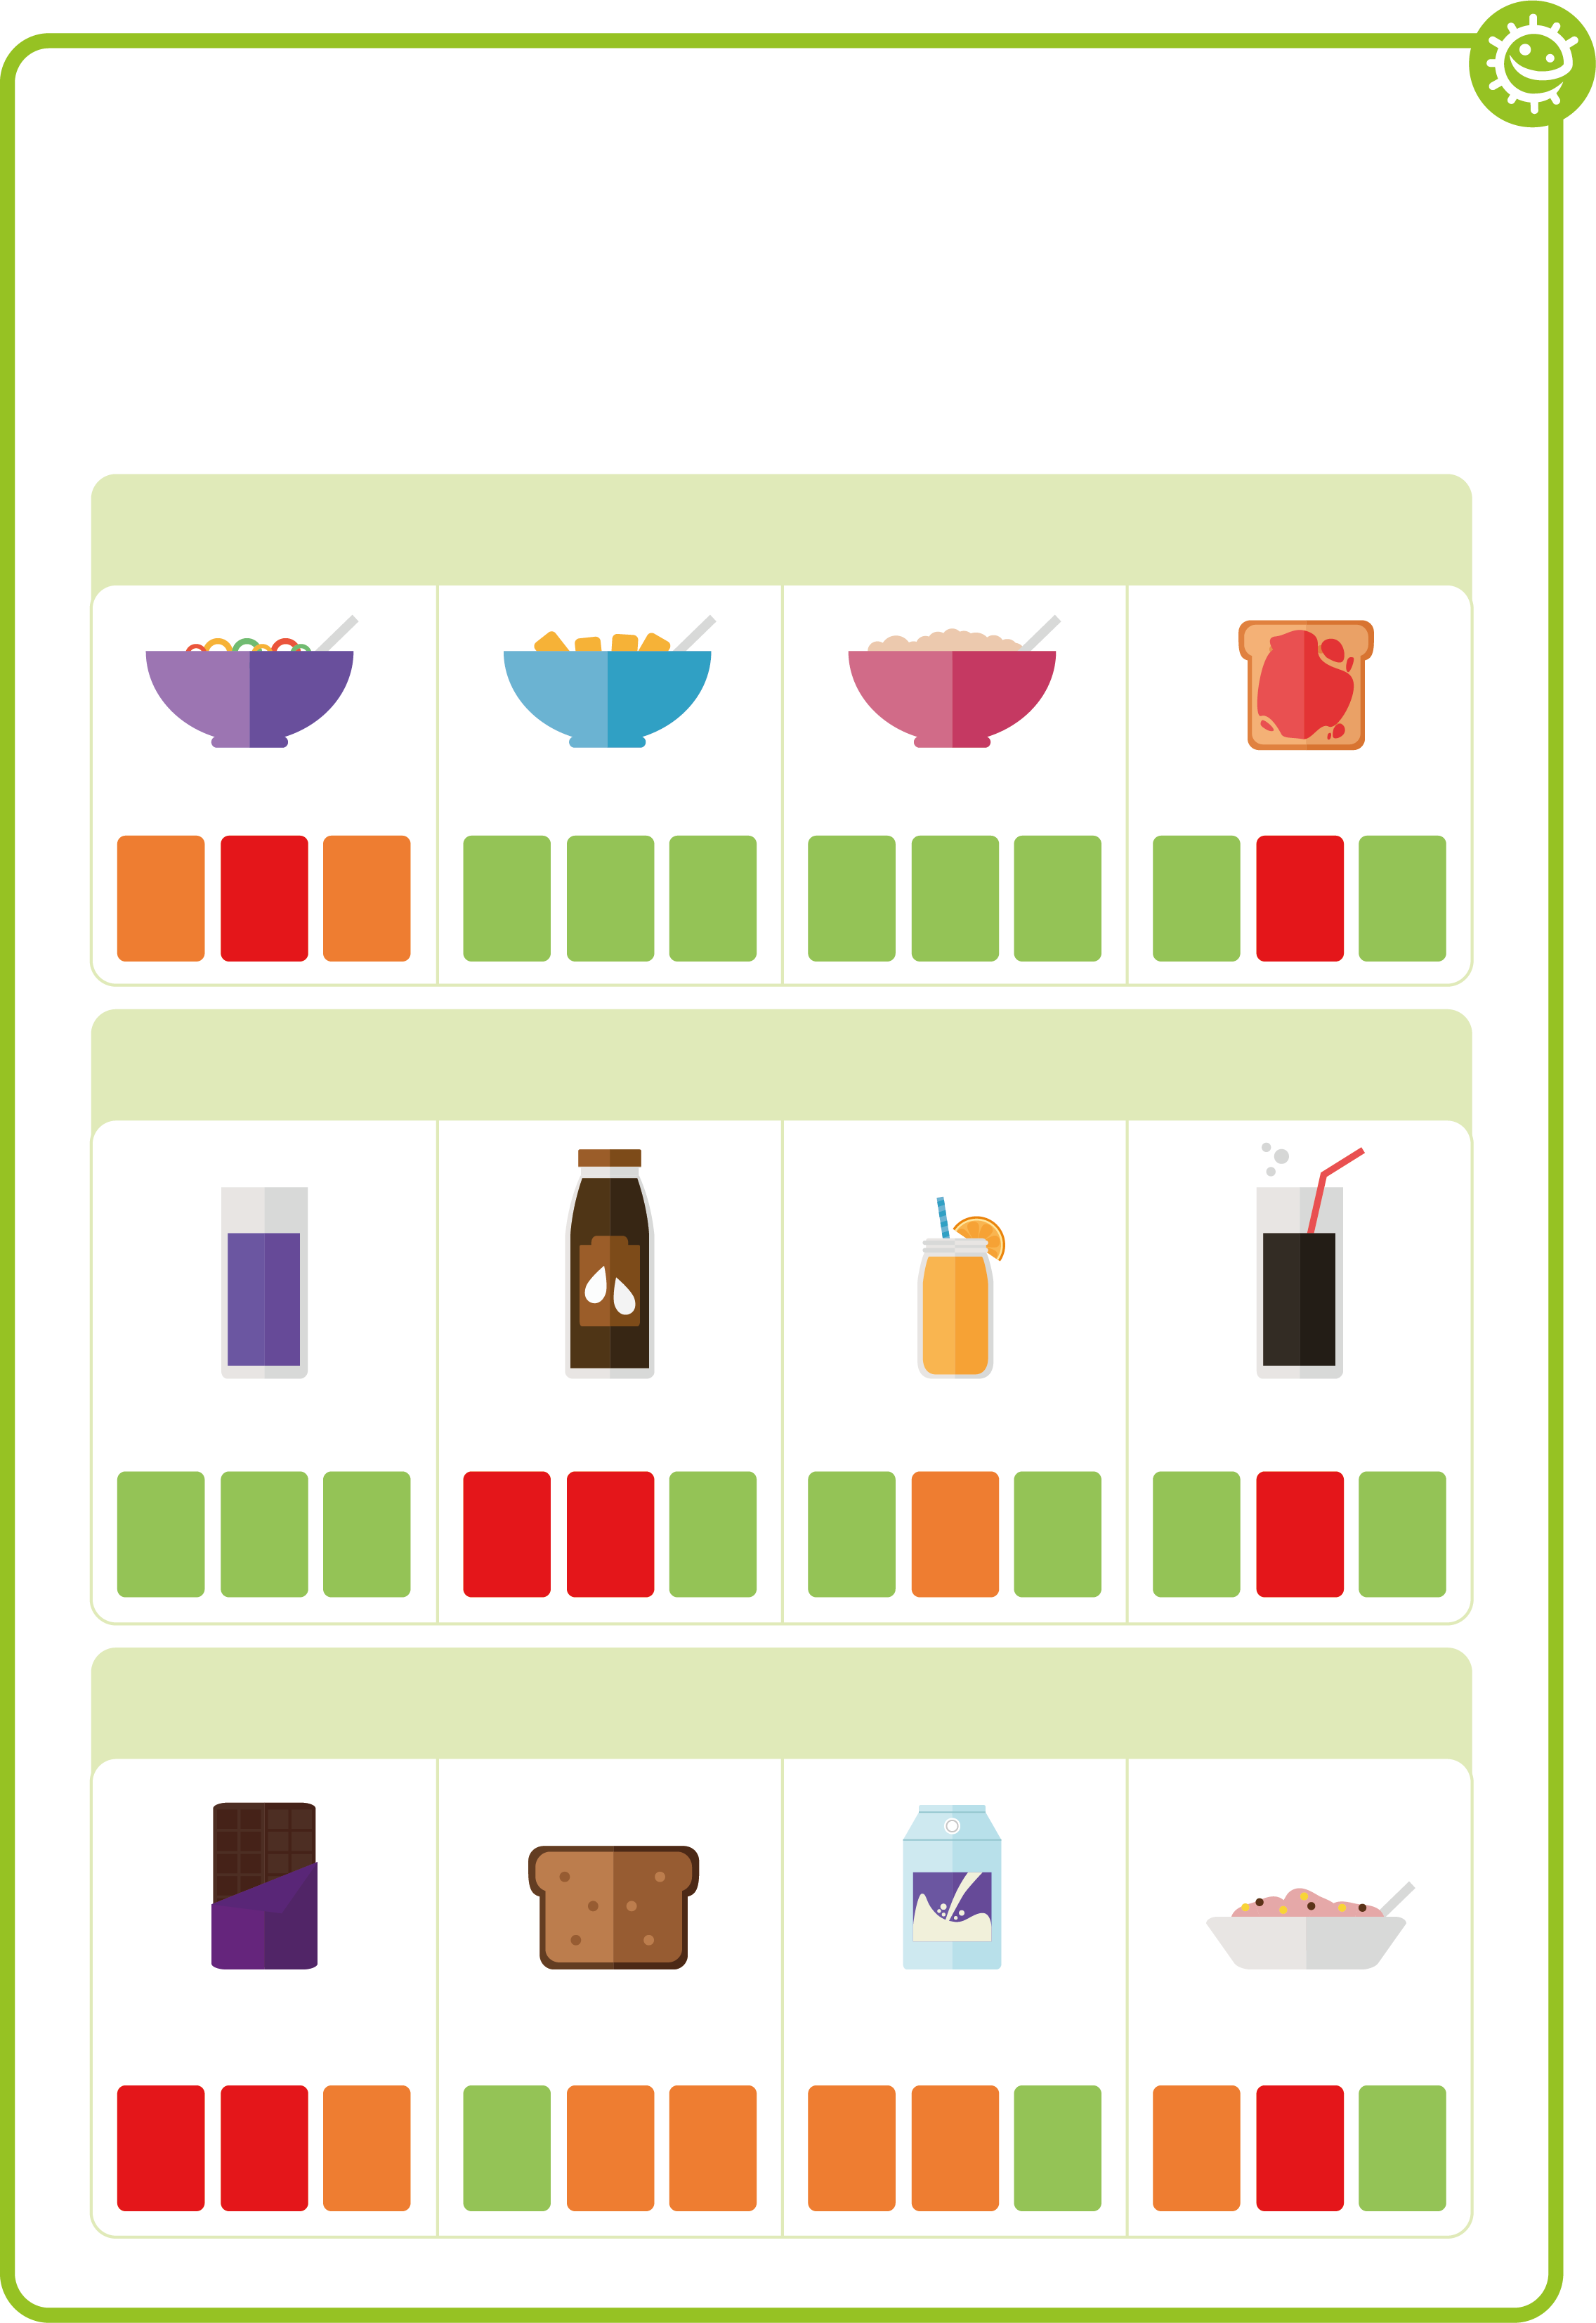
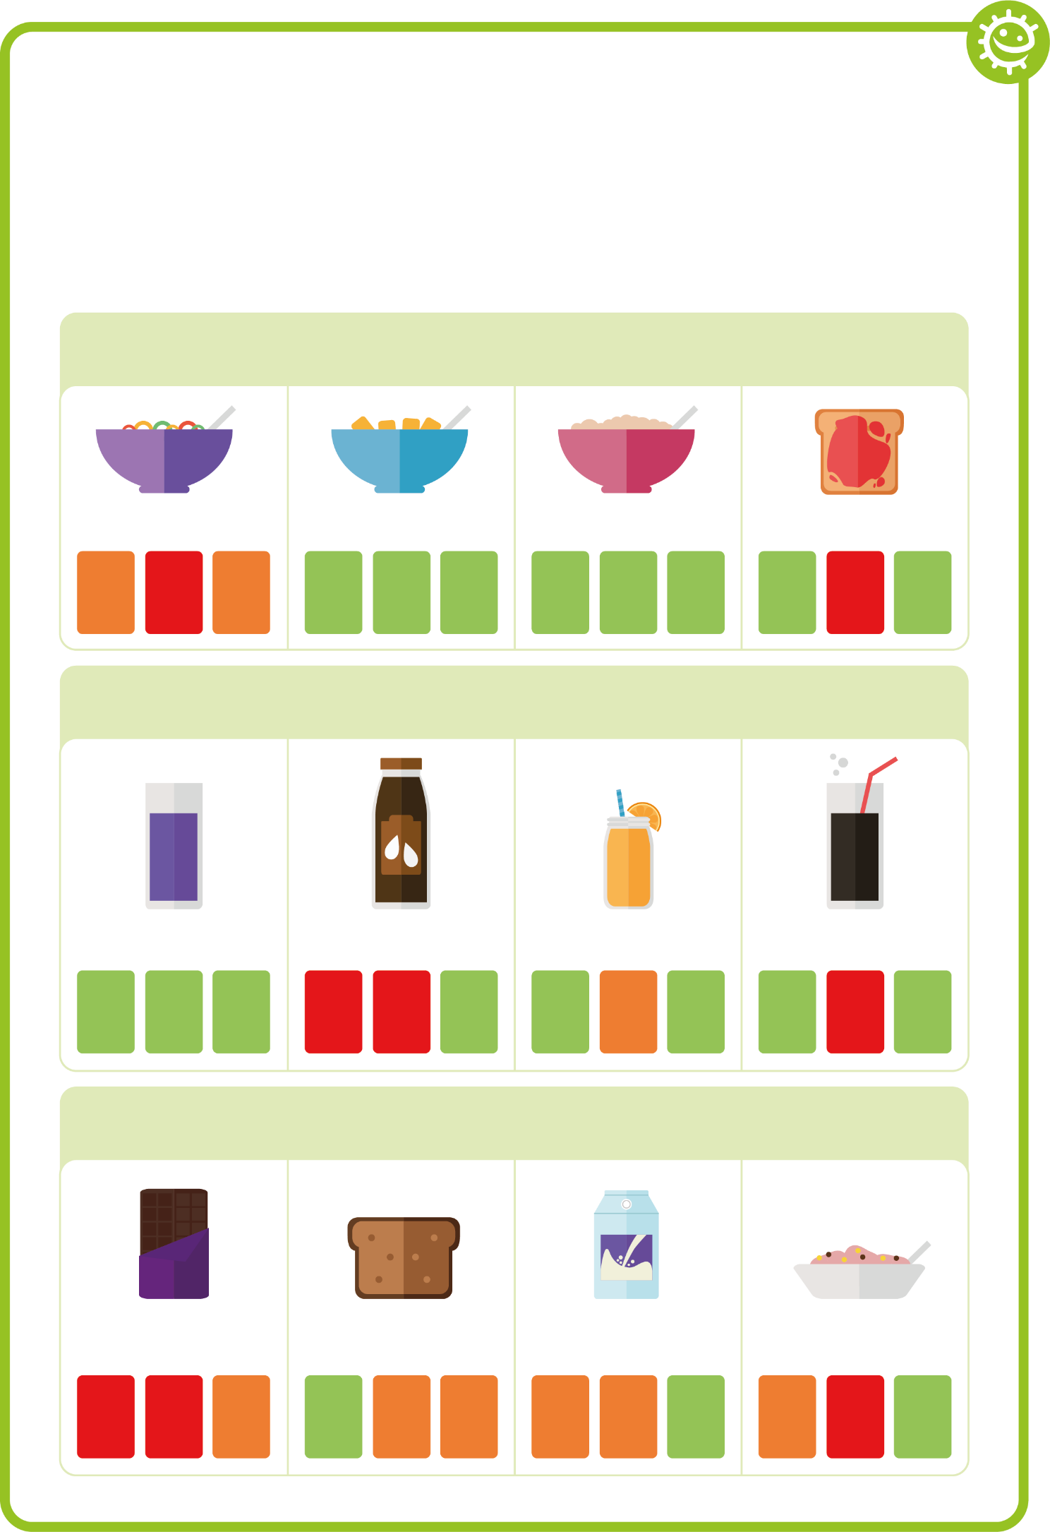
Healthy Food Choice Fact Sheet
Healthy Food Choice Fact Sheet
Breakfast
High sugar cereal
Wheat biscuit cereal
Porridge
Jam on toast
fat
sugar
salt
fat
sugar
salt
fat
sugar
salt
fat
sugar
salt
Drink
No-added sugar/ sugar free squash and water
Chocolate milk
Orange juice
Full sugar cola
fat
sugar
salt
fat
sugar
salt
fat
sugar
salt
fat
sugar
salt
Snack
Chocolate bar
Malt loaf
Low sugar yoghurt
Regular yoghurt
fat
sugar
salt
fat
sugar
salt
fat
sugar
salt
fat
sugar
salt

Slide 12
Healthy Food Choice Exercise
What breakfast, drink and snack would you drink to keep your teeth healthy?
Write your choice
Breakfast
Draw your choice
Drink
Snack

Slide 13
Healthy Teeth Brushing Chart
FRI
THU
WED
I cleaned my teeth in the morning
I cleaned my teeth for 2 minutes
I cleaned my teeth before bed
TUE
Add a picture or star each time you brush your teeth
MON
Name
Class

Slide 14
Learning Consolidation

Slide 15
What is the sticky substance made up of bacteria that clump together on our teeth called?
Plaque

Slide 16
Complete the sentence; When we consume sugary foods and drinks, this leads to an attack on our teeth that can lead to?
Tooth decay

Slide 17
How many times a day should you brush your teeth with toothpaste.
At least twice a day

Slide 18
After brushing, should you; a) spit out the toothpaste and rinse; b) spit out the toothpaste and don’t rinse?
Brush teeth
Spit out the toothpaste
Do not rinse

Slide 19
Alternatively, in small groups, ask children to create a ‘Toothbrushing Tips’ poster or set of rules based on what they have learned (e.g. Spit, don’t rinse, Brush twice a day for two minutes). Groups can then present their rules to the class.
Children can then reflect individually on:
What is one new thing I have learned about toothbrushing today?
What will I do differently when brushing my teeth?
Each child can then write a simple commitment statement, for example:
“From now on, I will _____________________________ to take better care of my teeth.”
Display these commitments in the classroom or send them home to involve families in reinforcing positive habits.
Poster challenge

