Slide 1
Treatment of Infection:
Antibiotics
Key Stage 2

Slide 2
Learning Intention
All pupils will:
Understand how the body fights infections, the role of antibiotics in treating bacterial infections, and the importance of using medicines responsibly to support personal and public health.

Slide 3
Northern Ireland Curriculum Links
Curriculum Key Elements
Personal Health and Moral Character
Curriculum Skills
Communication, Thinking, Problem Solving and Decision Making, Working with Others
Curriculum Areas of Learning
Personal Development and Mutual Understanding (PDMU), The World Around Us (TWAU)

Slide 4
Why Do We Use Antibiotics? (1/2)
Why Do We Use Antibiotics?
Before we get medicine for common infections, we should try and let our bodies fight the harmful microbes. Inside our bodies we have an immune system that fights harmful microbes. If we get plenty of sleep and eat properly we keep our immune system strong and it keeps fighting the harmful microbes.
Sometimes, if a lot of harmful microbes get into the body, the immune system may need help. This is when we need medicine. Different types of medicine are used to treat the symptoms of different infections e.g. cough remedies, painkillers, medicines to bring down temperatures.
Antibiotics are medicines that are used to treat only bacterial infections. Antibiotics make us better by stopping or killing the harmful bacteria that make us ill. Explain to pupils that different antibiotics affect different bacteria therefore we should not use other people’s antibiotics because they might not work; we should only take antibiotics given to us by the doctor, nurse or chemist.

Slide 5
Why Do We Use Antibiotics? (2/2)
Why Do We Use Antibiotics?
Antibiotics will not work on infections caused by a virus, for example antibiotics cannot stop or kill COVID-19 or the common cold.
If we do get antibiotics from the doctor, nurse or chemist then it is important to finish the course. If not, we may not kill all the harmful bacteria and they could make us ill again or become resistant to the bacteria.
You should know that many of the other medicines e.g. pain killers or cough mixtures are used to relieve the symptoms of infection such as headaches, fever, congestion, etc.

Slide 6
Main Activity:
Comic Strip Scenarios and Discussion

Slide 7

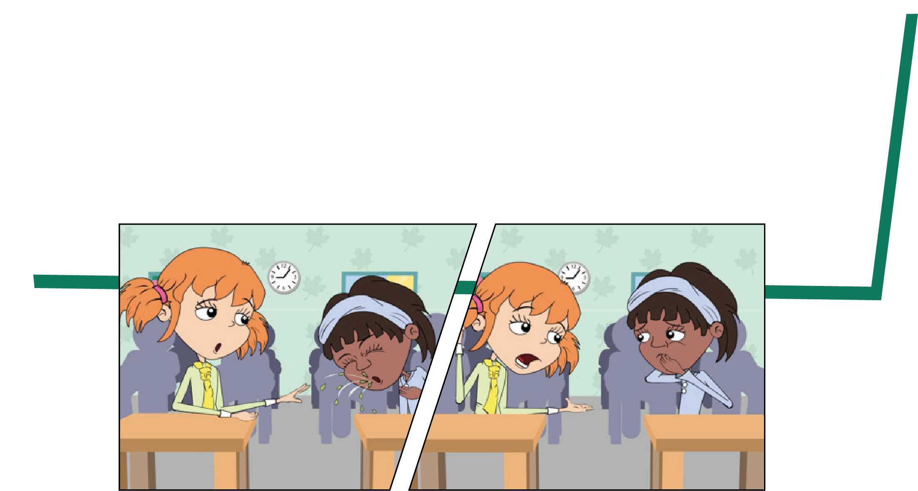
Comic Strip Activity
1. Read through the comic strips
2. Make decision about antibiotic use for the characters

Slide 8

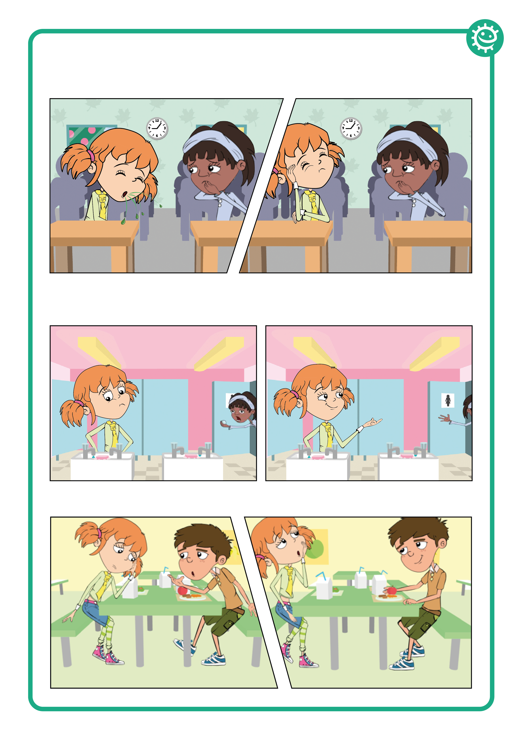
Antibiotics Comic Strip 1
Antibiotics Cosmic Strip
Ina went to school not feeling very well. She had a headache and a runny nose. When she arrived in the classroom she took a seat beside Eva. She soon realised that Eva was also not well.
Are you OK Eva?
Not really but my mum said that I have to come to school *cough*
Mine too. But I’m not coughing. You really should cover your mouth you know.

Slide 9
Antibiotics Comic Strip 2
Antibiotics Cosmic Strip
At lunch time, Eva and Ina went to the toilet. Ina was hungry and in a hurry to have her lunch.
Come on Eva, I’m hungry! And don’t forget to wash your hands.
Why do I need to wash my hands?

Slide 10
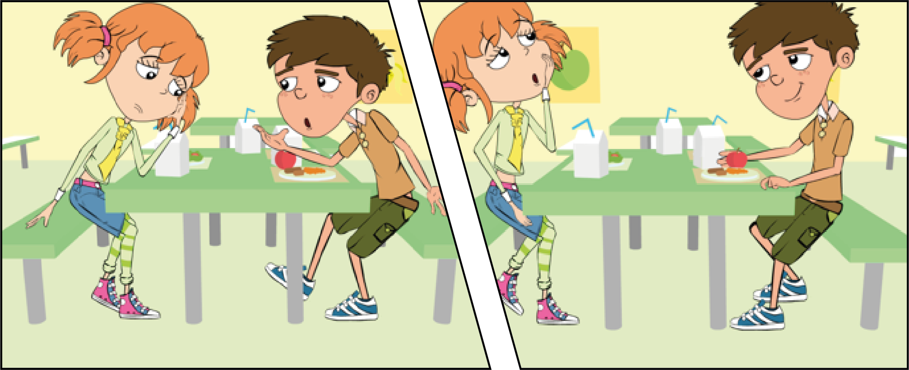
Antibiotics Comic Strip 3
Antibiotics Cosmic Strip
During lunch Eva was talking to her friend Luca about her headache and runny nose.
Don’t you have any antibiotics at home you can take?
That’s a good idea. We still have some from when my
sister had an ear infection. I’ll ask my mum.
It really hurts
and I think I’m getting a cold.

Slide 11
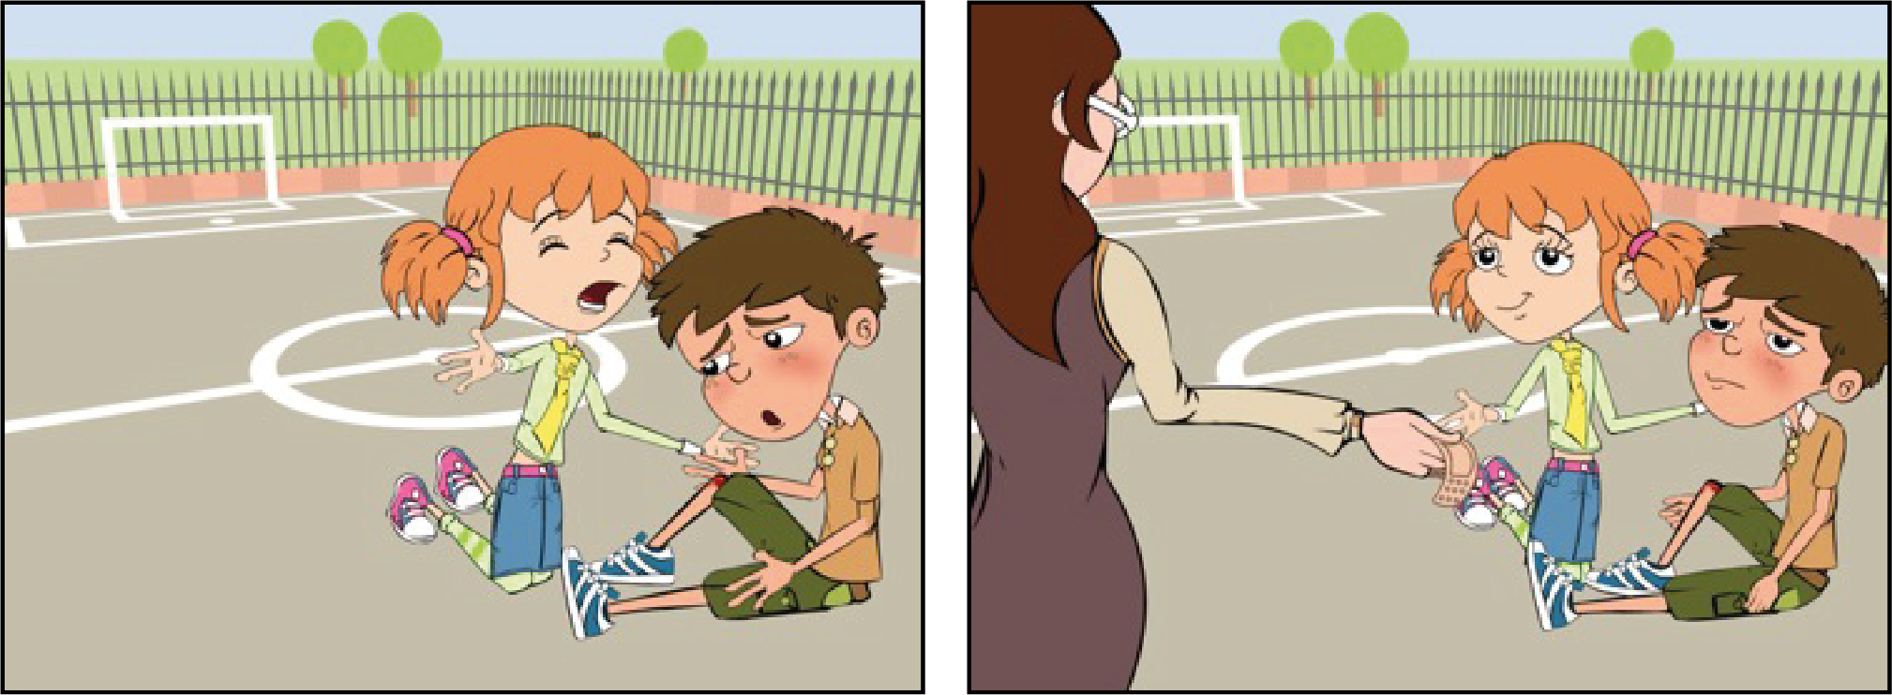
Antibiotics Comic Strip 4
Antibiotics Cosmic Strip
After they had eaten, the children went out to play. Luca fell over and cut his knee very deeply.
Owww my knee is bleeding.
Oh dear. Let me see. It’s not too bad. Let’s just put a plaster on it.
Come on, let’s take you to see Mrs Brooke.

Slide 12
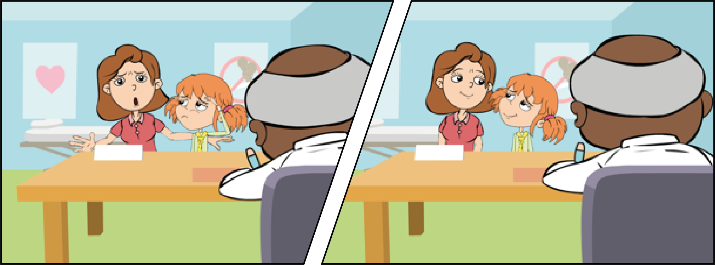
Antibiotics Comic Strip 5
Antibiotics Cosmic Strip
When Eva got home, her mother decided to take her to her doctor. Dr. Cooper said that she had a bad cold.
Go home and get some bed rest, take some painkillers for the headache if you need to
But she’s ill, you have to give her some antibiotics.
I’m sorry, but there’s no need.

Slide 13
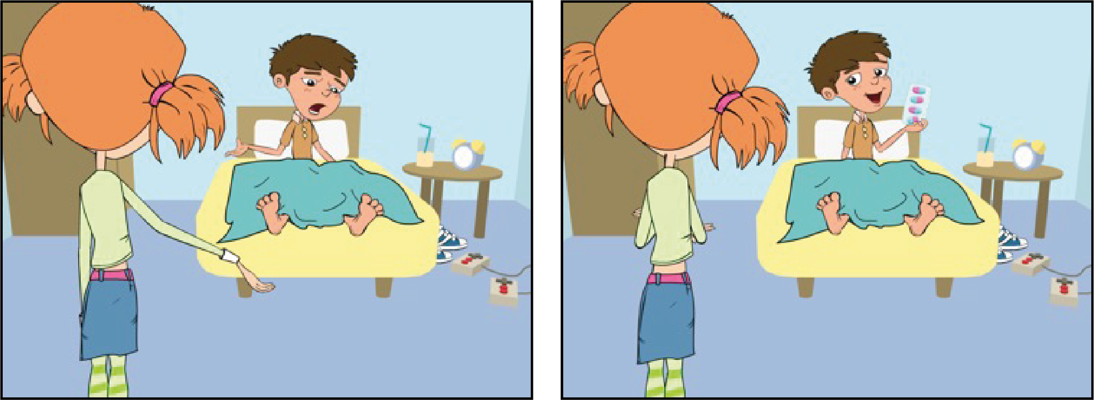
Antibiotics Comic Strip 6
Antibiotics Cosmic Strip
A few days later, Luca didn’t come to school, so Eva called around to see him on her way from school.
You weren’t in school today, are you OK?
Oh no, did he give you painkillers?
No, my knee Is still really painful, so my dad took me to see Dr Cooper and he said my cut was infected
No, he gave me antibiotics to help
fight the infection and told me to take them until they were all finished.

Slide 14
Discussion

Slide 15
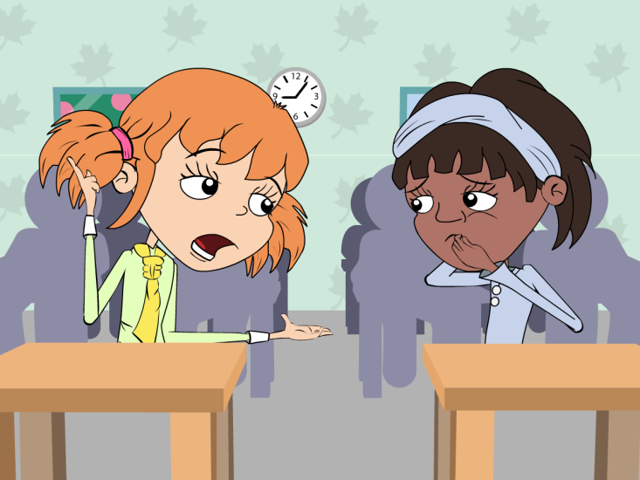
Antibiotics Comic Strip 1 Discussion Points
Antibiotics Comic Strip Discussion Points
Eva should cover her mouth whist coughing. Infection can easily spread from person to person through coughing and sneezing. A sneeze travels at approximately 100mph and at high force meaning that the microbes carried in a sneeze can travel very far and infect other people.

Slide 16
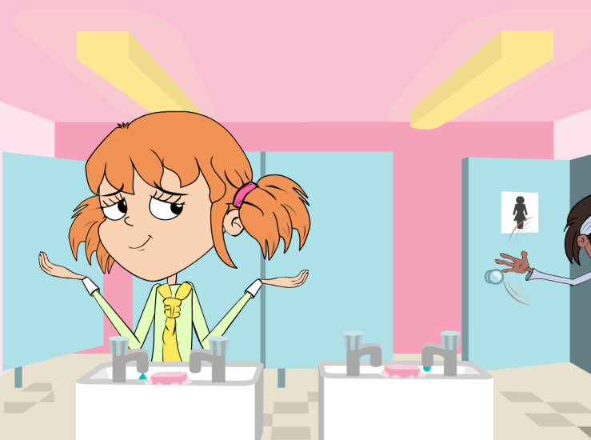
Antibiotics Comic Strip 2 Discussion Points
Antibiotics Comic Strip Discussion Points
You should always wash your hands after going to the toilet. Many harmful microbes that make you ill are found in toilets. Good personal hygiene is essential to a healthy lifestyle and can greatly reduce the spread of infection. Trials show that proper hand washing reduces absenteeism in schools, not just from tummy bugs but from coughs and colds too.

Slide 17
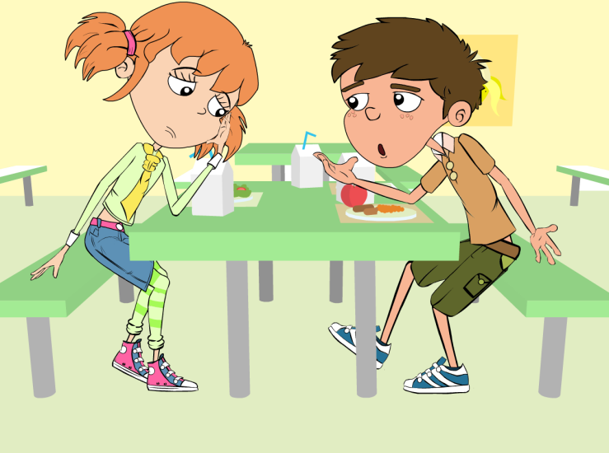
Antibiotics Comic Strip 3 Discussion Points
Antibiotics Comic Strip Discussion Points
Eva should NOT use her sisters antibiotics. There are many different types of antibiotics which treat different bacterial infections. Doctor’s prescribe specific antibiotics for specific illnesses and at a dose suitable for the patient. Taking someone else’s antibiotics may mean your infection does not get better.

Slide 18
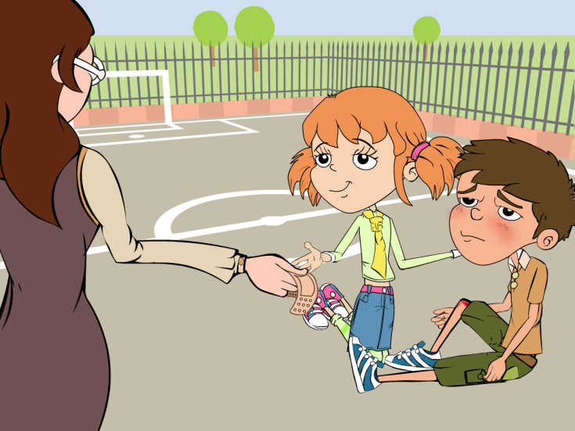
Antibiotics Comic Strip 4 Discussion Points
Antibiotics Comic Strip Discussion Points
Mrs Brooke should have washed Luca’s cut knee to clean any dirt or microbes which may have been present. Antiseptic cream applied to deeper cuts can also help prevent infection. There is generally no need to cover smaller cuts and grazes with a plaster, fresh air will help the scabbing process.

Slide 19
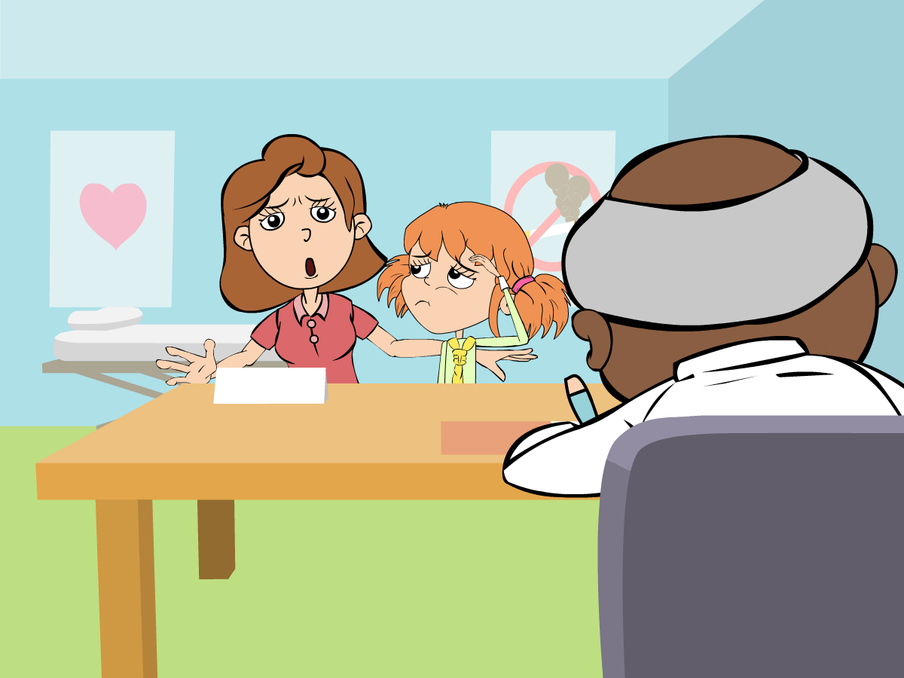
Antibiotics Comic Strip 5 Discussion Points
Antibiotics Comic Strip Discussion Points
Dr Cooper is right; antibiotics only work on bacterial infections. Coughs and colds are caused by viruses and in many cases the body’s own natural defences will fight these infections. Other medicines from the chemists help with the symptoms of coughs and colds.

Slide 20
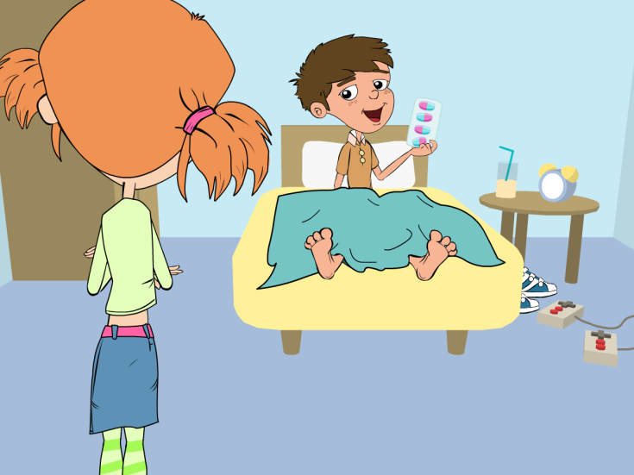
Antibiotics Comic Strip 6 Discussion Points
Antibiotics Comic Strip Discussion Points
It is important for Luca to finish the course of antibiotics. Not finishing the course could result in the bacteria not being killed properly and becoming resistant to the antibiotic in the future.

Slide 21
Discussion Points
When we should and should not use antibiotics?
Remember the las time you were ill. What was the illness?
How did you felt and what did you do?
Was it caused by microbe/germ?
Did you get any medicine?

Slide 22
Extension Activities

Slide 23
Antibiotics Flashcards 1
Antibiotics Flashcards
Harmful microbes make us ill
Yes or No
If my doctor gives me antibiotics to take for 7 days but I feel better after 3 days I can stop taking them
Yes or No

Slide 24
Antibiotics Flashcards 2
Antibiotics Flashcards
If my friend is ill I
can give them my old antibiotics
Yes or No
Antibiotics only
work on bacterial
Infections
Yes or No

Slide 25
Antibiotics Flashcards 3
Antibiotics Flashcards
I can treat coughs and colds with Antibiotics
Yes or No
I should always
cover my coughs
and sneezes with
a tissue
Yes or No

Slide 26
Antibiotics Flashcards 4
Antibiotics Flashcards
I should only take antibiotics prescribed by my doctor
Yes or No
I should always wash my hands after going
to the toilet
Yes or No
Most of the time my
immune system can fight infections like the common cold by itself
Yes or No

Slide 27
Antibiotics Flashcards 1 - Answers
Antibiotics Flashcards - Answers
Harmful microbes make us ill
If my doctor gives me antibiotics to take for 7 days but I feel better after 3 days I can stop taking them
YES
NO

Slide 28
Antibiotics Flashcards 2 - Answers
Antibiotics Flashcards - Answers
If my friend is ill I
can give them my old antibiotics
Antibiotics only
work on bacterial
Infections
NO
YES

Slide 29
Antibiotics Flashcards 3 - Answers
Antibiotics Flashcards - Answers
I can treat coughs and colds with Antibiotics
I should always
cover my coughs
and sneezes with
a tissue
NO
YES

Slide 30
Antibiotics Flashcards 4 - Answers
Antibiotics Flashcards - Answers
I should only take antibiotics prescribed by my doctor
I should always wash my hands after going
to the toilet
YES
YES
Most of the time my
immune system can fight infections like the common cold by itself
YES

Slide 31
Word Mix Up (1/2)
Word Mix Up
Antibiotic
A disease caused by a microbe
Bacteria
A drug used to treat a disease or injury
Infection
Very small microbe that can be helpful or harmful
Medicine
Special medicine used to treat bacterial infections

Slide 32
Word Mix Up (2/2)
Word Mix Up
Painkiller
The smallest of the microbes - usually harmful
Virus
A sign of illness e.g. headache, diarrhoea and fever
Symptom
A drug used to take away pain

Slide 33
Word Mix Up 1 - Answers
Word Mix Up - Answers
Antibiotic
A disease caused by a microbe
Bacteria
A drug used to treat a disease or injury
Infection
Very small microbe that can be helpful or harmful
Medicine
Special medicine used to treat bacterial infections

Slide 34
Word Mix Up 2 - Answers
Word Mix Up - Answers
Painkiller
The smallest of the microbes - usually harmful
Virus
A sign of illness e.g. headache, diarrhoea and fever
Symptom
A drug used to take away pain

Slide 35
Learning Consolidation

Slide 36
Discussion Question
Can you name different ways to
use antibiotics correctly?
Only use antibiotics prescribed to me by my doctor
Always finish the course once started
Never take somebody else’s antibiotics
Sign up to become an antibiotic guardian

Slide 37
Antibiotic Awareness Pledge
Ask each pupil to create their own Antibiotic Awareness Pledge based on what they have learned. They can write their pledge individually or in small groups, starting with the phrase: “ I pledge to use antibiotics responsibly by…”
Pupils can express their pledges creatively in various ways, such as:
Writing a short paragraph or list.
Designing a poster or badge to promote antibiotic awareness.
Composing a poem, slogan, or acrostic using the work “ANTIBIOTICS”
Invite pupils to share their pledges with the class. Use this as an opportunity to reinforce key learning points and encourage peer feedback.

