Slide 1
Spread of Infection:
Animal and Farm Hygiene
Key Stage 2

Slide 2
Learning Intention
All pupils will:
• Understand the importance of hygiene and care in both humans and animals, and how proper practices, such as hand washing, help prevent the spread of harmful microbes between animals, humans, and environments like farms.

Slide 3
Northern Ireland Curriculum Links
Curriculum Key Elements
Personal Health and Moral Character
Curriculum Skills
Communication, Thinking, Problem Solving and Decision Making, Working with Others
Curriculum Areas of Learning
Personal Development and Mutual Understanding (PDMU), The World Around Us (TWAU)

Slide 4
Why it is Important to Take Care of Animal’s Health? (1/2)
Why it is Important to Take Care of Animal’s Health?
There are many similarities between human and animal health.
Both people and animals harbour microbes. Useful microbes can help to keep animals in good health, while certain harmful microbes can make them ill, just as they can in people. Animals can also catch specific infections limited to their species, such as viral infections that can be deadly, like feline leukemia in cats and Parvovirus in dogs.
Some harmful microbes can spread from animals to humans (e.g. ringworm from cats or dogs) and vice versa, usually through touch. The best way to stop this happening is to wash our hands often.
Pets must be properly fed, de-wormed, their teeth and fur should be checked regularly, and they should be washed with suitable products. Pets should also have a dedicated spot of their own and their bedding should be regularly disinfected.

Slide 5
Why it is Important to Take Care of Animal’s Health? (2/2)
Why it is Important to Take Care of Animal’s Health?
Animals also need to be vaccinated to protect them against certain severe infections. Each species has its own vaccination schedule. For instance, rabies has disappeared in some countries thanks to vaccination, just like smallpox in the human population.
When our pet gets sick it must be taken to a vet. The vet can do special rapid tests to check for certain diseases. If the vet diagnoses a bacterial infection that needs antibiotics, the prescribed dosage and duration of treatment must be strictly followed. Left over antibiotics from a previous illness should never be used, they should be taken back to the vet or to the pharmacist.
Antibiotic use follows the same rules as for people; not using antibiotics properly can lead to bacterial resistance so that the antibiotics don’t work. After using antibiotics in both humans or animals, resistant bacteria may grow in the gut and then spread easily from animals to people, or vice versa, and of course between people. For example MRSP (Methicillin-Resistant Staphylococcus pseudintermedius) can be spread from humans to animals.

Slide 6
MS PowerPoint Presentation:
Taking Care of Your Pet

Slide 7
Animal and Farm Hygiene
Taking care of your pet

Slide 8
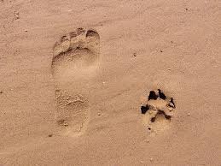
Animal and Human Health Have a lot in Common
Can you think of any similarities between human and animal health?

Slide 9
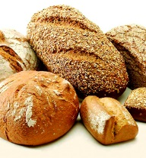

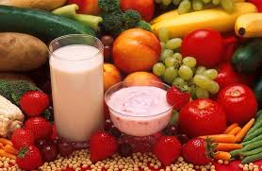
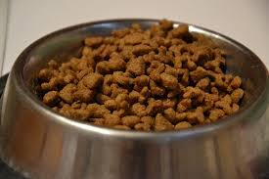
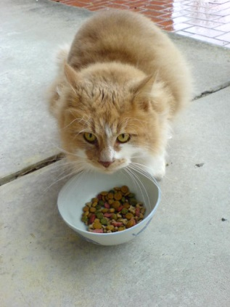
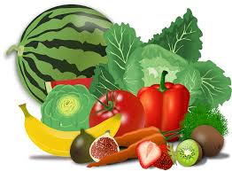
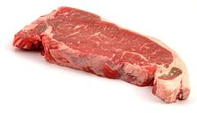
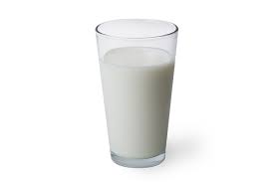
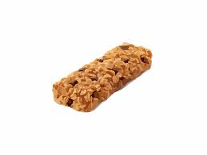
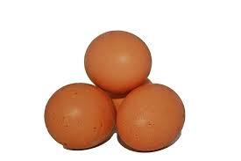
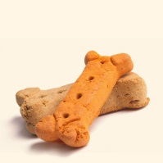
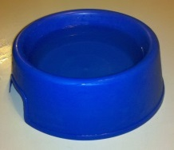
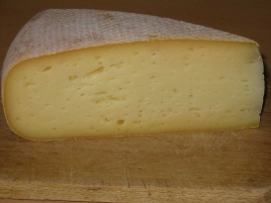
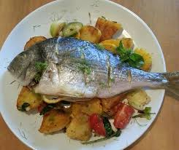
Diet
I eat a balanced diet
My pet eats a balanced diet
Notes:
https://www.pdsa.org.uk/taking-care-of-your-pet

Slide 10
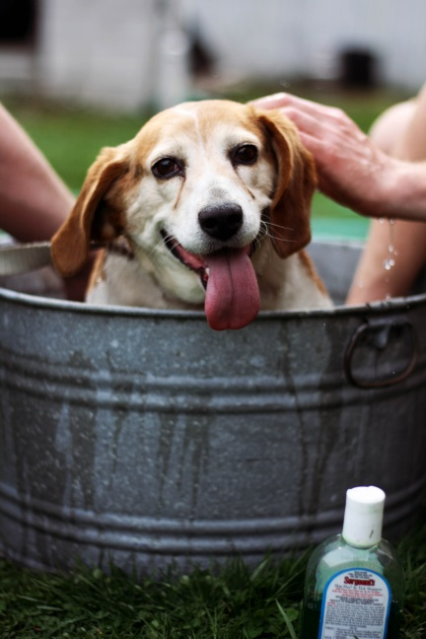
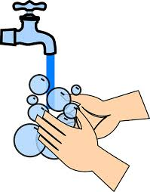
Hygiene
I wash my hands regularly with soap and water
When my pet is dirty, I wash it with suitable shampoo
Notes:
https://www.pdsa.org.uk/taking-care-of-your-pet
See our resources for hand hygiene: KS2 | Hand Hygiene (e-bug.eu)

Slide 11
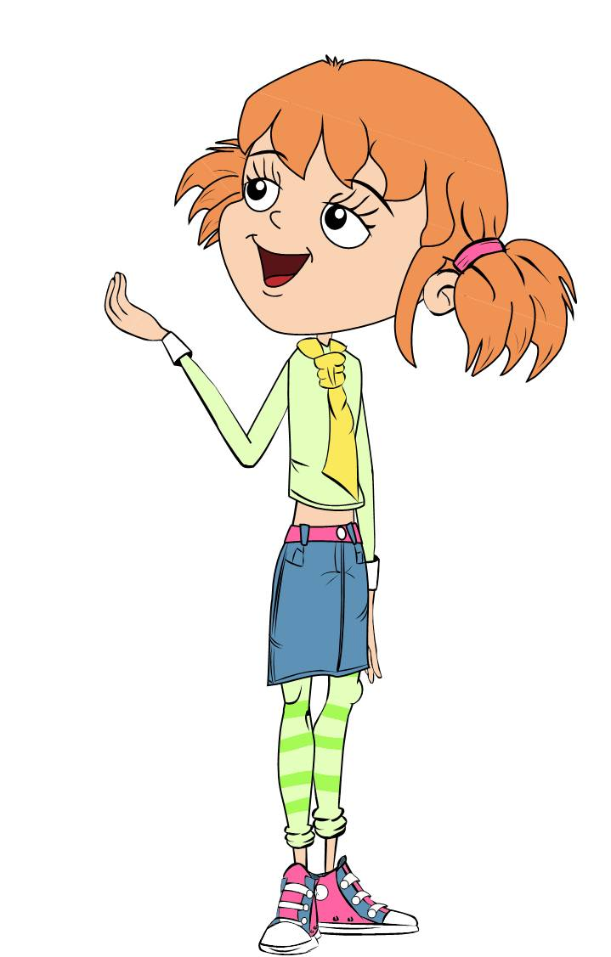

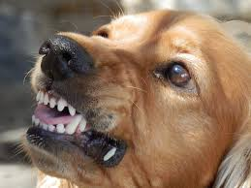
Dental Hygiene
I brush my teeth at least twice a day
I brush my pet’s teeth and check their teeth and gums
Notes:
See our resources on oral hygiene: KS2 | Oral Hygiene (e-bug.eu)

Slide 12
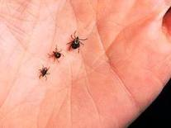
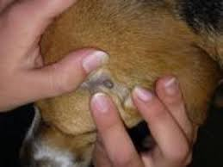
Ticks
After a walk in the forest or long grass, I check for ticks in my hair and on my skin.
Ticks can spread an infection called Lyme disease.
After a walk in the forest or long grass, I check my pet’s fur for ticks. Tick bites can spread microbes into my pet and make them ill.

Slide 13
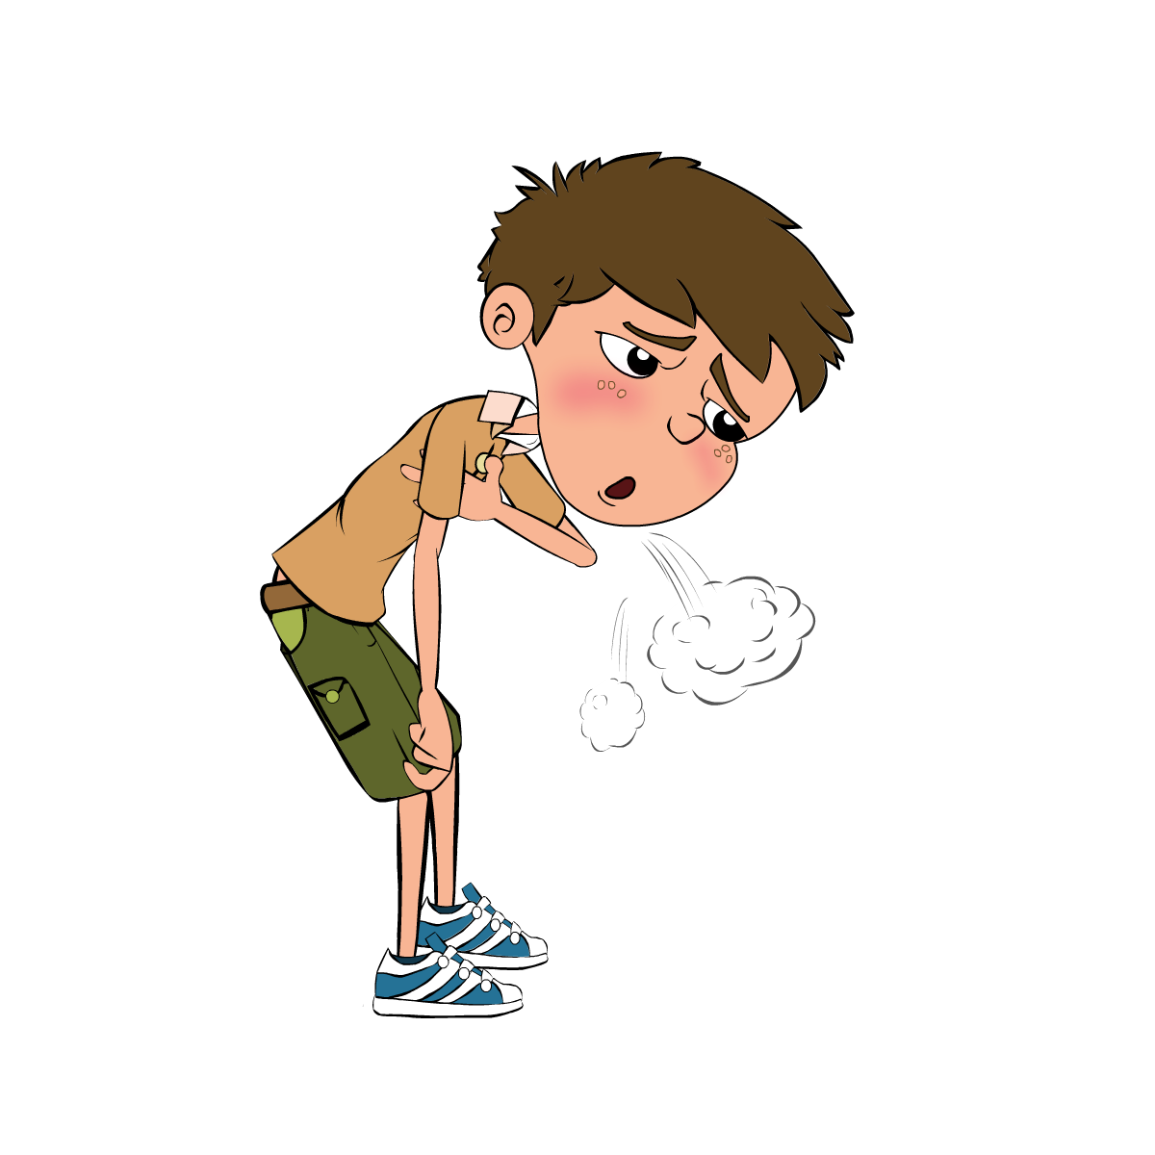
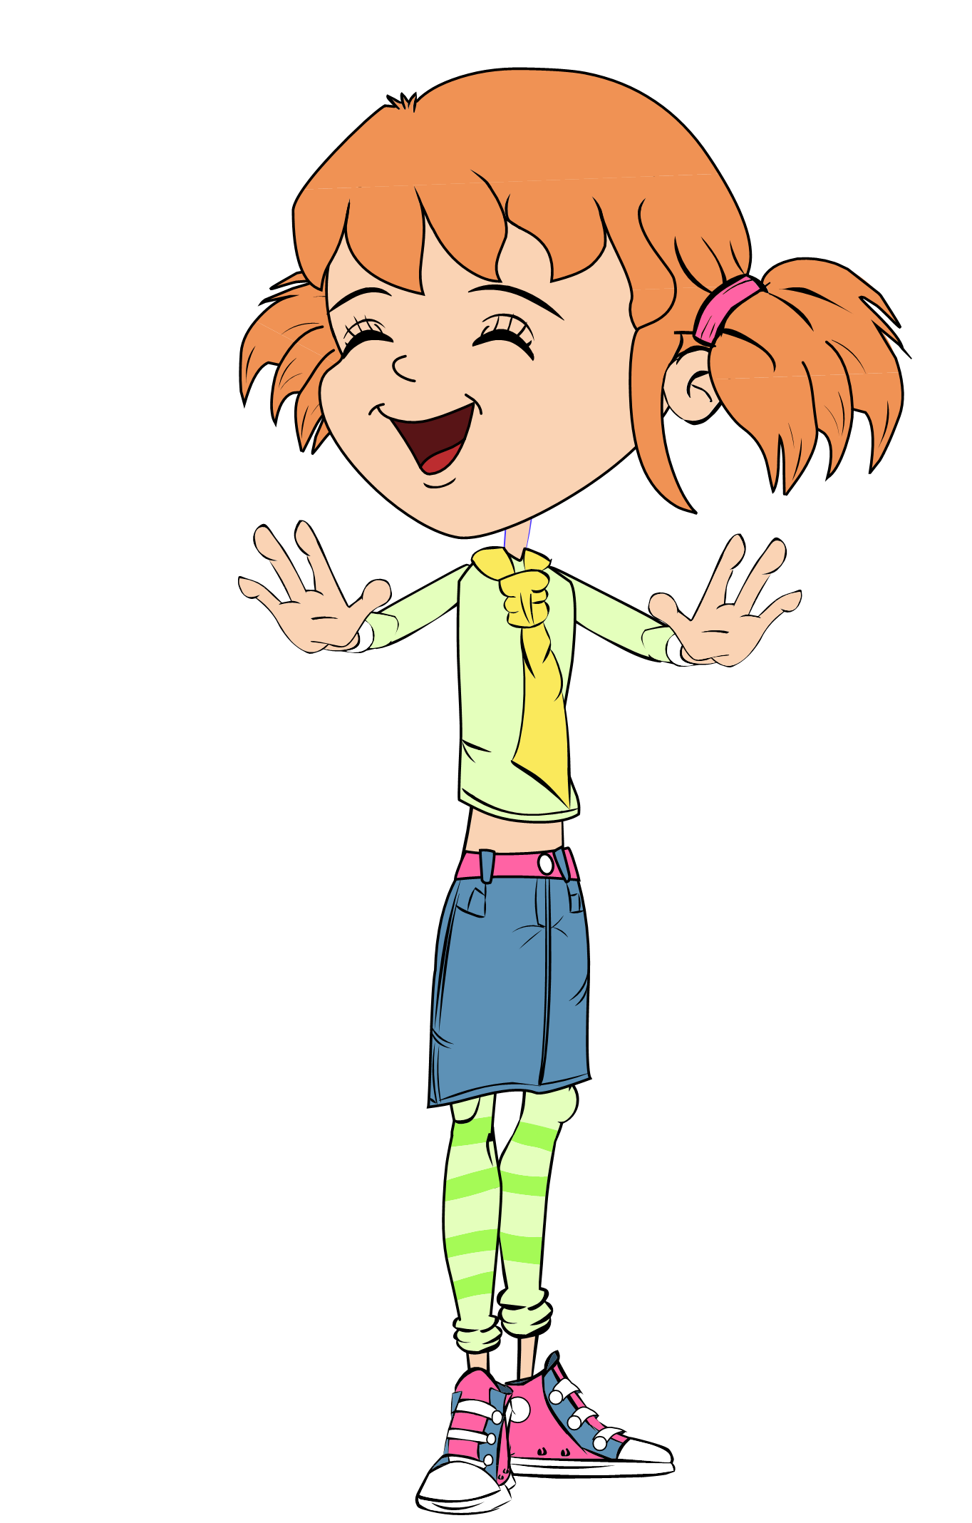
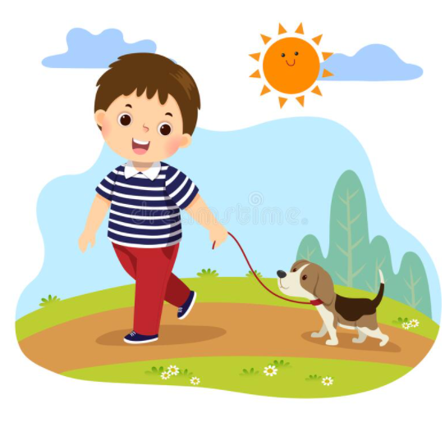
Exercise
I take exercise to keep myself fit and healthy
I take my dog for a walk to keep them healthy

Slide 14
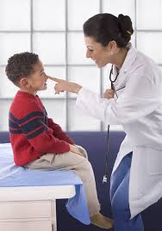
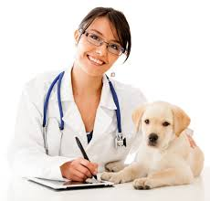
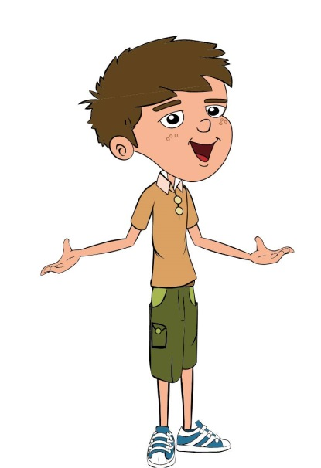
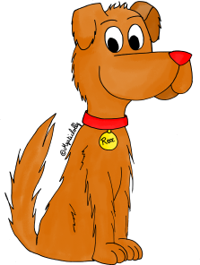
Vaccinations
I get vaccinated
I get my pet vaccinated
Notes:
See our resources on vaccinations: KS2 | Vaccinations (e-bug.eu)

Slide 15
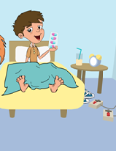
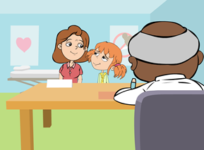
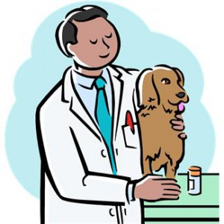
Antibiotics (1/2)
Antibiotics
If I get sick, I only take antibiotics if my doctor prescribes them. I always take them as directed.
I never take left-over antibiotics.
If my pet gets sick, I only give it antibiotics if precribed by the vet. I always give my pet medicines exactly as the vet advises.
I never give my pet left-over antibiotics.
Otherwise, the bacteria may become resistant to the antibiotic and then that antibiotic will be ineffective next time it is needed.
Notes:
See our resources on antibiotics for more information: KS2 | Antibiotic Use and Medicine (e-bug.eu)

Slide 16
Antibiotics (2/2)
Antibiotics
Taking antibiotics when not needed makes our bacteria fight back so that the antibiotics do not work.
When antibiotics do not work against a bacteria the bacteria is said to be antibiotic resistant.
The more antibiotics I take the more antibiotic resistant bacteria I have.
If I take antibiotics when not needed I encourage my gut bacteria to become antibiotic resistant.
Notes:
See our resources on antibiotics for more information: KS2 | Antibiotic Use and Medicine (e-bug.eu)

Slide 17
One Health
Keep your pet healthy the same way you keep yourself healthy!
Test your knowledge of animal hygiene by taking our quiz!
Notes:
Test your knowledge with the animal hygiene quiz see SW1 KS2 | Farm Hygiene (e-bug.eu)

Slide 18
Main Activity:
Memory Game

Slide 19

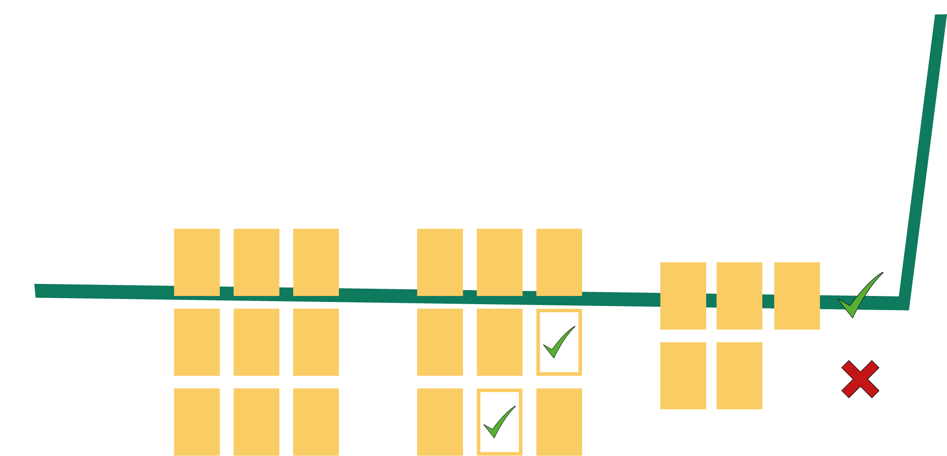
Memory Game Activity
1. Divide group into two teams; human health (blue) and animal health (green)
2. Shuffle cards and place facing down on a table
3. In turns, pick a card and try to match the pairs
4. The team with the most pairs wins

Slide 20
Discussion

Slide 21
Discussion Points
What are the main similarities between human and pet health?
What must be done to keep a pet in good health?
What must be done if a pet is sick?
How to prevent infections in your pet?

Slide 22
Extension Activities

Slide 23
Memory Game 1 – Human Health
Memory Game – Human Health
I have a vaccination record
I get vaccinated according to guidance
I’m getting vaccinated
I have a balanced diet with plenty of fruit and vegetables

Slide 24
Memory Game 2 – Human Health
Memory Game – Human Health
My immune system fights off most common infections
I wash my hands often during the day with soap and water
I brush my teeth
When I take a walk in the forest, I check my skin and my hair for ticks

Slide 25
Memory Game 3 – Human Health
Memory Game – Human Health
I have useful microbes in my digestive tract that help keep me healthy
I never take
antibiotics
from a previous
treatment
If I get sick, I only take antibiotics if my doctor prescribes them

Slide 26
Memory Game 4 – Human Health
Memory Game – Human Health
If my doctor prescribes antibiotics, I finish the treatment prescribed to me
I will return any leftover antibiotics to
my pharmacy
I don't feed my pet while I'm cooking or eating

Slide 27
Memory Game 1 – Animal Health
Memory Game – Animal Health
My pet has a
vaccination
certificate
My pet has immune
defences that fight
most common
infections
I will vaccinate
my pet
My pet has a
balanced diet
adapted to its
species

Slide 28
Memory Game 2 – Animal Health
Memory Game – Animal Health
I wash my pet
with suitable
shampoos
when it is dirty
My pet has useful
microbes in their
digestive tract that
help keep them
healthy
When I take a walk
in the forest with
my pet, I check their
fur for ticks
I check the
dental condition
of my pet

Slide 29
Memory Game 3 – Animal Health
Memory Game – Animal Health
I have my pet vaccinated according to the vaccine schedule of its species
If the vet prescribes
antibiotics to my pet,
I give them all the
prescribed course of
treatment
I never give
antibiotics from a
previous treatment to my pet
If my pet gets sick, I only give them antibiotics if the vet prescribes them

Slide 30
Memory Game 4 – Animal Health
Memory Game – Animal Health
I deworm my
pet regularly
I let my pet eat
its food in their
own bowl
I will return any leftover antibiotics to my vet

Slide 31
Memory Game. Human Health vs Animal Health - Answers
I have a vaccination record
My pet has a
vaccination
certificate
I get vaccinated according to guidance
I have my pet vaccinated according to the vaccine schedule of its species

Slide 32
Memory Game. Human Health vs Animal Health – Answers 1
Memory Game. Human Health vs Animal Health - Answers
I’m getting vaccinated
I will vaccinate
my pet
I have a balanced diet with plenty of fruit and vegetables
My pet has a
balanced diet
adapted to its
species

Slide 33
Memory Game. Human Health vs Animal Health – Answers 2
Memory Game. Human Health vs Animal Health - Answers
My immune system fights off most common infections
My pet has immune
defences that fight
most common
infections
I brush my teeth
I check the
dental condition
of my pet

Slide 34
Memory Game. Human Health vs Animal Health – Answers 3
Memory Game. Human Health vs Animal Health - Answers
I wash my hands often during the day with soap and water
I wash my pet
with suitable
shampoos
when it is dirty
When I take a walk in the forest, I check my skin and my hair for ticks
When I take a walk
in the forest with
my pet, I check their
fur for ticks

Slide 35
Memory Game. Human Health vs Animal Health – Answers 4
Memory Game. Human Health vs Animal Health - Answers
I have useful microbes in my digestive tract that help keep me healthy
My pet has useful
microbes in their
digestive tract that
help keep them
healthy
I never take
antibiotics
from a previous
treatment
I never give
antibiotics from a
previous treatment to my pet

Slide 36
Memory Game. Human Health vs Animal Health – Answers 5
Memory Game. Human Health vs Animal Health - Answers
If I get sick, I only take antibiotics if my doctor prescribes them
If my pet gets sick, I only give them antibiotics if the vet prescribes them
If my doctor prescribes antibiotics, I finish the treatment prescribed to me
If the vet prescribes
antibiotics to my pet,
I give them all the
prescribed course of
treatment

Slide 37
Memory Game. Human Health vs Animal Health – Answers 6
Memory Game. Human Health vs Animal Health - Answers
I will return any leftover antibiotics to
my pharmacy
I will return any leftover antibiotics to my vet
I don't feed my pet while I'm cooking or eating
I let my pet eat
its food in their
own bowl

Slide 38
Animal and Farm Hygiene Quiz 1
Animal and Farm Hygiene Quiz
When looking after pets, you should:
(3 points)
Brush their teeth
Get your pet vaccinated by a vet
Feed your pet with any food you can find
Deworm your pet regularly
Useful microbes can turn animal products into:
(3 points)
Milk
Yoghurt
Cream
Cheese

Slide 39
Animal and Farm Hygiene Quiz 2
Animal and Farm Hygiene Quiz
We can help prevent the spread of infection between animals and humans by:
(2 points)
Washing our hands with soap and water after playing with animals
Kissing or putting our face close to the animals face
Regularly wash pets with suitable products
Having separate resting spots for pets that are regularly cleaned
When visiting a farm people should wash their hands:
(3 points)
Before eating
After petting the animals
After touching the crops
After talking with the farmer

Slide 40
Animal and Farm Hygiene Quiz 3
Animal and Farm Hygiene Quiz
Where should you eat your food at a farm?
(1 point)
On the floor away from the animals
A designated picnic area/café
Next to the animals so you can share food
Near the toilets
If prescribed antibiotics for your pet by the vet, you should:
(2 points)
Give your pet the full course of treatment
Give your pet antibiotics from a previous treatment
Leave any remaining antibiotics at home
Follow the required dosage of the prescription

Slide 41
Animal and Farm Hygiene Quiz 1 - Answers
Animal and Farm Hygiene Quiz - Answers
When looking after pets, you should:
(3 points)
Brush their teeth
Get your pet vaccinated by a vet
Feed your pet with any food you can find
Deworm your pet regularly
Useful microbes can turn animal products into:
(4 points)
Milk
Yoghurt
Cream
Cheese
✓
✓
✓
✓
✓
✓
✓

Slide 42
Animal and Farm Hygiene Quiz 2 - Answers
Animal and Farm Hygiene Quiz - Answers
We can help prevent the spread of infection between animals and humans by:
(3 points)
Washing our hands with soap and water after playing with animals
Kissing or putting our face close to the animals face
Regularly wash pets with suitable products
Having separate resting spots for pets that are regularly cleaned
When visiting a farm people should wash their hands:
(3 points)
Before eating
After petting the animals
After touching the crops
After talking with the farmer
✓
✓
✓
✓
✓
✓

Slide 43
Animal and Farm Hygiene Quiz 3 - Answers
Animal and Farm Hygiene Quiz - Answers
Where should you eat your food at a farm?
(1 point)
On the floor away from the animals
A designated picnic area/café
Next to the animals so you can share food
Near the toilets
If prescribed antibiotics for your pet by the vet, you should:
(2 points)
Give your pet the full course of treatment
Give your pet antibiotics from a previous treatment
Leave any remaining antibiotics at home
Follow the required dosage of the prescription
✓
✓
✓

Slide 44
Learning Consolidation

Slide 45
Discussion Question
Can you name different ways we can look after our pet?
• Make sure to check pets general and dental hygiene regularly.
• Keep its resting spots clean and to wash my hands afterwards.
• Feed and de-worm pets correctly.
• See a vet to get pets vaccinated.
• If the vet prescribes antibiotics, make sure to follow the prescription correctly.

