Slide 1
Micro – organisms
Harmful Microbes
Key Stage 2

Slide 2
Learning Intention
• Explore how microbes can affect our health, recognising that some can cause illness, how they can spread, and that not all illnesses are caused by microbes.

Slide 3
Northern Ireland Curriculum Links
Curriculum Key Elements
Personal Health and Moral Character
Curriculum Skills
Communication , Thinking, Problem Solving and Decision Making
Curriculum Areas of Learning
Personal Development and Mutual Understanding (PDMU), The World Around Us (TWAU)

Slide 4
What are Harmful Microbes?
Sometimes microbes can be harmful to humans and makes us ill.
A pathogen is a word that refers to the bacteria, viruses and fungi that make you sick.
Microbes have adapted to live everywhere, such as in our classrooms, houses, bedrooms, all over our body and on food.
Harmful disease-causing microbes can spread easily from one person to another and are called infectious diseases because they can cause an infection.
Good news – our bodies have our own 'useful' microbes that try to stop the harmful pathogens from causing an infectious disease.

Slide 5
Main Activity:
Mouldy Bread Experiment

Slide 6


Mouldy Bread Experiment
1. Place 3 slices of bread into separate, sealable bags and label 1, 2, 3
2. Add water to one bag and store in a dark place
3. Put the second bag in a bright, sunny place
4. Put the third bag in the fridge
5. Wait at least one week. What can be seen?

Slide 7
Discussion

Slide 8
Discussion Points
What causes an infection?
Are sore throats always caused by harmful microbes?
Are all illnesses caused by microbes?
Can you think of any infections caused by harmful microbes?

Slide 9
Extension Activities

Slide 10
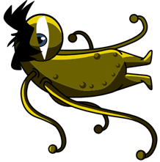

Fascinating Fact
Did you know that there are more microbes on the planet than any other species of living thing?

Slide 11
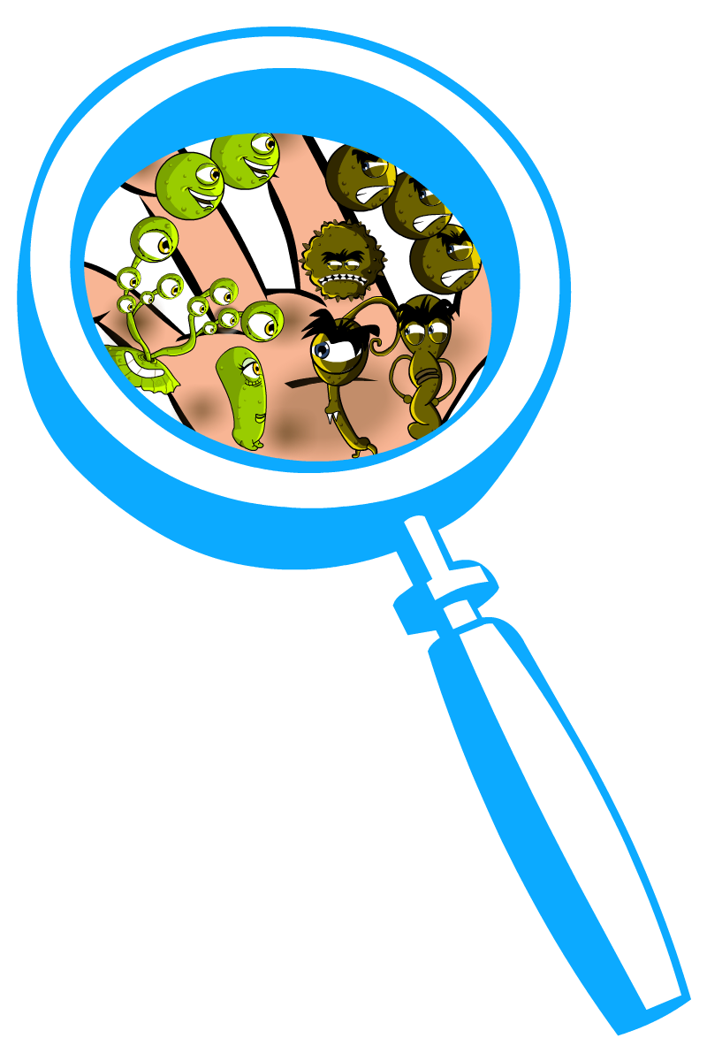
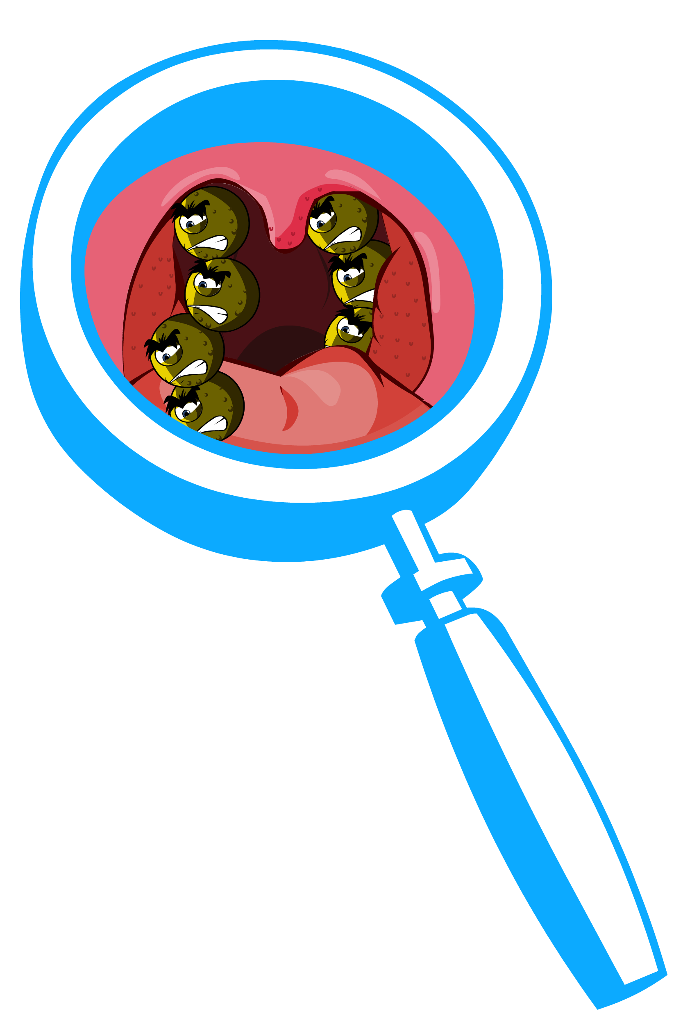
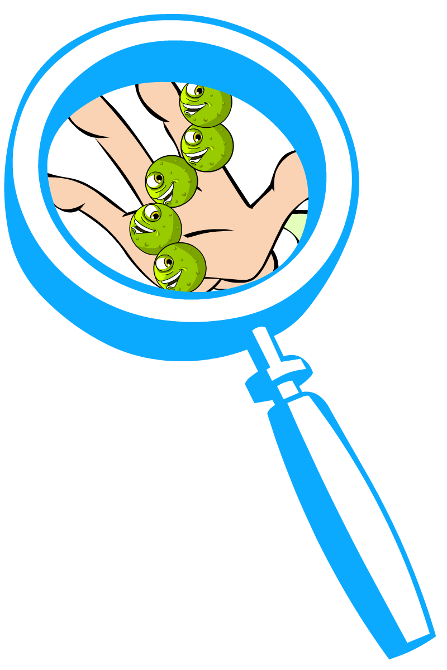
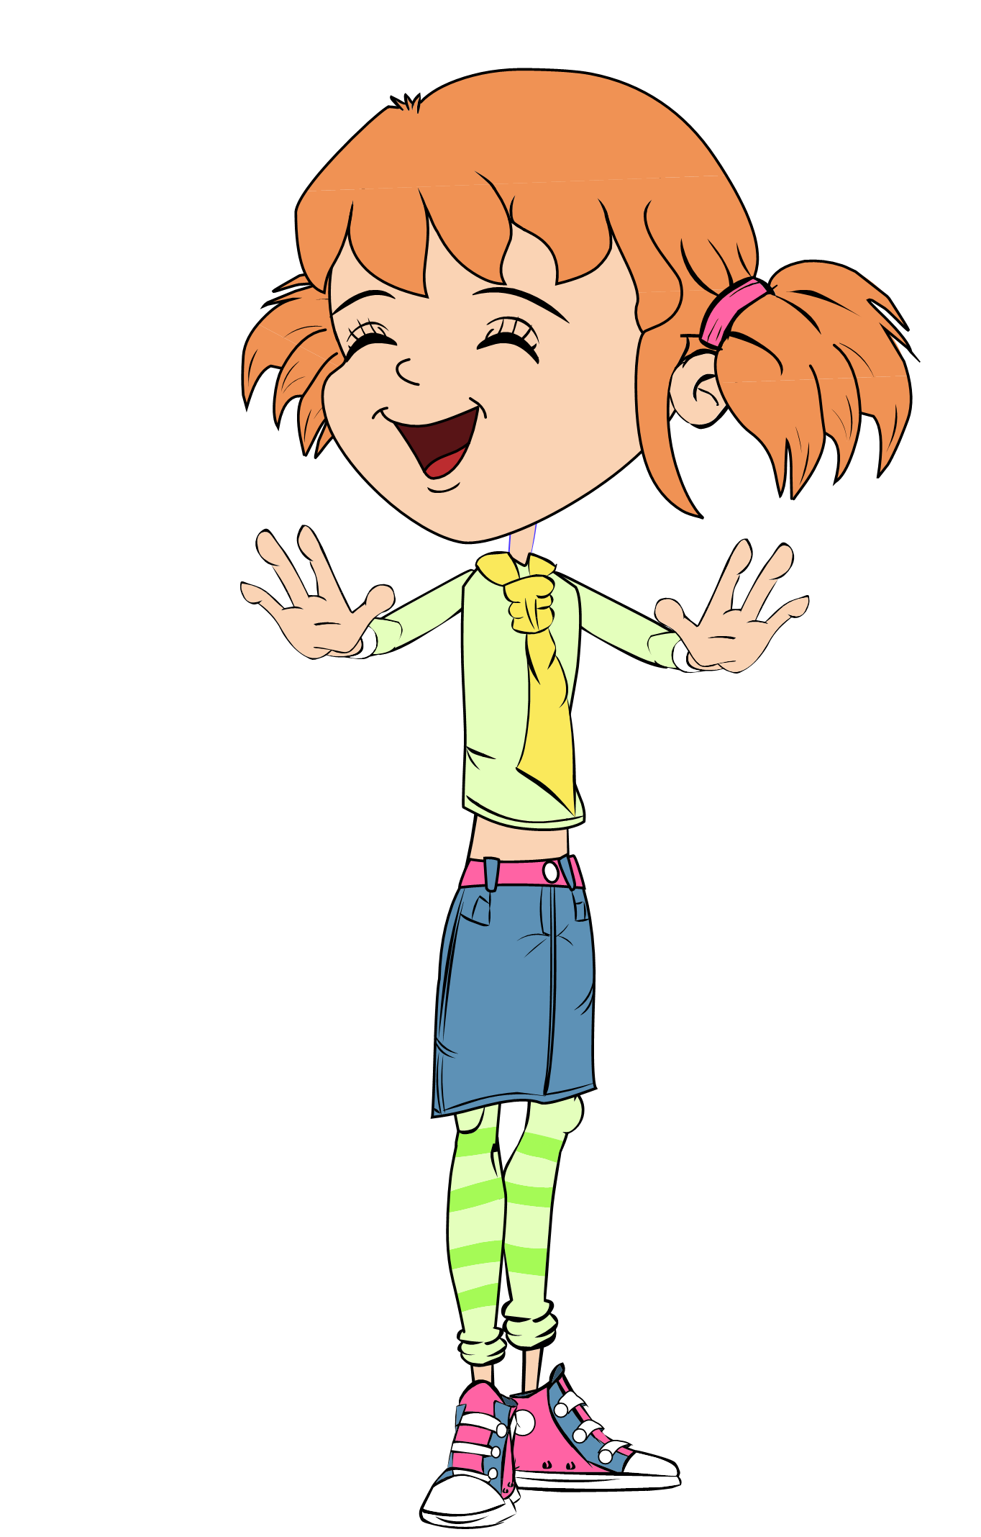
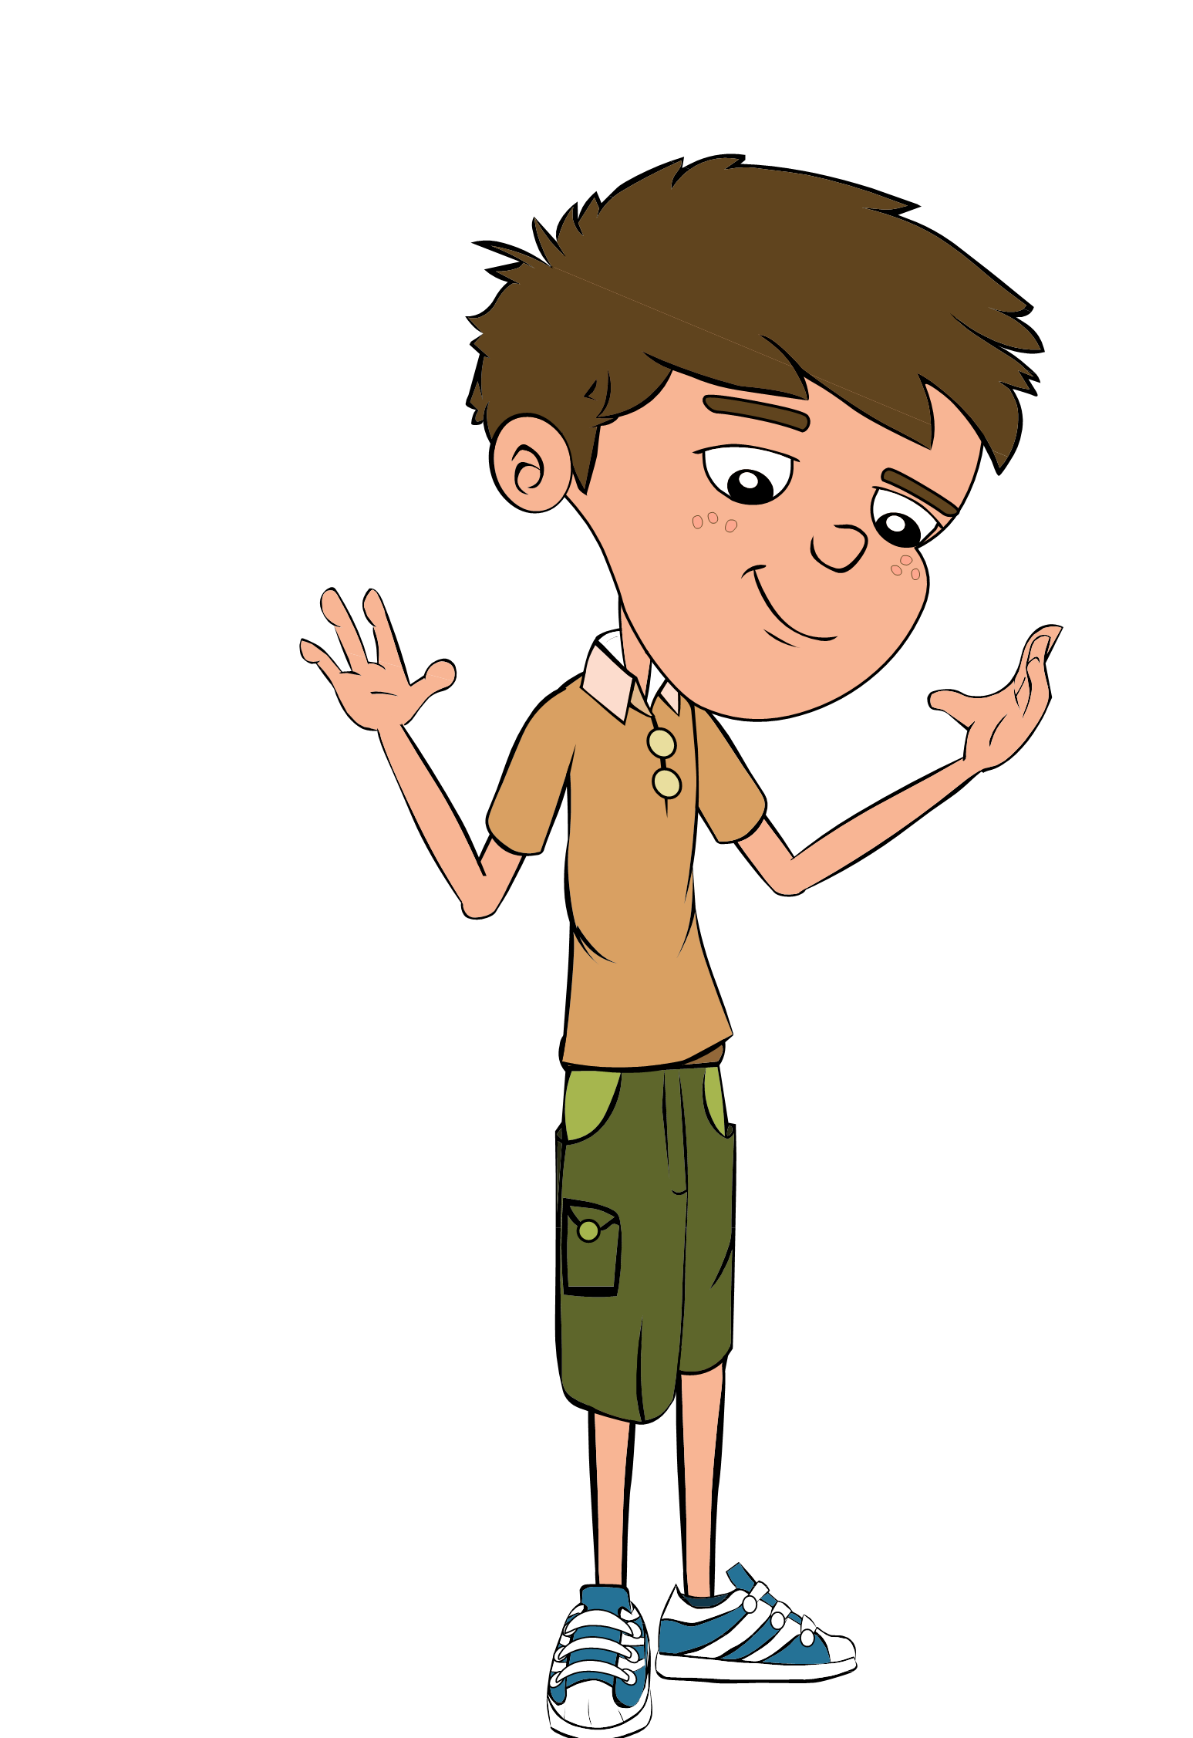
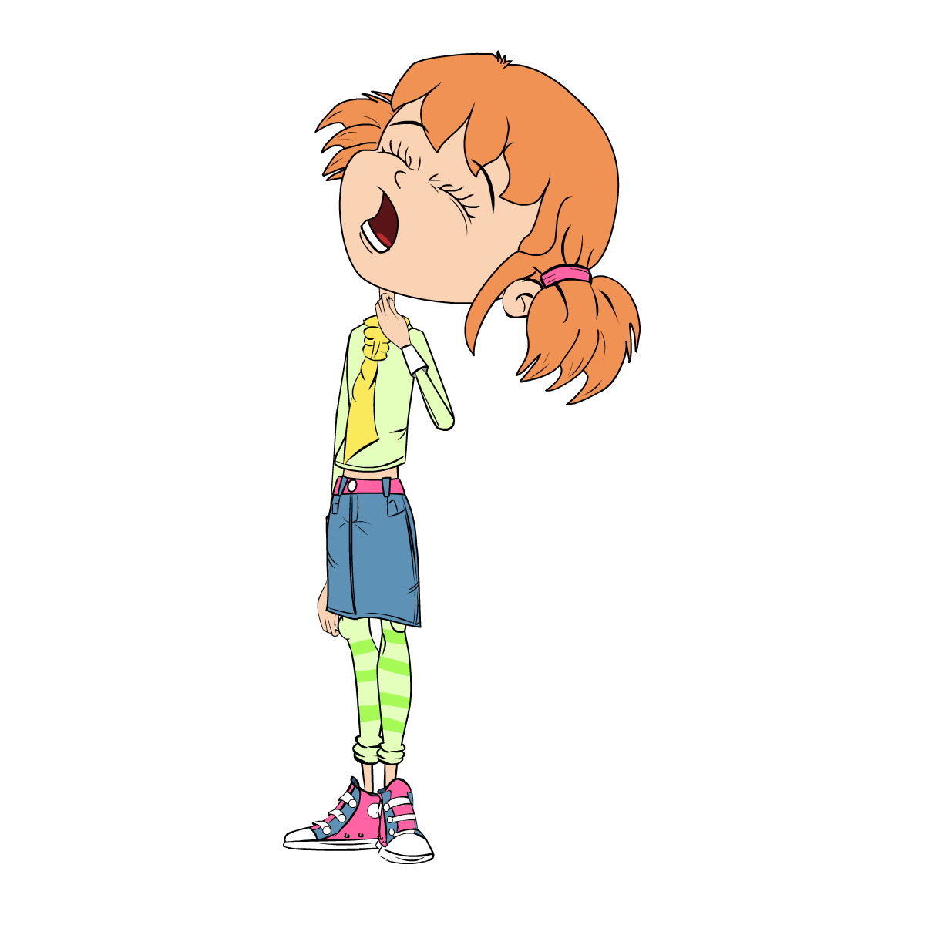

Class Discussion 1
Class Discussion
Harmful Microbes

Slide 12
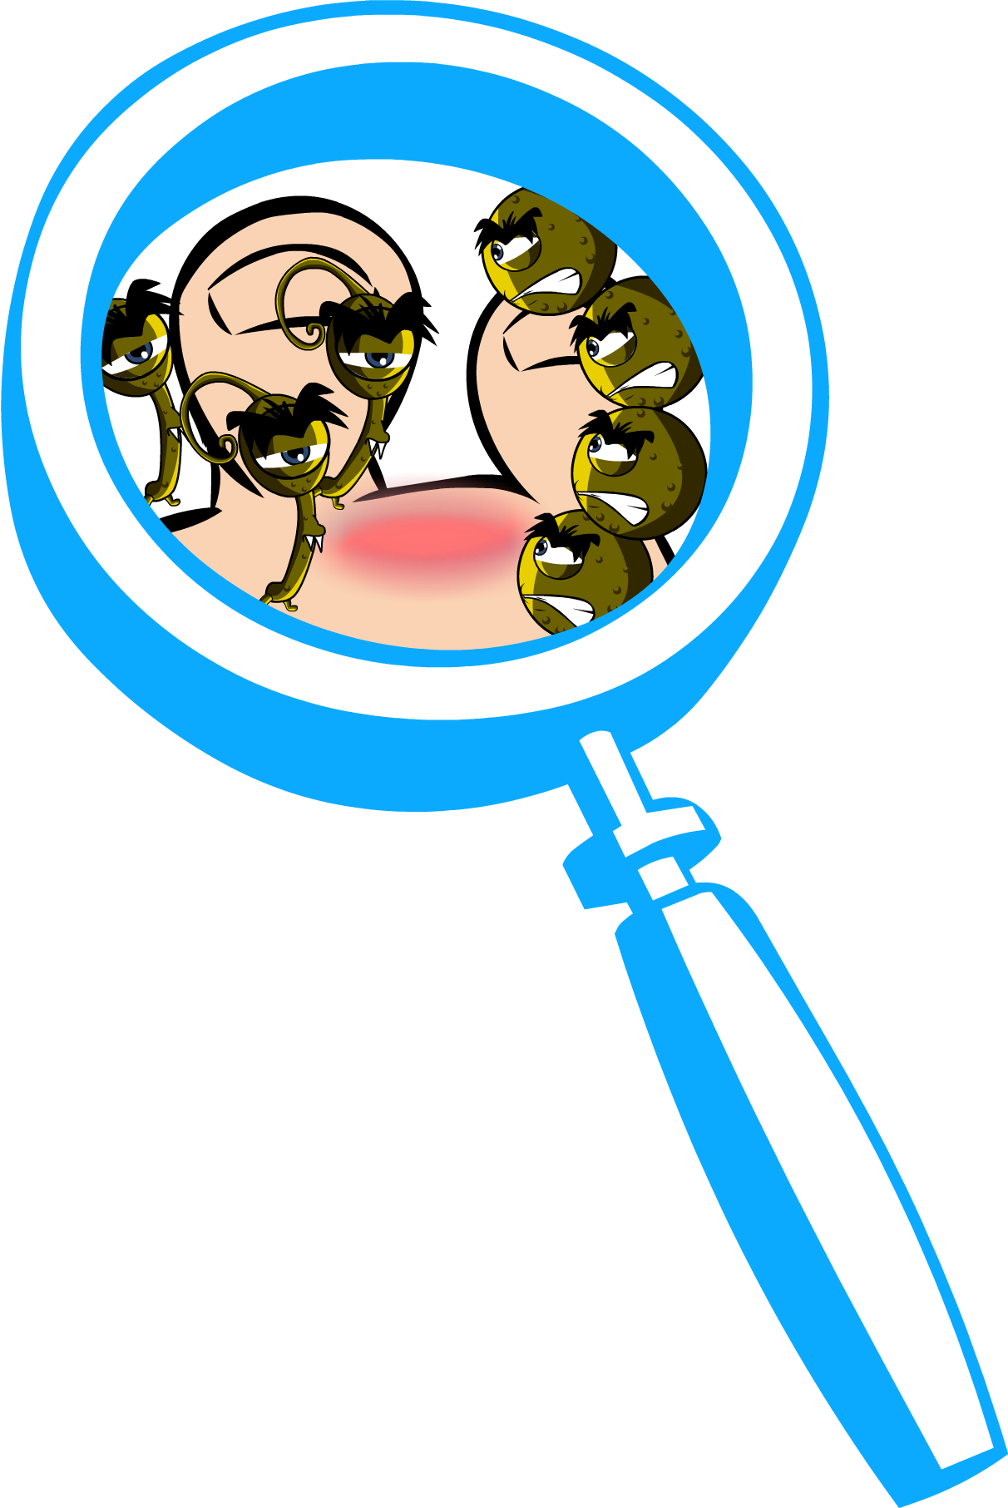
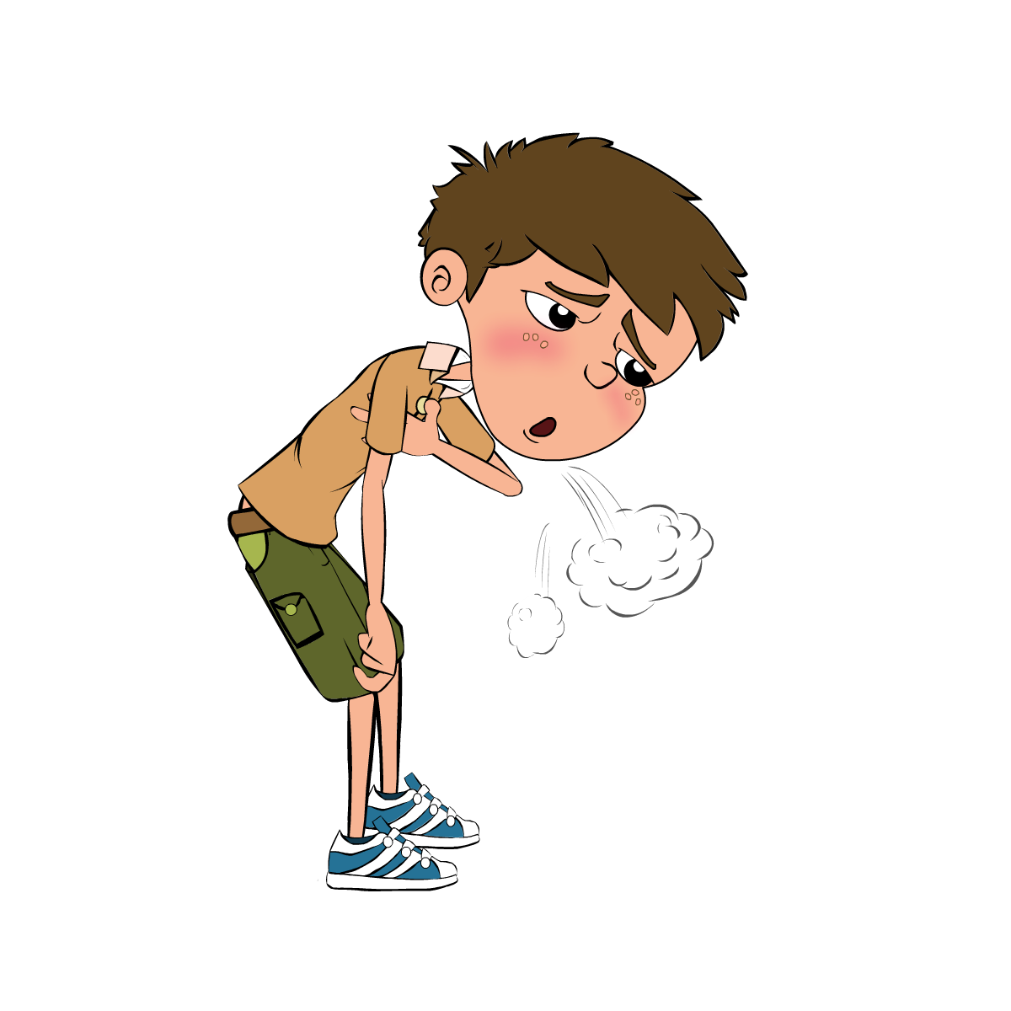

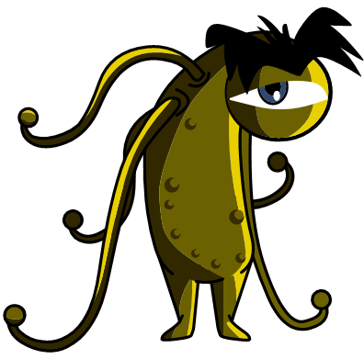
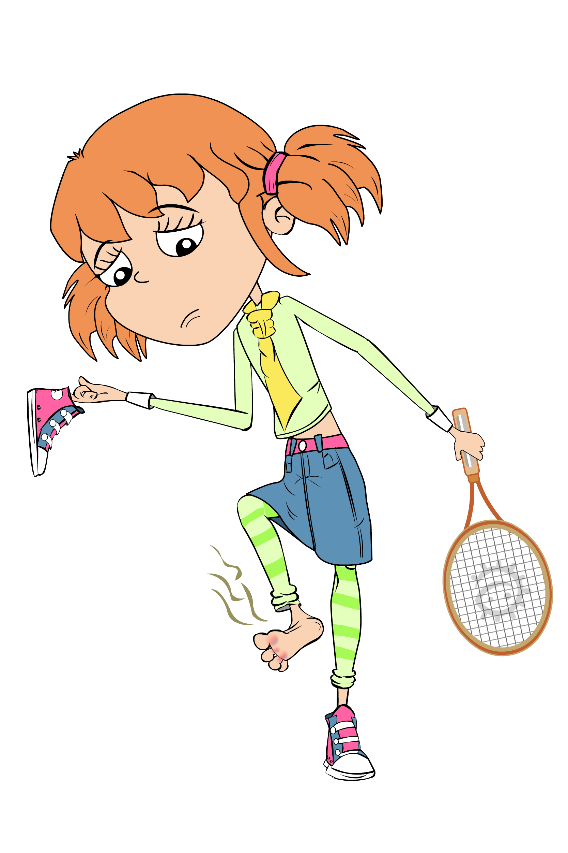
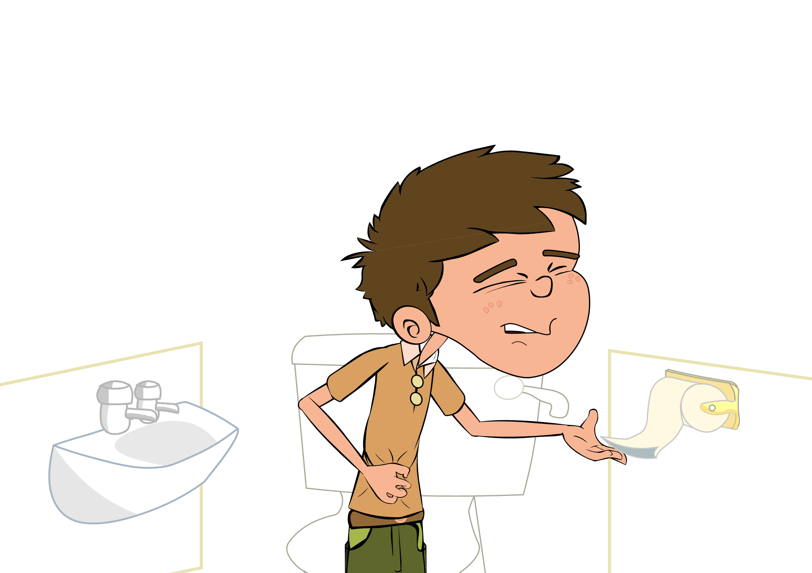
Class Discussion 2
Class Discussion
Harmful Microbes

Slide 13
Harmful Microbes Flashcards
True/False?
Sore throats are always caused by harmful microbes?
True or False
All illnesses are caused by microbes?
True or False
Fungi do not generally kill their hosts?
True or False
Athlete’s foot is caused by fungi?
True or False
Another name for a harmful microbe is a pathogen?
True or False
Influenza virus causes the common flu?
True or False

Slide 14
Harmful Microbes True/False Flashcards -Answers
Sore throats are always caused by harmful microbes?
All illnesses are caused by microbes?
Fungi do not generally kill their hosts?
False
False
True
Athlete’s foot is caused by fungi?
Another name for a harmful microbe is a pathogen?
Influenza virus causes the common flu?
True
True
True

Slide 15
Bad Bug Challenge Crossword
 | ₁ |  |  |  | ₂
 | ₃
₄
 |  |  |  |  |  |  |  | ₅
 |  |  | ₆
 |  |  | ₇
 |  | ₈
 | ₉ |  |  | ₁₀
 |  |  |  |  |  |  |  |  |  | ₁₁
 |  |  |  |  |  | ₁₂
 |  | ₁₃
Across:
1. I make you do this when you have a cold to spread microbes
by causing a tickle in your throat
4. I am a viral disease that can give you swollen itchy red spots
all over your body.
6. If they are not clean what part of your body can spread microbes
from person to person. Washing me gets rid of bad
microbes (2 words)
7. I am a viral disease that will give you headaches, a runny nose
and make you hot and sweaty.
9. You will get me if you don’t cook your meat properly or wash
your hands after handling raw meat (2 words).
12. I am a disease of the lungs, not caused by microbes. I make
you so short of breath that you need to use an inhaler.
13. I am another word for a pain in your head.
Down:
2. I make your eyes swollen and itchy. I am not caused by a microbe.
I am caused by an allergy to pollen.
3. How you feel when your body is fighting infection.
5. I am a fungal infection of your feet. I make your toes itchy. I
spread if you don’t wash and dry your feet well. (2 words).
8. I am often seen on teenager’s faces. I am sometimes caused
by microbes on the skin.
10. Bad microbes in your tummy can sometimes cause this. If you
don’t wash your hands after going to the toilet it can spread around
your school.
11. Watch out. Bad tummy microbes can sometimes take you by
Surprise and make you do this.

Slide 16
Bad Bug Challenge Crossword - Answers
C O U G H
Across:
1. I make you do this when you have a cold to spread microbes
by causing a tickle in your throat
4. I am a viral disease that can give you swollen itchy red spots
all over your body.
6. If they are not clean what part of your body can spread microbes
from person to person. Washing me gets rid of bad
microbes (2 words)
7. I am a viral disease that will give you headaches, a runny nose
and make you hot and sweaty.
9. You will get me if you don’t cook your meat properly or wash
your hands after handling raw meat (2 words).
12. I am a disease of the lungs, not caused by microbes. I make
you so short of breath that you need to use an inhaler.
13. I am another word for a pain in your head.
Down:
2. I make your eyes swollen and itchy. I am not caused by a microbe.
I am caused by an allergy to pollen.
3. How you feel when your body is fighting infection.
5. I am a fungal infection of your feet. I make your toes itchy. I
spread if you don’t wash and dry your feet well. (2 words).
8. I am often seen on teenager’s faces. I am sometimes caused
by microbes on the skin.
10. Bad microbes in your tummy can sometimes cause this. If you
don’t wash your hands after going to the toilet it can spread around
your school.
11. Watch out. Bad tummy microbes can sometimes take you by
Surprise and make you do this.
 | ₁ |  |  |  | ₂
 | ₃
₄
 |  |  |  |  |  |  |  | ₅
 |  |  | ₆
 |  |  | ₇
 |  | ₈
 | ₉ |  |  | ₁₀
 |  |  |  |  |  |  |  |  |  | ₁₁
 |  |  |  |  |  | ₁₂
 |  | ₁₃
M A S L S
S
L
E
E
P
Y
A
Y
F
E
V
E
R
D I T Y A N D S
I N F L U N Z A
A
T
H
L
E
T
E
S
F
O
O
T
S
P
O
T
F O D P O I O N I N G
A S H A
V
OM
I
T
I
A
R
R
OH
E
A
H E D A C H E

Slide 17
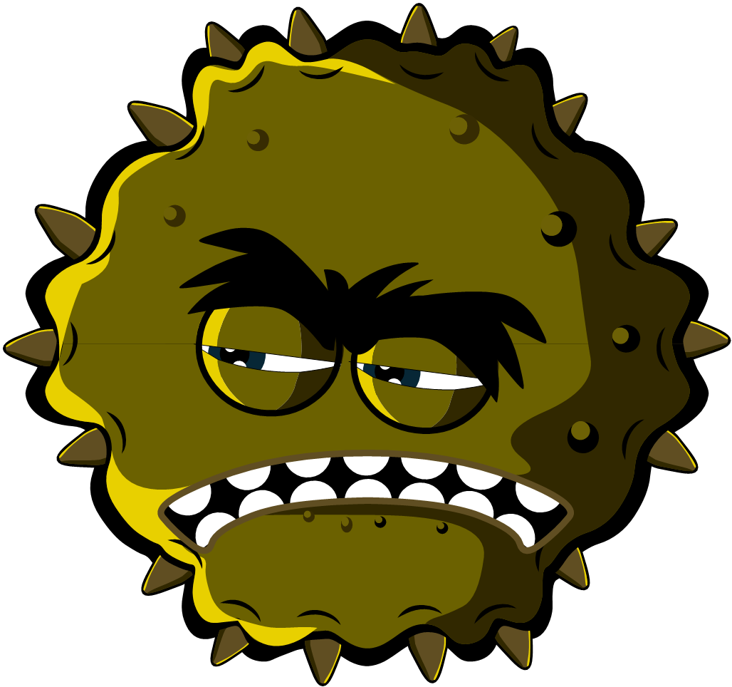
Bad Bug Challenge Wordsearch
F | C | E | A | R | T | M | Y | Y | U | A | N | S | D | F
F | O | M | G | B | F | L | U | M | B | H | N | H | J | K
Z | L | O | N | Z | R | W | K | A | Y | E | A | E | A | L
F | D | S | D | H | G | D | A | S | T | H | M | A | T | A
V | B | H | N | P | H | N | J | O | H | D | D | D | G | T
S | V | V | A | C | O | U | G | H | N | C | I | A | B | H
M | S | O | S | X | J | I | D | F | B | G | R | C | G | L
E | T | G | M | Z | U | N | S | A | M | A | T | H | A | E
A | N | M | D | I | A | R | H | O | E | A | Y | E | J | T
S | Z | X | C | V | T | B | G | T | N | D | H | J | H | E
L | R | T | A | Y | U | N | I | A | O | I | A | F | G | S
E | Q | W | E | R | I | N | F | L | U | E | N | Z | A | F
S | P | O | T | I | O | P | L | B | K | J | D | G | G | O
A | S | D | M | S | L | E | E | P | Y | E | S | S | F | O
H | A | Y | F | E | V | E | R | N | F | G | N | H | K | T
Key Words:
Cough; Cold; Food poisoning; Dirty Hands; Headache; Hay fever; Asthma; Spot; Flu; Influenza; Athletes foot; Sleepy; Measles; Vomit;

Slide 18
Bad Bug Challenge Wordsearch - Answers
F | C | E | A | R | T | M | Y | Y | U | A | N | S | D | F
F | O | M | G | B | F | L | U | M | B | H | N | H | J | K
Z | L | O | N | Z | R | W | K | A | Y | E | A | E | A | L
F | D | S | D | H | G | D | A | S | T | H | M | A | T | A
V | B | H | N | P | H | N | J | O | H | D | D | D | G | T
S | V | V | A | C | O | U | G | H | N | C | I | A | B | H
M | S | O | S | X | J | I | D | F | B | G | R | C | G | L
E | T | G | M | Z | U | N | S | A | M | A | T | H | A | E
A | N | M | D | I | A | R | H | O | E | A | Y | E | J | T
S | Z | X | C | V | T | B | G | T | N | D | H | J | H | E
L | R | T | A | Y | U | N | I | A | O | I | A | F | G | S
E | Q | W | E | R | I | N | F | L | U | E | N | Z | A | F
S | P | O | T | I | O | P | L | B | K | J | D | G | G | O
A | S | D | M | S | L | E | E | P | Y | E | S | S | F | O
H | A | Y | F | E | V | E | R | N | F | G | N | H | K | T
Key Words:
Cough; Cold; Food poisoning; Dirty Hands; Headache; Hay fever; Asthma; Spot; Flu; Influenza; Athletes foot; Sleepy; Measles; Vomit;

Slide 19
Harmful Microbes Quiz 1
Harmful Microbes Quiz
Which of these are microbes?
(3 points)
Bacteria
Virus
Antibiotic
Fungi
Microbes are found
(1 point)
In the air
On our hands
On surfaces
Everywhere

Slide 20
Harmful Microbes Quiz 2
Harmful Microbes Quiz
Which foods or drinks are
produced through the growth of microbes?
(4 points)
Cheese
Bread
Yogurt
Fizzy drinks
What is another word for a harmful microbe?
(1 point)
Infectious
Antibiotic
Pathogen
Flora

Slide 21
Harmful Microbes Quiz 3
Harmful Microbes Quiz
Microbes:
(1 point)
Are all harmful
Are all useful
Can be harmful or useful
Have no effect on the
human body
Which is the smallest?
(1 point)
Bacterium
Virus
Fungus
They are all the same size

Slide 22
Harmful Microbes Quiz 4
Harmful Microbes Quiz
Which of these microbes causes the common cold?
(1 point)
Bacteria
Virus
Antibiotic
Which of these are shapes of microbes?
(1 point)
Rods
Balls
Spirals
All of the above

Slide 23
Harmful Microbes Quiz 1 - Answers
Harmful Microbes Quiz - Answers
Which of these are microbes?
(3 points)
Bacteria
Virus
Antibiotic
Fungi
Microbes are found
(1 point)
In the air
On our hands
On surfaces
Everywhere
✓
✓
✓
✓

Slide 24
Harmful Microbes Quiz 2 - Answers
Harmful Microbes Quiz - Answers
Which foods or drinks are
produced through the growth of microbes?
(4 points)
Cheese
Bread
Yogurt
Fizzy drinks
What is another word for a harmful microbe?
(1 point)
Infectious
Antibiotic
Pathogen
Flora
✓
✓
✓
✓

Slide 25
Harmful Microbes Quiz 3 - Answers
Harmful Microbes Quiz - Answers
Microbes:
(1 point)
Are all harmful
Are all useful
Can be harmful or useful
Have no effect on the
human body
Which is the smallest?
(1 point)
Bacterium
Virus
Fungus
They are all the same size
✓
✓

Slide 26
Harmful Microbes Quiz 4 - Answers
Harmful Microbes Quiz - Answers
Which of these microbes causes the common cold?
(1 point)
Bacteria
Virus
Antibiotic
Which of these are shapes of microbes?
(1 point)
Rods
Balls
Spirals
All of the above
✓
✓

Slide 27
Learning Consolidation

Slide 28
Discussion Question 1
Some microbes can be harmful to humans and can cause disease. Provide one example.
Food poisoning
caused by bacteria called Campylobacter.

Slide 29
Discussion Question 2
Which microbe is very small and causes coughs, colds, sore throats and flu?
Virus

Slide 30
Discussion Question 3
Provide two ways that harmful microbes can spread from person to person.
Cough/sneeze in your hand
When you do not washing your hands

Slide 31
Group activity
Alternatively, allow the pupils to work in pairs or small groups to create their own quiz questions.
Each group writes 2-3 questions (and answers) on sticky notes or a digital platform.
Groups then swap questions and answer those from another group, discussing the correct answers together.

