Slide 1
Micro-organisms:
Introduction to Microbes
Key Stage 2

Slide 2
Learning Intention
• Explore the world of microbes, understanding their types, characteristics, and the ways in which they can impact our health and environment.

Slide 3
Northen Ireland Curriculum Links
Curriculum Key Elements
Personal Health and Moral Character
Curriculum Skills
Communication, Thinking, Being Creative, Problem Solving and Decision Making, Working with Others
Curriculum Areas of Learning
Personal Development and Mutual Understanding (PDMU), The World Around Us (TWAU), The Arts

Slide 4
What are Microbes?
Micro-organisms, sometimes called microbes, germs or bugs, are living things that are too small to be seen with our naked eyes; they can only be seen through a microscope.
There are three main types of microbes: bacteria, viruses and fungi.
Microbes can be found everywhere: floating around in the air we breathe, on the food we eat, on the surface of our bodies, in our mouth, nose and gut/tummy.
Some diseases called infections are caused by microbes, there are also microbes that can be very useful, for example, Lactobacillus in yoghurt and probiotics drinks, Penicillin from fungi, yeast in bread.

Slide 5
Main Activity:
Designabug

Slide 6

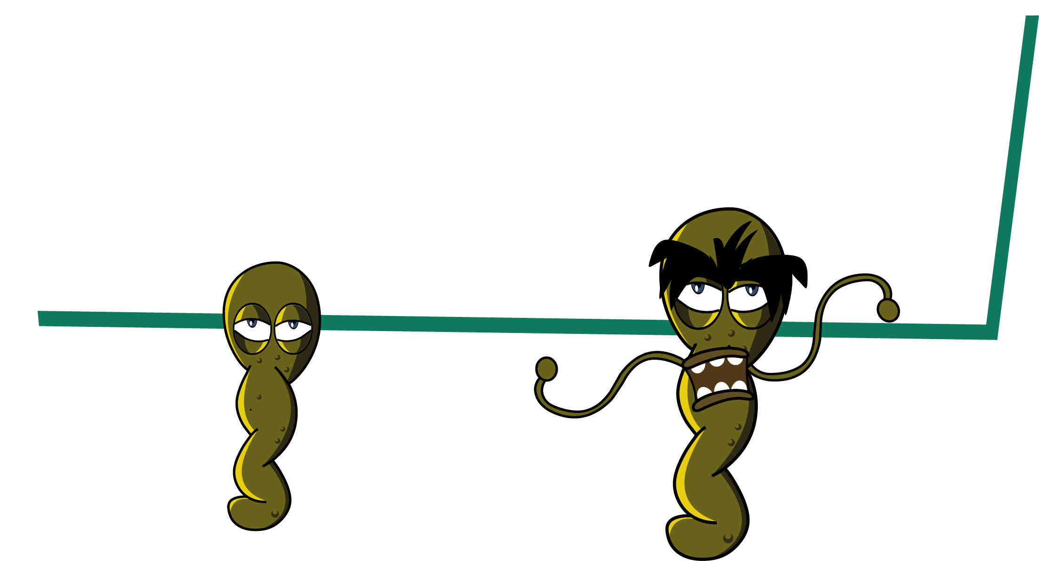
Designabug Activity
1. Choose which microbe you want to be (bacteria; virus; fungi)
2. Add more details to your microbe e.g., shape, useful or harmful microbe
3. Add special features to your microbe
4. Name your microbe

Slide 7
Discussion

Slide 8
Discussion Points
Where can microbes be found?
What can we found on our skin, mouth, gut and hands?
Why bacteria on our bodies are important?
Is it true that most microbes we carry on our bodies are harmless?

Slide 9
Extension Activities

Slide 10

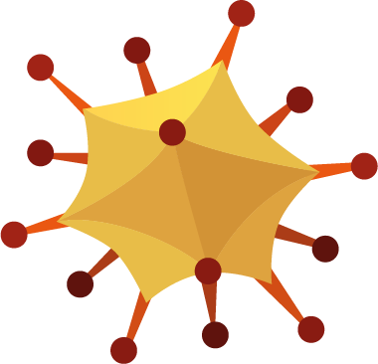
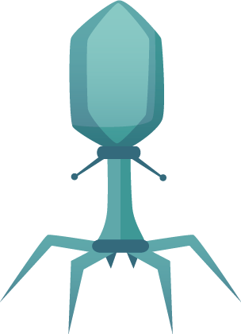
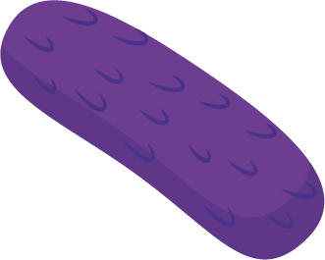
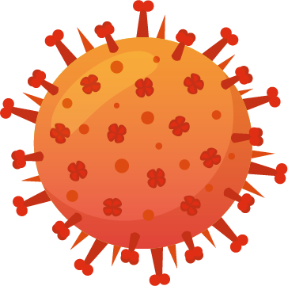



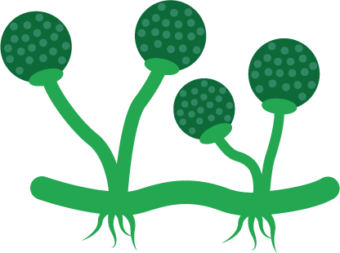
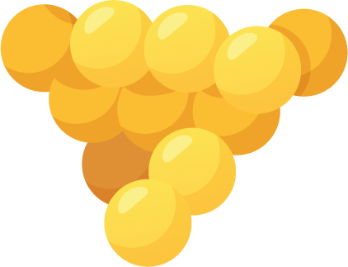








Designabug Types and Shapes Outline
Designabug
Microbe Types and Shape Outlines
Virus
Polyhedral
Enveloped
Complex
Fungi
The life cycle of a mushroom
Bacteria
Coccus
Diplococci
Streptococci
Staphylococci
Bacillus
Diplobacilli
Streplobacilli
Vibrio
Corkscrew’s form
Borrella burgorferi

Slide 11
Designabug Exercise Sheet
Designabug
Microbe name
Microbe type
Useful of Harmful
Special Features
Microbe Story
Strength/Weakness

Slide 12
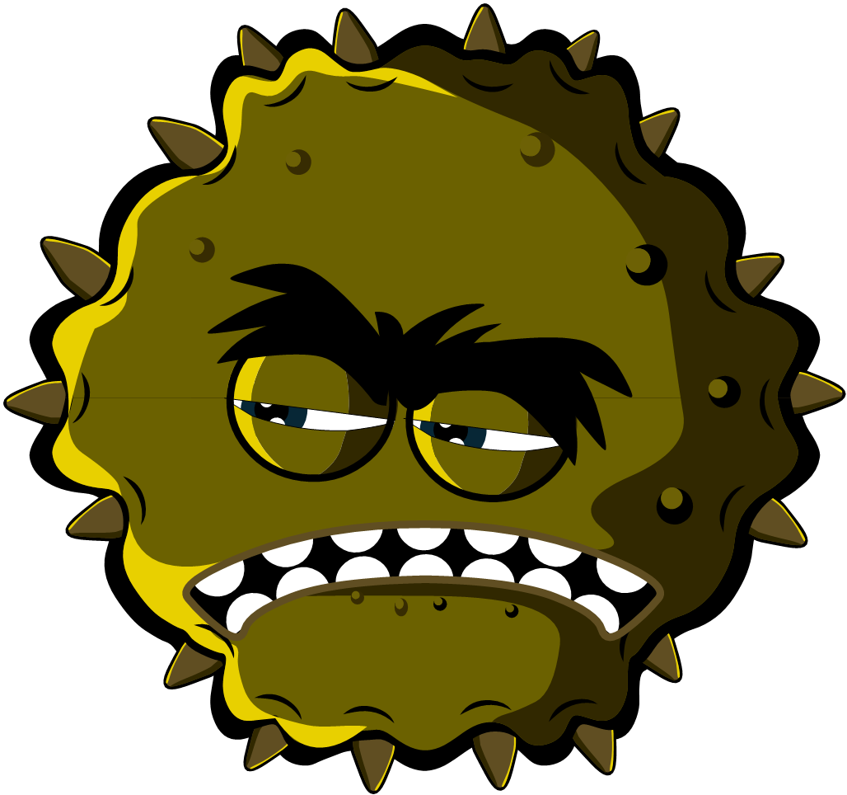
Designabug Example
Designabug
Microbe name
_{Charlotte Sneezysnot}
Microbe type
_{Virus}
Useful of Harmful
_{Harmful}
Special Features
Lots of sticky grippers all around my body and I’m very small
Microbe Story
I am a harmful virus and I like to live in your nose. My super sticky grippers help me stick to your nose cells. You don’t want me there because I make you sneeze and cough.
Strength/Weakness
I need to live in your cells do don’t sneeze in a tissue and throw me in the bin – I’ll die

Slide 13


What are Microbes? – Bullet points
What are Microbes?
Microbes are living organisms;
They are so small we need a microscope to see them;
They come in different shapes and sizes;
They are found EVERYWHERE!
Some microbes are useful or even good for us;
Some microbes can make us ill;
There are 3 different types of microbes:
VIRUSES, BACTERIA AND FUNGI

Slide 14
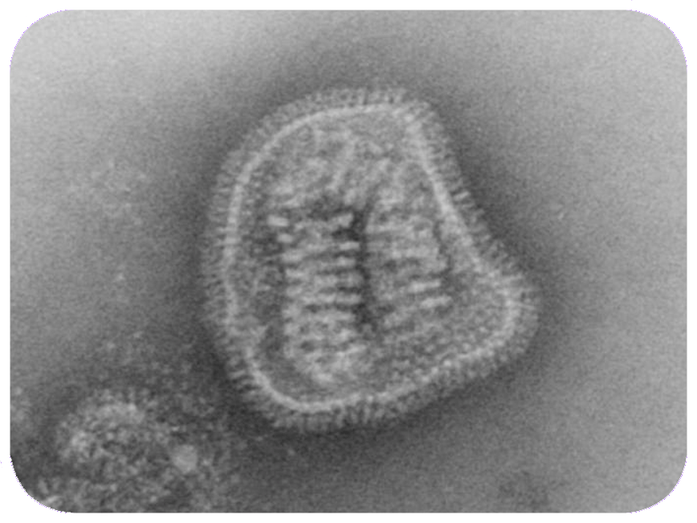
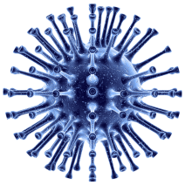
VIRUSES
Viruses
Influenza
Viruses are even smaller than bacteria and can sometimes live INSIDE bacteria.
Some viruses make us sick.
Diseases like CHICKENPOX and the FLU are caused by viruses.
Viruses can spread from one person to another but it depends on the type of virus.

Slide 15
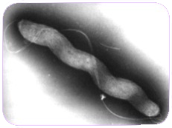
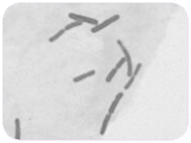
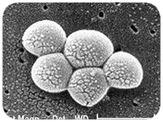


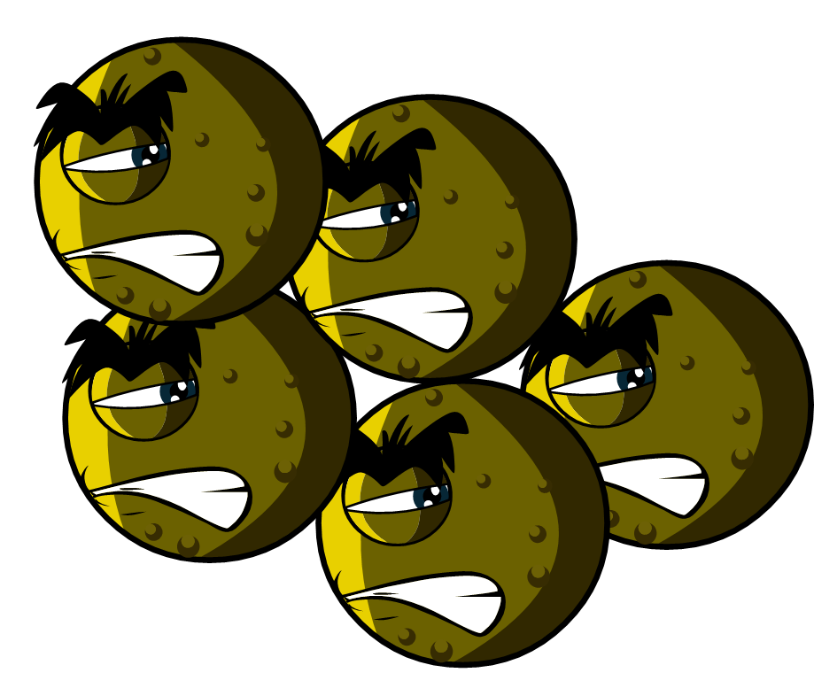
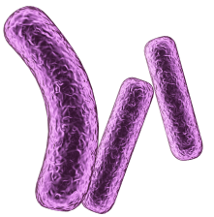
BACTERIA
Bacteria
There are three different types of bacteria.
They look like:
Spirals
(Campylobacter)
Rods
(Lactobacillus)
Balls
(Staphylococcus)
Bacteria are so small that 1000s could fit on the full stop at the end of this sentence.
Some bacteria are helpful in cooking, for example, making yoghurt and cheese.
Some bacteria are harmful and cause infection.
Bacteria multiply very fast..

Slide 16
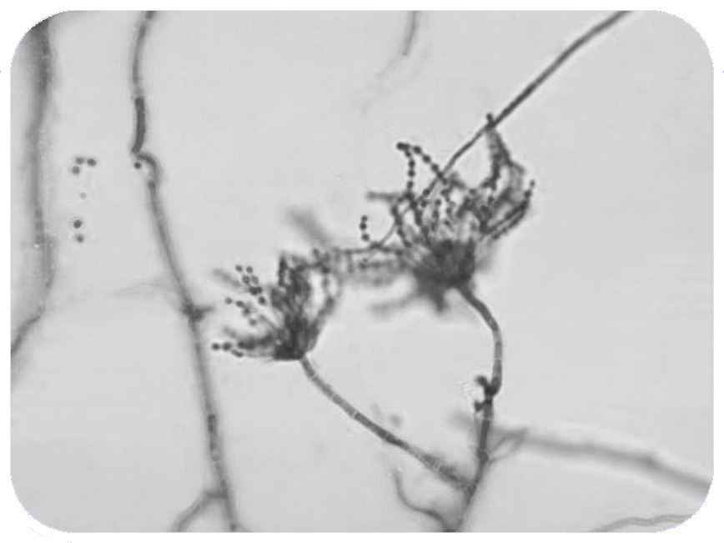
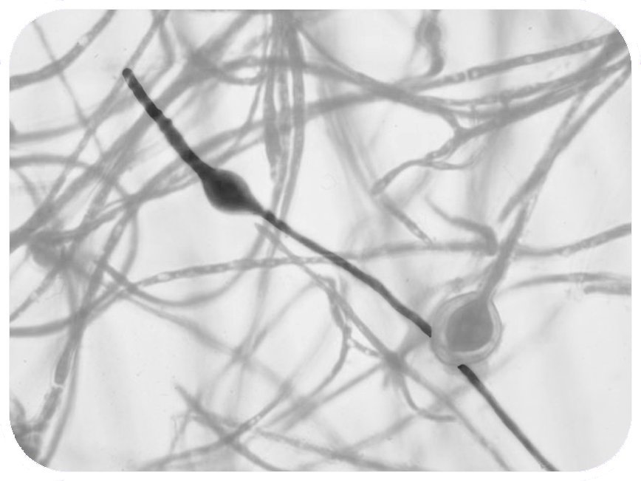
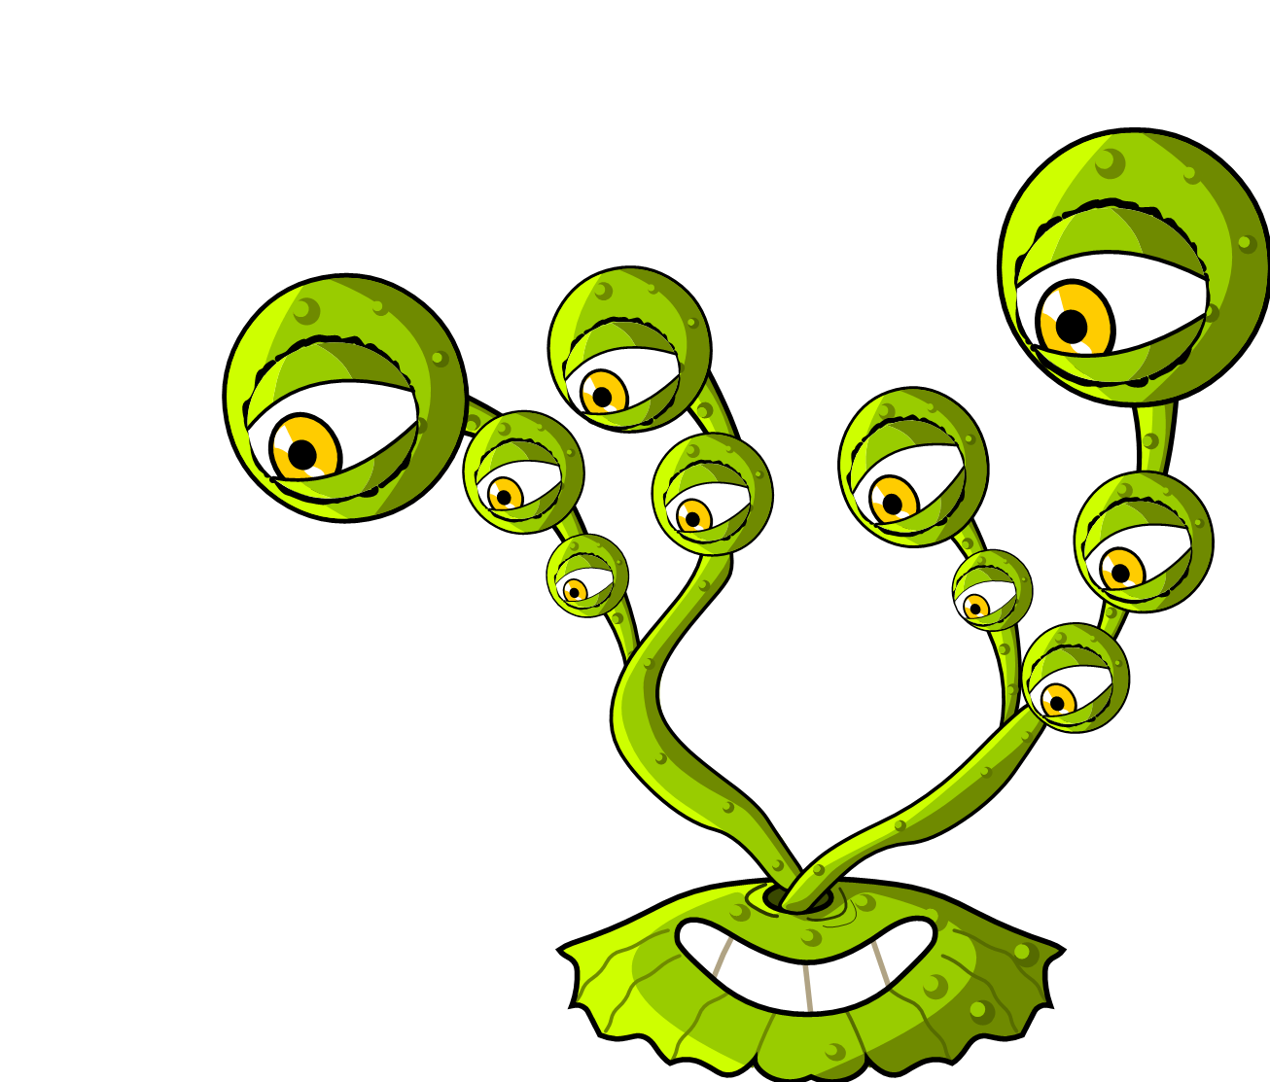
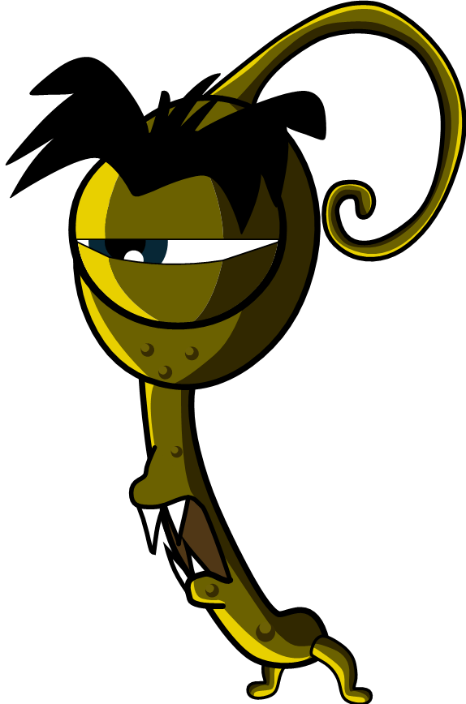
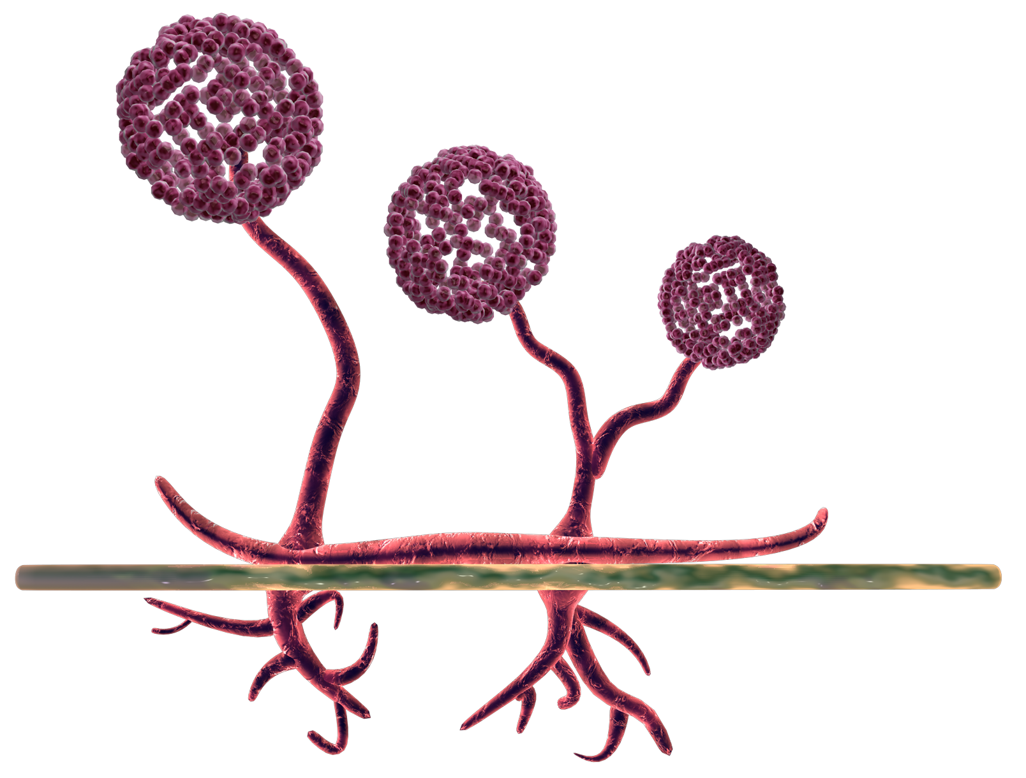
FUNGI
Fungi
Penicillium
Dermatophyte
Fungi are the largest of all microbes.
Fungi can be found in the air, on plants and in water.
Mould, which grows on bread, is a type of fungus.
Some antibiotics are made by fungi.

Slide 17
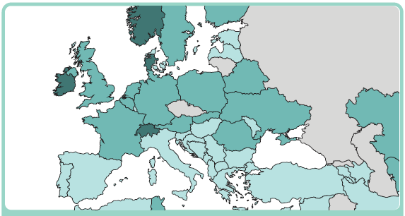
How Big is a Microbe? - You
How Big is a Microbe?
1. If you were as big as EUROPE…

Slide 18
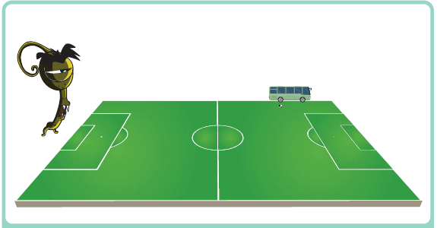
How Big is a Microbe? – Fungus
How Big is a Microbe?
2. A FUNGUS would be the size of a FOOTBALL PITCH

Slide 19
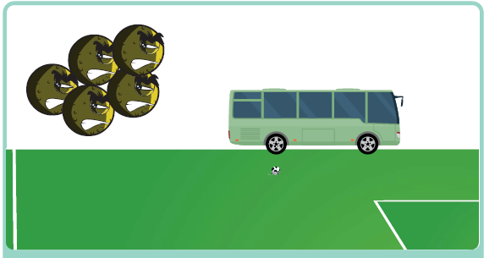
How Big is a Microbe? – Bacterium
How Big is a Microbe?
3. A BACTERIUM would be the size of a BUS

Slide 20
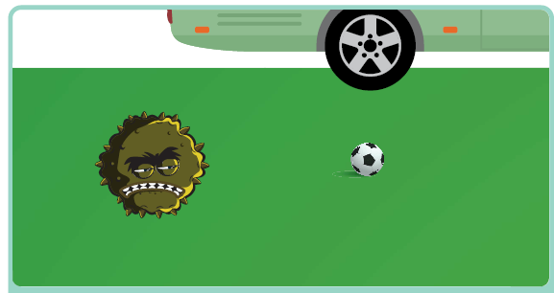
How Big is a Microbe? – Virus
How Big is a Microbe?
4. A VIRUS would be the size of a FOOTBALL

Slide 21
What Microbe am I? - Staphylococcus
What Microbe am I? Can you work out which microbe is which?
My name is Staphylococcus. I am round in shape and I like to live in your nose or armpit. If I live on your skin I can give you spots. If I get into your bloodstream I can
make you ill. What am I?
Staphylococcus is a:
______________________

Slide 22
What Microbe am I? – Lactobacillus
What Microbe am I? Can you work out which microbe is which?
My name is Lactobacillus. People call me ‘friendly’ because I change milk into yoghurt. When you eat me in yoghurt I live in your
guts and help you digest other food. What am I?
Lactobacillus is a:
_____________________

Slide 23
What Microbe am I? – Dermatophyte
What Microbe am I? Can you work out which microbe is which?
I’m called a Dermatophyte and I like to live on your skin. I especially like living in damp places like between the toes on sweaty feet. When I live there I give people athlete’s foot. What am I? Dermatophytes are:
______________________

Slide 24
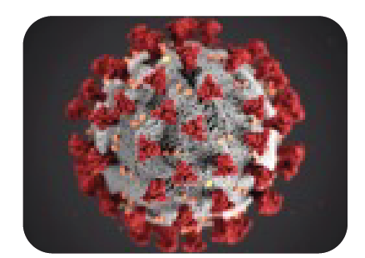
What Microbe am I? – SARS-CoV-2
What Microbe am I? Can you work out which microbe is which?
My name is SARS-CoV-2
although some people call me Covid-19. People don’t really like me because I can make them really ill. I easily spread from person to person through coughing and sneezing. What type of microbe am I? SARS-CoV-2 (COVID-19) is:
______________________

Slide 25
What Microbe am I? – Penicillium
What Microbe am I? Can you work out which microbe is which?
My name is Penicillium and you’ll find me growing on old oranges or stale bread making them look mouldy. Humans use me to make
an antibiotic known as Penicillin which can make them better, but only from bacterial infections. What am I? Penicillium is a:
_____________________

Slide 26
What Microbe am I? – Campylobacter
What Microbe am I? Can you work out which microbe is which?
My name is Campylobacter. I have a pretty spiral shape and I like to live in chickens but if I get into your tummy I make you very ill – I can give you diarrhoea. What am I? Campylobacter is a ______________________

Slide 27
What Microbe am I? Answers
What Microbe Am I?
There are three different types of microbe – bacteria, viruses and fungi.
From the pictures and descriptions, can you work out which microbe is which?
My name is Staphylococcus. I am round in shape and I like to live in your nose or armpit. If I live on your skin I can give you spots. If I get into your bloodstream I can
make you ill. What am I?
Staphylococcus is a:
My name is Lactobacillus. People call me ‘friendly’ because I change milk into yoghurt. When you eat me in yoghurt I live in your
guts and help you digest other food. What am I?
Lactobacillus is a:
I’m called a Dermatophyte and I like to live on your skin. I especially like living in damp places like between the toes on sweaty feet. When I live there I give people athlete’s foot. What am I? Dermatophytes are:
Bacterium
Bacterium
Fungi
My name is Penicillium and you’ll find me growing on old oranges or stale bread making them look mouldy. Humans use me to make
an antibiotic known as Penicillin which can make them better, but only from bacterial infections. What am I? Penicillium is a:
My name is SARS-CoV-2
although some people call me Covid-19. People don’t really like me because I can make them really ill. I easily spread from person to person through coughing and sneezing. What type of microbe am I? SARS-CoV-2 (COVID-19) is:
My name is Campylobacter. I have a pretty spiral shape and I like to live in chickens but if I get into your tummy I make you very ill – I can give you diarrhoea. What am I? Campylobacter is a:
Virus
Fungus
Bacterium

Slide 28
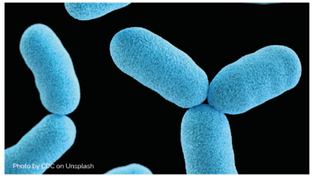
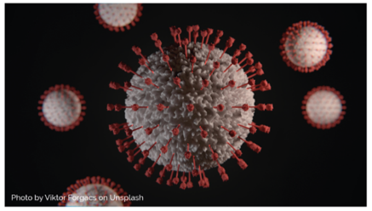
What are Microbes – Fill in the gaps with given words
______________, more commonly known as germs, bugs or microbes, are
tiny living things too small to be seen with the naked eye. They are found
almost everywhere on earth.
Some microbes are useful, and others can be harmful to humans. There
are ______ main groups of microbes:
In Word document answers says microbes not micro-organisms
__________ are the smallest of the three microbes described and can be
harmful to humans. Viruses cannot survive by themselves. They need a
‘host’ cell to survive. Once inside the host cell, they rapidly multiply and
destroy the cell in the process. One type of virus is SARS-CoV-2.
Fungi are the largest of the three microbes described and are multicellular
organisms (made up of more than one cell). Some fungi are useful,
and some can be harmful to humans. For example, Saccharomyces is a
_________ that is used to help bread rise.
Bacteria are ____________________organisms that are smaller than fungi
but larger than viruses. They can be divided into three main groups by their
shapes – cocci (balls), bacilli (rods) and spirals. Cocci can also be broken
down into three groups by how the cocci are arranged: staphylococci
(clusters), streptococci (chains) and diplococci (pairs). These shapes can be
used to identify the type of infection a patient has. If a single bacterial cell
was scaled up 5,000 times it would be the size of a garden ______.
Words to use: Viruses, pea, micro-organisms, single-celled, three, yeast

Slide 29
What are Microbes – Answers
Micro-organisms
______________, more commonly known as germs, bugs or microbes, are
tiny living things too small to be seen with the naked eye. They are found
almost everywhere on earth.
Some microbes are useful, and others can be harmful to humans. There
are ______ main groups of microbes:
three
Viruses
__________ are the smallest of the three microbes described and can be
harmful to humans. Viruses cannot survive by themselves. They need a
‘host’ cell to survive. Once inside the host cell, they rapidly multiply and
destroy the cell in the process. One type of virus is SARS-CoV-2.
Fungi are the largest of the three microbes described and are multicellular
organisms (made up of more than one cell). Some fungi are useful,
and some can be harmful to humans. For example, Saccharomyces is a
_________ that is used to help bread rise.
Bacteria are ____________________organisms that are smaller than fungi
but larger than viruses. They can be divided into three main groups by their
shapes – cocci (balls), bacilli (rods) and spirals. Cocci can also be broken
down into three groups by how the cocci are arranged: staphylococci
(clusters), streptococci (chains) and diplococci (pairs). These shapes can be
used to identify the type of infection a patient has. If a single bacterial cell
was scaled up 5,000 times it would be the size of a garden ______.
yeast
single-celled
pea
Words to use: Viruses, pea, micro-organisms, single-celled, three, yeast

Slide 30
Learning Consolidation

Slide 31

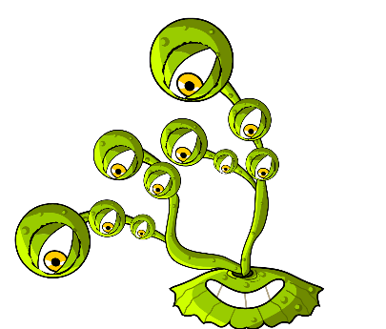
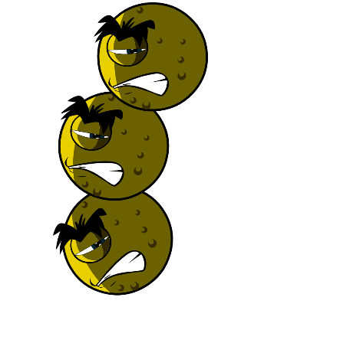
What are 3 main types of microbe?
Viruses
Fungi
Bacteria

Slide 32
Discussion Question 1
All microbes can be seen by the naked eye.
True/False?
False

Slide 33
Discussion Question 2
On what objects can microbes be found?
Microbes are found everywhere

Slide 34
Discussion Question 3
Are microbes useful, harmful or both?
Useful
Both
Harmful

Slide 35
Pupils could also make 3D models of microbes using art materials and explain their features, where they are found, and their effects on people and the environment.
Alternatively, pupils could work in groups to solve a real-world scenario, such as:
“A new virus is spreading in the community – what can you do to help keep those people safe?”
They would brainstorm and present their strategies, incorporating knowledge of microbes.
Consolidation Activities continued

