Slide 1
Prevention of Infection:
Oral Hygiene
Key Stage 2

Slide 2
Learning Intention
All pupils will:
Understand the importance of oral health by exploring the causes and consequences of tooth decay and developing effective habits to maintain healthy teeth.

Slide 3
Northern Ireland Curriculum Links
Curriculum Key Elements
Personal Health and Moral Character
Curriculum Skills
Communication, Thinking, Problem Solving and Decision Making, Working with Others
Curriculum Areas of Learning
Personal Development and Mutual Understanding (PDMU), The World Around Us (TWAU)

Slide 4
How to Prevent Tooth Decay?
Tooth decay is a preventable disease.
You can prevent tooth decay by eating sugary foods and drinks less often, and in smaller amounts, and by brushing teeth with a fluoride toothpaste last thing before bed and in the morning.
After brushing it is important to spit rather than rinse to leave some of the fluoride to protect the teeth from the bacteria.

Slide 5
Why Does Oral Hygiene Matter?
All the time, a white sticky film builds up on our teeth called dental plaque. This gets thicker if you don’t brush your teeth.
Dental plaque is made up of bacteria.
The bacteria can use the sugar from our diets to make acid to dissolve the teeth and form a hole (cavity). This is tooth decay.
Without dental treatment, this can penetrate the nerve and inflame bone structures and result in an abscess – this is very painful!
Over 1 in 5 children have tooth decay and it is the main reason for children aged 5-9 years being admitted to hospital.
Q1: How many adult teeth do we have?
Notes:
A – we have 32 adult teeth! Once we have these, we do not get any more. This is why it is so important to prevent tooth decay.
Our first teeth appear at ~6 months and we will have a full set of 20 baby (primary) teeth by 2 ½ years
At ~6 years these start being replaced by permanent teeth and we will have a full set by 12 years

Slide 6
Q2: How can we prevent tooth decay?
A good diet that is low in sugar
Brushing teeth twice a day
Using fluoride toothpaste

Slide 7
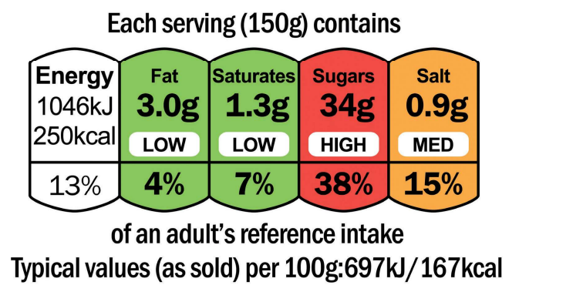
Why do we Need a Good Diet to Prevent Tooth Decay?
A sugar attack is when sugar in the food or drink we consume attacks the tooth and dissolves the enamel so holes (cavities) appear.
Sugar attacks should be kept to a minimum and limited to mealtimes to reduce the risk of tooth decay.
Food and drink high in sugar include sweets, cakes, biscuits and some fruit juices and fizzy drinks.
Q3: What is this image? What information can you learn from it?
Notes:
A: This is an example of a nutrition label that can identify the sugar content of food and drinks. Red= high sugar content, amber= medium and green= low.

Slide 8
Why do we Need to Brush our Teeth?
  Brushing last thing before going to bed and in the morning with a pea sized amount of fluoride toothpaste helps remove the plaque and bacteria.
  After brushing it is important to spit rather than rinse to leave some of the fluoride to protect the teeth from the bacteria.
Q4: Why is fluoride toothpaste recommended?
Notes:
A: Fluoride is a naturally occurring mineral. When we brush it on our teeth it helps to keep the enamel ( a protective layer on your teeth) strong, which reduced the chance of acid damaging teeth and causing tooth decay

Slide 9
Main Activity:
Attack the Plaque

Slide 10
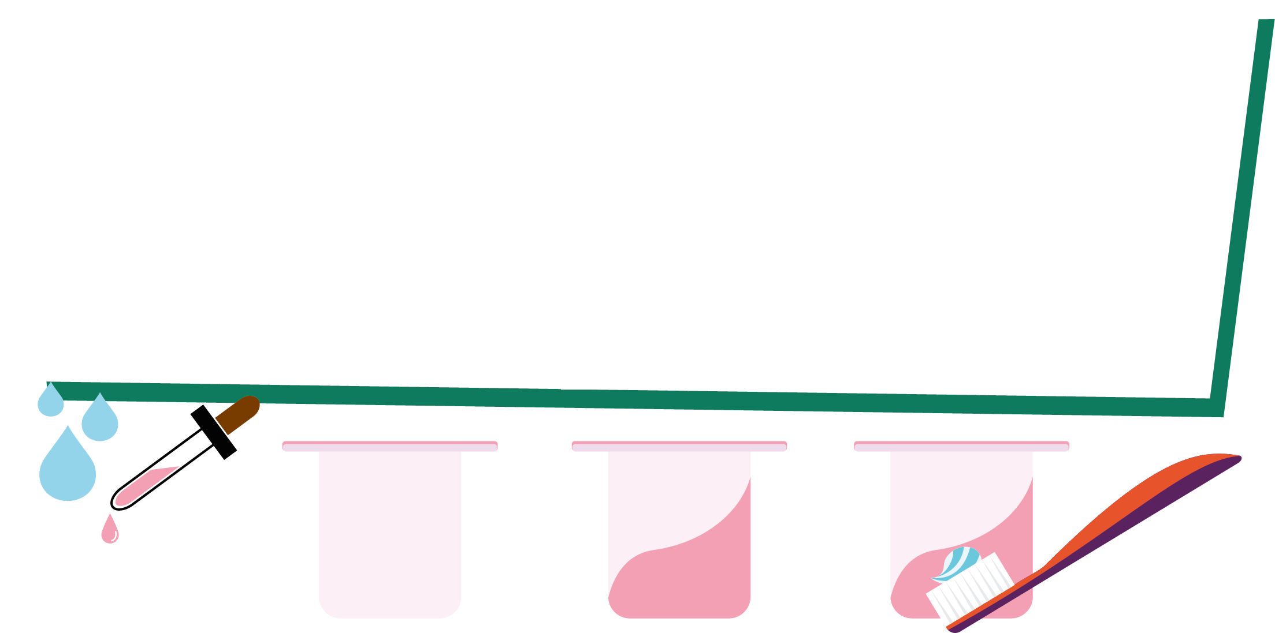
Attack the Plaque Activity
1. Mix water, flour, cornflour and food colouring
2. Paint the outside of the yoghurt pot with the mixture
3. Wait to dry
4. Try to brush the mixture off the yoghurt pots with a toothbrush

Slide 11
Activity 2:
Sugar Drink Activity

Slide 12
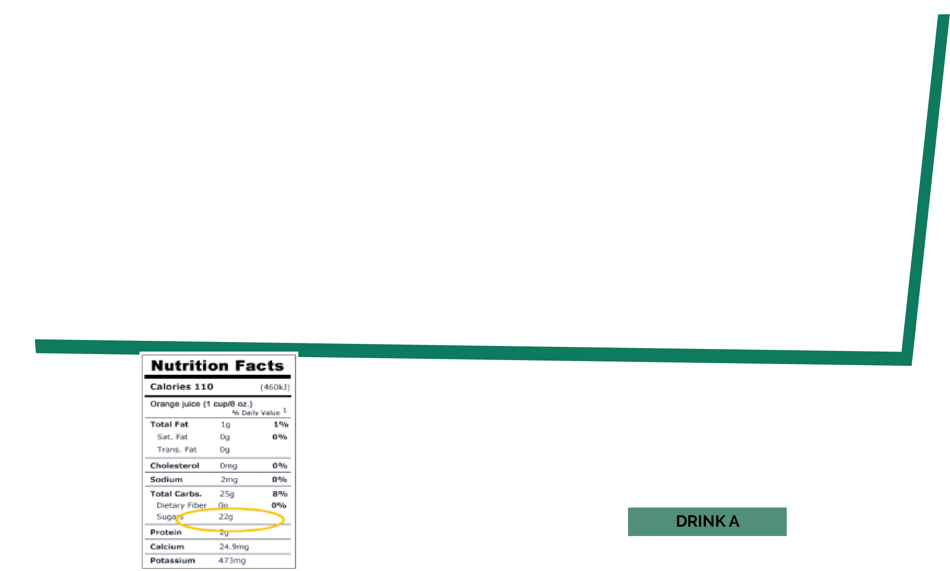
Sugar Drink Activity
1. Look at the nutritional information and identify how much sugar is contained in each drink
2. Fill up each bag with the amount of sugar in the drink
3. Make a note of which bag is which drink
4. Ask others if they can identify which drink is which based on the bags

Slide 13
Discussion Points

Slide 14
Discussion
How do we get dental decay?
Which foods should we limit, and only have occasionally?
Is it OK to drink fizzy drinks that do not contain sugar?
How often should we brush our teeth, and how?
What event occurs at around the age of 6 years?
How can we remember to brush our teeth?

Slide 15
Extension Activities

Slide 16


Brushing Diary
Tick for every time you brush your teeth
Day
Day 1
Day 2
Day 3
Day 4
Day 5
Write the day of the week in the diary and tick each time you have brushed your teeth in that box that day
Day 6
Day 7
Week total

Slide 17
Learning Consolidation

Slide 18
Discussion Question 1
What is the sticky substance made up of bacteria that clump together on our teeth?
Plaque

Slide 19
Discussion Question 2
What sweet substance found in many food and drinks can lead to bacteria and acid attacking our teeth?
Sugar

Slide 20
Discussion Question 3
Why should we limit the number of times we eat foods and drinks with added sugar?
To prevent plaque build up and tooth decay

Slide 21
Discussion Question 4
How many times a day should we brush our teeth with fluoride toothpaste?
At least twice a day

Slide 22
Creative task
Design a campaign to teach others about how to maintain healthy teeth and prevent tooth decay.
Provide pupils with different options for their campaign, such as:
Designing a poster or infographic.
Creating a short skit or role-play to present to the class.
Writing a short story or comic strip featuring characters learning about oral health.
Composing a jingle, song, or rap about brushing teeth and avoiding sugary foods.
Encourage pupils to address the following in their campaign:
What is plaque, and how does it form?
Which foods and drinks can lead to tooth decay?
Why is it important to limit sugary foods and drinks?
How should we brush our teeth effectively?
What happens if we don’t take care of our teeth?

Slide 23
Once pupils have completed their campaigns, invite each group or individual to share their work with the class.
As they present, ask open-ended questions to encourage reflection and critical thinking, such as:
Why did you choose this format to share your message?
How do you think this campaign could encourage others to take care of their teeth?
Is there anything else you learned that you want to add to your campaign?
Wrap up the activity by discussing how their campaign could help their family, friends, and community understand the importance of oral health. Use the fact-checking questions subtly during the discussion to reinforce key points and direct Q&A format.

