Slide 1
Micro – organisms: Useful Microbes
Key Stage 2

Slide 2
Learning Intention
• Investigate how microbes interact with their environment, exploring how some support health and are used in beneficial ways, and understanding the factors that influence growth.

Slide 3
Northern Ireland Curriculum Links
Curriculum Key Elements
Personal Health and Moral Character
Curriculum Skills
Communication, Using Mathematics, Thinking, Problem Solving and Decision Making, Being Creative, Working with Others
Curriculum Areas of Learning
Personal Development and Mutual Understanding (PDMU), The World Around Us (TWAU)

Slide 4
What are Useful Microbes?
Microbes can have both harmful and useful effects on our health.
Probiotic bacteria in yoghurt is an example of useful or ‘friendly’ bacteria.
Microbes are helpful in the breakdown of dead animals and plants, in helping animals and humans digest foods and in turning milk into yoghurt, cheese and butter
Bread dough rises through the action of helpful fungus known as yeast. The yeast eats the sugars present in food and produces gas and acids. These acids change the taste, smell and form of the original foodstuff whereas the gas makes the dough rise.

Slide 5
Main Activity:
Yeast Races

Slide 6
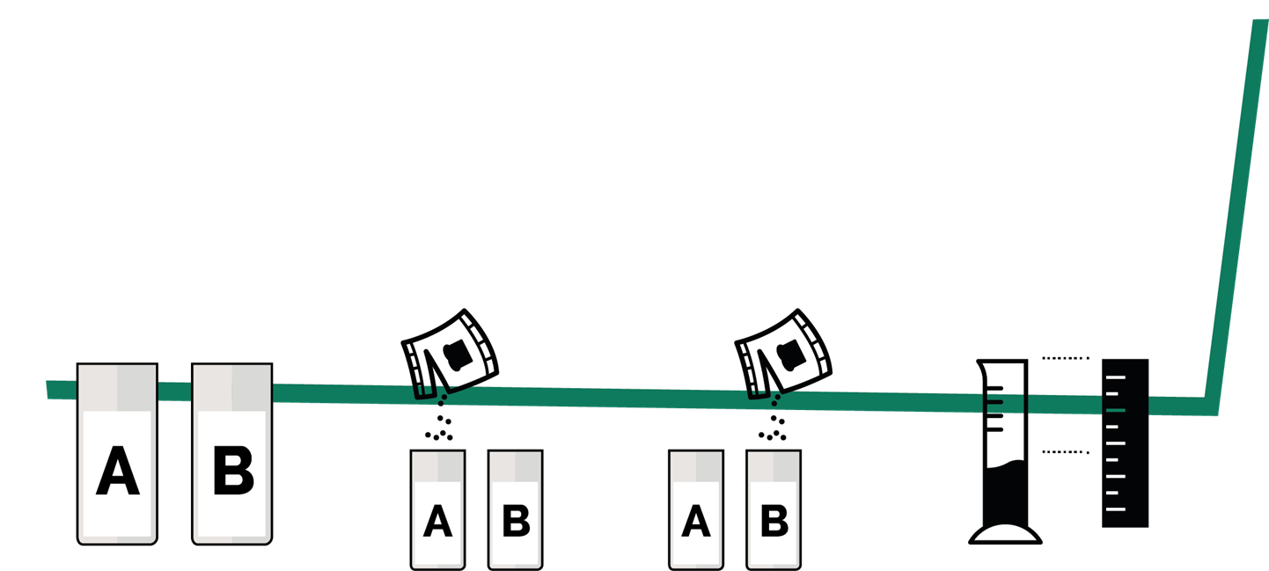
Yeast Race Activity
1. Label 2 cups A and B. Add 4 teaspoons of flour to each cup
3. Add yeast and sugar to cup B and mix
4. Pour each cup into cylinders and measure the height of the dough
2. Add yeast to cup A and mix

Slide 7
Discussion

Slide 8
Discussion Points
What is the process which caused the yeast mixture to rise?
What would have happened if there were no live yeast in the mixture?
Why was the mixture kept in a basin of warm water?
What other food products are made using bacteria or fungi?
Why does the yeast and sugar solution move faster than the yeast alone?

Slide 9
Extension Activities

Slide 10
Fascinating Fact
Elie Metchnikoff won the Nobel Prize in 1908 for his ‘discovery’ of probiotics. He was convinced that Bulgarian labourers lived longer than other people because of the microbes in the sour milk they drank. The microbes were later identified as Lactobacillus bulgaricus.

Slide 11
Yeast Races – Recording Sheet
Yeast Races
Procedure
Follow the instructions on the yeast races handout
My Results
Yeast only (cup A)
Yeast and Sugar (cup B)
Time | Volume of dough (ml) | Change in volume of dough (ml)
0 | 30ml | 0
5
10
15
20
25
30
Volume of dough (ml) | Change in volume of dough (ml)
30ml | 0

Slide 12
Yeast Races – Conclusions
My Conclusions
What caused the dough to rise up the container? _______________________________
What is this process called? ________________________________
Why did the dough in container B move faster than container A? ________________________________
Did you know?
The average adult carries approx. 2kg of good microbes in their guts – the same weight as 2 bags of sugar.

Slide 13
Yeast Races - Answers
Yeast Races
Procedure
Follow the instructions on the yeast races handout
My Results
Yeast only (cup A)
Yeast and Sugar (cup B)
Time | Volume of dough (ml) | Change in volume of dough (ml)
0 | 30ml | 0
5
10
15
20
25
30
Volume of dough (ml) | Change in volume of dough (ml)
30ml | 0
Your calculations

Slide 14
Yeast Races Conclusions - Answers
My Conclusions
What caused the dough to rise up the container? _______________________________
What is this process called? ________________________________
Why did the dough in container B move faster than container A?
The yeast breaks down the complex sugars present in food (the flour) and produces gas and acids. These acids change the taste, smell, and form of the mixture, whereas the gas makes the dough rise.
Fermentation
The addition of sugar provides a readily available food source for the yeast to catalyse the process.
Did you know?
The average adult carries approx. 2kg of good microbes in their guts – the same weight as 2 bags of sugar.

Slide 15
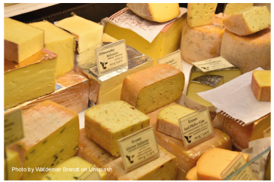
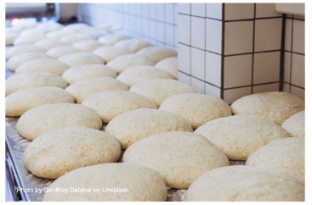
Microbes and Food – Fill in the Blanks Worksheet
Microbes are single-celled organisms, most of which are useful, although some of them cause illness and disease. One of the main ways in which microbes are useful is in the food industry. Cheese, bread, yoghurt, chocolate, vinegar and alcohol are all produced through the growth of microbes. The microbes used to make these products cause a chemical change known as _ _ _ _ _ _ _ _ _ _ _ _ a process by which the microbes break down the complex sugars into simple compounds like carbon dioxide and alcohol. Fermentation changes the product from one food to another.
When the bacteria Streptococcus thermophilous or _ _ _ _ _ _ _ _ _ _ _ _ _ _ _ _ _ _ _ _ _ _ _ are added to milk they consume the sugars during growth, turning the milk into yoghurt. So much acid is produced in fermented milk products that few potentially harmful microbes can survive there. Lactobacillus is generally referred to as a good or ‘friendly’ bacterium. The friendly bacteria that help us digest food have been termed probiotic bacteria, literally meaning ‘for life’. It is these bacteria that we find in _ _ _ _ _ _ _ _ and probiotic drinks.
_ _ _ _ _, Saccharomyces cerevisiae, is used to make _ _ _ _ _ and
_ _ _ _ _ products through fermentation. In order to multiply and grow, yeast needs the right environment, which includes moisture, food (in the form of sugar or starch) and a warm temperature (20° to 30°C is best). When the yeast eats sugar, it changes the sugar into two things: ethanol (a type of alcohol) and _ _ _ _ _ _ _ _ (a gas that makes bubbles). This process, known as fermentation, typically occurs in the absence of the oxygen in the air.
Words to use: Lactobacillus bulgaricus, bread, carbon dioxide, fermentation, yeast, yoghurt, cheese

Slide 16
Microbes and Food - Answers
Microbes are single-celled organisms, most of which are useful, although some of them cause illness and disease. One of the main ways in which microbes are useful is in the food industry. Cheese, bread, yoghurt, chocolate, vinegar and alcohol are all produced through the growth of microbes. The microbes used to make these products cause a chemical change known as
_ _ _ _ _ _ _ _ _ _ _ _ a process by which the microbes break down the complex sugars into simple compounds like carbon dioxide and alcohol. Fermentation changes the product from one food to another.
Fermentation
Lactobacillus
When the bacteria Streptococcus thermophilous or _ _ _ _ _ _ _ _ _ _ _ _ _ _ _ _ _ _ _ _ _ _ _ are added to milk they consume the sugars during growth, turning the milk into yoghurt. So much acid is produced in fermented milk products that few potentially harmful microbes can survive there. Lactobacillus is generally referred to as a good or ‘friendly’ bacterium. The friendly bacteria that help us digest food have been termed probiotic bacteria, literally meaning ‘for life’. It is these bacteria that we find in _ _ _ _ _ _ _ _ and probiotic drinks.
_ _ _ _ _, Saccharomyces cerevisiae, is used to make _ _ _ _ _ and _ _ _ _ _ products through fermentation. In order to multiply and grow, yeast needs the right environment, which includes moisture, food (in the form of sugar or starch) and a warm temperature (20° to 30°C is best). When the yeast eats sugar, it changes the sugar into two things: ethanol (a type of alcohol) and _ _ _ _ _ _ _ _ (a gas that makes bubbles). This process, known as fermentation, typically occurs in the absence of the oxygen in the air.
bulgaricus
yoghurt
bread
Yeast
cheese
Words to use: Lactobacillus bulgaricus, bread, air (CO2), fermentation, yeast, yoghurt, cheese
Carbon dioxide

Slide 17
Learning Consolidation

Slide 18
Discussion Question 1
Do microbes have both useful and harmful effects on our health?
Both

Slide 19
Discussion Question 2
Some microbes can help keep us healthy.
True/False?
True

Slide 20
Discussion Question 3
Some microbes can be put to good use in the food industry. List five food or drink items.
Bread
Cheese
Yogurt
Kombucha
Sauerkraut

