Slide 1
Micro-organisms: Harmful Microbes
Key Stage 3

Slide 2
Learning Intention
All pupils will:
•Explore how microbes can cause infections, how they spread, and how individuals, organisations, and global factors influence the control of infectious diseases.

Slide 3
Northern Ireland Curriculum Links
Curriculum Key Elements
Personal Health and Moral Character
Curriculum Skills
Communication, Managing Information, Thinking, Problem Solving and Decision-Making, Working with others
Curriculum Areas of Learning
Learning for Life and Work (Personal Development: Personal Health), Science and Technology (Science: Organisms and Health)

Slide 4
What are Harmful Microbes?
Sometimes microbes can be harmful to humans. Bacteria can produce toxins when they reproduce which are harmful to the body. Viruses enter the body and stick to the cell surface multiplying inside our cells and destroying them. Some fungi like to grow on our skin making it itchy and sore.
In the early 1900s the disease of greatest threat was measles; thankfully today we now have a vaccine to prevent this.
Bacteria and other microbes that can cause infection and which can spread easily from person to person are called infectious. For example, the difference between an infectious microbe and a non-infectious is the Lactobacilli bacteria we learned about in lesson 2.
There are various routes of transmission, for example, touch, water, food, body fluid and air.

Slide 5
Main Activity:
Infectious Disease Group Discussion

Slide 6
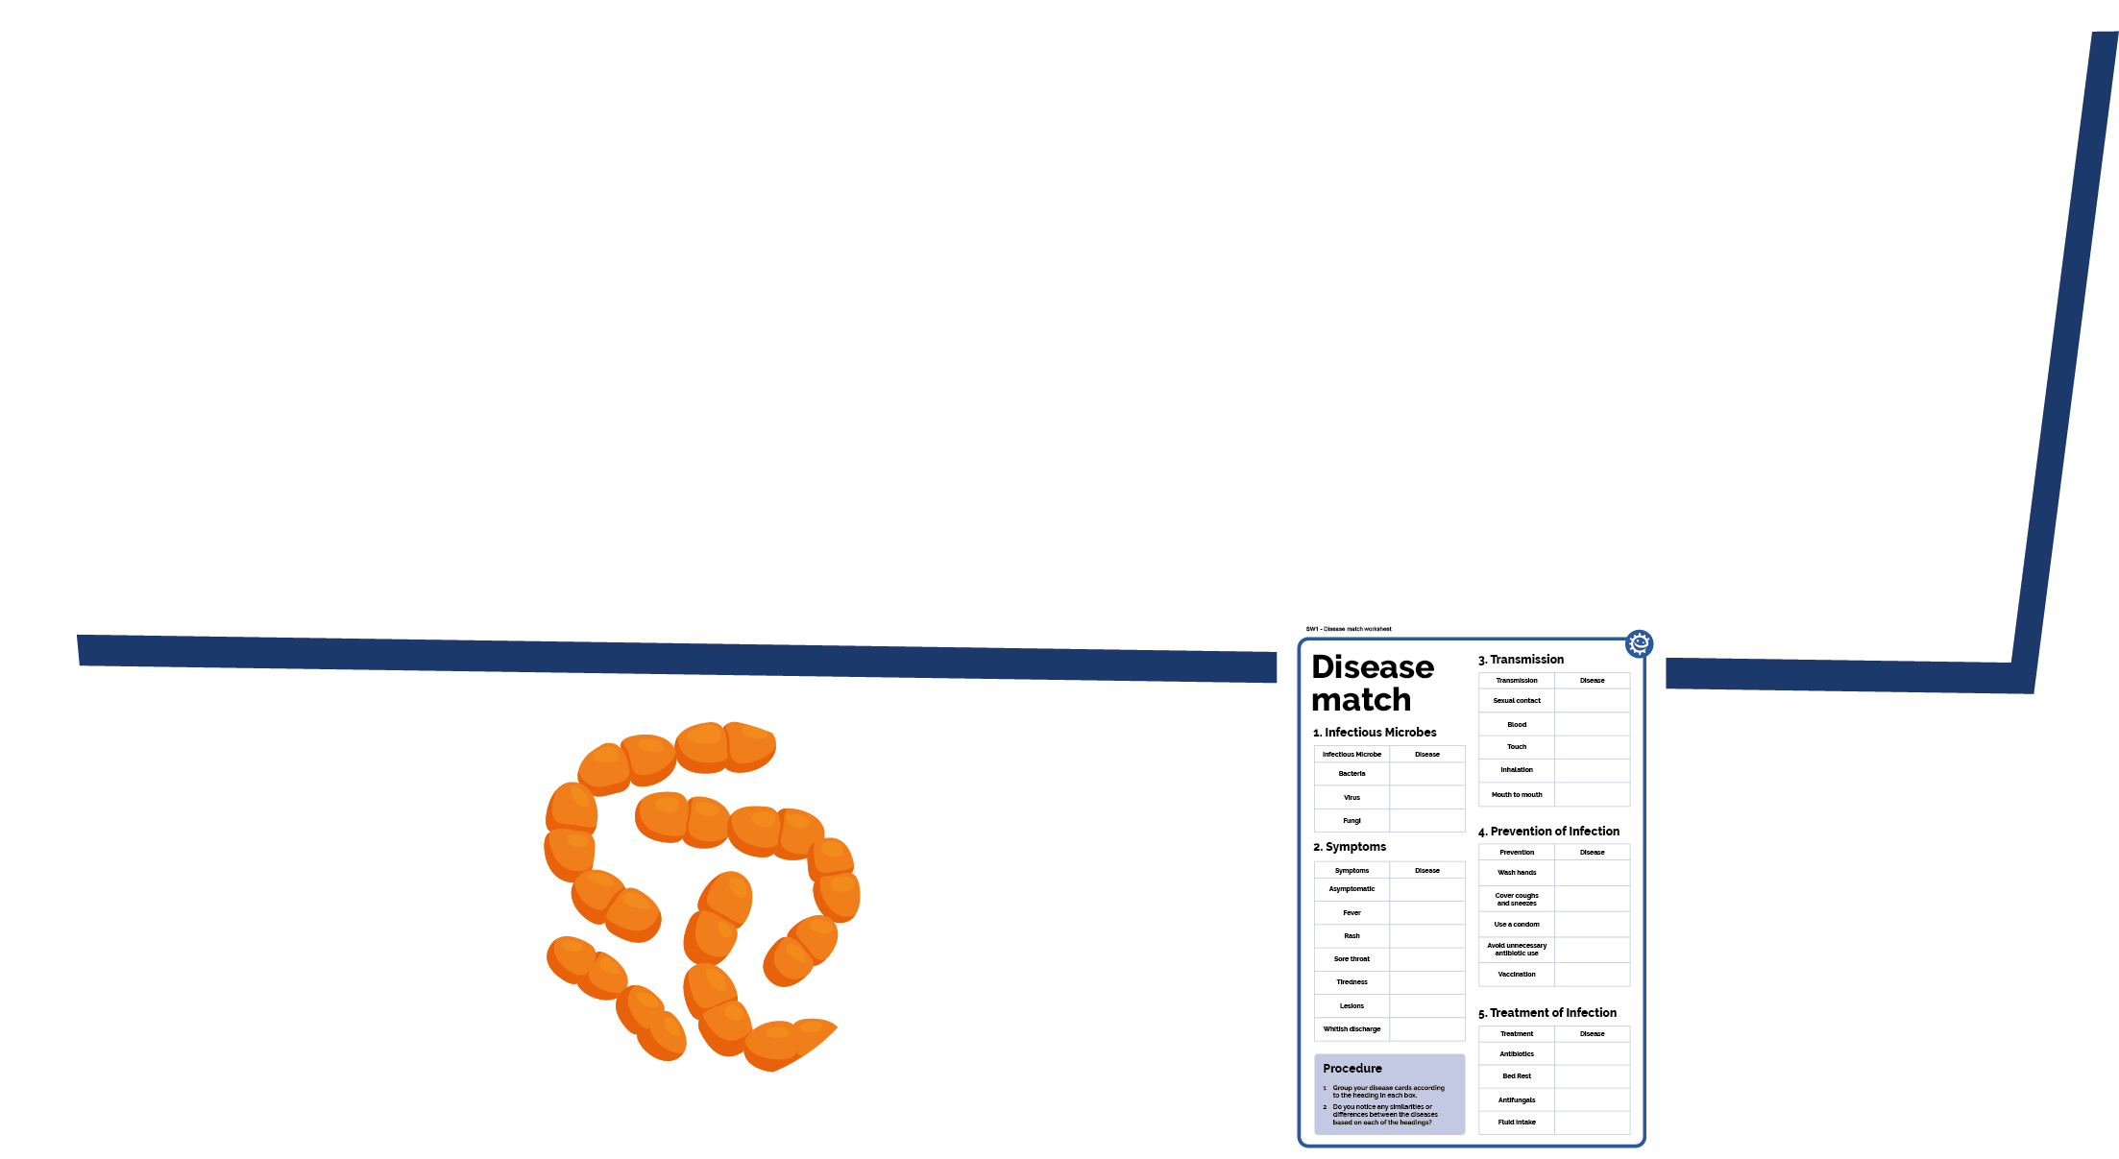
Disease Match Steps
1. Discover the different types of infectious diseases caused by harmful microbes and their characteristics
2. By working in groups, fill in the various subheadings (symptoms, transmission, treatment)
3. Present your results to the class

Slide 7
Discussion

Slide 8
Discussion Points
What is a disease?
What is an infectious disease?
Why do we see infectious diseases that used to be found in a single region, all over the world today?
Are all microbes harmful?

Slide 9
Disease Match Information (MRSA)
Disease Match Information
Methicillin Resistant Staphylococcus aureus (MRSA)
Infectious agent | Bacterium: Staphylococcus aureus
Symptoms | Asymptomatic in healthy individuals. Can cause skin infections, infect surgical wounds, the bloodstream, the lungs, or the urinary tract in previously ill patients.
Diagnosis | Swab and antibiotic sensitivity test.
Mortality rate | High – if not given the correct antibiotics.
Transmission | Contagious. Direct skin contact.
Prevention | Regular hand washing.
Treatment | Resistant to many antibiotics. While some antibiotics still work, MRSA is constantly adapting.
History | First reported 1961, increasing problem globally.

Slide 10
Disease Match Information (Measles)
Disease Match Information
Measles
Infectious agent | Virus: Paramyxovirus
Symptoms | Fever, runny nose, red and runny eyes, a cough, a red rash and a sore, swollen throat.
Diagnosis | Blood sample and antibody test.
Mortality rate | Low, but can be high in lower income countries, where treatment can be hard to access
Transmission | Contagious. Droplets from coughs and sneezes, skin contact or contact with objects that have the live virus on them.
Prevention | Prevention via vaccination.
Treatment | Bed rest and fluid intake.
History | Virus first reported 1911, has decreased dramatically in high and middle income countries in recent years although small epidemics do occur. Still a pandemic problem for low income countries.

Slide 11
Disease Match Information (Flu)
Disease Match Information
Flu
Infectious agent | Virus: Influenza
Symptoms | Headache, fever, chills, muscle aches; possibly sore throat, cough, chest pain.
Diagnosis | Blood sample and antibody test.
Mortality rate | Medium but higher in the very young and elderly.
Transmission | Highly contagious. Inhalation of viruses on airborne particles. Direct skin contact.
Prevention | Vaccination against current strains.
Treatment | Bed rest and fluid intake. Antivirals in the elderly.
History | Present for centuries, epidemics occur at regular intervals.

Slide 12
Disease Match Information (Thrush)
Disease Match Information
Thrush
Infectious agent | Fungus: Candida albicans
Symptoms | Itching, burning, soreness and white coating of the mouth or irritation of the vagina with a whitish discharge.
Diagnosis | Swab, microscopic examination and culturing.
Mortality rate | None.
Transmission | Person to person contact but is a normal part of the flora of the gut.
Prevention | Symptoms are caused by overgrowth of this fungus due to antibiotics killing off the normal protective bacteria. Therefore avoid unnecessary antibiotic use.
Treatment | Antifungals
History | Almost 75% of all women have had this infection at least once.

Slide 13
Disease Match Information (Chlamydia)
Disease Match Information
Chlamydia
Infectious agent | Bacterium: Chlamydia trachomatis
Symptoms | In many cases there are no symptoms but sometimes there is a discharge from the vagina or penis. Swollen testicles and inability to have children can also occur.
Diagnosis | Swab or urine sample for molecular testing.
Mortality rate | Rare
Transmission | Contagious through sexual contact.
Prevention | Use a condom during sexual intercourse.
Treatment | Antibiotics
History | First discovered in 1907. Global problem which is on the increase.

Slide 14
Disease Match Information (Meningitis)
Disease Match Information
Bacterial Meningitis
Infectious agent | Bacterium: Neisseria meningitidis
Symptoms | Headache, neck stiffness, high fever, irritability, delirium, rash.
Diagnosis | Spinal fluid sample and molecular testing.
Mortality rate | Medium – higher risk in the young and elderly.
Transmission | Contagious, through saliva and inhalation of droplets.
Prevention | Vaccination against many strains, avoid contact with infected patients.
Treatment | Penicillin, oxygen and fluids.
History | First identified as a bacteria in 1887. Regular epidemics in low income countries.

Slide 15
Disease Match Information (HIV)
Disease Match Information
HIV/AIDS
Infectious agent | Virus: Human immunodeficiency virus (HIV).
Symptoms | Failing immune system, pneumonia, lesions.
Diagnosis | Blood sample and antibody test.
Mortality rate | Medium – high in countries where access to HIV testing and anti-HIV drugs is limited
Transmission | Highly contagious. Sexual contact, blood to blood contact, sharing of needles, mother to new born transmission.
Prevention | Always wear a condom during sexual intercourse.
Treatment | There is no cure although anti-HIV drugs can prolong life expectancy.
History | First identified in 1983. Currently a global epidemic.

Slide 16
Disease Match Information (Glandular Fever)
Disease Match Information
Glandular Fever (Kissing Disease)
Infectious agent | Virus: Epstein Barr
Symptoms | Sore throats, swollen lymph glands, extreme tiredness.
Diagnosis | Blood sample and antibody test.
Mortality rate | Low
Transmission | Not very contagious. Direct contact such as kissing and sharing drinks.
Prevention | Avoid direct contact with infected patients.
Treatment | Bed rest and fluid intake, paracetamol can be used to relieve the pain.
History | First described in 1889, 95% population have had the infection, however, only 35% develop symptoms. Occasional isolated outbreaks.

Slide 17
Disease Match Information (Chickenpox)
Disease Match Information
Chickenpox
Infectious agent | Virus: Varicella-zoster
Symptoms | Blistering rash on the body and head.
Diagnosis | Blood sample and antibody test.
Mortality rate | Low
Transmission | Highly contagious. Direct skin contact or inhalation of droplets from sneezing and coughing.
Prevention | Prevention by vaccine.
Treatment | Bed rest and fluid intake, antivirals in some adult cases.
History | First identified in 1865. Decreased in countries where vaccination programmes have been implemented. No change elsewhere.

Slide 18
Disease Match Information - Measles
Disease Match Information
Measles
Microbe | Virus: Paramyxovirus
Symptoms | Fever, runny nose, red and runny eyes, a cough, a red rash and a sore, swollen throat.
Transmission | Spread in coughs and sneezes. Skin contact. Touching objects that have the live virus on them.
Prevention | Vaccination. Handwashing.
Treatment | Bed rest and fluid intake.

Slide 19
Disease Match Information - Flu
Disease Match Information
Flu
Microbe | Virus: Influenza
Symptoms | Headache, fever, chills, muscle aches; possibly sore throat, cough, chest pain.
Transmission | Spread in coughs and sneezes. Breathing in virus in the air. Touching objects that have the live virus on them.
Prevention | Vaccination against current strains.
Treatment | Bed rest and fluid intake. Antivirals in the elderly.

Slide 20
Disease Match Information - Thrush
Disease Match Information
Thrush
Microbe | Fungus: Candida albicans
Symptoms | Itching. Burning. Soreness. White coating of the mouth or irritation of the vagina with a whitish discharge.
Transmission | Person to person contact.
Prevention | The fungus that causes symptoms can grow better when our natural bacteria are killed off. Therefore avoid unnecessary antibiotic use.
Treatment | Antifungals

Slide 21
Disease Match Information - Chlamydia
Disease Match Information
Chlamydia
Microbe | Bacterium: Chlamydia trachomatis
Symptoms | In many cases there are no symptoms but sometimes there is a discharge from the vagina or penis. Swollen testicles. Inability to have children can also occur.
Transmission | Sexual contact.
Prevention | Use a condom during sexual intercourse.
Treatment | Antibiotics.

Slide 22
Disease Match Information - Chickenpox
Disease Match Information
Chickenpox
Microbe | Virus: Varicella-zoster
Symptoms | Blistering rash on the body and head.
Transmission | Direct skin contact. Spread in coughs and sneezes. Breathing virus in the air.
Prevention | Vaccination. Handwashing.
Treatment | Bed rest and fluid intake. Antivirals in some adult cases.

Slide 23
Disease Match Worksheet 1
Disease Match Worksheet
1.Infectious Microbe | Disease
Bacteria | Chlamydia
Virus | 1 2 3
Fungi | 1
Procedure:
1. Use the information sheets to find out with diseases should go in each empty box. This has been started for you.
2. Do you notice any similarities or differences between the disease?

Slide 24
Disease Match Worksheet 2
Disease Match Worksheet
2.Symptoms | Disease
Asymptomatic | 1
Fever | 1 2 3
Rash | 1 2
Sore throat | 1
White discharge | 1 2
3.Transmission | Disease
Sexual contact | 1 2
Touch | 1 2 3
Inhalation | 1 2 3
Mouth to mouth | 1

Slide 25
Disease Match Worksheet 3
Disease Match Worksheet
4. Prevention | Disease
Wash hands | 1 2 3
Cover coughs and sneezes | 1 2 3
Use a condom | 1 2
Avoid unnecessary antibiotic use | 1
Vaccination | 1 2 3
5. Treatment | Disease
Antibiotics | 1
Bed rest | 1 2 3
Antifungals | 1
Fluid intake | 1 2 3

Slide 26
Disease Match Worksheet 4
Disease Match Worksheet
1.Infectious Microbe | Disease
Bacteria
Virus
Fungi
Procedure:
1. Group your disease cards according to the heading in each box.
2. Do you notice any similarities or differences between the diseases based on each of the headings?

Slide 27
Disease Match Worksheet 5
Disease Match Worksheet
2.Symptoms | Disease
Asymptomatic
Fever
Rash
Sore throat
Tiredness
Lesions
White discharge
3.Transm-ission | Disease
Sexual contact
Blood
Touch
Inhalation
Mouth to mouth

Slide 28
Disease Match Worksheet 6
Disease Match Worksheet
4. Prevention | Disease
Wash hands
Cover coughs and sneezes
Use a condom
Avoid unnecessary antibiotic use
Vaccination
5. Treatment | Disease
Antibiotics
Bed rest
Antifungals
Fluid intake

Slide 29
Disease Match Worksheet 1 - Answers
Disease Match Worksheet - Answers
1.Infectious Microbe | Disease
Bacteria | Chlamydia
Virus
Fungi
Procedure:
1. Use the information sheets to find out with diseases should go in each empty box. This has been started for you.
2. Do you notice any similarities or differences between the disease?
Chickenpox Flu
Measle
Thrush

Slide 30
Disease Match Worksheet 2 - Answers
Disease Match Worksheet - Answers
2.Symptoms | Disease
Asymptomatic
Fever
Rash
Sore throat
White discharge
3.Transmission | Disease
Sexual contact
Touch
Inhalation
Mouth to mouth
Chlamydia
Chlamydia
Thrush
Chickenpox Flu
Measles
Chickenpox Flu
Measles
Chickenpox
Measles
Chickenpox Flu
Measles
Flu
Chlamydia
Thrush
Flu

Slide 31
Disease Match Worksheet 3 - Answers
Disease Match Worksheet - Answers
4. Prevention | Disease
Wash hands
Cover coughs and sneezes
Use a condom
Avoid unnecessary antibiotic use
Vaccination
5. Treatment | Disease
Antibiotics
Bed rest
Antifungals
Fluid intake
Chickenpox Flu
Measles
Chlamydia
Chickenpox Flu
Measles
Chickenpox Flu
Measles
Chlamydia
Thrush
Thrush
Thrush
Chickenpox Flu
Measles
Chickenpox Flu
Measles

Slide 32
Disease Match Worksheet 4 - Answers
Disease Match Worksheet - Answers
1.Infectious Microbe | Disease
Bacteria
Virus
Fungi
Procedure:
1. Group your disease cards according to the heading in each box.
2. Do you notice any similarities or differences between the diseases based on each of the headings?
Bacterial meningitis,
Chlamydia, MRSA
HIV, Chickenpox, Flu, Measles, Glandular fever
Thrush

Slide 33
Disease Match Worksheet 5 - Answers
Disease Match Worksheet - Answers
2.Symptoms | Disease
Asymptomatic
Fever
Rash
Sore throat
Tiredness
Lesions
White discharge
3.Transm-ission | Disease
Sexual contact
Blood
Touch
Inhalation
Mouth to mouth
Chlamydia, MRSA
Flu, Measles,
Chickenpox, Bacterial meningitis
Chlamydia, HIV, Thrush
Bacterial meningitis,
Chickenpox, Measles
HIV, Bacterial meningitis
Flu,
Glandular fever
Flu, Measles, Chickenpox, MRSA
Glandular fever
Flu, Measles,
Chickenpox, Bacterial meningitis
HIV
Flu, Glandular fever
Chlamydia, Thrush

Slide 34
Disease Match Worksheet 6 - Answers
Disease Match Worksheet - Answers
4. Prevention | Disease
Wash hands
Cover coughs and sneezes
Use a condom
Avoid unnecessary antibiotic use
Vaccination
5. Treatment | Disease
Antibiotics
Bed rest
Antifungals
Fluid intake
Flu, Measles,
Chickenpox, MRSA,
Bacterial meningitis
Chlamydia, Bacterial meningitis, MRSA
Flu, Measles,
Chickenpox, Bacterial meningitis
Chickenpox, Glandular fever, Measles, Flu
Chlamydia, HIV,
Thrush
Thrush,
MRSA
Thrush
Chickenpox, Glandular fever, Measles, Flu
Flu, Chickenpox, Measles

Slide 35
Fascinating Fact
According to the WHO, the top 10 causes of death in 2019 accounted for 55% of the 55.4 million deaths worldwide. Four out of ten were caused by infectious diseases.

Slide 36
Learning Consolidation

Slide 37
Write a paragraph or three statements to summarise what you have learned during the lesson.


