Slide 1
Micro-organisms:
Introduction to Microbes
Key Stage 3

Slide 2
Learning Intention
All pupils will:
Develop an understanding of the different types of microbes, their presence in various environments, their varying sizes and the role of useful bacteria in the human body.

Slide 3
Northern Ireland Curriculum Links
Curriculum Key Elements
Personal Health and Moral Character
Curriculum Skills
Communication, Managing Information, Thinking, Problem Solving and Decision-Making, Working with others
Curriculum Areas of Learning
Learning for Life and Work (Personal Development: Personal Health), Science and Technology (Science: Organisms and Health)

Slide 4
What are Microbes? (1/2)
What are Microbes?
Micro-organisms, sometimes called microbes, germs or bugs, are living things but are too small to be seen with our eyes; they can only be seen through a microscope.
Microbes are the smallest living creatures on Earth and that the word micro-organism literally translates into micro: small and organism: life. Microbes are so small they cannot be seen without the use of a microscope.
Antonie van Leeuwenhoek created the first microscope in 1676. He used it to examine various items around his home and termed the living creatures (bacteria) he found on scrapings from his teeth ‘animalcules’.

Slide 5
What are Microbes? (2/2)
What are Microbes?
There are three different types of microbe: bacteria, viruses and fungi.
Some microbes cause disease, but there are also useful microbes. Examples of some benefits of useful microbes are: Lactobacillus in yoghurt, probiotic bacteria in our gut which aid digestion and the fungus Penicillium which produces the antibiotic penicillin.
Microbes can be found EVERYWHERE – floating around in the air we breathe, on the food we eat, in the water we drink and on the surface of and in our bodies. Although there are harmful microbes that can make us ill, there are many more useful microbes that we can use.

Slide 6
Main Activity:
Microbe Mayhem

Slide 7

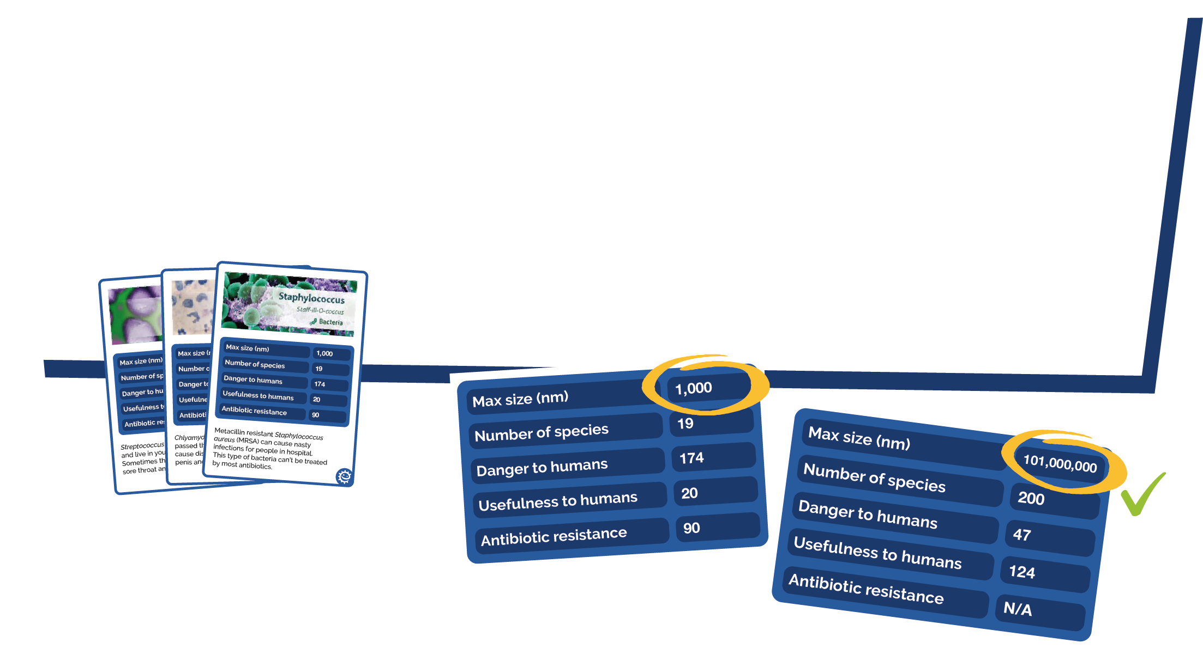
Microbe Mayhem Instructions
1. Shuffle the deck and deal the cards to players
2. Make sure only you can see your cards
3. Take turns to choose which microbe characteristic you want to battle others with
4. The player with the highest characteristic score wins the round!

Slide 8
Microbe Mayhem Cards

Slide 9






Microbe Mayhem Cards 1
Staphylococcus
Staff-ill-O-coccus
Bacterium
Chlamydia
Clam-id-E-A
Bacterium
Streptococcus
Strep-Toe-Coccus
Bacterium
Max size (nm)
1,000
Max size (nm)
1,000
Max size (nm)
1,000
Number of species
19
Number of species
3
Number of species
21
Danger to humans
174
Danger to humans
37
Danger to humans
50
Usefulness to humans
20
Usefulness to humans
1
Usefulness to humans
75
Antibiotic resistance
90
Antibiotic resistance
70
Antibiotic resistance
50
Meticillin resistant Staphylococcus aureus (MRSA) are a type of Staphylococcus aureus that have mutated to become resistant to most antibiotics. They can cause severe infection in humans.
Chlamydia is a sexually transmitted infection (STI) that is caused by the bacteria Chlamydia trachomatis. Although symptoms are generally mild i.e. discharge from the penis or vagina, it can lead to infertility.
Many Streptococcus species are
harmless to humans and are the normal flora of the mouth and hands. However, Group A Streptococcus bacteria cause about 15% of sore throats.
Lactobacillus
Lac-Toe-Ba-Sil-Us
Bacterium
Escherichia coli
Esh-Er-lc-E-Ah
Bacterium
Treponema
Trep-O-Nee-Ma
Bacterium
Max size (nm)
1,500
Max size (nm)
2,000
Max size (nm)
2,000
Number of species
125
Number of species
7
Number of species
3
Danger to humans
0
Danger to humans
70
Danger to humans
115
Usefulness to humans
195
Usefulness to humans
184
Usefulness to humans
8
Antibiotic resistance
10
Antibiotic resistance
80
Antibiotic resistance
50
Lactobacilli are very common and usually harmless to humans; they make up a small portion of the gut flora. These bacteria have been extensively used in the food industry - in yoghurt and cheese making.
Many strains of E. coli are harmless, and huge numbers are present in the human and animal gut. In some cases, however, E. coli cause both urinary infections and food poisoning.
Syphilis is an extremely contagious disease, caused by Treponema bacteria. In severe cases syphilis can lead to brain damage or death. Syphilis can be cured with antibiotics however resistant strains are becoming more frequent.

Slide 10






Microbe Mayhem Cards 2
Salmonella
Sam-on-ella
Bacterium
Tinea
Tin-Ee-A
Fungus
Stachybotrys
Stack-Ee-Bo-Trys
Fungus
Max size (nm)
1,000
Max size (nm)
110,000
Max size (nm)
72,000
Number of species
3
Number of species
12
Number of species
2
Danger to humans
89
Danger to humans
43
Danger to humans
83
Usefulness to humans
15
Usefulness to humans
14
Usefulness to humans
2
Antibiotic resistance
60
Antibiotic resistance
n/a
Antibiotic resistance
n/a
Salmonella are most commonly known for causing food poisoning. Symptoms range from vomiting to diarrhoea. Salmonella is becoming resistant to antibiotics with an estimated 6,200 resistant cases per year in the US.
Although a variety of fungi can cause foot rashes, Tinea cause the itchy, cracked skin between toes known as Athlete’s foot, which is the most common fungal skin infection. Athlete’s foot affects nearly 70% of the population.
Stratchybotrys (or straw mould) is a black toxic fungus that although itself is not pathogenic, it does produce a number of toxins that can cause rashes or life threatening reactions for those with respiratory problems.
Pseudomonas
Sued-O-Moan-Us
Bacterium
Verticillium
Ver-Tee-Sil-Ee-Um
Fungus
Aspergillus
Ass-Per-Gill-Us
Fungus
Max size (nm)
5,000
Max size (nm)
8,500,00
Max size (nm)
101,00,000
Number of species
126
Number of species
4
Number of species
200
Danger to humans
50
Danger to humans
1
Danger to humans
47
Usefulness to humans
150
Usefulness to humans
18
Usefulness to humans
124
Antibiotic resistance
90
Antibiotic resistance
n/a
Antibiotic resistance
n/a
Pseudomonas are one of the most common microbes found in almost all environments. Although some may cause disease in humans, other species are involved in decomposition. Some Pseudomonas species are becoming resistant to multiple antibiotic treatment.
Verticillium is a widely distributed fungus that inhabits decaying vegetation and soil. Some may be pathogenic to insects, plants, and other fungi but very rarely cause human disease.
Aspergillus is both beneficial and harmful to humans. Many are used in industry and medicine. It accounts for over 99% of global citric acid production and is a component of medications which manufacturers claim can decrease flatulence!

Slide 11






Microbe Mayhem Cards 3
Penicillium
Pen-Ee-Sil-Ee-Um
Fungus
Saccharomyces
Sac-A-Row-My-Sees
Fungus
Influenza A
In-Flu-En-Za A
Virus
Max size (nm)
332,000
Max size (nm)
1,000
Max size (nm)
90
Number of species
16
Number of species
19
Number of species
1
Danger to humans
64
Danger to humans
1
Danger to humans
146
Usefulness to humans
198
Usefulness to humans
184
Usefulness to humans
12
Antibiotic resistance
n/a
Antibiotic resistance
n/a
Antibiotic resistance
n/a
Penicillium is a fungus that naturally produces the antibiotic penicillin. Since this discovery, the antibiotic has been mass produced to fight bacterial infections. Unfortunately, due to its overuse many bacterial species have become resistant to this antibiotic
For at least 6,000 years, Saccharomyces cerevisiae (Brewers yeast) has been used to make beer and bread! It is also used to make wine and it is widely used in biomedical research. One yeast cell can turn into 1,000,000 in only six hours.
The flu is an infection caused by Orthomyxoviridae. Every year 5 – 40% of the population get the flu but most people recover completely in a couple of weeks.
Cryptococcus
Cryp-Toe-Coccus
Fungus
Candida
Can-Did-a
Fungus
Simplex Virus
Sim-Plex Virus
Virus
Max size (nm)
7,500
Max size (nm)
10,000
Max size (nm)
200
Number of species
37
Number of species
44
Number of species
2
Danger to humans
98
Danger to humans
74
Danger to humans
64
Usefulness to humans
37
Usefulness to humans
175
Usefulness to humans
2
Antibiotic resistance
n/a
Antibiotic resistance
n/a
Antibiotic resistance
n/a
Cryptococcus is a fungus which grows as a yeast. It is known for causing a severe form of meningitis in people with HIV/AIDS. The majority of Cryptococci live in the soil and are not harmful to humans.
Candida is naturally found living in the human mouth and gastrointestinal tract. Under normal circumstances these fungi live in 80% of the human population with no harmful effects, although overgrowth results in candidiasis (Thrush).
Herpes simplex is one of the oldest known sexually transmitted infections. In many cases, Herpes infections produce no symptoms, but scab-like symptoms do occur in about one third of people infected.

Slide 12






Microbe Mayhem Cards 4
Neisseria
Nai–sheer–e-a
Bacterium
Mycobacterium
My–co–back–tear–e–um
Bacterium
Tobamovirus
Tob-A-Mo-Virus
Virus
Max size (nm)
800
Max size (nm)
4,000
Max size (nm)
18
Number of species
13
Number of species
5
Number of species
125
Danger to humans
120
Danger to humans
150
Danger to humans
12
Usefulness to humans
0
Usefulness to humans
0
Usefulness to humans
34
Antibiotic resistance
20
Antibiotic resistance
100
Antibiotic resistance
n/a
Neisseria meningitidis is a bacterium that can cause meningitis, a life threatening disease. A vaccine is available to protect against the 4 main types of this bacteria A, C, W and Y.
Tuberculosis (TB) is caused by the bacterium Mycobacterium tuberculosis and is one of the top 10 causes of death worldwide. Although treatable with antibiotics, many strains of TB are becoming resistant to multiple antibiotics.
Tobamovirus are a group of viruses that infect plants, the most common being tobacco mosaic virus, which infects tobacco and other plants. This virus has been very useful in scientific research.
Filovirus
File-o-vi-rus
Virus
Lymphocryptovirus
Lim-Foe-Cryp-Toe-Virus
Virus
Lyssavirus
Lice-A-Virus
Virus
Max size (nm)
1,500
Max size (nm)
110
Max size (nm)
180
Number of species
1
Number of species
7
Number of species
10
Danger to humans
200
Danger to humans
37
Danger to humans
74
Usefulness to humans
0
Usefulness to humans
2
Usefulness to humans
5
Antibiotic resistance
n/a
Antibiotic resistance
n/a
Antibiotic resistance
n/a
Filovirus causes a disease more commonly known as Ebola. It is one of the more dangerous viruses known to humans. 25 – 90% of victims died from the disease before the development and approval of a vaccine in 2019.
The Epstein-Barr virus, a type of Lymphocryptovirus, causes an illness known as the Kissing Disease or Glandular fever. Symptoms include sore throats and extreme tiredness. Transmission requires close contact such as kissing.
The Lyssavirus infect both plants and animals. The most common Lyssavirus is the Rabies virus and is usually associated with dogs. Rabies results in over 55,000 deaths worldwide every year but can be prevented by vaccination.

Slide 13






Microbe Mayhem Cards 5
Varicellovirus
Var-E-Cell-O-Virus
Virus
Norovirus
Nor-o-virus
Virus
HIV
HIV
Virus
Max size (nm)
200
Max size (nm)
35
Max size (nm)
120
Number of species
2
Number of species
8
Number of species
2
Danger to humans
21
Danger to humans
25
Danger to humans
150
Usefulness to humans
7
Usefulness to humans
0
Usefulness to humans
0
Antibiotic resistance
n/a
Antibiotic resistance
n/a
Antibiotic resistance
n/a
Chickenpox is caused by the Varicella-Zoster virus. It is highly contagious although rarely serious and is spread through direct contact (or coughing and sneezing). Almost everyone caught chickenpox in their childhood prior to the discovery of the chickenpox vaccine.
Norovirus, known as the winter vomiting bug, is the most common cause of gastroenteritis causing symptoms of diarrhoea , vomiting and stomach pain. The virus is highly contagious and can be prevented through hand washing and disinfection.
The human immunodeficiency virus (HIV) is a sexually transmitted infection (STI) which leads to acquired immunodeficiency syndrome (AIDS). Individuals with this condition are more at risk of infection and cancer
Zika
Zee-ka
Virus
Papillomavirus
Pap-ill-O-Ma-virus
Virus
Rhinovirus
Rhino-Virus
Virus
Max size (nm)
40
Max size (nm)
55
Max size (nm)
25
Number of species
1
Number of species
170
Number of species
2
Danger to humans
98
Danger to humans
130
Danger to humans
28
Usefulness to humans
0
Usefulness to humans
0
Usefulness to humans
14
Antibiotic resistance
n/a
Antibiotic resistance
n/a
Antibiotic resistance
n/a
The zika virus is spread by mosquitoes. Zika can be passed from a pregnant woman to her foetus. Infection during pregnancy can cause certain birth defects. There is no vaccine or medicine for Zika.
Human papillomavirus (HPV) is a sexually transmitted infection (STI) which can cause genital warts. It is the most common cause of cervical cancer in women but there is now a vaccine available for teenagers which protects against this.
There are over 250 different kinds of cold viruses but Rhinovirus is by far the most common. Rhinovirus can survive three hours outside someone’s nose. If it gets on your fingers and you rub your nose, you’ve caught it!

Slide 14
Discussion

Slide 15
Discussion Points
Why are bacteria on our bodies important?
Where microbes can be found?
Are all microbes harmful?
What are different types of microbes?
Which of those is the smallest?

Slide 16
Extension Activities

Slide 17

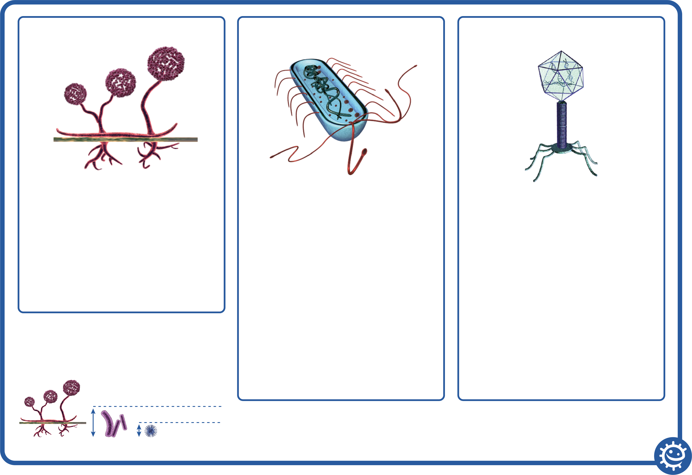
How Big is a Microbe?
Microbe size
Fungi 100x
Bacteria 20x
Viruses 1x

Slide 18
How Big is a Microbe? (Fungi)
How Big is a Microbe?
Sporangia
Fungi
Sporangi-
ophore
Sporangia:
Spore producing body.
Sporangiophore:
Filamentous stalk on which the sporangium forms.
Rhizoids:
The sub-surface hyphae are specialized for food absorption.
Rhizoids

Slide 19
How Big is a Microbe? (Bacteria)
How Big is a Microbe?
Bacteria are free living and are found everywhere
Chromosome:
Genetic material (DNA) of the cell.
Cell wall:
The cell wall is made of peptidoglycan and maintains the overall shape of a bacterial cell.
Cell membrane:
Lining the inside of the cell wall providing a boundary for the contents of the cell and a barrier to substances entering and leaving.
Cytoplasm:
Jelly like substance inside of the cell
holding the contents.
Bacteria
Cell membrane
Chromosome
Cell wall
Cytoplasm

Slide 20
How Big is a Microbe? (Viruses)
How Big is a Microbe?
Viruses
Viruses are NOT free living – they MUST live inside another living cell/organism
Capsid:
Double lipid layer holding the cells
genetic material.
Glycoproteins:
These serve 2 purposes:
Anchor the virus to the host cell.
Transport genetic material from the
virus to the host cell.
Nucleic acid:
Either DNA or RNA material, but viruses rarely contain both. Most viruses contain RNA material.
Capsid
Nucleic acid
Glycoproteins

Slide 21
Microbes Quiz 1
Microbes Quiz
Which of these are microbes?
(3 points)
Bacteria
Virus
Antibiotic
Fungi
Microbes are found:
(1 point)
In the air
On our hands
On surfaces
Everywhere

Slide 22
Microbes Quiz 2
Microbes Quiz
Which foods or drinks are
produced through the growth of microbes?
(4 points)
Cheese
Bread
Yogurt
Fizzy drinks
What is another word for
a harmful microbe?
(1 point)
Infectious
Antibiotic
Pathogen
Flora

Slide 23
Microbes Quiz 3
Microbes Quiz
Which is the smallest?
(1 point)
Bacterium
Virus
Fungus
They are all the same size
Microbes:
(1 point)
Are all harmful
Are all useful
Can be harmful or useful
Have no effect on the
human body

Slide 24
Microbes Quiz 4
Microbes Quiz
Which of these microbes
causes the common cold?
(1 point)
Bacteria
Virus
Antibiotic
Which of these are
shapes of microbes?
(1 point)
Rods
Balls
Spirals
All of the above

Slide 25
Microbes Quiz 1 - Answers
Microbes Quiz - Answers
Which of these are microbes?
(3 points)
Bacteria
Virus
Antibiotic
Fungi
Microbes are found:
(1 point)
In the air
On our hands
On surfaces
Everywhere
✓
✓
✓
✓

Slide 26
Microbes Quiz 2 - Answers
Microbes Quiz - Answers
Which foods or drinks are
produced through the growth of microbes?
(4 points)
Cheese
Bread
Yogurt
Fizzy drinks
What is another word for
a harmful microbe?
(1 point)
Infectious
Antibiotic
Pathogen
Flora
✓
✓
✓
✓
✓

Slide 27
Microbes Quiz 3 - Answers
Microbes Quiz - Answers
Which is the smallest?
(1 point)
Bacterium
Virus
Fungus
They are all the same size
Microbes:
(1 point)
Are all harmful
Are all useful
Can be harmful or useful
Have no effect on the
human body
✓
✓

Slide 28
Microbes Quiz 4 - Answers
Microbes Quiz - Answers
Which of these microbes
causes the common cold?
(1 point)
Bacteria
Virus
Antibiotic
Which of these are
shapes of microbes?
(1 point)
Rods
Balls
Spirals
All of the above
✓
✓

Slide 29
Learning Consolidation

Slide 30
Present Your Posters to the Class


