Slide 1
Micro-organisms:
Useful Microbes
Key Stage 3

Slide 2
Learning Intention
All pupils will:
• Understand the beneficial roles of microbes, including how bacterial colonisation supports a healthy body and the importance of protecting our natural microbial flora.

Slide 3
Northern Ireland Curriculum Links
Curriculum Key Elements
Personal Health and Moral Character
Curriculum Skills
Communication, Managing Information, Thinking, Problem Solving and Decision-Making, Working with others
Curriculum Areas of Learning
Learning for Life and Work (Personal Development: Personal Health), Science and Technology (Science: Organisms and Health)

Slide 4
What are Useful Microbes? (1/2)
What are Useful Microbes?
There are millions of different species of microbes and that most of these are completely harmless to humans; some are actually very useful to us.
There are ways in which we use microbes to our advantage, for examples, Penicillium (fungus) to make antibiotics; some microbes break down dead animals and plant material to make compost; some microbes help us digest foods and some are even used to turn milk into yoghurt, cheese and butter.
Bacteria and fungi, like us, are alive – they need a food source to grow and multiply. They vary in their food requirements but generally anything we consider food can be used as food by many microbes.

Slide 5
What are Useful Microbes? (2/2)
What are Useful Microbes?
Microbes also produce waste products and it is these waste products that can either be beneficial or harmful to humans. When milk turn sour; this may be seen as a problem to us, industry uses this process (fermentation) in making yoghurt.
Fermentation is a chemical change/process by which bacteria ‘eat’ sugars and produce acids and gas as waste. We use this process in the food industry to create wine, beer, bread, yoghurt and many more foodstuffs.
When making yoghurt, the bacteria added to milk consume the milk sugars, and through fermentation convert these sugars to lactic acid which causes the milk to thicken into a yoghurt.

Slide 6
Main Activity:
Yoghurt Experiment

Slide 7


Yoghurt Experiment Steps
1. Add 2 tbsp of powdered milk to a pint of whole milk
2. Stir the mixture while heating
4. Divide mixture into 2 labelled sterile beakers and add live yoghurt to one, and sterile yoghurt to the other
5. Heat and stir mixtures
6. Cover top of container and wait >9 hours
3. Cool mixture down

Slide 8

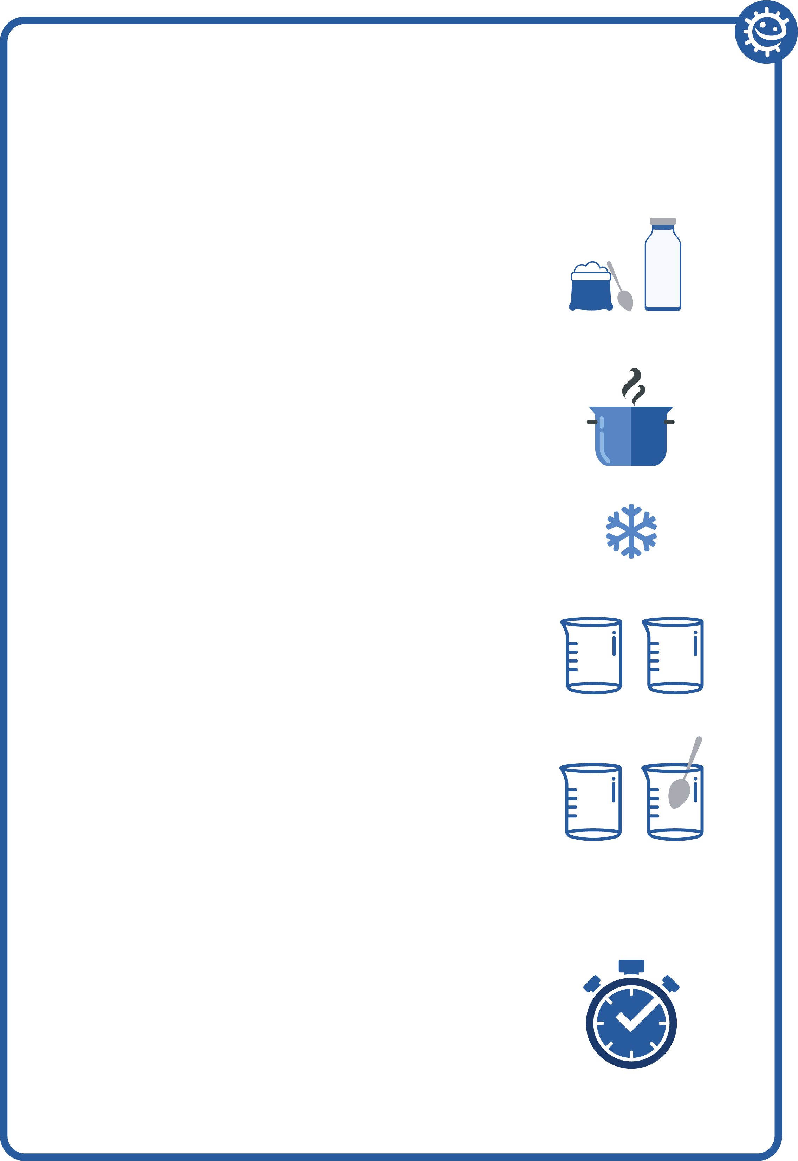
How to Make Yoghurt Instructions (1/2)
How to Make Yoghurt Instructions
Experiment
Add two tablespoons of powdered, skimmed milk to 500ml (one pint) of whole milk.
Bring the mixture to a boil over medium heat for 30 seconds, stirring constantly to kill any unwanted bacteria present. Take care it does not overflow!
Cool to 46-60°C.
Divide the cooled mixture into 2 sterile beakers and label test 1 and test 2.
Test 1 : add 1-2 teaspoons of live yoghurt
Test 2 : add 1-2 teaspoons of sterile yoghurt

Slide 9
How to Make Yoghurt Instructions (2/2)
How to Make Yoghurt Instructions
Experiment
5. Stir both mixtures well using a spoon previously sterilised by standing it in boiling water.
6. Cover each container with aluminium foil.
7. Incubate the mixtures at 32-43°C in a hot water bath, for 9-15 hours until desired firmness is reached.

Slide 10
Yoghurt Experiment Observations 1
Yoghurt Experiment Observations
Test 1 - Yoghurt | Before Incubation | After Incubation
What was the consistency of the mixture?
What did the mixture smell like?
What was the colour of the mixture?

Slide 11
Yoghurt Experiment Observations 2
Yoghurt Experiment Observations
Test 2 – Sterile Yoghurt | Before Incubation | After Incubation
What was the consistency of the mixture?
What did the mixture smell like?
What was the colour of the mixture?

Slide 12
Yoghurt Experiment Observations 3
Yoghurt Experiment Observations
How did the mixture change during fermentation?
__________________________________________________________________________________________________________________________________________
Test 3
How long did it take to make the yoghurt when the mixture was incubated at:
20°C - ____________
40°C - ____________

Slide 13
Yoghurt Experiment Conclusions 1
Yoghurt Experiment Conclusions
What caused the change from milk to yoghurt?
________________________________________________________________________________
What is this process called?
________________________________________________________________________________
Explain the difference in results in test 1 and test 2.
________________________________________________________________________________

Slide 14
Yoghurt Experiment Conclusions 2
Yoghurt Experiment Conclusions
4. What is the type and name of microbes which can be used to make yoghurt?
_________________________________________________
5. Why did it take longer to make yoghurt at 20°C than at 40°C?
___________________________________________________________________________________________________________________________________________________
6. A sterile spoon is used to stir the mixture (step 5) before incubating, what do you think might happen if a dirty spoon was used?
__________________________________________________________________________________________________

Slide 15
Yoghurt Experiment Observations 1 - Answers
Yoghurt Experiment Observations - Answers
Test 1 - Yoghurt | Before Incubation | After Incubation
What was the consistency of the mixture? | Runny liquid | Thick and creamy
What did the mixture smell like? | Like milk | Like rotting food
What was the colour of the mixture? | White | Cream / white

Slide 16
Yoghurt Experiment Observations 2 - Answers
Yoghurt Experiment Observations - Answers
Test 2 – Sterile Yoghurt | Before Incubation | After Incubation
What was the consistency of the mixture? | Runny liquid | Runny liquid (no change)
What did the mixture smell like? | Like milk | Like milk (no change)
What was the colour of the mixture? | White | White (no change)

Slide 17
Yoghurt Experiment Observations 3 - Answers
Yoghurt Experiment Observations - Answers
How did the mixture change during fermentation?
Answer:
During test 1 the mixture changed to a thicker creamier texture consistent with yoghurt, this was due to the lactic acid fermentation of the microbes present. No change was observed in the second test due to the lack of microbes present
Test 3
How long did it take to make the yoghurt when the mixture was incubated at:
20°C – Answer: approx. 3-5 days
40°C – Answer: overnight

Slide 18
Yoghurt Experiment Conclusions 1 - Answers
Yoghurt Experiment Conclusions - Answers
What caused the change from milk to yoghurt?
Answer: The microbes added to the milk converted the sugars to lactic acid which caused the milk to thicken into a yoghurt.
What is this process called?
Answer: Lactic acid fermentation.
Explain the difference in results in test 1 and test 2.
Answer: Everything in test 2 was sterile; therefore there were no microbes present to carry out lactic acid fermentation.

Slide 19
Yoghurt Experiment Conclusions 2 - Answers
Yoghurt Experiment Conclusions - Answers
4. What is the type and name of microbes which can be used to make yoghurt?
Answer: Bacteria of the genus Lactobacillus and Streptococcus.
5. Why did it take longer to make yoghurt at 20°C than at 40°C?
Answer: Bacteria prefer to grow at body temperature i.e. approx. 37° C, at 20° C it takes the bacteria longer to multiply therefore they are slower to produce the lactic acid.
6. A sterile spoon is used to stir the mixture (step 5) before incubating, what do you think might happen if a dirty spoon was used?
Answer: The resulting yoghurt may be contaminated with harmful microbes.

Slide 20
Discussion

Slide 21
Discussion Points
What is the process that caused a change in the milk?
What changes occurred as the mixture changed from milk to yoghurt and why did these changes occur?
Why was it important to keep the mixture warm overnight?
Why was it important to add some yoghurt to the milk mixture?
What happens when sterile yoghurt is added to the milk, and why?
What happens when the experiment goes wrong?

Slide 22
Extension Activities

Slide 23

Microscopic Yoghurt
Procedure
Test 1
Place a small drop of yoghurt onto one side of a glass microscope slide.
Taking a second clean slide, streak the yoghurt across the length of the slide creating a thin smear.
Leave the slide to air dry and then pass once through a Bunsen flame in order to heat fix the smear.
Cover the smear with a few drops of Methylene Blue and leave for 2 minutes.
Wash off any excess stain by running under a slow running tap.
Cover smear with a cover slip and examine the slide under a high powered microscope.
Record your observations below.
Test 2
Repeat steps 1-7 above using sterile yoghurt instead of live culture yoghurt.
How to prepare a smear:
1. Approach
2. Adhesion
3. Advancement

Slide 24
Microscopic Yoghurt
Observations
What did you see in the yoghurt smear?
__________________________________________________________________________________________________
What did you see in the sterile yoghurt smear?
__________________________________________________________________________________________________
What, in your opinion, caused the difference?
__________________________________________________________________________________________________

Slide 25
Microscopic Yoghurt - Answers
Observations
What did you see in the yoghurt smear?
__________________________________________________________________________________________________
What did you see in the sterile yoghurt smear?
__________________________________________________________________________________________________
What, in your opinion, caused the difference?
__________________________________________________________________________________________________
Your Observations

Slide 26
Poster design
Divide the class into groups of 3 or 4 pupils. Ask each group to create a poster. Choose a type of food that utilises microbes during production e.g. yoghurt, bread, beer, soy sauce, kombucha, salami, cheese, chocolate. Ask pupils to include
Type and name of the microbe used.
History of when this food was first produced.
How this food is produced?
Are there associated health benefits?
Class visit
As a fun alternative, pupils could visit a food room to observe fermentation in the making of ginger beer, bread, kombucha or even kimchi. This will support pupil understanding by providing further examples of how microbes can be useful.

Slide 27
Learning Consolidation

Slide 28
Discussion Question 1
Many microbes are useful and help us make foods like yoghurt or bread.
TRUE/FALSE?
TRUE

Slide 29
Discussion Question 2
Fermentation happens when microbes digest sugars, this is the process by which milk changed to yoghurt.
TRUE/FALSE?
TRUE

Slide 30
Discussion Question 3
Yoghurt contains bacteria including Lactobacilli and Streptococcus, meaning eating yoghurt is good for your gut health.
TRUE/FALSE?
TRUE

Slide 31
Present Your Posters to the Class


