Slide 1
Treatment of Infection:
Antibiotic Use and Antimicrobial Resistance
Key Stage 4

Slide 2
Learning Intention
All pupils will:
• Understand that antibiotics do not work on viruses, as bacteria and viruses have different structures.
• Understand that bacteria are continually adapting to develop ways of not being killed by antibiotics, this is called antibiotic resistance.
• Understand that taking antibiotics also affects your useful bacteria, not just the ones causing an infection.
• Understand that antibiotic resistant bacteria can be carried by healthy or ill people and passed onto others without knowing.
• Understand that antibiotic resistance spreads between different bacteria within our body.
• Understand that controlling antibiotic resistance is everyone’s responsibility including you.

Slide 3
Northern Ireland Curriculum Links
Curriculum Skills
Communication, Problem Solving, Working with Others
Areas of Learning
Learning for Life and Work (Personal Development statutory content)
Develop an understanding of how to maximise and sustain their own health and well-being, Recognise, assess, and manage risk in a range of real-life contexts.
Science and Technology (including relevant CCEA qualifications)
GCSE Biology, GCSE Science Double Award, GSCE Science Single Award

Slide 4
What are Antibiotics Used for? (1/2)
What are Antibiotics Used for?
Antibiotic is – a type of medicine that kills or stops bacteria increasing in number.
In 1928 Alexander Fleming went on holiday and left some laboratory agar plates from an unrelated experiment out on his desk. When he came back from holiday he discovered that the bacteria growing in his agar plates couldn’t grow near the mould that was also growing on the plate, he concluded that the mould had produced a chemical to protect itself from the bacteria using an antibacterial agent. Scientists used this new chemical to develop antibiotics.

Slide 5
What are Antibiotics Used for?
What are Antibiotics Used for? (2/2)
Before the development of antibiotics, such as during World War 2, people with injuries died from bacterial infections. Once antibiotics were being produced many deaths and diseases were prevented and surgeons were able to perform much more difficult operations, like hip replacements.
Antibiotics can kill our body’s useful bacteria (commensals) leaving our body open to harmful microbes (pathogens). One or two bacteria may change (mutate) so the antibiotic cannot kill them – these are antibiotic resistant bacteria.
Overuse and misuse of antibiotics has led to bacteria developing resistance to antibiotics through natural selection (survival of the fittest).

Slide 6
How Can Everyone Help to Prevent Antibiotic Resistance?
Only using antibiotics when prescribed by a health care professional (HCP).
Finishing your course of antibiotics as recommended by your HCP.
Not using left over antibiotics (if for any reason you don’t finish your course of antibiotics, any left over should be given to your local pharmacy to dispose of).
Not using antibiotics for most ear aches, sore throats or any colds or flu which are usually caused by viruses.

Slide 7
Main Activity:
Agar Experiment

Slide 8

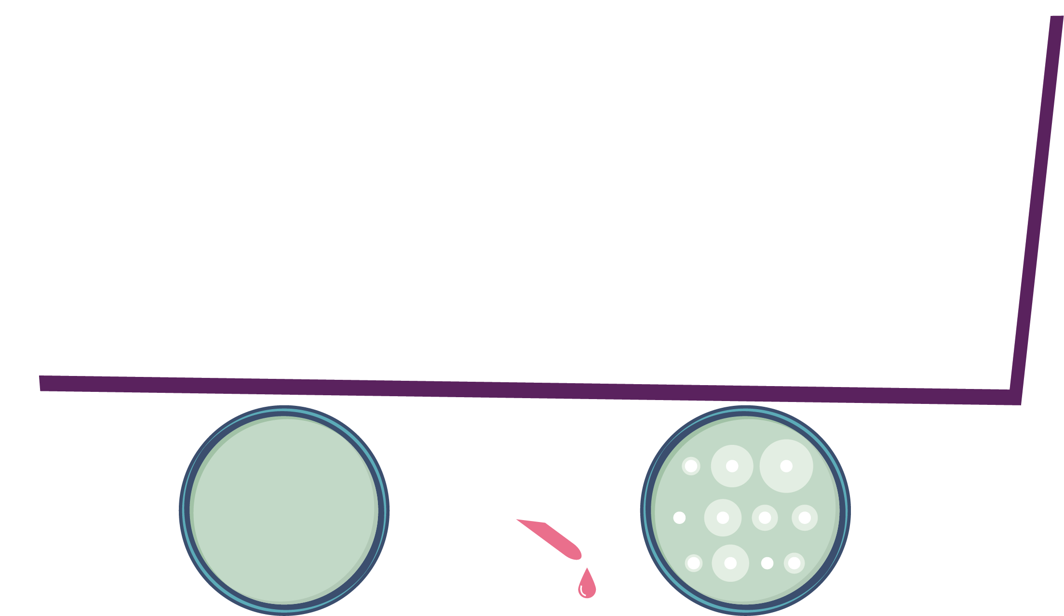
Agar Experiment Steps
Which antibiotic should be prescribed to each patient?
1. Place each agar plate on a sheet of white paper and label the boreholes (one per antibiotic).
2. Carefully and slowly use the pipette to drop antibiotics into the appropriately labelled hole until it is filled
3. Replace the lid on the Petri dish and leave for 5 mins
4. Measure the size of the decolourised zone (if present)
5. Record your findings on the worksheet

Slide 9



Agar Experiment Worksheet
Eva is on a summer work placement at the local hospital laboratory.
It is her job to read the test results and fill in the paperwork. Eva has missed up some of the test results.
Her results sheet shows the following:
Patient | Peni- cillin | Meti- cillin | Erythro- mycin | Vanco- mycin | Amoxi- cillin | Diagnosis
 |  |  |  |  |  | Influenza
 |  |  |  |  |  | Strep throat
 |  |  |  |  |  | Staphylococcus wound infection
 |  |  |  |  |  | MRSA
Sensitive – no zone of growth visible
Not sensitive – no zone visible
She has cultured the infectious organism isolated from each of the patients on agar plates and identified the diagnosis.
Can you repeat the antibiotic sensitivity test and match the patient to the results.

Slide 10
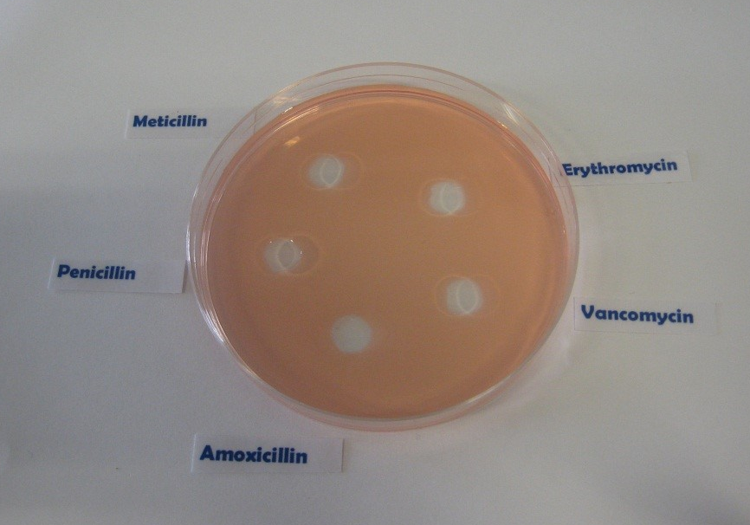
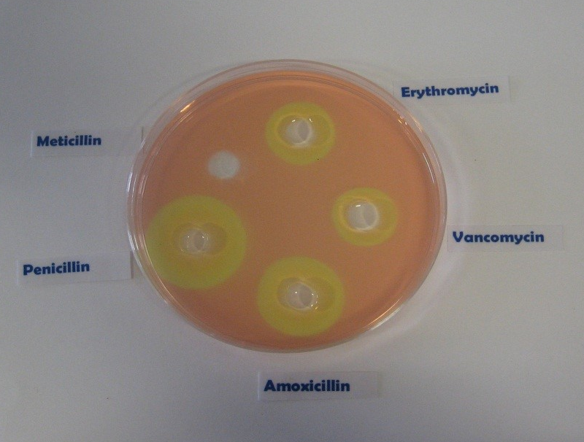
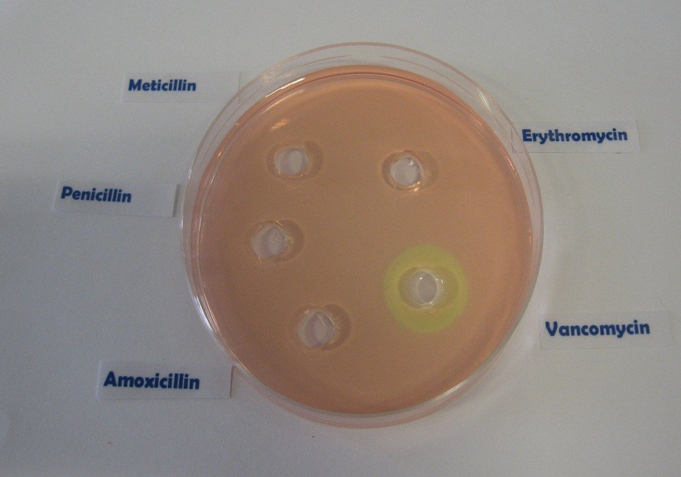
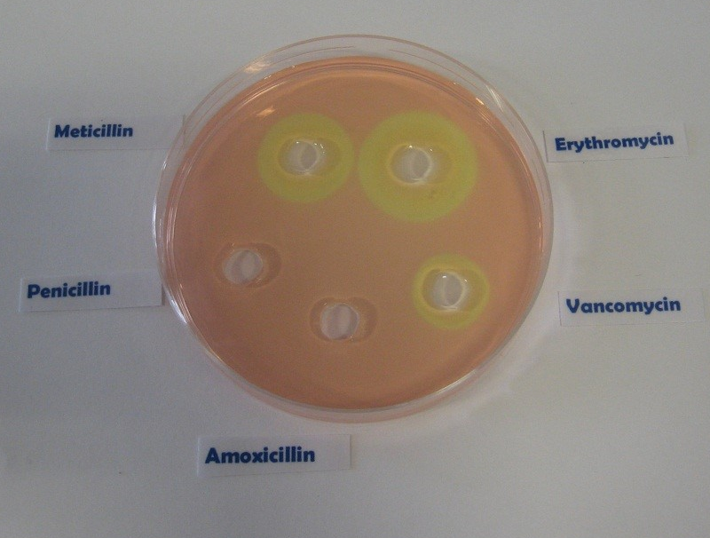
Antibiotic Sensitivity Test Results
Patient A
Patient B
Patient C
Patient D

Slide 11
Agar Experiment Worksheet: Patient A
In the results section below, record the results of your sensitivity test and identify which antibiotic you would recommend the doctor to prescribe.
Patient A___________________
Flu (Influenza virus) | Zone of Inhibition Size (mm)
Penicillin
Methicillin
Erythromycin
Vancomycin
Amoxicillin
Recommended antibiotic
_________________________________________________________

Slide 12
Agar Experiment Worksheet: Patient B
In the results section below, record the results of your sensitivity test and identify which antibiotic you would recommend the doctor to prescribe.
Patient B___________________
Strep Throat (Streptococcus) | Zone of Inhibition Size (mm)
Penicillin
Methicillin
Erythromycin
Vancomycin
Amoxicillin
Recommended antibiotic
_________________________________________________________

Slide 13
Agar Experiment Worksheet: Patient C
In the results section below, record the results of your sensitivity test and identify which antibiotic you would recommend the doctor to prescribe.
Patient C___________________
MRSA (Methicillin Resistant Staphylococcus aureus) | Zone of Inhibition Size (mm)
Penicillin
Methicillin
Erythromycin
Vancomycin
Amoxicillin
Recommended antibiotic
_________________________________________________________

Slide 14
Agar Experiment Worksheet: Patient D
In the results section below, record the results of your sensitivity test and identify which antibiotic you would recommend the doctor to prescribe.
Patient D___________________
Staph Wound Infection (Staphylococcus aureus) | Zone of Inhibition Size (mm)
Penicillin
Methicillin
Erythromycin
Vancomycin
Amoxicillin
Recommended antibiotic
_________________________________________________________

Slide 15
Agar Experiment Worksheet - Q1
Antibiotics don’t cure the cold or flu, what should the doctor recommend or prescribe to patient A to get better?
___________________________________________________________________________________________________________________________________________________________________________________________________________________________________________________________________________________________________________________________________________________________________________________________________

Slide 16
Agar Experiment Worksheet - Q2
2. Methicillin used to be used to treat a Staphylococcal infection, what would happen to Patient C’s infection if they had been prescribed Methicillin?
_____________________________________________________________________________________________________________________________________________________________________________________________________________________________________________________________________________________________________________________________________________________________________________________________________________________

Slide 17
Agar Experiment Worksheet - Q3
3. If you had some amoxicillin left over in your cupboard from a previous chest infection, would you take them later to treat a cut on your leg that got infected? Explain your answer.
________________________________________________________________________________________________________________________________________________________________________________________________________________________________________________________________________________________________________________________________________________________________________

Slide 18
Agar Experiment Worksheet - Q4
4. Patient D doesn’t want to take the prescribed flucloxacillin for their wound infection.
“I took more than half of those pills the doc gave me before and it went away for a while but came back worse.”
Can you explain why this happened?
______________________________________________________________________________________________________________________________________________________________________________________________________________________________________

Slide 19
Agar Experiment Worksheet: Patient Results
Eva is on a summer work placement at the local hospital laboratory.
It is her job to read the test results and fill in the paperwork. Eva has missed up some of the test results.
Her results sheet shows the following:
Patient | Peni- cillin | Meti- cillin | Erythro- mycin | Vanco- mycin | Amoxi- cillin | Diagnosis
 |  |  |  |  |  | Influenza
 |  |  |  |  |  | Strep throat
 |  |  |  |  |  | Staphylococcus wound infection
 |  |  |  |  |  | MRSA
A
B
C
D
Sensitive – no zone of growth visible
Not sensitive – no zone visible
She has cultured the infectious organism isolated from each of the patients on agar plates and identified the diagnosis.
Can you repeat the antibiotic sensitivity test and match the patient to the results.

Slide 20
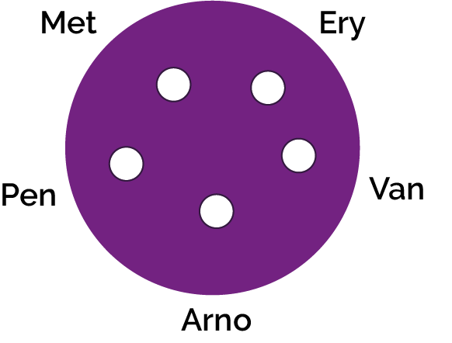
Agar Experiment Answers: Patient A
Patient A:
Influenza is caused by a virus as such none of the antibiotics will have an effect as antibiotics can only be used on bacterial infections.

Slide 21

Agar Experiment Worksheet Answers: Patient B
Patient B:
Sore throat infections are quite common and generally get better on their own. In sever cases, most antibiotics will treat this infection. Penicillin is the antibiotic of choice for this infection as the group of bacteria responsible (Streptococcus) have yet to develop a mechanism of resistance. Antibiotics should not be given unnecessarily for mild sore throats as 80% of sore throats are due to viruses and other bacteria can develop resistance during treatment.

Slide 22
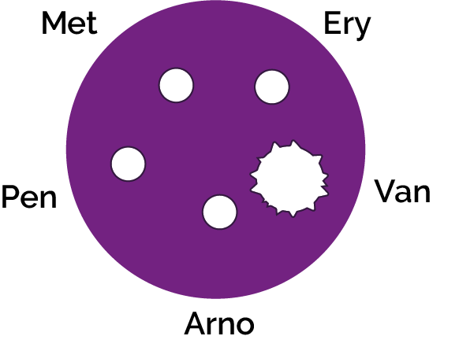
Agar Experiment Worksheet Answers: Patient C
Patient C:
Methicillin Resistant Staphylococcus aureus (MRSA) infections are becoming increasingly difficult to treat. These S.aureus bacteria have developed resistance to Methicillin, the previous antibiotic of choice. Vancomycin in one of the last lines of defence against these potentially fatal bacteria however some organisms have been detected with also show resistance to this.

Slide 23

Agar Experiment Worksheet Answers: Patient D
Patient D:
Penicillin was the first antibiotic discovered and produced, unfortunately many people viewed it as a ‘wonder drug’ and used it to treat many common infections. This resulted in the majority of Staphylococcal bacteria quickly developing resistance to this antibiotic. As ampicillin is a derivative of penicillin, Staphylococcus bacteria are resistant to this as well. Methicillin is the drug of choice for this sensitive Staphylococcus infection.

Slide 24
Agar Experiment Answers – Q1
Antibiotics don’t cure the cold or flu, what should the doctor recommend or prescribe to patient A to get better?
________________________________________________________________________________________________________________________________________________________________________________________________________________________________________________________________________________________________________________________________________________________
A) Antibiotics can be used to treat viral infections, the doctor should prescribe antibiotics.
B) Antibiotics can only be used to treat bacterial infections; the cold or flu is caused by a virus. The doctor should prescribe medicines to help with the symptoms.
C) The doctor should prescribe antifungals.

Slide 25
Agar Experiment Answers – Q2
2. Methicillin used to be used to treat a Staphylococcal infection, what would happen to Patient C’s infection if they had been prescribed Methicillin?
_______________________________________________________________________________________________________________________________________
A) Nothing. MRSA is resistant to antibiotics.
B) Patient C would have gotten better; their infection would have gone away.

Slide 26
Agar Experiment Answers – Q3
3. If you had some amoxicillin left over in your cupboard from a previous chest infection, would you take them later to treat a cut on your leg that got infected? Explain your answer.
________________________________________________________________________________________________________________________________________________________________________________________________________________________________________________________________________________________________________________________________________________________________________
__________________________________________________________________________________________
A) No, you should never use other people’s antibiotics or antibiotics which have been prescribed for a previous infection. There are many different types of antibiotics which treat different bacterial infections. Doctors prescribe specific antibiotics for specific illnesses and at a dose suitable for that patient. Taking someone else’s antibiotics may mean your infection does not get better.
B) No, you should get some new medicine.
C) Yes.

Slide 27
Agar Experiment Answers – Q4
4. Patient D doesn’t want to take the prescribed flucloxacillin for their wound infection.
“I took more than half of those pills the doc gave me before and it went away for a while but came back worse.”
Can you explain why this happened?
__________________________________________________________________________________________________________________________________________________________________________________________________________________________________________________________________________________________________________________________________
A) Patient D should not have taken their medicine.
B) Patient D should only have taken one pill.
C) It is very important to finish a course of prescribed antibiotics, not just stop halfway through. Failure to finish the course may result in not all the bacteria being killed and possibly becoming resistant to that antibiotic in future.

Slide 28
Activity 2:
Antibiotics ‘Right’ or ‘Wrong’?

Slide 29
Right or Wrong Q1 and Q2
Discuss Which of These Statements are Right or Wrong
1 He was coughing and sneezing everywhere. You would have thought the doctor would have given him antibiotics!
2 My doctor told me to
take my antibiotics for 5 days so that is what I did.

Slide 30
Right or Wrong Q3 and Q4
Discuss Which of These Statements are Right or Wrong
3. When my friend was ill, I gave her my old
antibiotics. I like helping my friends.
4. Antibiotics don’t help
coughs and colds; you
just need bed rest, lots
of fluids and eat healthily.

Slide 31
Right or Wrong Q5 and Q6
Discuss Which of These Statements are Right or Wrong
5 All drugs are bad for you. I can’t see the point in taking antibiotics.
6 My doctor gave me
antibiotics to take for 10 days but I feel better after 3 days so I’m going to stop taking them.

Slide 32
Right or Wrong Q7 and Q8
Discuss Which of These Statements are Right or Wrong
7 My headache and flu
symptoms are really
getting me down. I think I need antibiotics!
8 I don’t take antibiotics unless I really need them
as they might not work in the future.

Slide 33
Right or Wrong Answers – Q1 and Q2
Discuss Which of These Statements are Right or Wrong - Answers
Wrong
Most common infections that cause coughing and sneezing are caused by viruses, and will get better by themselves with bed rest and fluid intake. Antibiotics are not effective against viruses.
1 He was coughing and sneezing everywhere. You would have thought the doctor would have given him antibiotics!
Right
Antibiotics should be taken exactly as advised by your healthcare professional.
2 My doctor told me to
take my antibiotics for 5 days so that is what I did.

Slide 34
Right or Wrong Answers – Q3 and Q4
Discuss Which of These Statements are Right or Wrong - Answers
Wrong
You must not use other people’s or any leftover antibiotics.
Right
Most common infections that cause coughing and sneezing are caused by viruses, and will get better by themselves with bed rest and fluid intake. Antibiotics are not effective against viruses.
When my friend was ill, I gave her my old
antibiotics. I like helping my friends.
4 Antibiotics don’t help
coughs and colds; you
just need bed rest, lots
of fluids and eat healthily.

Slide 35
Right or Wrong Answers – Q5 and Q6
Discuss Which of These Statements are Right or Wrong - Answers
Wrong
Antibiotics can help severe bacterial infections such as pneumonia or kidney/ urine infections.
5 All drugs are bad for you. I can’t see the point in taking antibiotics.
Wrong
Antibiotics should be taken exactly as advised by your healthcare professional.
6 My doctor gave me
antibiotics to take for 10 days but I feel better after 3 days so I’m going to stop taking them.

Slide 36
Right or Wrong Answers – Q7 and Q8
Discuss Which of These Statements are Right or Wrong - Answers
Wrong
Antibiotics are not effective against headaches or viruses, such as the one that causes flu.
Right
If you over-use antibiotics they might not work when you really need them for a severe infection.
7 My headache and flu
symptoms are really
getting me down. I think I need antibiotics!
8 I don’t take antibiotics unless I really need them
as they might not work in the future.

Slide 37
Discussion

Slide 38
Discussion Points
Antibiotics don’t cure the cold or flu, what should the doctor recommend or prescribe to a patient to get better?
What would happen if a patient was prescribed an antibiotic to treat a bacterial infection, but the bacteria was resistant to that antibiotic?

Slide 39
Discussion Points (cont.)
Discussion Points
If you had some Penicillin left over in your cupboard from a previous sore throat, would you take them later to treat a cut on your leg that got infected? Explain your answer.
A patient doesn’t want to take the prescribed antibiotic for their wound infection. They say: ‘I took more than half of those pills the doc gave me before and the infection went away for a while but came back worse!’ Can you explain why this happened?

Slide 40
Extension Activity

Slide 41
Essay Writing
Write an essay based on the message from the e-Bug antibiotics animation and the common misconceptions you have learnt about during the lesson.
You should consider the following points:
What are the most common misconceptions around antibiotics and why might there be such widespread misunderstanding?
b. How would tackling common misconceptions around antibiotics help to slow or prevent the rise of resistance?
c. What methods or approaches should be used to tackle misconceptions?
d. Personal, family or friends’ experiences of antibiotics can also be included, such as why antibiotics were taken and if the user thought they may have been unnecessary. What would have helped in this situation?

Slide 42
Learning Consolidation

Slide 43
Antibiotics do not work on viruses, as bacteria and viruses have different structures.
True/False?
True

Slide 44
Bacteria are continually adapting to develop ways of not being killed by antibiotics, this is called antibiotic adaptation.
True/False?
False, it is called antibiotic resistance.

Slide 45
Antibiotic resistant bacteria can be carried by healthy or ill people and can be passed on silently to others.
True/False?
True

