Slide 1
Infection Prevention and Control (IPC):
Hand and Respiratory Hygiene
Key Stage 4

Slide 2
Learning Intention
All pupils will:
• Understand that infection can be spread through unclean hands.
• Understand that hand washing can prevent the spread of infection.
• Understand how pathogens can be transmitted.
• Understand that covering your mouth and nose with a tissue or your sleeve (not your hands) when you cough, or sneeze helps prevent the spread of infection.

Slide 3
Northern Ireland Curriculum Links
Curriculum Skills
Communication, Problem Solving, Working with Others
Areas of Learning
Learning for Life and Work (Personal Development statutory content)
Develop an understanding of how to maximise and sustain their own health and well-being, Recognise, assess, and manage risk in a range of real-life contexts.
Science and Technology (including relevant CCEA qualifications)
GCSE Biology, GCSE Home Economics, GCSE Science Double Award, GSCE Science Single Award

Slide 4
Why is it Important to Wash Hands and Cover Our Sneezes/Coughs with Tissue?
There are different ways in which microbes can be transmitted to people. Examples include through the food we eat, the water we drink and bathe in, the things we touch and from sneezing.
We wash our hands to wash away any microbes that might be on our hands; and if we didn’t wash away the microbes we might get ill. We use our hands all the time, and we pick up millions of microbes every day. Although many of these are harmless some could be harmful.
We spread our microbes to our friends and others through touch, and therefore we wash our hands to help prevent the spread of microbes.

Slide 5
Main Activity:
Toilet Paper Experiment

Slide 6

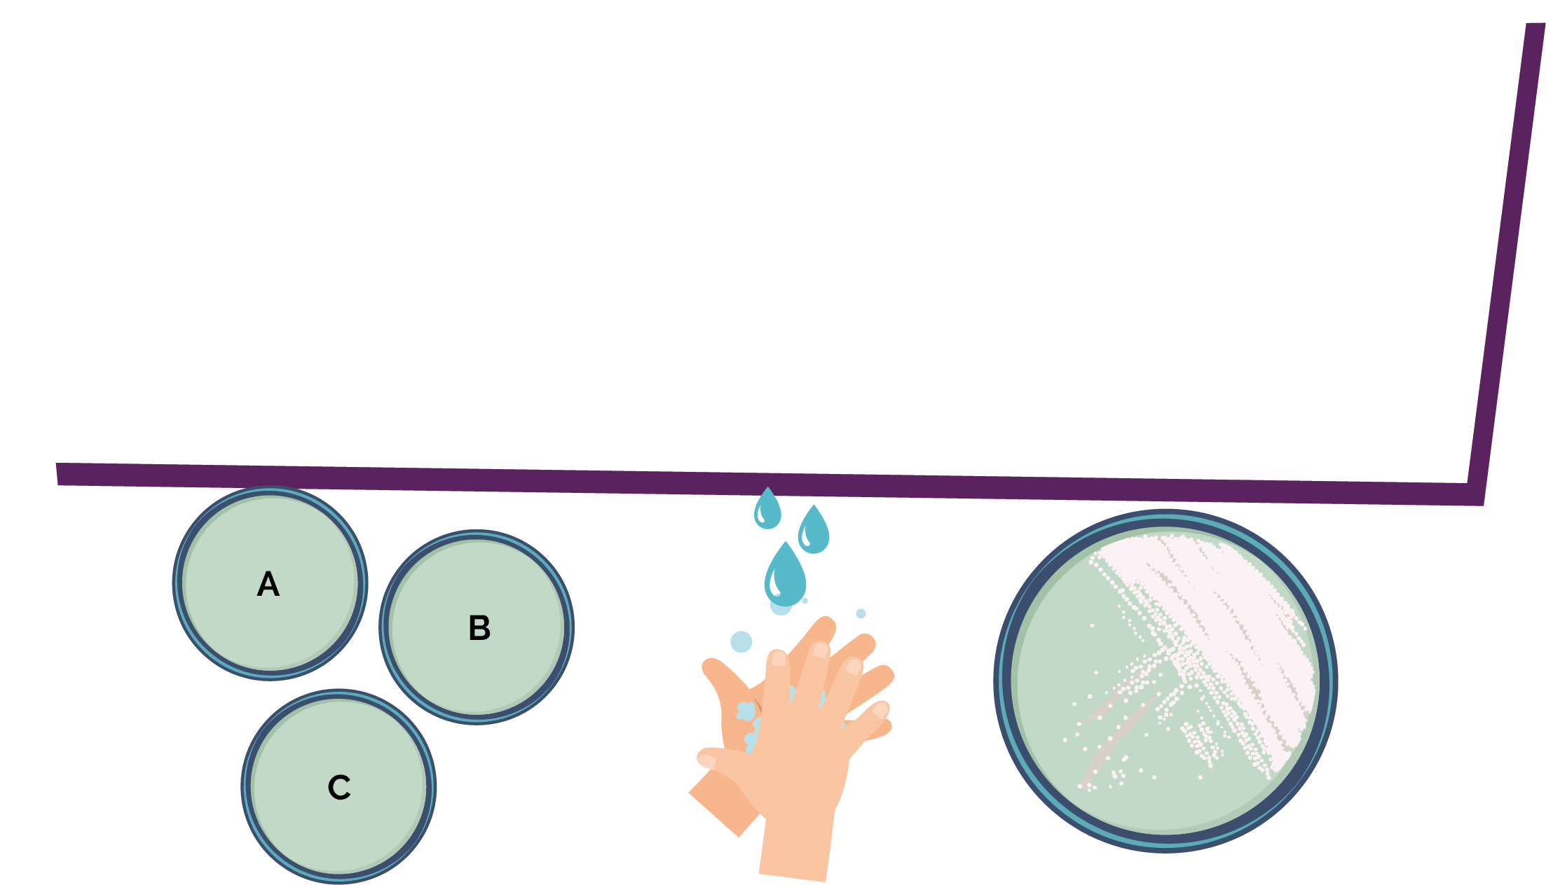
Toilet Paper Experiment Steps
1. Label 3 sterile malt agar plates A to C with your name and date
3. Swab the plate of Saccharomyces cerevisiae then wipe it on plate A
5. Repeat step 4 then wash the swab and wipe it on plate C
4. Cover a new swab with a layer of toilet paper then swab the plate of Saccharomyces cerevisiae and wipe it on plate B
6. Turn the plates upside down
2. Wash your hands and dry thoroughly

Slide 7
Discussion

Slide 8
Discussion Points
Does the appearance of your dishes match your predictions?
Are the class results consistent?
What do the results suggest about personal hygiene procedures?
Why is it important to wash your hands (a) before meals, (b) after using the lavatory?
Suggest as many methods as you can to prevent the spread of infectious disease.

Slide 9
Extension Activities

Slide 10
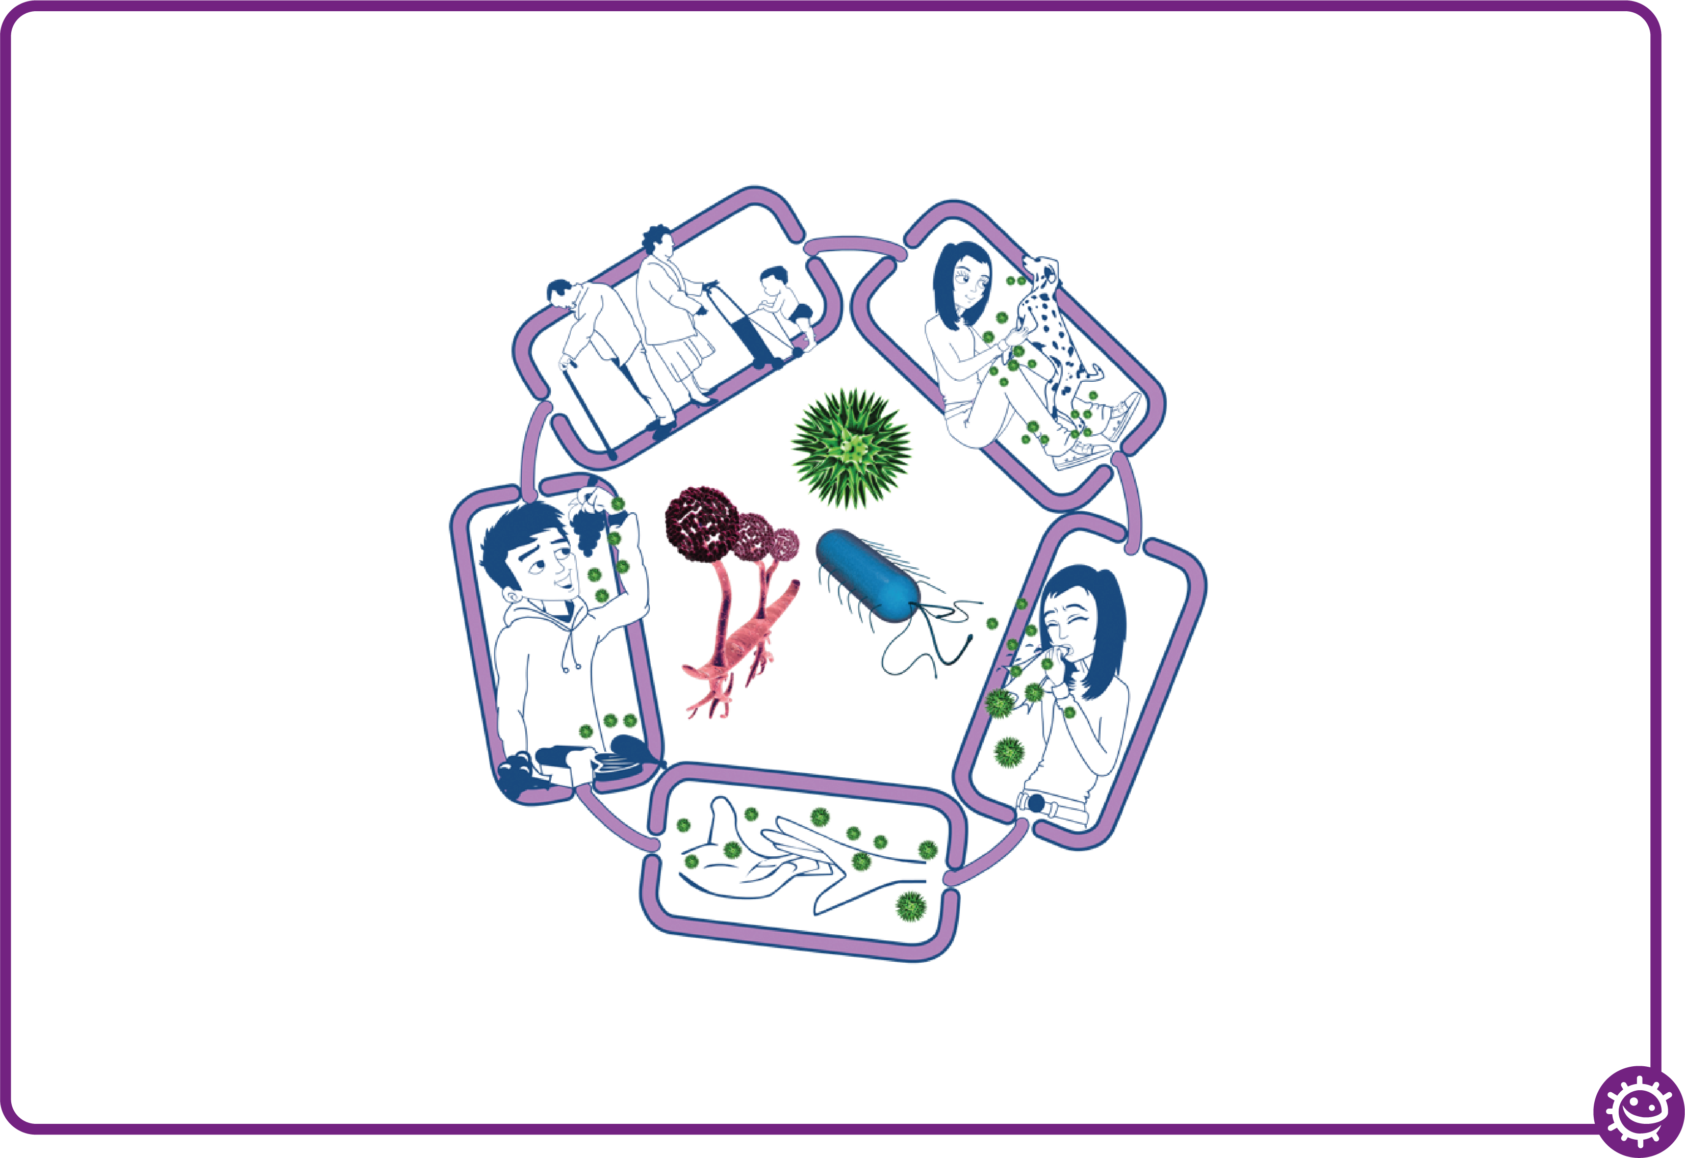

The Chain of Infection
Source of infection
Someone or something carrying the harmful microbes that causes the infection. There are many different sources of infection, these can include:
• People already infected
• Pets or animals
• Contaminated food
People at risk from
infection
We are all at risk from
infection, but some are at greater risk:
• People on medication
e.g chemotherapy
• The very young/elderly
• People with underlying diseases e.g HIV/AIDS, diabetes
Way out for microbes
Harmful microbes need a way to get out of an infected person or source before they can spread to someone else. Routes include:
• Sneezing, coughing, saliva
• Bodily fluid
• Juices from raw meat and poultry
Way in for microbes
Harmful microbes need a
way to enter the body before they can cause an infection. This can be
through:
• The food we eat
• Inhalation of aerosols
or droplets
• Open cuts or sores
• Things we put in our
mouths
Spread of infection
Harmful microbes need a way to be passed from a source to a person. This can be through:
• Direct touch/contact
• Sexual transmission
Harmful microbes are also spread via:
• Hands, hand contact surfaces (e.g. door handles, keyboards, toilets)
• Food contact surfaces
• Air

Slide 11
Breaking the Chain of Infection
Source of infection
• Isolate infected people
• Take care with raw food
• Wash pets regularly
• Treat pets for pathogens when needed
• Dispose of nappies and soiled clothing appropriately
People at risk from
infection
Everyone:
• Take appropriate vaccinations
High risk people:
• Keep away from people who are infectious
• Take extra care about cleanliness
• Take extra care when cooking and preparing food
Way out for microbes
Prevent any:
• Coughs and sneezes
• Faeces
• Vomit
• Bodily fluid
Getting onto surfaces or hands
Way in for microbes
• Cover cuts and open sores with a water proof dressing
• Cook food properly
• Take care to drink only clean water
Spread of infection
• Wash hands thoroughly and regularly
• Cover cuts and open sores
• Take appropriate precautions during
sexual activity

Slide 12
Stomach Bug Chain of Infection
This activity can be carried out in groups of 2 – 4 students or as a classroom discussion. Imagine the spread of gastroenteritis (a stomach bug) in your school from a single infected student.
Take into account the situations of everyday life in school (going to the toilets without washing hands or washing them without soap, going to eat at the school canteen, borrowing pens or other things from friends, holding hands, hugging friends, using a computer…).
Report on ways in which the infection could spread and how quickly it could spread in their class or in the school. Consider the different ways you could stop the spread of infection.
Think about and discuss the difficulties you encounter with respect to hand hygiene in school and to suggest how to use the existing hygiene facilities better.

Slide 13
Spread of Infection on a Cruise Scenario
This activity can be carried out as a group or individual. You are going to predict how many people can become infected and how far influenza can travel in a week by an infected person. Imagine that you are on a Mediterranean cruise that will call at ports in Spain, France, Italy, Malta and Greece. At each port-of-call passengers can choose to get off for shore excursions or stay on the ship. On the cruise there are:
a. A family who will be returning home to Australia after the cruise.
b. Two passengers planning an onward journey from Greece to Turkey.
c. Four passengers planning an interrailing excursion through Hungary, Czech Republic and Germany.
The remaining passengers plan to return home to the USA and China.
A passenger boarding the cruise has a new strain of the influenza virus and it is very contagious.
a. Hypothesise and consider how many people he might infect and how far this virus could travel in 24 hours, and in 1 week.
b. What could have been done to prevent the infection travelling so far?

Slide 14
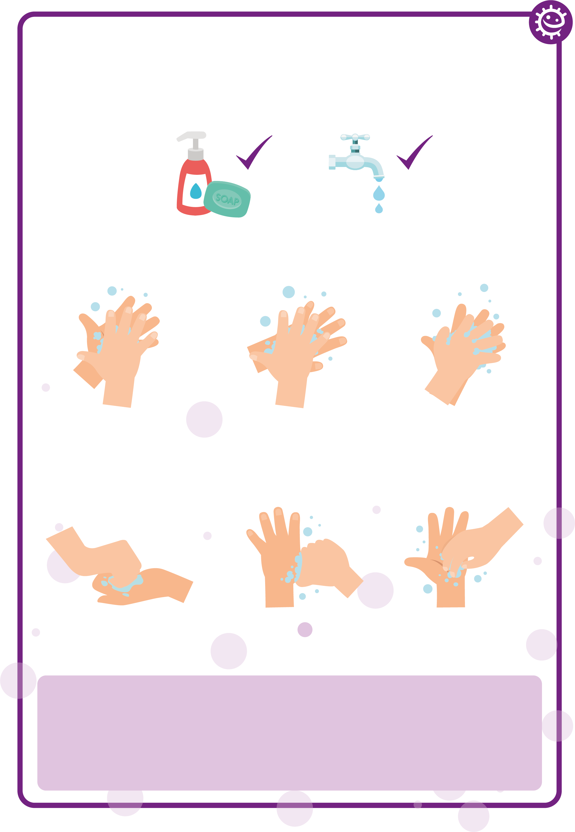
Hand Washing Poster
Wash your hands with soap and water for 20 seconds
1
2
3
Palm to palm
Back of hands
Between fingers
4
5
6
Back of fingers
Thumbs
Tip of fingers
To help keep time, sing ‘Happy Birthday’ twice

Slide 15
Learning Consolidation

Slide 16
Quiz Questions 1 and 2
Hand Hygiene Quiz
How can you spread microbes to others?
(2 points)
By touching them
By looking at them
By speaking to them on the phone
By sneezing
Why should we use soap to wash our hands?
(2 points)
It helps remove invisible microbes too small to be seen by our eyes
It breaks up the oil on our hands which trap microbes
It keeps our hands moist
It doesn’t matter if we use soap or not

Slide 17
Quiz Questions 3 and 4
Hand Hygiene Quiz
Which is NOT one of the 6 steps of hand washing?
(1 point)
Palm to palm
The thumbs
Arms
In between fingers
Who might be at risk as a result of you not washing your hands properly?
(1 point)
You
Your family
Your friends
All of the above

Slide 18
Quiz Questions 5 and 6
Hand Hygiene Quiz
When should we wash our hands?
(3 points)
After stroking a pet
After sneezing or coughing
After watching TV
After using the bathroom or changing a soiled nappy
How can you stop harmful microbes from spreading?
(2 points)
Do nothing
Wash hands in water
Use hand sanitiser if soap and water are not available
Wash your hands with running water and soap

Slide 19
Quiz Questions 7 and 8
Hand Hygiene Quiz
After we sneeze into our tissue, we should:
(2 points)
Wash our hands immediately
Dry our hands on our clothes
Take antibiotics
Put the tissue straight into the bin
How long should we wash our hands for?
(1 point)
10 seconds
20 seconds (length of Happy birthday song twice)
1 minute
5 minutes

Slide 20
Quiz Answers 1 and 2
Hand Hygiene Quiz - Answers
How can you spread microbes to others?
(2 points)
By touching them
By looking at them
By speaking to them on the phone
By sneezing
Why should we use soap to wash our hands?
(2 points)
It helps remove invisible microbes too small to be seen by our eyes
It breaks up the oil on our hands which trap microbes
It keeps our hands moist
It doesn’t matter if we use soap or not
✓
✓
✓
✓

Slide 21
Quiz Answers 3 and 4
Hand Hygiene Quiz - Answers
Which is NOT one of the 6 steps of hand washing?
(1 point)
Palm to palm
The thumbs
Arms
In between fingers
Who might be at risk as a result of you not washing your hands properly?
(1 point)
You
Your family
Your friends
All of the above
✓
✓

Slide 22
Quiz Answers 5 and 6
Hand Hygiene Quiz - Answers
When should we wash our hands?
(3 points)
After stroking a pet
After sneezing or coughing
After watching TV
After using the bathroom or changing a soiled nappy
How can you stop harmful microbes from spreading?
(2 points)
Do nothing
Wash hands in water
Use hand sanitiser if soap and water are not available
Wash your hands with running water and soap
✓
✓
✓
✓
✓

Slide 23
Quiz Answers 7 and 8
Hand Hygiene Quiz - Answers
After we sneeze into our tissue, we should:
(2 points)
Wash our hands immediately
Dry our hands on our clothes
Take antibiotics
Put the tissue straight into the bin
How long should we wash our hands for?
(1 point)
10 seconds
20 seconds (length of Happy birthday song twice)
1 minute
5 minutes
✓
✓
✓

Slide 24
Respiratory Quiz Questions 1 and 2
Respiratory Hygiene Quiz
How can you spread microbes to others?
(3 points)
Touching
Sleeping
Sneezing
Coughing
After we sneeze into our hands, we should:
(1 point)
Wash our hands
Dry our hands on our clothes
Take antibiotics
None of the above is necessary

Slide 25
Respiratory Quiz Questions 3 and 4
Respiratory Hygiene Quiz
If you do not have a tissue available, the next best option is to sneeze:
(1 point)
Into your hands
Into your sleeve
Into an empty space
Onto your desk
The best way to stop microbes from spreading is:
(2 points)
To use your hand to cover your sneeze
To use a tissue to cover your sneeze
To use a sleeve if you haven’t got a tissue
To drink plenty of fluids

Slide 26
Respiratory Quiz Questions 5 and 6
Respiratory Hygiene Quiz
What should you do with a tissue after sneezing into it?
(1 point)
Put it in your pocket for next time
Put it straight in the bin
Put it up your sleeve for next time
Any of the above
What might happen if we don’t wash our hands after sneezing into them?
(1 point)
Nothing
Transfer harmful microbes to other people
Help protect our microbes

Slide 27
Respiratory Quiz Answers 1 and 2
Respiratory Hygiene Quiz - Answers
How can you spread microbes to others?
(3 points)
Touching
Sleeping
Sneezing
Coughing
After we sneeze into our hands, we should:
(1 point)
Wash our hands
Dry our hands on our clothes
Take antibiotics
None of the above is necessary
✓
✓
✓
✓

Slide 28
Respiratory Quiz Answers 3 and 4
Respiratory Hygiene Quiz - Answers
If you do not have a tissue available, the next best option is to sneeze:
(1 point)
Into your hands
Into your sleeve
Into an empty space
Onto your desk
The best way to stop microbes from spreading is:
(2 points)
To use your hand to cover your sneeze
To use a tissue to cover your sneeze
To use a sleeve if you haven’t got a tissue
To drink plenty of fluids
✓
✓
✓

Slide 29
Respiratory Quiz Answers 5 and 6
Respiratory Hygiene Quiz - Answers
What should you do with a tissue after sneezing into it?
(1 point)
Put it in your pocket for next time
Put it straight in the bin
Put it up your sleeve for next time
Any of the above
What might happen if we don’t wash our hands after sneezing into them?
(1 point)
Nothing
Transfer harmful microbes to other people
Help protect our microbes
✓
✓

