Slide 1
Micro-organisms:
Useful Microbes
Key Stage 4

Slide 2
Learning Intention
All pupils will:
• Understand that some microbes can keep us healthy.
• Understand that some microbes can be useful.
• Understand that we need bacterial colonisation to live a healthy life.
• Understand that we need to protect our normal microbial flora.
• Begin to explore scientific research.
Most pupils will:
• Understand that microbes are important in decomposition and nutrient recycling.

Slide 3
Northern Ireland Curriculum Links
Curriculum Skills
Communication, Problem Solving, Working with Others
Areas of Learning
Learning for Life and Work (Personal Development statutory content)
Develop an understanding of how to maximise and sustain their own health and well-being, Recognise, assess, and manage risk in a range of real-life contexts.
Science and Technology (including relevant CCEA qualifications)
GCSE Biology, GCSE Science Double Award, GSCE Science Single Award

Slide 4
What are Useful Microbes? (1/2)
What are Useful Microbes?
There are millions of different species of microbes and that most of these are completely harmless to humans; some are actually very good for us.
We use microbes to our advantage, for example, Penicillium (fungus) to make antibiotics; some microbes break down dead animals and plant material to make compost; some microbes help us digest foods and some are even used to turn milk into yoghurt, cheese and butter.
Bacteria and fungi, like us, are alive – they need a food source to grow and multiply. They vary in their food requirements but generally anything we consider food can be used as food by many microbes.

Slide 5
What are Useful Microbes? (2/2)
What are Useful Microbes?
Microbes also produce waste products and it is these waste products that can either be beneficial or harmful to humans. When milk turn sour this may be seen as a problem to us, industry uses this process (fermentation) in making yoghurt.
Fermentation is a chemical change/process by which bacteria ‘eat’ sugars and produce acids and gas as waste. We use this process in the food industry to create wine, beer, bread, yoghurt and many more foodstuffs. When making yoghurt, the bacteria added to milk consume the milk sugars, and through fermentation convert these sugars to lactic acid which causes the milk to thicken into a yoghurt.

Slide 6
Main Activity:
The Story of Insulin

Slide 7

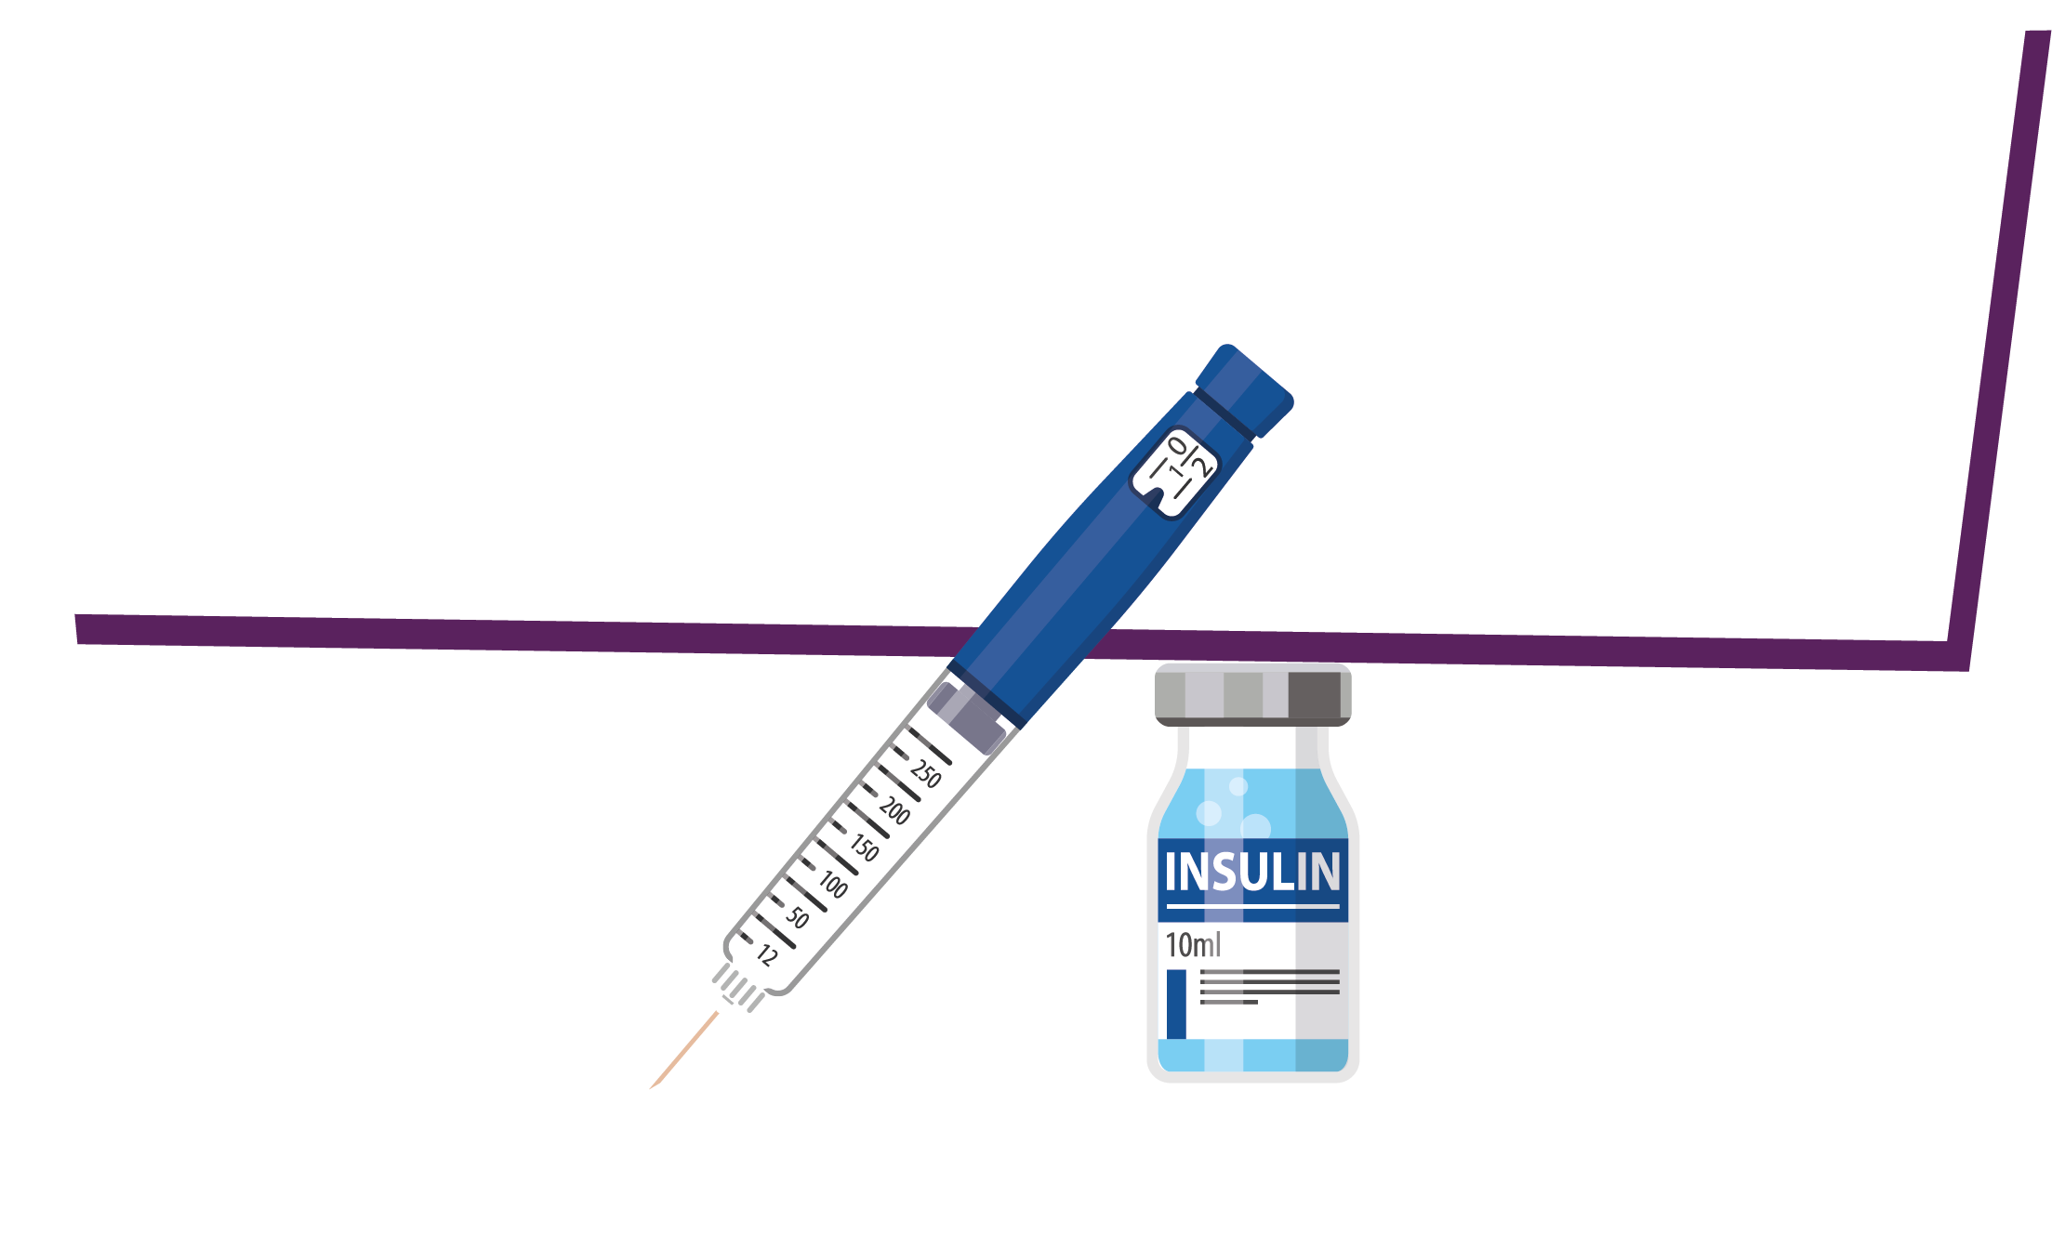
Story of Insulin Steps
1. Conduct research on the history of insulin, what it’s used for, how microbes are involved, and the ethical considerations in insulin production
2. Share your research with the class

Slide 8
You Will Now be Conducting Research Into the Production of Insulin
Plan your research and include answers to the following questions:
How was insulin historically made?
How is insulin made using microbes today? Why?
What microbes are involved? Why?
Are there any ethical considerations in this field of science?
You may choose to present your research as an essay or a presentation.

Slide 9
Discussion

Slide 10
Discussion Points
Why is it important to maintain healthy gut microbiome?
What is the main drive in shaping gut microbiome?
What crucial role does microbiome play in our gut?
What can be influenced by gut microbiota?

Slide 11
Extension Activities

Slide 12

Useful Microbes and Their Properties
Useful Microbe Name | Type of Microbe | Use
 |  | Produce cheese, yogurt, kefir and kimchi
 |  | Make bread, beer, cider and wine
Acetic Acid Bacteria (AAB) | Bacteria | Traditional manufacturing of vinegar
Bacillus thuringiensis (Bt) | Bacteria
Cyanobacteria | Bacteria

Slide 13
Useful Microbes and Their Properties - Answers
Useful Microbe Name | Type of Microbe | Use
 |  | Produce cheese, yogurt, kefir and kimchi
 |  | Make bread, beer, cider and wine
Acetic Acid Bacteria (AAB) | Bacteria | Traditional manufacturing of vinegar
Bacillus thuringiensis (Bt) | Bacteria
Cyanobacteria | Bacteria
Lactobacillus
Bacteria
Grown in open ponds or photobioreactors and fed CO2 and other nutrients to support photosynthesis. The cell components can be extracted to make biodiesel or bioethanol (from carbohydrates, with the help of Saccharomyces.
Saccharomyces
Fungi
Organic pesticide
Grown in open ponds or photobioreactors and fed CO2 and other nutrients to support photosynthesis. The cell components can be extracted to make biodiesel or bioethanol (from carbohydrates, with the help of Saccharomyces.

Slide 14
Useful Microbes Presentation
In a groups or individually, using the useful microbes and their properties worksheet, present other useful microbes, for example the fungus Fusarium, which produces mycoprotein, a protein-rich food suitable for vegetarians.

Slide 15
Learning Consolidation

Slide 16
Many microbes are useful, they can help us make food such as bread and yoghurt and can be used in industry due to the proteins or enzymes they produce.
True/False?
True

Slide 17
Fermentation happens when bacteria break down the simple sugars into carbon dioxide.
True/False?
False. Fermentation happens when bacteria break down the complex sugars into simple compounds like carbon dioxide, and lactic acid and alcohol.

Slide 18
Yoghurt contains bacteria including Lactobacilli and Streptococcus, meaning eating yoghurt is good for your gut health.
True/False?
True

