Slide 1


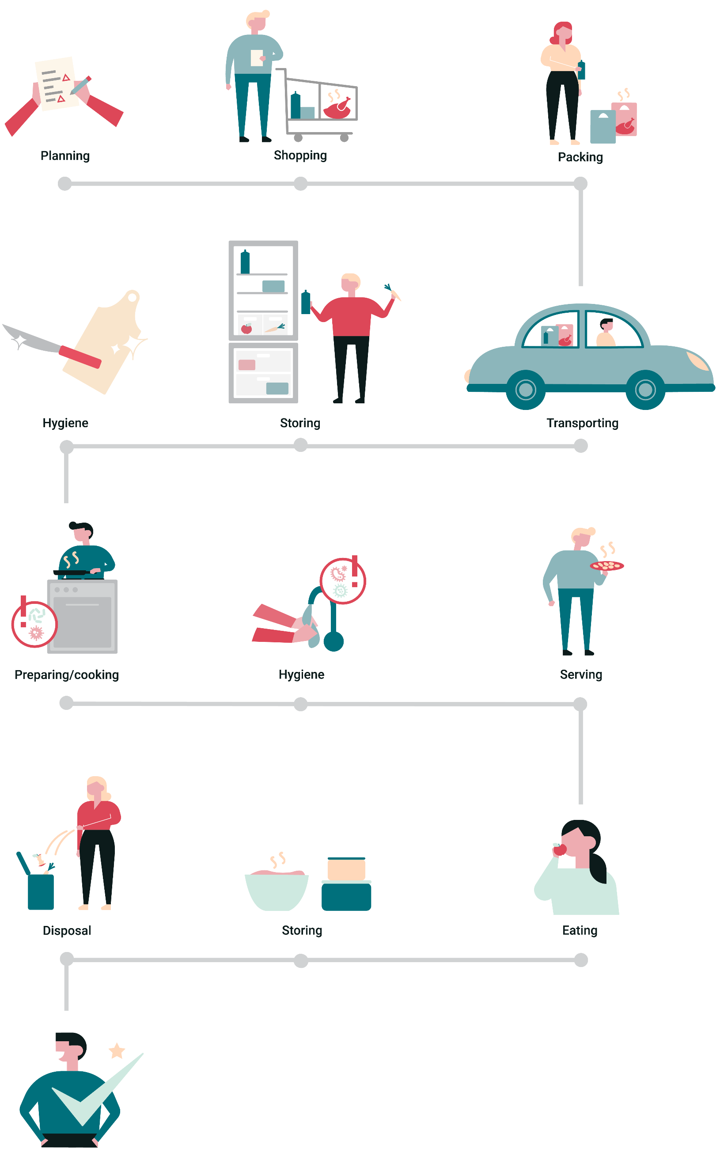

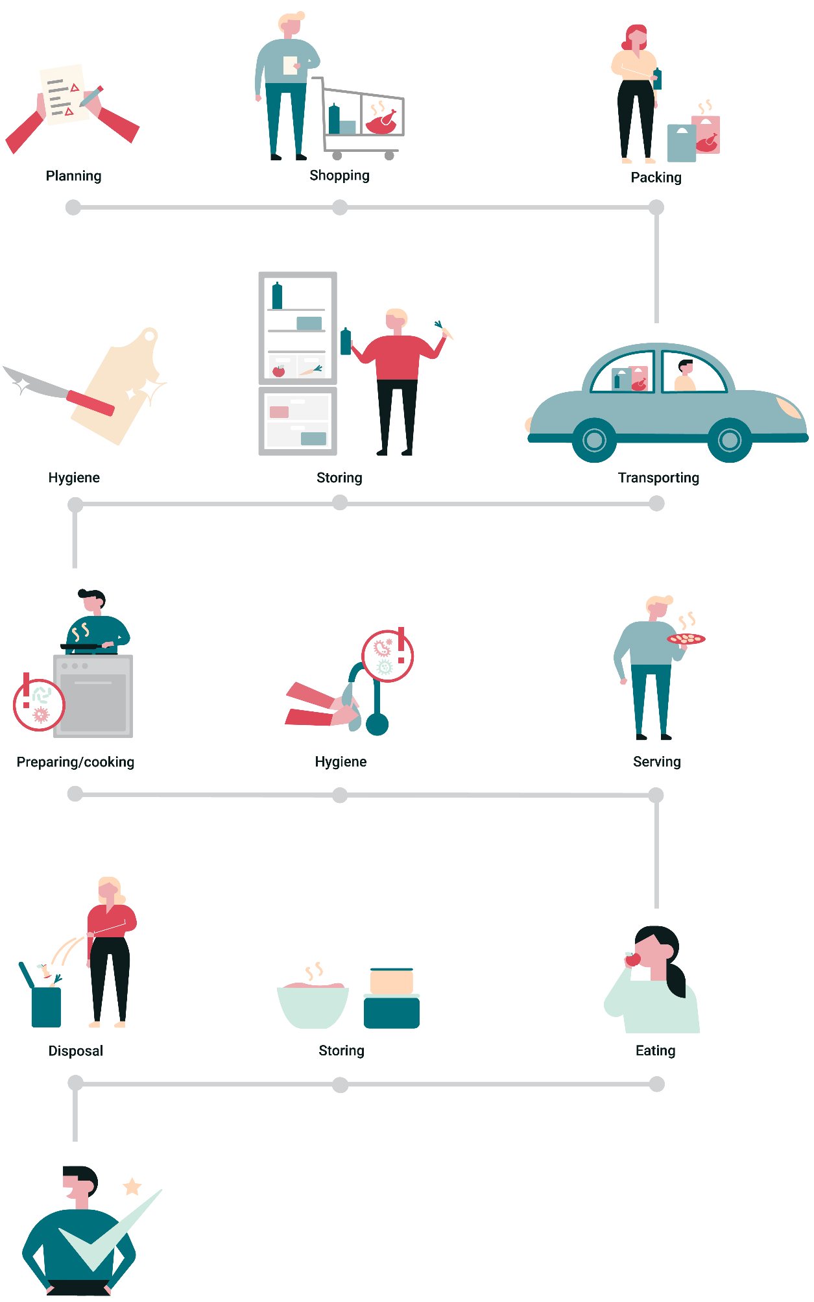
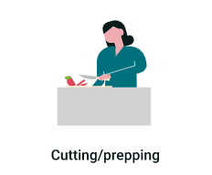

Food Hygiene & Safety
The Food Journey
This project has received funding from the European Union’s Horizon 2020 research and innovation programme under grant agreement No 727580.

Slide 2
Learning Intention
To understand how harmful microbes in food can cause food poisoning, the risks of cross-contamination and the importance of good hygiene practices in food preparation and everyday life to prevent infection and maintain good health.

Slide 3
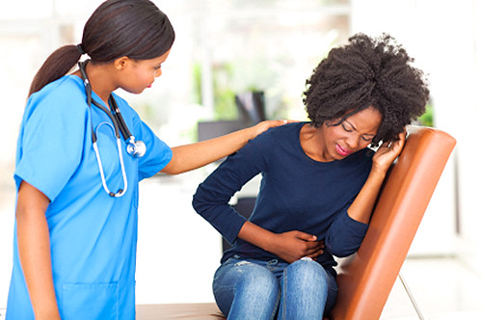
Foodborne illness
What is foodborne illness?
What are the symptoms of foodborne illness?
How quickly do symptoms appear and last for?
Any illness that arises from contaminated food that may occur at any stage in the process from food production to consumption.
Diarrhoea, vomiting, stomach cramps and fever. Some symptoms can be more serious, or even fatal.
Symptoms can appear immediately or take longer (sometimes up to 90 days, e.g. with Listeria monocytogenes ) and last anywhere from a few days to a week or longer.
Can you tell what food caused the illness?
It is difficult to tell what food caused the illness. People often blame the food eaten just before symptoms appear, however as symptoms can take time to develop, it may have been the meal eaten a day or two days previously!
Notes:
Ask the class each question and as they answer click the mouse or spacebar and the box will pop up by animation
Other questions:
Can you tell where you got it from?
A particular restaurant?
At home?
A particular food? E.g. Chicken?
What consequences are there to illness?
Missed school?
Went to hospital?
Had to take medication?
Don’t want to eat that food again
Who will suffer the most from foodborne illness? Pregnant women, babies, elderly people and those who are immunocompromised, e.g. cancer patients undergoing chemotherapy may suffer the most

Slide 4
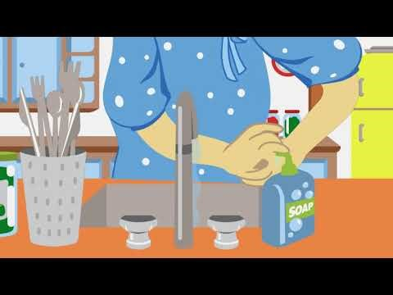
Food Journey Animation

Slide 5


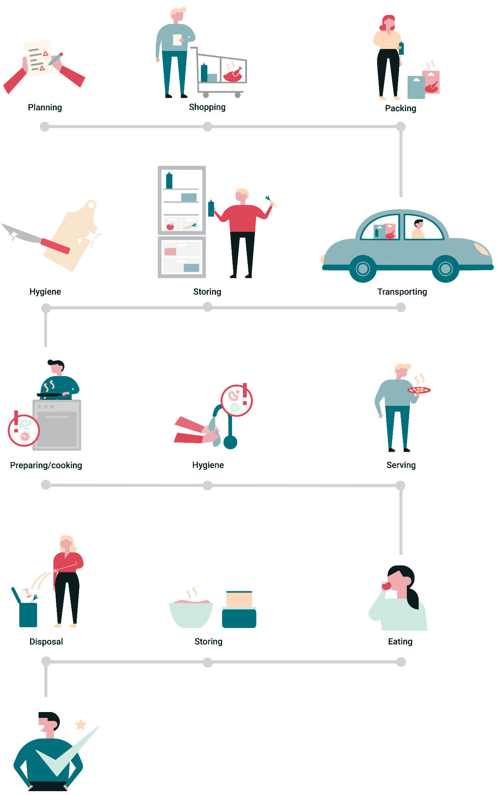


During this journey, microbes can multiply and there are risks for contamination, which can lead us to becoming ill
What can we do to ensure food is safe at every step in this journey?
The food on our plate goes through a journey from when we buy it to when we eat it

Slide 6

Planning & shopping - Risks
What food safety risks might occur during planning and shopping?
Are you involved in planning and shopping?
What do you help buy and pack?
Where do you buy your food from?
How do you put the food in the trolley?
What do you check on the packaging?
On the worksheet: write down food safety risks and share with the class
Notes:
The worksheet is split into sections for each stage of the user journey, ask students to complete each section as you go through the stages. Alternatively you could ask students to complete the full worksheet after going through all of the stages.
Ask students to complete the first section of the worksheet with 4 food safety risks that could happen when planning and shopping.
Students should use the questions on this slide to think of the risks, e.g. contamination of food in trolley
Ask students to feedback what risks they can think of.
Only eggs labelled with the British Lion mark are certified Salmonella free. Eggs from other sources could contain Salmonella.
Fruit and vegetables may be contaminated with harmful microbes from the ground.
Juices from meat could contaminate other food and items in the shopping cart.
If you don’t check the use-by dates of perishable foods, you may end up buying items close to their use-by date and risk harmful microbes growing within the food.

Slide 7
Planning & shopping - Solutions
How can we reduce food safety risks during planning & shopping?
Consider where you are buying, or growing your own food
Place risky food, such as chicken, in separate compartments in a trolley e.g. meat separate from vegetables
Timing – Buy chilled foods and high-risk foods towards the end of the shopping trip
Plan what you are going to cook to avoid wasting foods close to their use by date
Notes:
This slide covers examples of actions to reduce food safety risks.
During this section ask students to complete the second section of the worksheet with solutions to reduce each of the risks.
Ask students to feedback on solutions that would help reduce the risks.
You could go through these slides before or after students complete the worksheet.
Check your eggs have the British Lion Mark - this guarantees that all hens are vaccinated against Salmonella. If buying locally, check that the eggs are Salmonella-free and ask if unsure.
Wash fruit and vegetables to take off any loose dirt or soil which may contain harmful microbes.
Place risky food in separate compartments in a trolley e.g. meat and vegetables should be kept separate to avoid cross-contamination in the trolley.
Timing – buy chilled foods and high-risk foods towards the end of the shopping trip. This reduces the time they are spent out of the fridge.
Plan what you are going to cook - to avoid wasting foods and buying foods that are close to their use by date.

Slide 8
Packing & transporting - Risks
What food safety risks might occur during packing and transporting?
Do you use the same bag for all food?
How long will the food be out of the fridge?
Are you going home straight away?
What if it’s a hot day?
On the worksheet: write down food safety risks and share with the class
Notes:
Ask students to complete the first section of the worksheet with 4 food safety risks that could happen when packing and transporting.
Students should use the questions on this slide to think of the risks, e.g. how long it will take to take food back home.
Ask students to feedback what risks they can think of.
Cross-contamination from raw meat/fish to other foods such as vegetables might happen in shopping trolley/bags – could any objects pierce the packaging?
Food may be out the fridge for a long time if travelling or not going home straight away.
Chilled food may heat up quickly during transportation – especially if it is a hot day. Microbes can grow very quickly in the warm environment of the car. The longer the food is left in the car, the more microbes may grow in the food.

Slide 9
Packing & transporting - Solutions
How can we reduce food safety risks during packing & transporting?
Pack meat and vegetables in separate bags
Use cool bags to keep chilled or frozen food cold. Pack these separately to other items
Wash your reusable bags
Take food home immediately if possible
Notes:
This slide covers examples of actions to reduce food safety risks.
During this section ask students to complete the second section of the worksheet with solutions to reduce each of the risks.
Ask students to feedback on solutions that would help reduce the risks.
You could go through these slides before or after students complete the worksheet.
Pack meat and vegetables in separate bags to prevent cross-contamination.
Use cool bags to keep chilled or frozen food cold - this may help to reduce the growth of microbes in risky foods like chicken, but do not rely on this to fully stop microbes growing.
Wash your reusable bags – this is because microbes may be present on them and have the potential to spread to other foods next time you use them.
Take food home immediately if possible – this reduces the time harmful microbes may be growing on food before it is refrigerated.

Slide 10
Storing - Risks
What food safety risks might occur during storing?
Is the fridge temperature cold enough?
Where should different food items be kept in the fridge?
Do you store eggs in the fridge?
How often do you clean out the fridge?
On the worksheet: write down food safety risks and share with the class
Notes:
Ask students to complete the first section of the worksheet with 4 food safety risks that could happen when packing and transporting.
Students should use the questions on this slide to think of the risks, e.g. is the fridge temperature cold enough?
Ask students to feedback what risks they can think of.
The fridge may not be set to the correct temperature to limit microbial growth.
Cross-contamination can occur between different types of food in the fridge, i.e. meat placed above vegetables could lead to meat juices dripping down onto the vegetables.
Salmonella may grow in non-British Lion marked eggs, if stored at room temperature. Eggs free of Salmonella should still be kept in the fridge to keep them fresher for longer.
A full fridge or lack of planning could lead to food going out of date and if this food is eaten it may lead to foodborne illness.

Slide 11
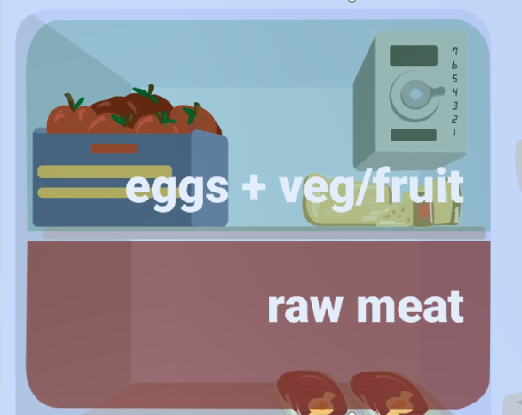
Storing – Solutions
How can we reduce food safety risks during storage?
Set fridge to 4°C or below
Remove out of date items from the fridge
Avoid filling the fridge with unnecessary items – e.g. large bottles of water. Items that need to be in the fridge include meat and dairy products, and some foods that have been opened e.g. jars of jam, and sauces
Stick to use by dates
Store eggs in the fridge to keep fresh. Non-British Lion-marked eggs can grow Salmonella at room temperature
Cover raw meat, or keep in a well-sealed package to prevent spillage and cross-contamination
Freeze ready to eat foods if you wont be eating in the next few days
Eggs+ Veg/Fruit
Raw meat
Notes:
This slide covers examples of actions to reduce food safety risks.
During this section ask students to complete the second section of the worksheet with solutions to reduce each of the risks.
Ask students to feedback on solutions that would help reduce the risks.
You could go through these slides before or after students complete the worksheet.
Set the fridge to 4°C or below to reduce microbial growth.
Remove out of date items from the fridge regularly, or anything growing mould, such as cheese.
Avoid filling the fridge with items that do not need to be there, e.g. large bottles of water. Items that need to be kept refrigerated include meat and dairy products, and some foods that have been opened, e.g. jars of jam, and sauces.
Stick to use-by dates - these indicate food safety.
Store eggs in the fridge to keep them fresh for longer. Eggs that are not labelled with the British Lion mark must be kept in the fridge to prevent the growth of Salmonella.
Cover raw meat or keep in a well-sealed package to prevent spillage and cross-contamination in the fridge.
Freeze ready to eat foods if you won’t be eating them in the next few days. Although this hits the pause button on microbial growth, bacteria are not killed, and foods should be consumed within 24 hours of defrosting. Consume foods within three to six months of freezing, as quality will deteriorate over time.

Slide 12
Food preparation - Risks
What food safety risks might occur during food preparation?
Do you prepare or cook food when ill?
What tools would you use to prepare raw meat and vegetables?
How do you handle raw meat?
At what points should you wash hands?
How do you clean surfaces/utensils?
Do you wash raw fruits and vegetables?
On the worksheet: write down food safety risks and share with the class
Notes:
Ask students to complete the first section of the worksheet with 4 food safety risks that could happen when packing and transporting.
Students should use the questions on this slide to think of the risks, e.g. tools used for preparing raw meat and vegetables.
Ask students to feedback what risks they can think of.
If you have an infection (e.g. Norovirus or a cold) you could contaminate the food or kitchen surfaces with the infectious microbes and pass the infection on to other people.
If the same knife or chopping board is used to prepare meat and vegetables this can cause cross-contamination.
During cooking, your hands can spread harmful microbes to surfaces and other food.
Food to be eaten without further cooking, such as cooked meat, salad, and fruit pose different risks to food that will be cooked before consumption.
Raw food, such as fruits and vegetables, meat, seafood, can be covered in harmful microbes, and therefore pose a risk in food preparation.
Kitchen surfaces, or utensils may be contaminated if they have not been cleaned since last use.
Contaminated cloths and sponges can spread harmful microbes to hands and surfaces.
Washing chicken in the sink could spread harmful microbes over kitchen surfaces and food.

Slide 13
Food preparation - Solutions
How can we reduce food safety risks during food preparation?
Don’t prepare food or cook for others if you are ill
Use separate chopping boards and knives for cutting meat and vegetables
Wash hands with soap and water and clean surfaces
Use separate cloths / dish brushes for washing dishes, cleaning surfaces, and drying hands. Make sure to dry them after use and replace regularly
Do NOT wash chicken or other meat but DO wash raw fruits and vegetables
All of the above can help to reduce the risk of cross-contamination onto other foods, and surfaces
Notes:
This slide covers examples of actions to reduce food safety risks.
During this section ask students to complete the second section of the worksheet with solutions to reduce each of the risks.
Ask students to feedback on solutions that would help reduce the risks.
You could go through these slides before or after students complete the worksheet.
Do NOT prepare food or cook for others if you are ill, to prevent the spread of infection.
To avoid cross-contamination:
- Use separate chopping boards and knives for meat and vegetables or wash thoroughly with warm soapy water after using it for meat.
- Wash hands with soap and water and clean surfaces thoroughly.
- Use separate cloths / dish brushes for washing dishes, cleaning surfaces, and drying hands. Make sure to dry them after use and replace regularly.
- Do NOT wash chicken or other meat.
- Do wash raw fruits and vegetables.

Slide 14
Cooking food - Risks
What food safety risks might occur when cooking food?
How do you cook raw meat?
How do you cook eggs?
How do you check if meat is cooked through?
What could distract you in the kitchen?
On the worksheet: write down food safety risks and share with the class
Notes:
Ask students to complete the first section of the worksheet with 4 food safety risks that could happen when packing and transporting.
Students should use the questions on this slide to think of the risks, e.g. tools used for preparing raw meat and vegetables.
Ask students to feedback what risks they can think of.
If food is not cooked thoroughly e.g. chicken, this may increase the risk of foodborne illness, e.g. Campylobacter in undercooked chicken or Salmonella in non British Lion marked eggs could make you very ill.
It is easy to get distracted in the kitchen by many things, such as your phone, tablet, or even pets, which can lead to making mistakes in the kitchen that compromise on food safety.

Slide 15
Cooking food - Solutions
How can we reduce food safety risks during cooking?
Check meat is cooked thoroughly using a meat thermometer, by inserting it at the thickest part and wait 15 seconds. For smaller pieces of meat cut at its thickest part – making sure there are no pink bits
Cook eggs thoroughly - Salmonella is naturally found in eggs
If you eat non British Lion marked eggs and serve them raw or undercooked, (e.g. ‘wet’ scrambled eggs) you are at greater risk of getting ill from Salmonella
Be aware of distractions to ensure you don’t miss food safety steps – phones and tablets can be a source of cross-contamination
Notes:
This slide covers examples of actions to reduce food safety risks.
During this section ask students to complete the second section of the worksheet with solutions to reduce each of the risks.
Ask students to feedback on solutions that would help reduce the risks.
You could go through these slides before or after students complete the worksheet.
Before you serve pork, poultry and minced meat, make sure it is steaming hot and cooked all the way through. When you cut into the thickest part of the meat, check that none of the meat is pink and that any juices run clear. In a whole bird this is the area between the leg and the breast. You could also use a temperature probe (if you have one) to check the temperature of the thickest part of the meat. The temperature needs to reach one of the following combinations to make sure it has been cooked properly:
o 60°C for 45 minutes
o 65°C for 10 minutes
o 70°C for 2 minutes
o 75°C for 30 seconds
o 80°C for 6 seconds
Eggs that are not marked with the British Lion mark will not be guaranteed Salmonella free. When cooking these, ensure to cook the egg thoroughly.
Be aware of distractions while preparing and cooking food, to ensure crucial food safety steps are not missed.
Be aware of possible cross contamination when using phones while preparing and cooking food. Wash your hands before and after using devices to limit the spread of microbes from other sources.

Slide 16

Storing leftovers - Risks
What food safety risks might occur with storing leftovers?
How do you cool the food after cooking?
How do you defrost your food?
Where do you store the leftovers?
How many times can you reheat leftovers?
On the worksheet: write down food safety risks and share with the class
Notes:
Ask students to complete the first section of the worksheet with 4 food safety risks that could happen when packing and transporting.
Students should use the questions on this slide to think of the risks, e.g. tools used for preparing raw meat and vegetables.
Ask students to feedback what risks they can think of.
Food left for extended periods of time sitting out of the fridge to cool down can encourage the growth of microbes, which grow at room temperature.
Food may not have been defrosted properly in the fridge, i.e. chicken may have been left out next to the sink to defrost, which can be a problem for the growth of Campylobacter.
Leftovers may not have been stored in the fridge if they are to be eaten quickly, or the freezer if they will be eaten at a later date.
Leftovers may have been heated more than once which can encourage the growth of microbes as food moves up and down heating and cooling stages.

Slide 17
Storing leftovers - Solutions
How can we reduce food safety risks during storage of leftovers?
Cool and place leftovers in the fridge within two hours. Keep the fridge at 4°C
Reheat leftovers thoroughly
Keep leftovers for no more than two days
Defrost food in the fridge not at room temperature
Put labels and dates on leftovers
Freeze leftovers and note down the date
Notes:
This slide covers examples of actions to reduce food safety risks.
During this section ask students to complete the second section of the worksheet with solutions to reduce each of the risks.
Ask students to feedback on solutions that would help reduce the risks.
You could go through these slides before or after students complete the worksheet.
Cool and place leftovers in the fridge as quickly as possible - this should be within two hours of cooking. This is especially important for rice which can contain Bacillus cereus whose spores can survive heat. Bacillus cereus can then multiply at low temperatures of 4 to 6°C.
Reheat leftovers thoroughly until piping hot throughout to kill any bacteria that may be present.
Use chilled leftovers within two days to limit microbial growth. If in doubt, freeze leftovers as this pauses microbial growth.
Defrost food (especially meat) in the fridge, not at room temperature.
Put labels and dates on leftovers, especially if they are going in the freezer so that you know when they were cooked, food should be kept in the freezer for no more than three to six months, after which time it will deteriorate in quality.

Slide 18
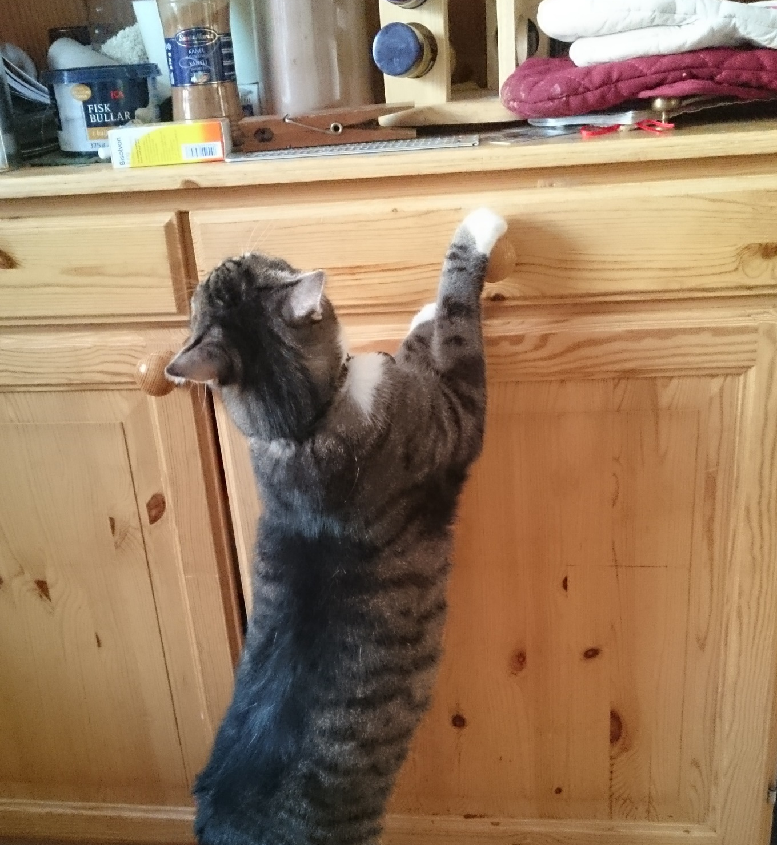
Optional activity
Distractions in the kitchen!
Simulate how easy it is to be distracted in the kitchen and do the wrong thing
1 volunteer to act out cooking a chicken roast dinner using props in the class. Speak aloud about how you would safely prepare and cook the meal.
3 – 4 students must attempt to distract the student from cooking safely.
As a class, decide what distractions are most common in your kitchens.
Be as creative and fun as you like!
Suggestions:
Pet distracting the owner, stealing food or getting in the way
Baby crying or asking for attention
Phone ringing
Food falls on the floor
Something burns or catches fire!
Notes:
This should be a fun demonstration/drama activity to show how distractions in the kitchen (phone, pet, rushing) can lead to lapses in judgement around food safety.
Ask for volunteers who do not mind acting in front of the class
One volunteer must pretend to cook a chicken dinner from start to finish (e.g. starting from taking the food out of the fridge to preparing, cooking and eating). Using what they have learnt in the lesson they need to speak and act out food safety and hygiene steps for each stage of the preparation.
The other volunteers aim is to try and prevent the student that is cooking from remembering to do safety steps such as washing hands and changing chopping boards. You could use the suggested distractions, ask the students to come up with their own or ask the class to suggest ones based on their own homes.
Encourage students to have fun, e.g. to act as a baby wanting attention, or pretend to be a phone ringing.
Try to make a note of what steps the student manages to do and what they miss while being distracted. You could also ask the students watching to note down what the student does right and wrong and what they can do to prevent distractions

Slide 19
Summary
Cross-contamination is a food safety risk, and various risks of contamination are found during the different steps of the food journey, from buying, to transporting, preparing, cooking, and managing leftovers
Foodborne illness can affect all of us and can be serious
There are several actions, including hygiene, and preventing cross-contamination, keeping food refrigerated, and cooking meat thoroughly that can help avoid foodborne illness
It is easy to be distracted and do the wrong thing when you are cooking, be aware of these and try to minimise distractions where possible, and handle them appropriately

