Slide 1



Food Hygiene & Safety
Microbes in food
This project has received funding from the European Union’s Horizon 2020 research and innovation programme under grant agreement No 727580.

Slide 2
Learning intention
To understand:
the different types of microbes that cause foodborne illness, the role of useful microbes in food and the importance of proper food handling to prevent illness.

Slide 3

Foodborne illness (Food poisoning)
Food poisoning or foodborne illness is illness from eating food contaminated by harmful microbes (pathogens)
Every year 1 in 10 people globally will have a food infection and 420,000 people will die
For most people it is not serious and you get better within a week.
It can be serious for people with a weakened immune system, or older people (over 65 years) or younger children (under 5 years)
What symptoms does foodborne illness have?
How long do you get symptoms after eating contaminated food?
    Common symptoms:
    Vomiting
    Nausea (feeling sick)
    Diarrhoea
    High temperature (fever)
  Symptoms usually last between a few hours to a few days
  In some cases it can be over a week after eating the food, depending on the cause

Slide 4
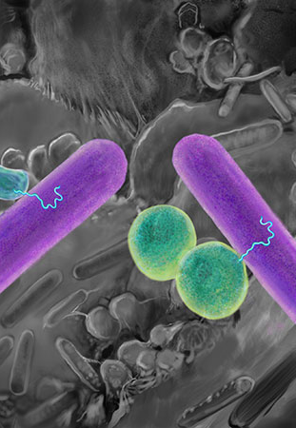
Microbes
Microbes are tiny living things, too small to be seen with the naked eye
There are different groups of microbes
  Bacteria
  Virus
  Fungi
  Protozoa / Parasites
Microbes are everywhere, including in the food we eat
Most microbes are harmless or even beneficial for us
When microbes cause illness or disease, they are called pathogens
There are an estimated 200 disease-causing pathogens that can be transmitted by food!
Now play a quick matching activity to revise microbes
Notes:
Give students the cut outs of bacteria, virus, fungi and parasite and ask them to match the statements for each.

Slide 5
Characteristics of Microbes
Bacteria
Fungi
Can be harmful (cause illness) and beneficial/useful (decomposition - “recycling” of organic materials)
Multiplies in humid environments with nutrients (e.g. sugar, fat, proteins), for example in food, drains, wounds
They spread directly between people or through food, water, soil and blood Most are killed by high temperatures and cooking Most are not killed by freezing, and cold temperatures can reduce growth
Examples: Campylobacter and Salmonella cause foodborne illness. Lactic acid bacteria are used to produce yoghurt, soy sauce and chorizo sausage
The largest type of microbe. Can be harmful (cause illness) and beneficial/useful (decomposition – “recycling” of organic materials)
Multiplies in environments with nutrients, e.g. in food and humid building materials Mould is spread by spores and food can be contaminated from air. Food with visible growth of mould (e.g. leftovers, bread, jam) should not be eaten
Relatively tolerant to heat. Not killed by freezing. Cold temperatures can reduce their growth
Examples: Aspergillus flavus that produce aflatoxins in food (e.g. nuts). Saccharomyces cerevisiae (yeast) for baking and Penicillium camemberti for camembert and brie cheese
Virus
Parasite
The smallest type of microbe
Cannot grow or survive without a host (e.g. a human or animal)
They spread from person to person or from person to food through the air (e.g. sneezing), through vomit, through faeces, or other bodily fluids (e.g. blood or saliva). Killed by cooking. They will not grow, but can survive in food.
Examples: Norovirus in oysters or soft fruits e.g strawberries.
Different sizes. Can be harmful. Cannot grow without a host (e.g. a human or animal)
Can be spread between animals and humans through contaminated food, water, soil and blood
Killed by cooking and freezing. They will not grow but can survive in food
Examples: Toxoplasma in meat and on vegetables, intestinal worms (e.g. roundworm)
Notes:
Hide this slide during the main lesson whilst students are playing the matching activity.
Get the students to match the different statements to the four different types of microbe: bacteria, fungi, virus and parasite.
Answers to the matching activity are below each heading.
Go through the answers as a class or in pairs.

Slide 6
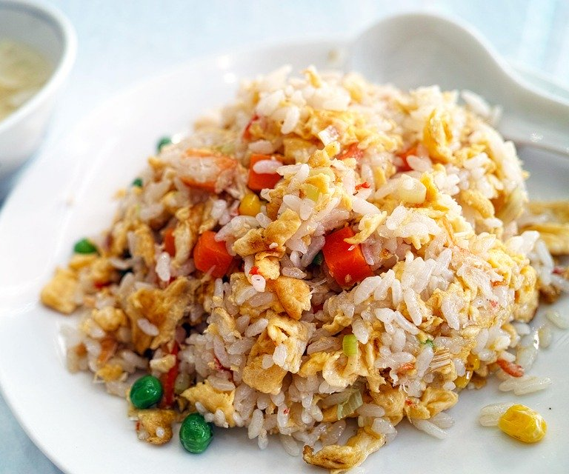
Spores
Some bacteria can live for long periods of
time without water or nutrients, by creating
spores
These spores have a hardy outer coat that protects the bacterium from conditions including:
  Extreme heat (not killed by boiling at 100°C)
  Dehydration
  Disinfectants
When conditions improve, these spores can ‘germinate’ and start growing - this can happen when food is cooled slowly at room temperature

Slide 7
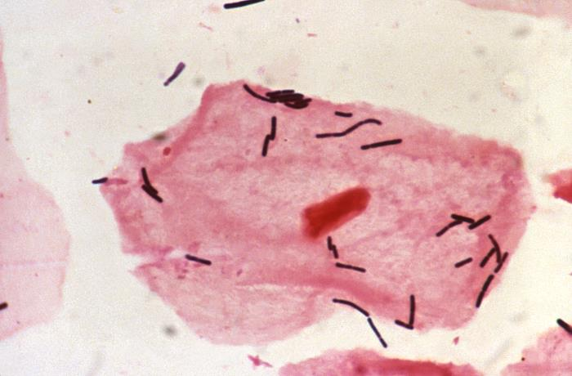
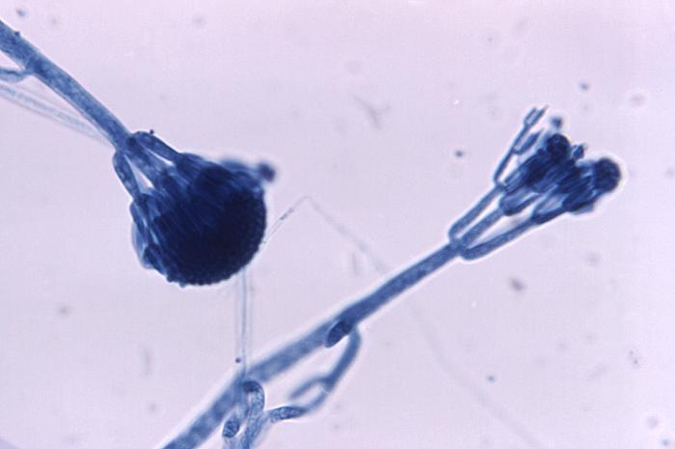
Are microbes always harmful?
When can microbes be useful or beneficial for us?
We have used microbes to make food for 1000s of years in a process called fermentation
Microbes live naturally in our bodies (particularly the gut) and are essential for us to survive.
Penicillin (antibiotic) is made from a fungi
Lactobacillus is found in the gut and aids digestion
Lactobaccilus
Penicillium

Slide 8




Examples of useful microbes
Bread, beer, wine and spirits are made with the help of yeast: Saccharomyces cerevisiae
Vinegar is a further fermentation of wine with Acetobacter
The fresh, fermented products such as yoghurt are made with two types of lactic acid bacteria: Streptococcus thermophilus and Lactobacillus bulgaricus. They metabolise lactose, the sugar in milk and make lactic acid. The acid makes the milk proteins curdle, giving a thick consistency.
Cheese is made with a variety of lactic acid bacteria (Lactococcus, Lactobacillus or Streptococcus spp.) but may also contain Propionibacterium sp. as used in Emmental cheese. Brie, Camembert and blue cheese are also made from Penicillium moulds.
Notes:
The examples in this slide are common foods and drinks such as bread, beer, wine, spirits and vinegar, that rely on useful bacteria such as yeast, and lactic acid in order to be produced.
Saccharomyces cerevisiae is the most common yeast used.
Lactobacillus species of bacteria are used in dairy products and found naturally in our gut.

Slide 9
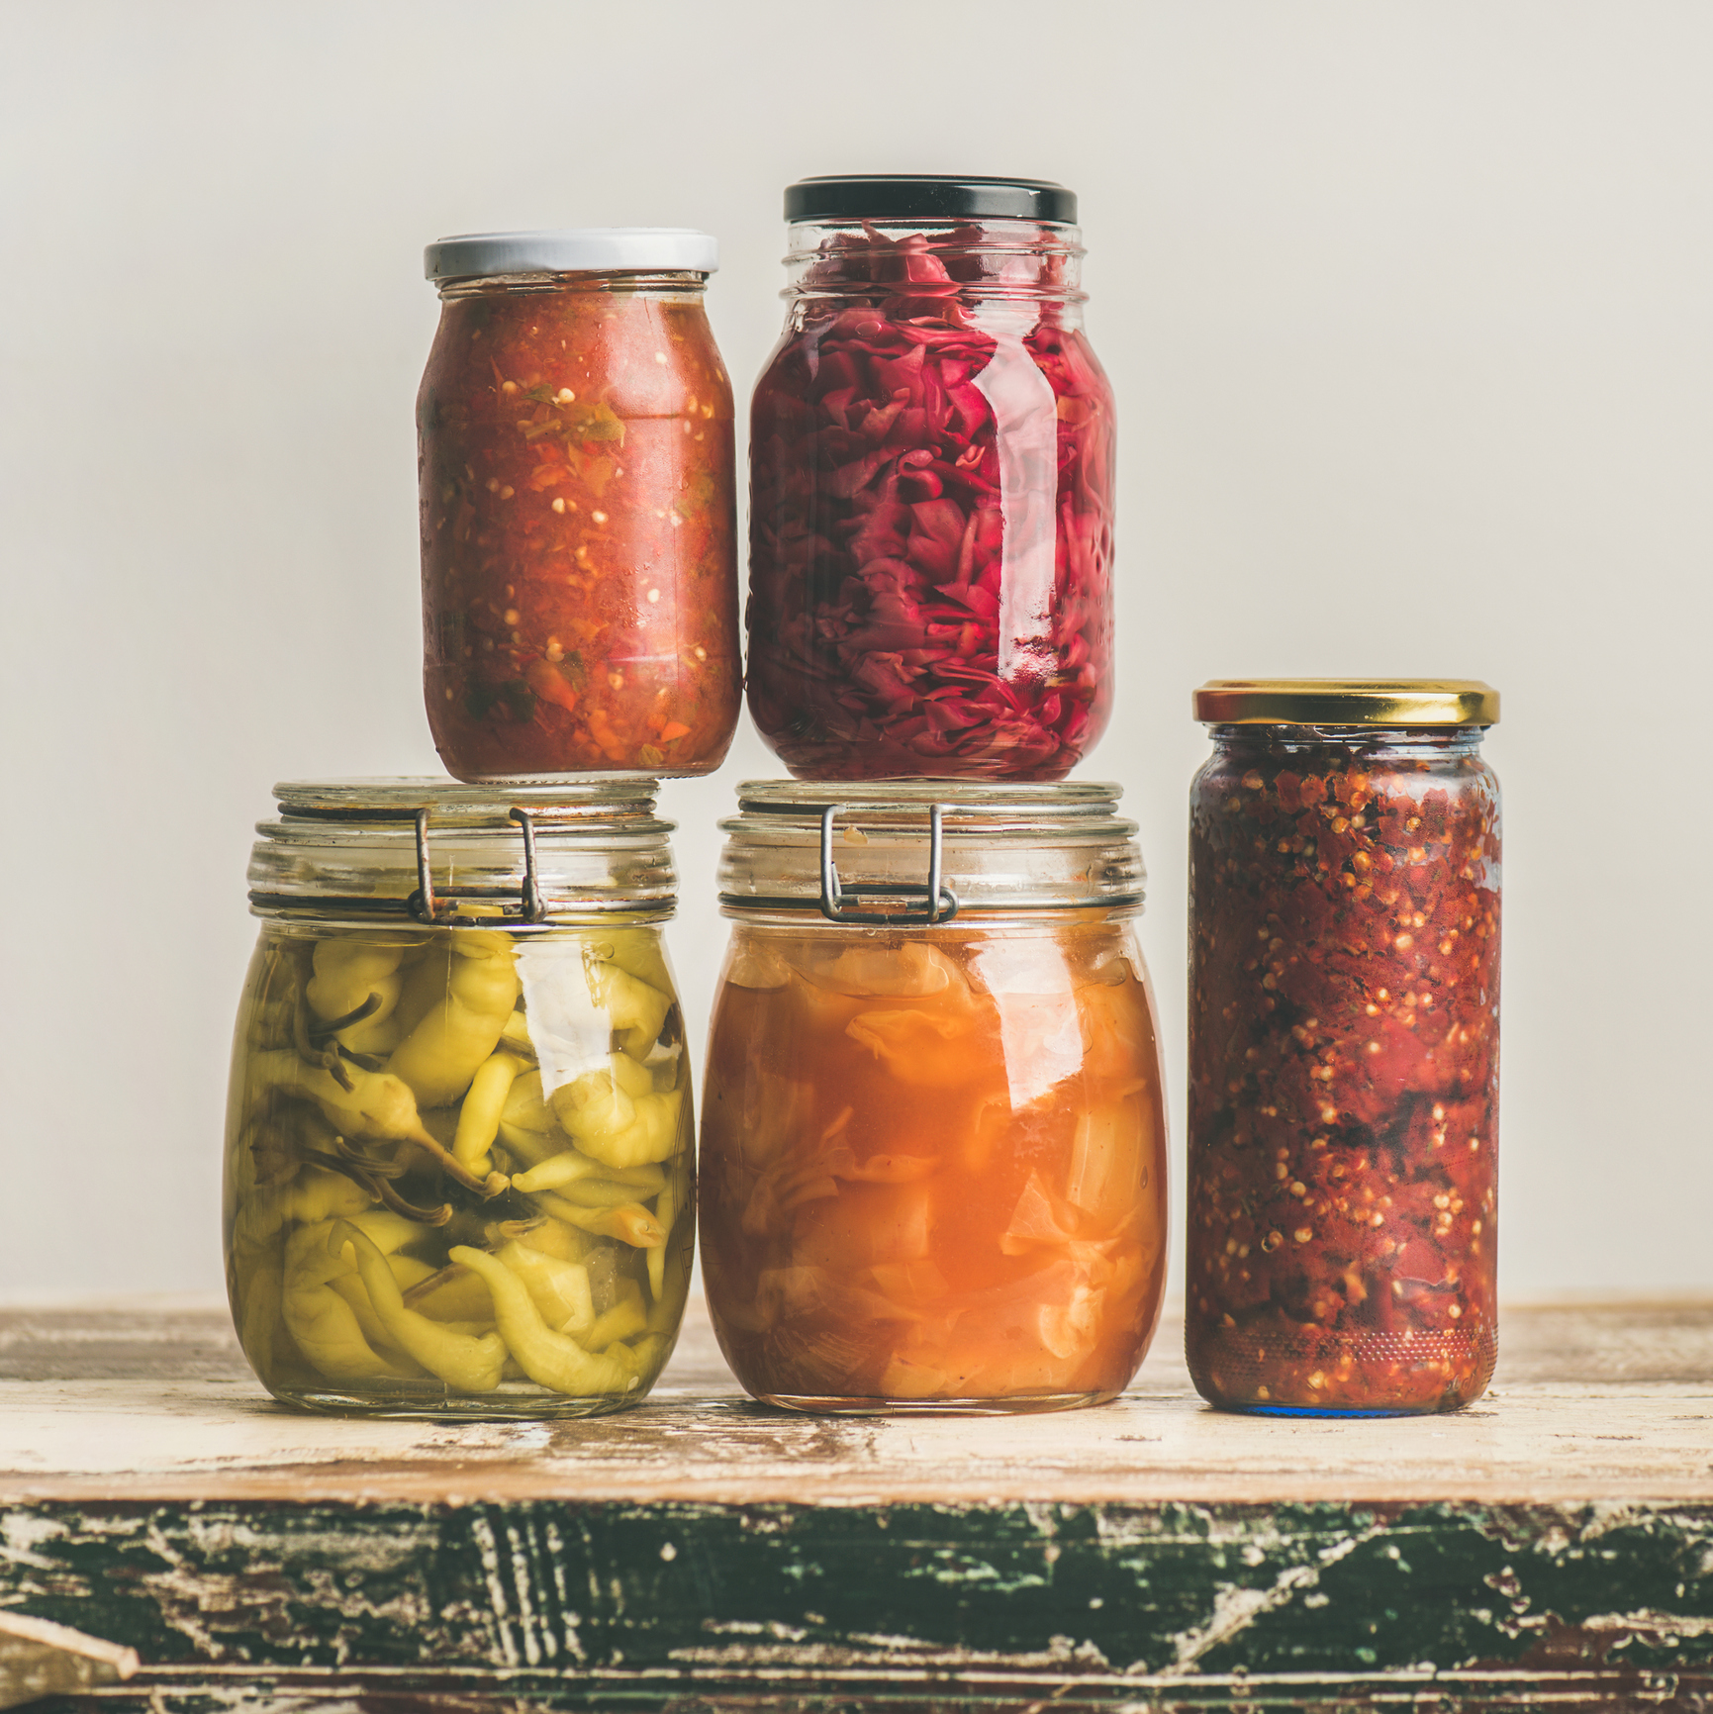

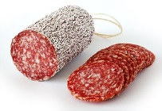
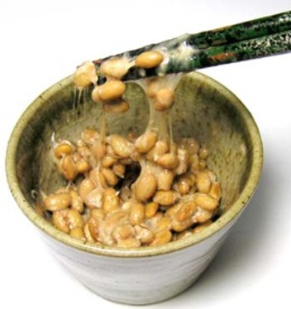
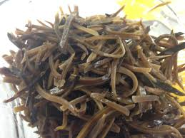
More examples of useful microbes
Many popular vegetable dishes, such as olives, kimchi and sauerkraut are fermented with lactic acid bacteria of the Lactobacillus species
Fermented, traditional sausages, such as salami are also made with lactic acid bacteria as acidifiers but also other microorganisms such as coagulase-negative staphylococci
Soy sauce is a result of mould (Aspergillus oryzae). Made from fermented soybeans which are further fermented with yeasts
Japanese “Natto” (from fermented soybeans) are made with Bacillus spp, and have a sticky and stringy structure. These bacteria have a strong and pungent smell
Nigerian “Ugba” is made from fermented oil bean seeds
Notes:
This slide contains more examples of foods across the world that are made from useful microbes through the process of fermentation. Many of these may be unfamiliar with students, but some they may have heard of.
Ask students which of these examples they may have heard of before.

Slide 10
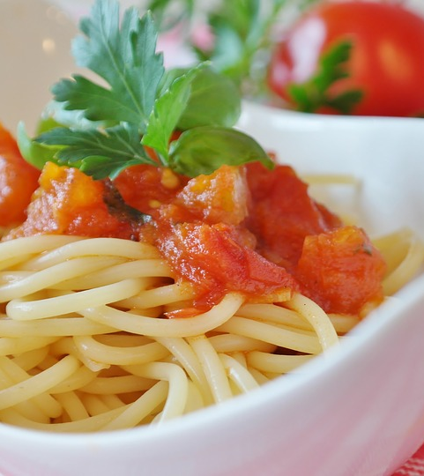
Case study: a cautionary tale
In 2008, a 20 year old man in Belgium died 10 hours after consuming spaghetti with tomato sauce
It had been left unrefrigerated at room temperature for 5 days and reheated in the microwave before consumption.
The culprit: a bacteria called Bacillus cereus which can commonly contaminate rice and pasta
In pairs, read the case study about Bacillus cereus, and answer the questions
Feedback your answers and thoughts to the class

Slide 11
Extension activity– top 5 microbes
The top 5 pathogens which cause the most food poisoning in Europe are below
The class will be split into 5 groups and as a group you will be given one of these microbes and will create a poster or fact file
Follow the instructions on the handout for what to include in your poster/fact file
Salmonella
Campylobacter
Toxoplasma
Norovirus
Listeria monocytogenes
Notes:
Alternatively, this activity could be given as homework, if there is a lack of time.

Slide 12
Group task – top 5 microbes
Your poster must answer:
What type of microbe is it?
What illness does it cause?
How many people are ill each year?
How is it spread?
How is it treated?
How many people die each year?
Who is most at risk?
Where can it be found?
How can you prevent being infected?
Each group will present their poster/fact file to the class
Rest of class: listen carefully and complete the worksheet for each presentation

