Slide 1



Teaching food hygiene
Overviews and links
X
Close
Previous Next
>
Close
Next

Slide 2
Overviews and links
Teacher training sessions and students resources
S1
An introduction
S2
Microbiological aspects
S3
Food labels
S4
Infection transmission
Food safety versus food quality
Useful and harmful microbes
The food journey
Recipes book
Food safety facts
Food safety debate kit
Outbreak investigation
X
Back to main page
Next
Close

Slide 3
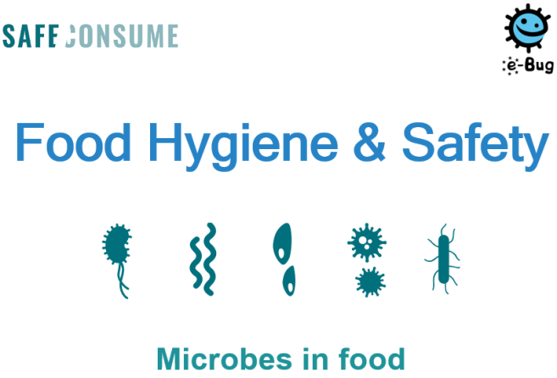
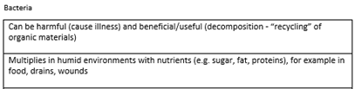


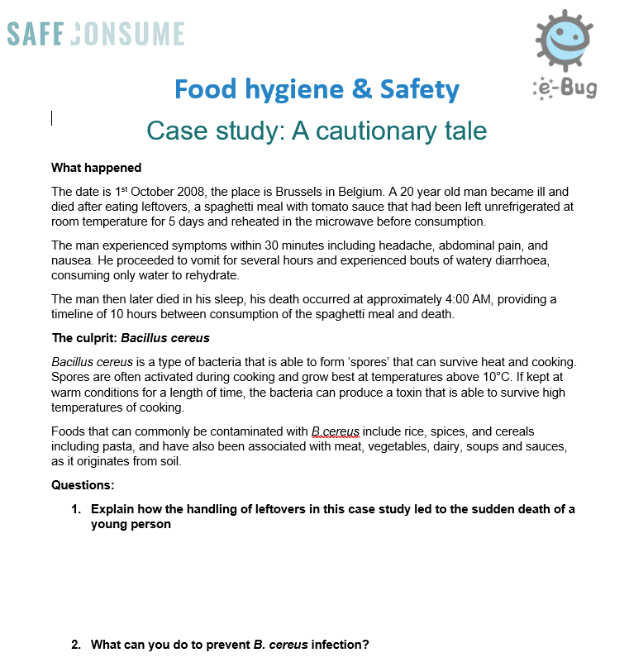

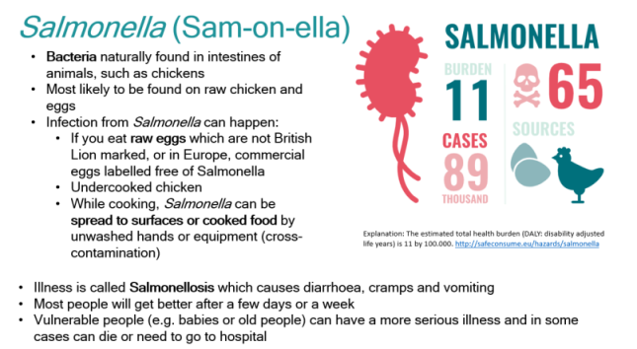

Useful and harmful microbes
  Lesson learning outcomes:
  To identify harmful microbes that are commonly found in food
  To identify conditions that promote the growth of harmful microbes and how to prevent it
  To understand how to safely transport, store and prepare food
  To understand risks and consequences of food poisoning
  Resources:
  Teacher sheet ⬄ Lesson plan
  The Microbes in Food PowerPoint linking to different activities:
    Slide “Microbes” + Microbe match activity statement ⬄ Gives students the cut outs of bacteria, virus, fungi and parasite and ask them to match the statements.
    Slide “Spores” ⬄ Explain to students that some bacteria develop spores that can survive harsh conditions and live without water or nutrients.
    Slide “Example of useful microbes” ⬄ discuss the useful and beneficial microbes that live naturally within us and foods that are made with or contain microbes.
    Slide “Case study : a cautionary tale” + Student handout : Case Study: a cautionary tale (1) + answer sheet (2) ⬄ Students will be looking at a case study of how microbes can cause foodborne illness.
    Slides “Extension activity: Research group task” ⬄ Allows students to work on a poster or fact file on one of the top five pathogens. It could also be given as homework.
  Harmful microbes additional slides PowerPoint ⬄ Explains the common foodborne pathogens in Europe
X
Back to menu
Next
Close

Slide 4
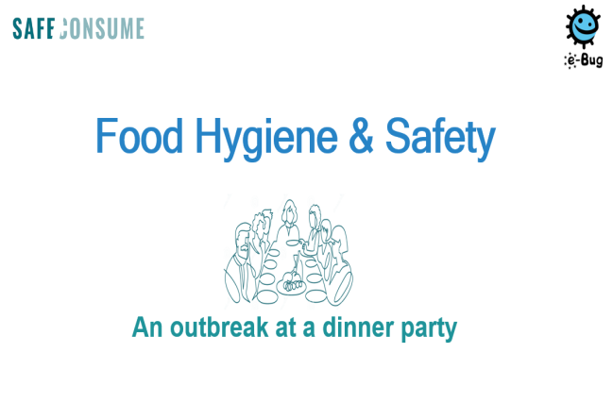
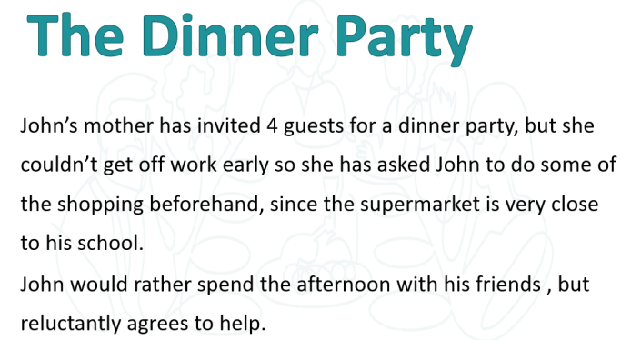
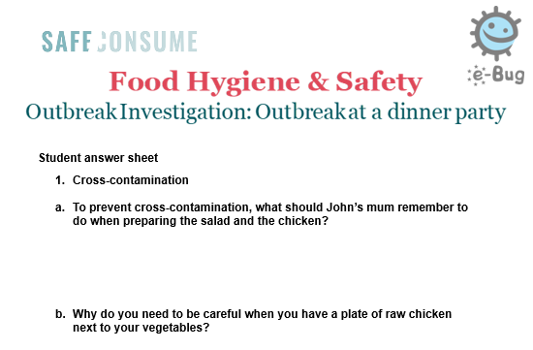

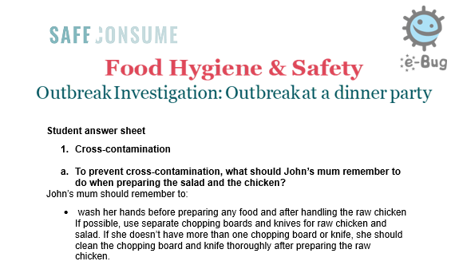
Outbreak investigation
  Lesson learning outcomes:
  Foodborne illness is caused by microbes, of which there are four different types
  The difference between viruses, bacteria, parasites and fungi
  There are useful microbes in food
  The importance of handling food correctly to avoid foodborne illness
Resources - Outbreak investigation
  Teacher notes ⬄ contains the lesson plan.
  PowerPoint ⬄ There are questions associated with each part of the preparation of food at the dinner party, e.g. preparation of vegetables, and grilling and serving. This activity may be done as a class, or students may work in pairs or small groups to discuss each of the questions within the presentation.
  Student worksheet ⬄ Encourage students to write down notes in the student worksheet, to share feedback with the rest of the class and discuss their answers.
  Student answer worksheet ⬄ Can be used as a guide for discussion, to check all points have been raised.
X
Back to menu
Next
Close

Slide 5
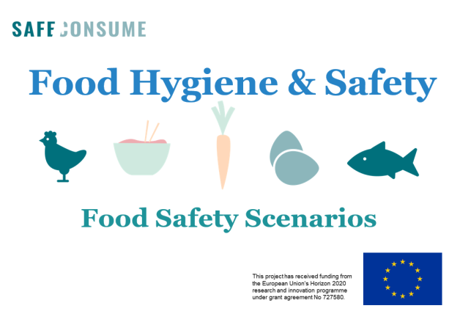
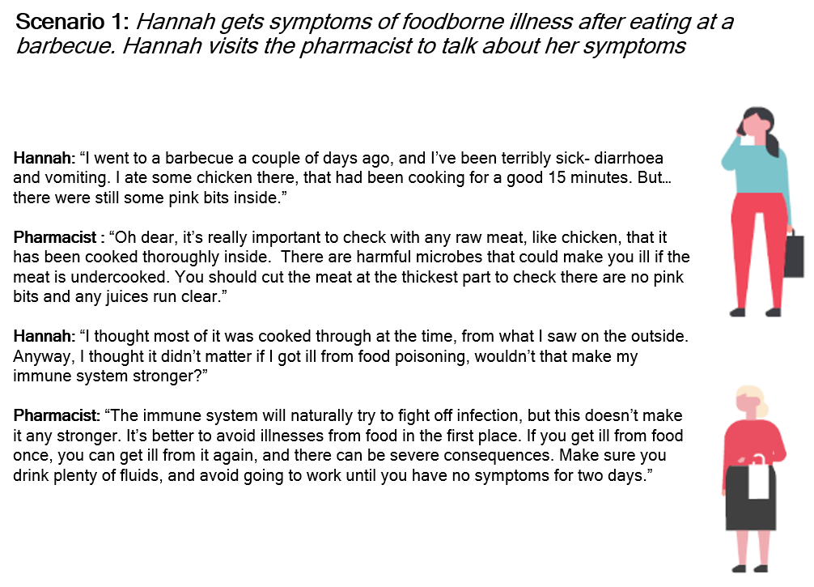
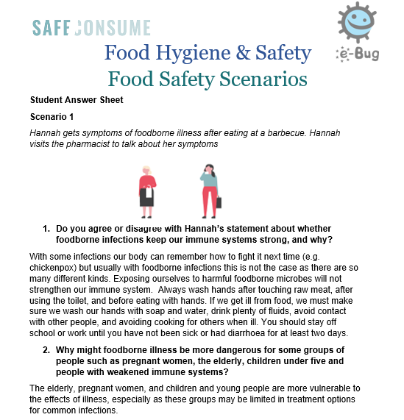
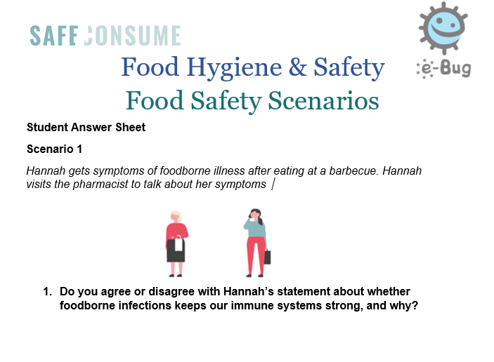


Food safety facts
  Lesson learning outcomes:
  To understand that foodborne illness can have severe consequences and does not contribute to strengthening the immune system
  To understand the consequences of not following food hygiene rules at home, such as cross-contamination, and how to prevent this
  To understand types of food labels and why these are important
  To explain the difference between food safety and food quality
  To understand the food cooked at home is not necessarily safer than food eaten at restaurants
Resources – Food safety scenarios
  Teacher notes ⬄ contains the lesson plan.
  PowerPoint ⬄ Go through each of the food safety scenarios within the Food Safety Scenarios PowerPoint. Each scenario features different characters in common situations.
  Student worksheet ⬄ Encourage students to write down notes for each question, to share feedback with the rest of the class, and discuss their answers.
  Student answer worksheet ⬄ Can be used as a guide for discussion, to check all points have been raised.
X
Back to menu
Next
Close

Slide 6
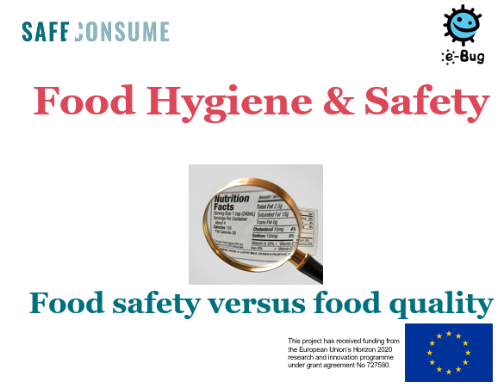
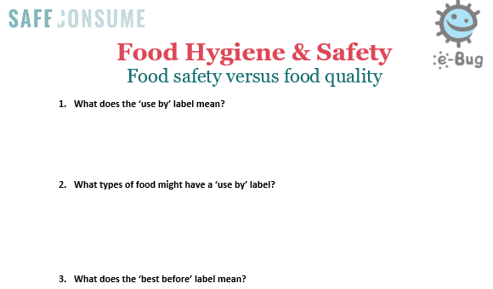
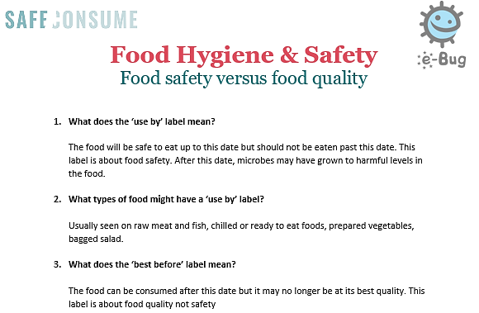

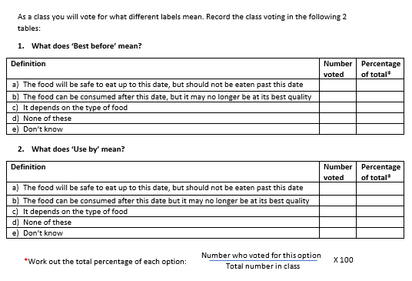

Food safety versus food quality
  Lesson learning outcomes:
  To understand types of food labels and why these are important
  To understand the difference between food safety and food quality
  To understand how to store and use different types of food
  To understand consequences of not following food labels properly
Resources – Food safety versus food quality
  Teacher notes ⬄ contains the lesson plan.
  PowerPoint with different activities:
    Slide “Components of a label” ⬄ Introduce the importance of food labels.
    Slides “Cast your votes” ⬄ Ask the class to vote for what they think “use by” and “best before” labels mean.
    Slide “What happens if we don’t follow the labels” ⬄ In pairs, ask students to discuss the consequences of eating food that is past its ‘use by’ and ‘best before’ and then to vote by a show of hands if they would throw away food past its use by and best before dates.
    Slides “Tackle food waste” ⬄ Recap with students how freezing food can help to reduce waste with leftovers or food bought close to the use by date. If time allows, ask them to discuss and develop a poster or mind map by groups.
  Student worksheet ⬄ Encourage students to write down notes for each question, to share feedback with the rest of the class, and discuss their answers.
  Student answer worksheet ⬄ Can be used as a guide to check all points have been raised.
  Optional student worksheet : Data analysis activity ⬄ If you would like to revise student’s data analysis skills, there is an optional activity whereby students complete a pie chart based on the class vote mentioned above and then answer some questions on EU data.
X
Back to menu
Next
Close

Slide 7
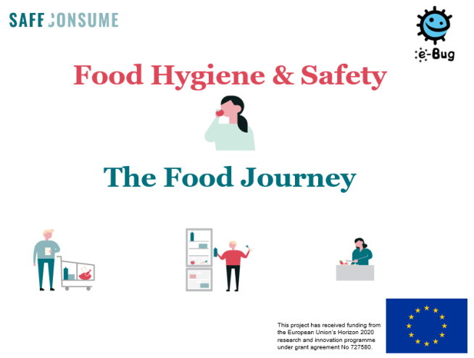
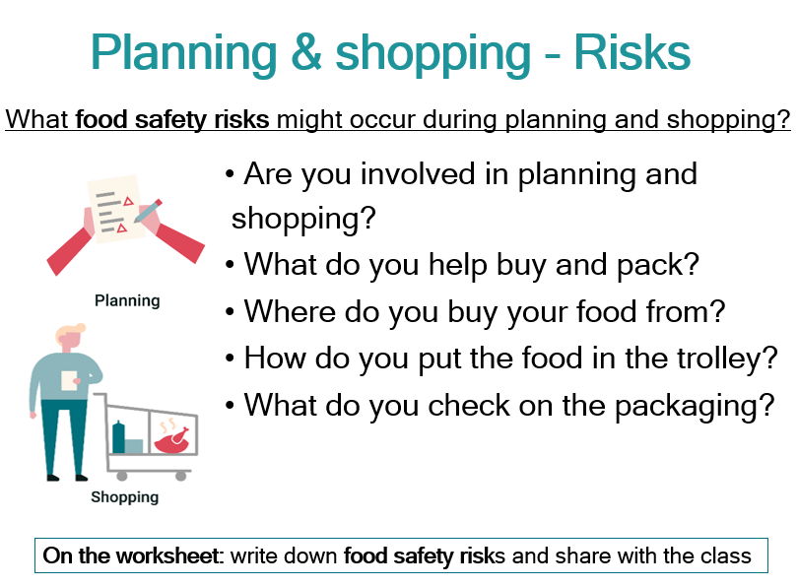

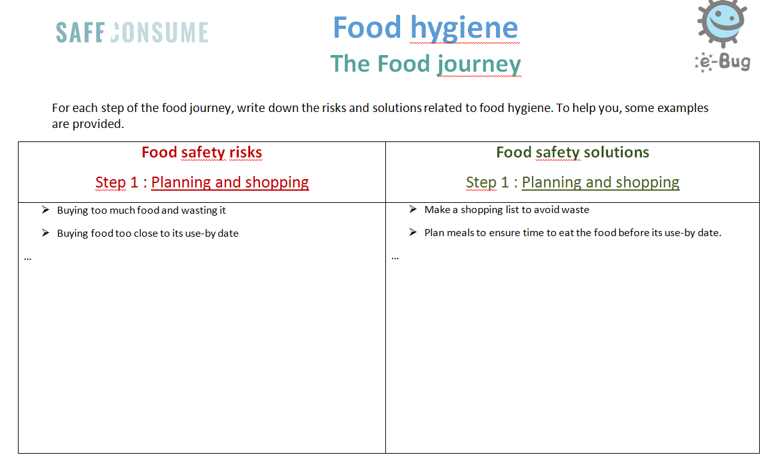

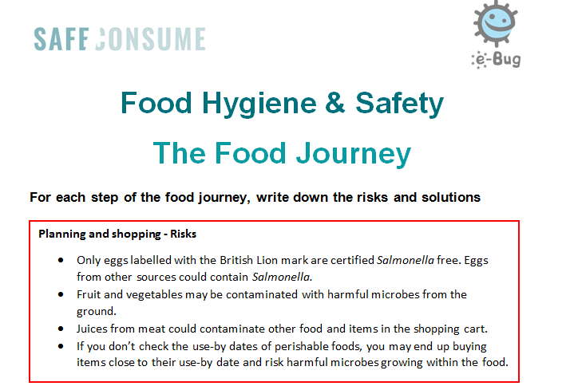

The Food Journey
  Lesson learning outcomes:
  To understand that there are harmful microbes in food that can cause food poisoning, where they can be found, and risks and consequences of food poisoning
  To understand cross-contamination and how it occurs and develop and normalise skills for good hand and food hygiene and preparation in everyday life to remain in good health
  To understand the chain of infection and critical points for food hygiene
Resources – The Food Journey
  Teacher notes ⬄ Contains the lesson plan and all the risks and the solutions from the student worksheet.
  PowerPoint ⬄ Introduce the notion of foodborne illness and the different risks to avoid for each step of the food journey from shopping to serving.
  Student worksheet ⬄ It is split into sections for each stage of the user journey, ask students to complete each section as you go through the stages. Alternatively you could ask students to complete the full worksheet after going through all of the stages.
  Student answer worksheet ⬄ Can be used as a guide to check all points have been raised.
  SafeConsume Food Journey animation.
X
Back to menu
Next
Close

Slide 8
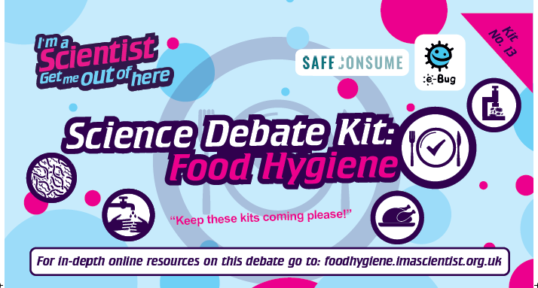
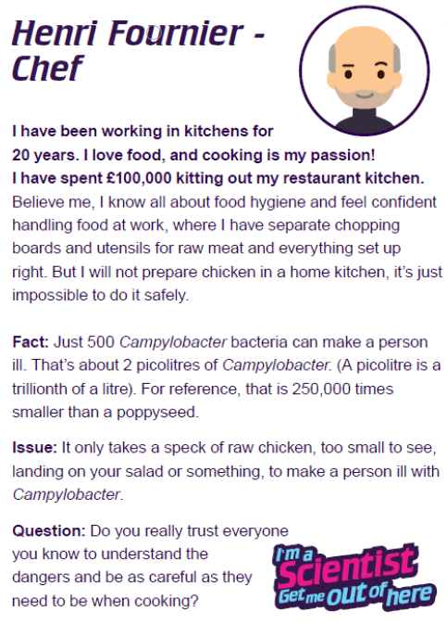
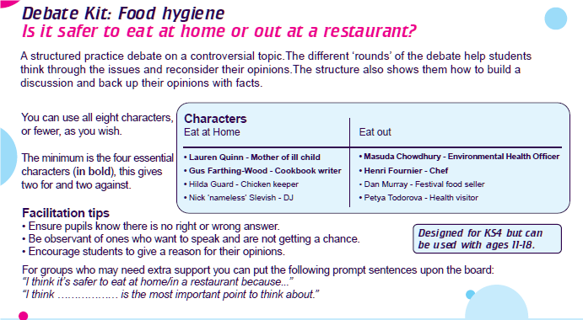
Food safety debate kit
  Lesson learning outcomes:
  To practise discussing and debating issues an expressing an opinion
  Consider social, ethical and factual issues in an integrated way
  Think about different points of view
  Learn to back up their opinions with facts
X
Back to menu
Next
Close

Slide 9


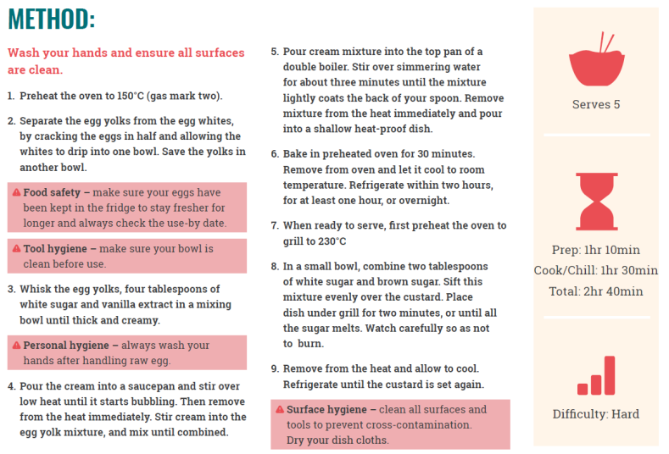
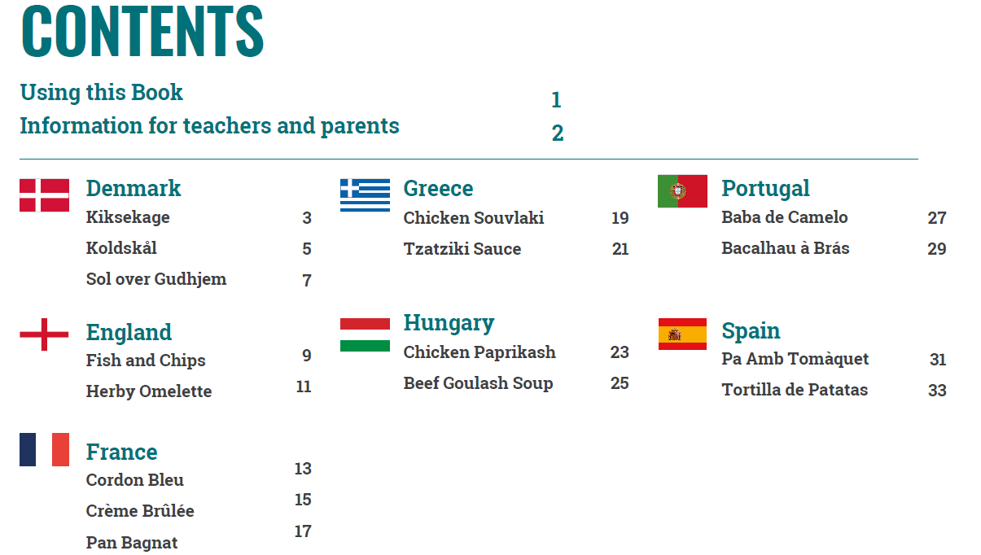
Recipes book
  Lesson learning outcomes:
  To understand cross-contamination and how it occurs
  To develop and normalise skills for good hand and food hygiene and food preparation in everyday life
Each recipe includes step-by-step instructions, with added food hygiene information in between each step :
    Food safety refers to safe food preparation methods. For example, cut into the thickest part of the chicken to make sure there are no pink bits, and juices run clear.
    Tool hygiene refers to the use of tools such as knives and chopping boards. For example, use a separate knife and chopping board to cut chicken.
    Surface hygiene refers to kitchen surfaces or use of dish cloths. For example, clean all surfaces / dry dish cloths.
    Personal hygiene refers to you, and how you can keep yourself and food safe. For example, wash your hands after touching raw meat.
The food hygiene instructions are there to remind you to carry out these activities the right way, and at the right times.
X
Back to menu
Next
Close

Slide 10
Introduction
Global perspective
  Foodborne disease risks
Recent analyses from WHO estimate that bacteria, parasites, toxins and allergens in food account for about 23 million cases of illness and 5000 deaths in Europe every year.
40% of foodborne outbreaks occur at home due to:
  Poor hygiene
  Insufficient heating and cooling
Consumers themselves, through safe behavior (food choice, storage and preparation), can partly or completely eliminate risk.
Nutrition
Microbiology
Ecology
Allergy
Culture
Main microbes leading to foodborne illnesses
Salmonella
Campylobacter
Toxoplasma
Norovirus
Listeria monocytogenes
X
Back to menu
Next
Close

Slide 11
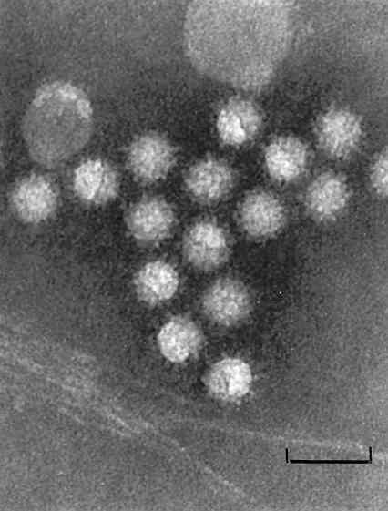
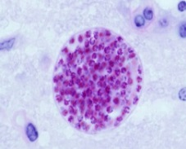
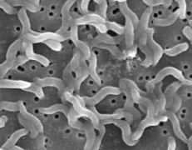
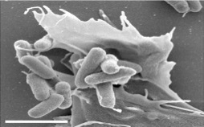
Microbiological aspects - Harmful microbes
Name | Type of microbe | Living environment | Transmission | Symptoms | Treatment | Barrier gestures
Norovirus | Virus | Human beings | On hands, in vomit and faeces, sewages By food (contaminated by the hands of infected persons, fruits/vegetables contaminated through irrigation, bivalves molluscs) | During 2-3 days Acute gastro-enteritis: diarrhea, vomiting/nausea, abdominal pain, headaches, fever… | No drug Drinking plenty of water (to avoid dehydratation) | Carefully wash fruits and vegetables Eat bivalve molluscs well cooked Wash hands with soap Disinfect surfaces Avoid preparing food if ill
Toxoplasma gondii | Parasite | Animals (cats) | Consumption of raw or undercooked meat, raw fruits and vegetables Direct transmission from an infected cat | Usually no symptoms Risks for the fœtus and immunocompromised individuals | Antiparasitic drugs (can last for several months) | Avoid contact with cat litter Wash hands with soap Wash raw fruits and vegetables Cook meat (> 70°C) or freeze (< -12°C) the meat
Campylobacter | Bacteria | Digestive tracts of animals, in particular domestic birds (poultry) | Raw or undercooked poultry Meat and milk Cross contamination | During 2-5 days Acute gastro-enteritis Systemic infections (very rarely) | In most cases, no treatment Antibiotics (severe cases) | Eat well cooked poultry meat Don’t wash raw chicken Wash hands with soap Wash utensils and surfaces carefully, use separate cutting boards
Salmonella | Bacteria | Digestive tracts of animals (in particular poultry, pig and cattle) | Eggs and egg products Meat and meat products Dairy products | Acute gastro-enteritis | No treatment is required (drinking plenty of water) Antibiotics (in risk of invasive disease) | Avoid eating raw or undercooked eggs (or use pasteurized eggs) and meat Store eggs in the fridge
X
Back to menu
Next
>
Close
Next

Slide 12
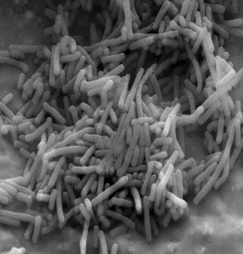
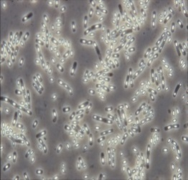
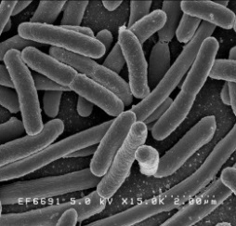
Microbiological aspects - Harmful microbes
Name | Type of microbe | Living environment | Transmission | Symptoms | Treatment | Barrier gestures
Listeria | Bacteria | Soil, waters, decaying plants Can multiply at low temperature (1-2°) | Ready to eat food Surface colonisation (fridge) | Bacteremia, meningitis, brain abscess or other local infections Premature birth, abortion, neonatale infections | Antibiotics (need to be applied early and do not always permit to avoid lethality) | Keep ready to eat food at refrigeration temperature Wash carefully raw vegetables, fruits and leafy greens but also surfaces and equipments Pregnant women : avoid some ready to eat foods (cheeses from raw milk, cold cuts, raw or smoked fish and sea foods preparations, sprouted seeds, raw meat)
Bacillus cereus | Bacteria | Soil | Spores and toxines resistant to heat Cooked or pasteurized food not refrigerated rapidly | Diarrhea, vomiting, nausea, abdominal pain | No drugs | Store food in fridge rapidly after cooking Check the fridge temperature Respect use by date
E.coli producing shigatoxins (STEC or VTEC) | Bacteria | Normal inhabitant of the gut of humans and animals | STEC can contaminate raw milk and raw diary products, raw meat, the environment via animal feaces which can contaminate water, fruit, vegetables, cereals, seed… | Diarrheas, sometimes bloody, abdominal pain, fever, Sometimes hemolytic uremic syndrome (HUS) | Supportive, nonspecific therapy Avoid antibiotics and anti-diarrheic (increase the risk of developing HUS) | Avoid raw or undercooked meat and raw milk especially for young children Wash fruits and vegetables Avoid eating raw cake dough Wash hands with soap
X
Back to menu
<
Previous Next
>
Close
Next

Slide 13
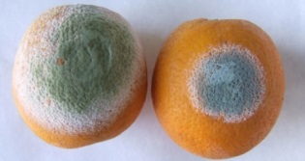
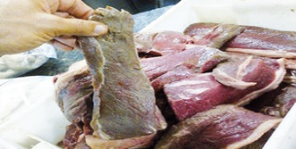
Microbiological aspects
Food spoilage
What is food spoilage?
Due to food spoilage, one-third of the worlds' food produced for the consumption of humans is lost every year.
Main causes:
Physico-chemical causes: light /oxygen
Physical causes: water loss / water movements in the food
Microbial causes
Cultural aspects
Fungi
Yeasts Molds
→ Fruit salads → Fruits and vegetables
→ Fruit juices → Mouldy breads
→ Sweet drinks
To avoid/delay food spoilage
Processing:
At home:
Combining barriers
Foods treated at high temperature
Vacuum packaging
Keep food in a very clean environment
Respect use by dates
Store fresh food in the fridge
Cooking food
How to avoid it?
Bacteria
→ Fresh vegetables → Canned foods
Fresh meat and fish → Prepared cooked
Milk and cheese dishes
→ Pastries → Food leftovers
X
Back to menu
<
Previous Next
>
Close
Next

Slide 14
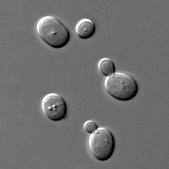
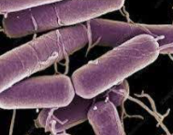
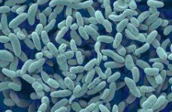
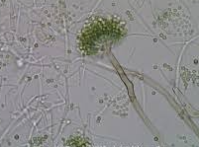
Microbiological aspects
Useful microbes
Microorganisms involved?
Yeasts Lactic acid bacteria Acetobacter
→ Bread, wine, beer and spirits → Dairy products, fermented food → Vinegar
Aspergillus oryzae Bacillus subtilis
→ Soja sauce → Japanese « Natto »
X
Back to menu
<
Previous Next
>
Close
Next

Slide 15
Microbiological aspects
Useful microbes
How?
Fermentation is a metabolic process in which an organism converts a carbohydrate, such as starch or a sugar, into an alcohol or an acid. For example, yeast performs fermentation to obtain energy by converting sugar into alcohol. Bacteria perform fermentation, converting carbohydrates into lactic acid.
Microbial fermentations have helped to preserve food since ancient times and people applied fermentation to make products such as wine, mead, cheese, and beer long before the biochemical process was understood.
Benefits of useful microbes
Improve gastrointestinal health, lowering the risk of type two diabetes and cardiovascular diseases
Preserves the microbiota
Make some foods more digestable and reduces toxicity
Preservation and microbiological safety of a food
Why?
X
Back to menu
<
Previous
Close
Next

Slide 16
Food labels
Labels
Labels can be divided into 3 main categories:
Food identity (name, description, origine etc.)
Nutritional aspects (ingredients list, nutritional declaration, etc.)
Food hygiene and safety (date of minimum durability, special storage conditions, allergens, etc.) including:
    « Use by » indicates the date until when the food can be eaten safely without health risks
    « Best before » indicates the date until when food retains its expected quality (eating the food after this date will not mean you’ll get ill but the flavour might not be as good)
    « Display until »
    « Consume within 3 days of opening »
    « Keep refrigerated once opened »
How can we reduce food waste ?
At purchase
Plan your shopping
Check the dates on labels
At home
Store food in accordance with the instructions on the packaging
Rotate (new food at the back – check the dates)
Maintain the cold chain
Serve small amounts of food and use up your leftovers
Freeze (except if the mention « not suitable for home freezing » appears)
Food waste
1/3 of the world’s food is lost or wasted every year (1,3 billion ton per year)
280 kg/year per capita of food loss in Europe
95 kg/year per capita of food waste is due to consumers
10% of food waste is linked to date labelling on food products
X
Back to menu
Next
Close

Slide 17

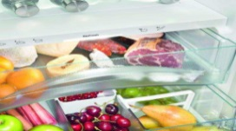

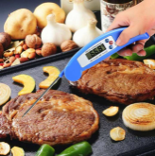


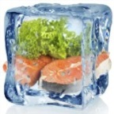
Infection transmission
For equipment
Use separate cutting boards/ustensils for
poultry/meat and vegetables (or wash it thoroughly)
Do not put cooked meat in the plate used for raw meat
Wash all tools after contact with raw poultry/meat
Clean the fridge regularly
Renew or wash sponges frequently
For food
Do not wash the meat
Wash fruits and vegetables thoroughly
For the body
Wash hands with soap before, during and after meal preparation
Use clean dry cloths or paper towels
Avoid outside interactions (telephone, animal...)
Prefer pedal bins
How to limit infection transmission during the food journey ?
Avoid cross contamination
Respect hygiene rules
Store food separately
Monitor the cooking process
Limit bacterial growth
Respect a minimum temperature in all parts of the food
Homogeneous cooking: Avoid cold spots
Maintain the cold chain
Freezing process
Egg handling
Store raw meat/poultry separately from vegetables and ready to eat food during shopping, packing, transport and in the fridge
Throw away the packaging
The day of purchase
Buy fresh and frozen products last and use cooler bags
Rapid transport
Store fresh and frozen products first
In the refrigerator
Control temperature of the fridge (≤ 4°C)
Store the most sensitive foods in the coldest areas
Identify use by dates
Respect the 1,2,3,4 rule for leftovers.
Do not put too much hot food in the fridge
Store eggs in the fridge (not in the door)
Preferably use pasteurized eggs
Check the date and do not buy dirty eggs or dirty packages
Eggs from backyards hens are more at risk (Salmonella enterica)
Use a cooking thermometer
(75°C for poultry/pork meat/hamburger
65°C for red meat)
The inside of the meat should not be pink or glossy
Do not freeze twice
Defrost food in the fridge, microwave or hot water
Be careful with the use of barbecues
Use a covered container
X
Back to menu
Next
Close

